Slide 1
Designing a stochastic individual-based multi-pathogen model to understand hepatitis E virus (HEV) dynamics in a farrow-to-finish pig farm
Morgane Salines, Nicolas Rose, Mathieu Andraud
ANSES, French Agency for Food, Environmental and Occupational Health & Safety
Epidemiology, Health & Welfare Research Unit
ModStatSAP conference – March 12th 2019

Slide 2
Context and aims

Slide 3
Context
Zoonotic virus mainly transmitted by pork products
High HEV prevalence in pig farms: at least 65% HEV-seropositive farms in European countries
HEV infection dynamics may be affected by:
husbandry practices in terms of hygiene, biosecurity and rearing conditions
partial protection conferred by maternally-derived antibodies
immunomodulating pathogens
There are still knowledge gaps to be addressed for a better understanding of HEV spread and persistence in pig farms

Slide 4
Aims & modelling framework
Aims:
Understand how identified risk-factors interplay and act on HEV spread and persistence.
Evaluate the efficacy of potential control measures.
Modelling framework: stochastic individual-based model to represent the population dynamics in a farrow-to-finish pig farm combined with a multi-pathogen model of HEV transmission with or without co-infections with an immunomodulating virus (IMV).

Slide 5
Why a multi-pathogen model?
High variability of HEV infection dynamics
Hypothesis of the influence of immunomodulating pathogens ➔ Field and experimental studies
Longitudinal follow-up in 3 HEV-infected farrow-to-finish farms
HEV transmission trial in pigs co-infected with PRRSV
HEV transmission trial in pigs co-infected with PCV2
Influence of PRRSV, alone or associated with PCV2, on HEV infection features
(Salines et al., 2019, TBED, submitted)
Chronic HEV infection and presence of HEV in blood and muscles
(Salines et al., 2015, Vet Res; Salines et al., 2018, IJFM)
Minor effect on the HEV infection dynamics
(Salines et al., 2019, Vet Microbiol, submitted)

Slide 6
Model design

Slide 7
Metapopulation dynamics model
Individual-based approach in view of the epidemiological issue:
Sow-Offspring relationship ➔ Maternally-derived antibodies
Co-circulation of two viral agents ➔ Sequence of infections
Individual variability ➔ Parameter distributions
Individual-based management ➔ Cross-fostering, mingling, sow housing
Herd renewal
Quarantine sector
(42 days)
Service room
(26 days)
Gestating room
(86 days)
Within-herd flow of breeding sows
Within-herd flow of growing pigs
Shared facilities
Farrowing rooms
(28 days and 33 days)
Nursery rooms
(58 days)
Finishing rooms
(94 days)
Slaughterhouse

Slide 8
Multi-pathogen model: design
HEV
MDA : Maternally-Derived Antibodies
With MDA
M
$\frac{1}{σ}$ : maternal immunity duration
$π$ : infection probability with MDA
$β$ : direct transmission rate
$β_{E}$ : indirect transmission rate
$\frac{1}{ρ}$ : latency duration
$\frac{1}{γ}$ : infectious period duration
$\frac{1}{μ}$ : active immunity duration
$ω$: quantity of HEV particles shed in the environment / g of feces
$dr$ : HEV natural decay rate
$sf$: HEV elimination through the slatted floor
$cr$: HEV removal rate through cleaning
$$σ$$
Passive immunity loss
Infection
with MDA
Susceptible
S
$$π$$
$$β\frac{I(t)}{N(t)}$$
Infection
$$\frac{β_{E}}{N(t)}$$
Exposed
E
Active immunity loss
$$μ$$
$$ρ$$
Infectious
I
Environment
En
$$ω$$
Recovery
$$γ$$
$$dr$$
$$sf$$
$$cr$$
Recovered
R

Slide 9
HEV
With MDA
M
$$σ$$
Passive immunity loss
Infection
with MDA
IMV
Susceptible
S
$$π$$
M
$$β\frac{I(t)}{N(t)}$$
Infection
$$\frac{β_{E}}{N(t)}$$
S
Exposed
E
Active immunity loss
$$μ$$
$$ρ$$
I
Infectious
I
Environment
En
$$ω$$
R
Recovery
$$γ$$
$$dr$$
$$sf$$
$$cr$$
Recovered
R

Slide 10
Multi-pathogen model: forces of infection (1)
Within-pen force of infection for HEV:
$$λ_{\text{p}\text{,}\text{r}}^{\text{HEV}\text{,}\text{wp}}\left(t\right)=\frac{\sum_{\text{i}\text{=1}}^{N_{\text{p}\text{,}\text{r}}\left(t\right)}{β_{HEV}^{i}× I_{p,r}^{i,HEV}\left(t\right)+β_{E}^{WP}×{WPQ}_{p,r}×fQ}}{N_{p,r}\left(t\right)}$$
Direct transmission between pigs
Environmental transmission via faeces accumulated in the pen
Notes:
Various transmission routes → several forces of infection
Environmental transmission: Takes into account:
The environmental transmission rate
The viral load accumulated in the pen per gram of faeces, that depends on the quantity of faeces shed by a pig per day X quantity of HEV per gram of faeces, minus the faeces elimination through the slatted floor, the natural death of the virus in the environment, and the elimination of the virus during pen cleaning operations
The quantity of faeces ingested by a pig per day

Slide 11
Multi-pathogen model: forces of infection (2)
Between adjacent pens force of infection for HEV:
Finally, the probability of infection is:
$$λ_{p,r}^{HEV,bap}\left(t\right)=\frac{\sum_{i=1}^{N_{p−1,r}}{β_{E}^{BP}×{WPQ}_{p−1,r}^{}\left(t\right)}×fQ}{N_{p−1,r}\left(t\right)}+\frac{\sum_{i=1}^{N_{p+1,r}}{β_{E}^{BP}×{WPQ}_{p+1,r}^{}\left(t\right)×fQ}}{N_{p+1,r}\left(t\right)}$$
Coefficient of transmission between adjacent pens through faecal projection
Sum of the forces of infection of two adjacent pens
$$p=1−exp\left(−\left(λ_{\text{p}\text{,}\text{r}}^{\text{HEV}\text{,}\text{wp}}\left(t\right)+λ_{\text{p}\text{,}\text{r}}^{\text{HEV}\text{,}\text{bap}}\left(t\right)\right)\right)$$

Slide 12
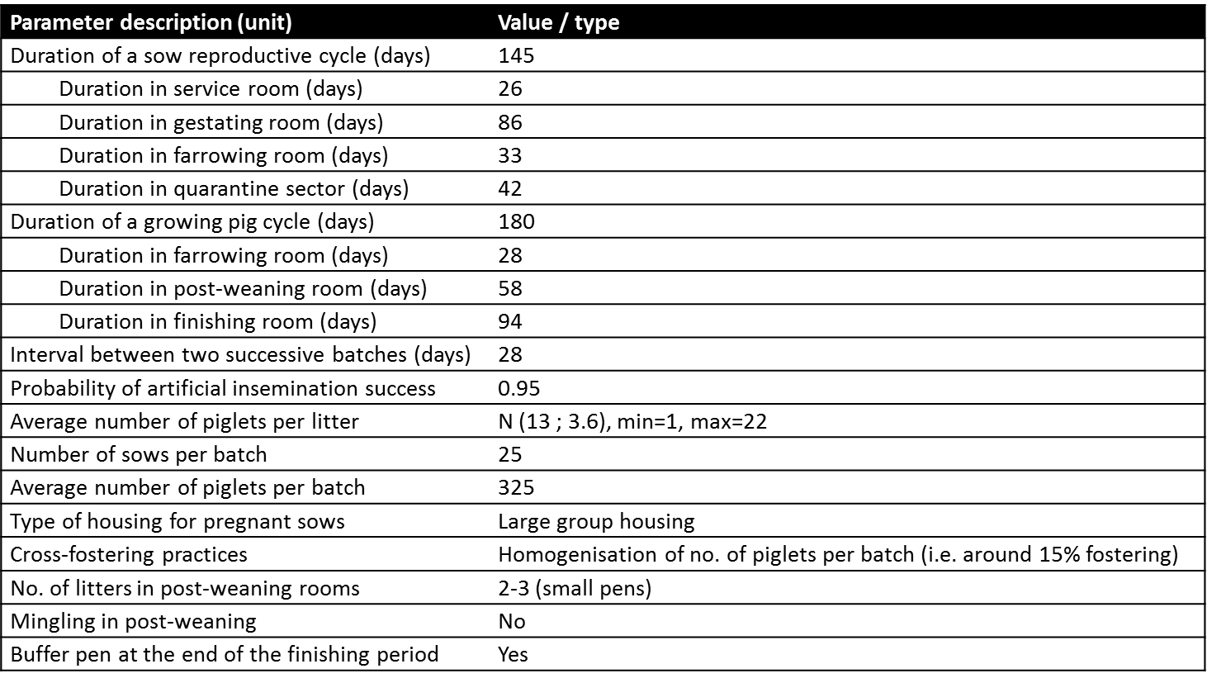
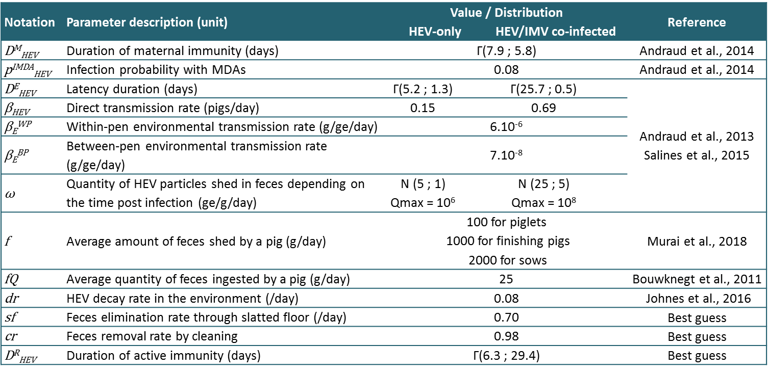
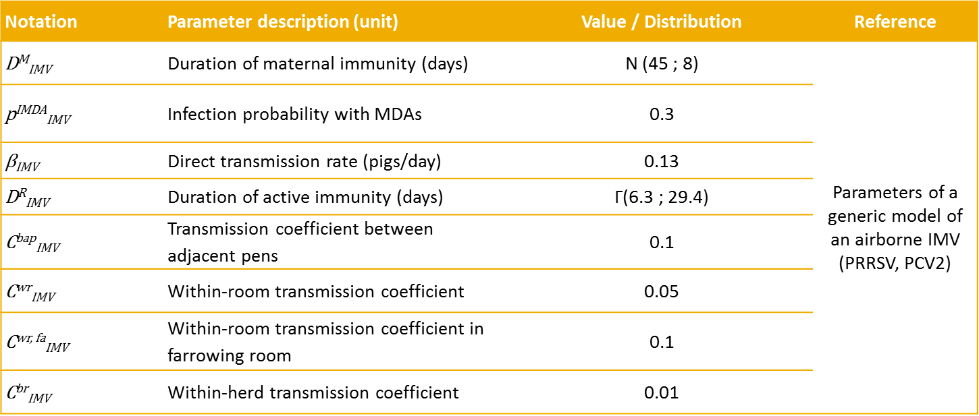
Model parametrization
Parameters for the population model and the two epidemiological models
Notes:
Population parameters: classical parameters for a 7-batch rearing system in France. IMV: chosen to represent the dynamics of a typical respiratory immunomodulating virus (PCV2, PRRSV). HEV: parameters derived from experimental infection trials

Slide 13
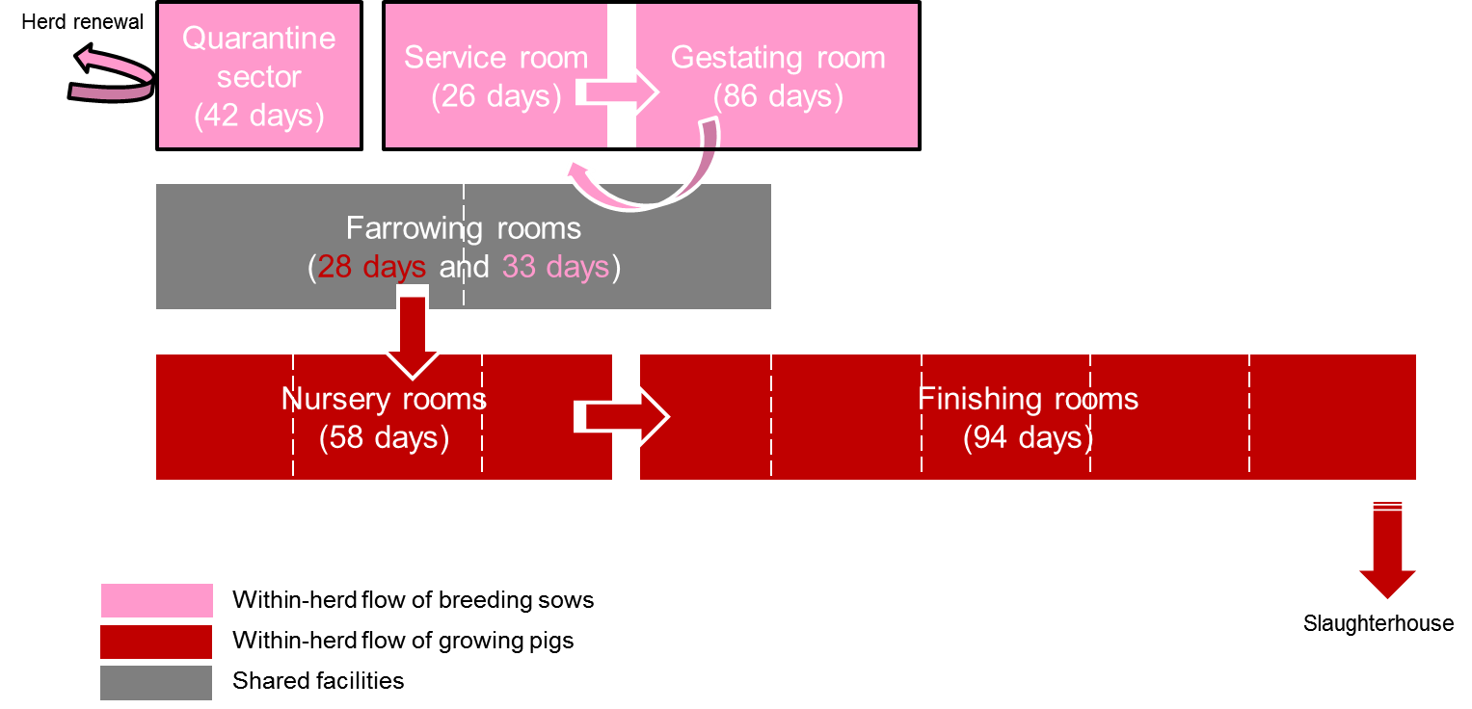
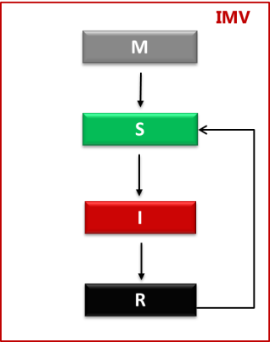
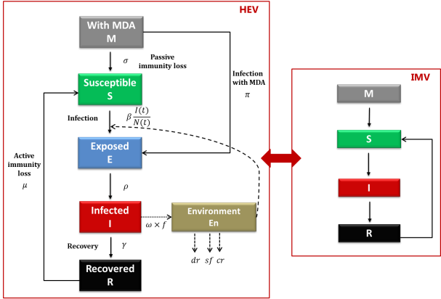
Full model
200 simulations
Year 0
Year 10
Year 15
Year 20
Herd stabilisation
Records
IMV introduction
HEV introduction
New populated herd (gilts)
Notes:
préciser qu'à chaque scénario, un seul animal infectieux est introduit, à la fois pour l'IMV et le VHE.
5 ans d'IMV pour se placer dans une situation d'endémicité.
Aucune réintroduction.

Slide 14
Model outcomes
Notes:
Data presented only for a 7-BRS farm

Slide 15
HEV infection dynamics
Enzootic HEV spread in growing pigs and sows

Slide 16
HEV on-farm spread
HEV on-farm spread in the model is consistent with literature data
 | Seroprevalence | Prevalence
Weaning | 4.4 | 0.7
End of post-weaning | 9.1 | 2.0
Before slaughter (170 days) | 22.8 | 2.9
Comparaison avec données de terrain :
31% [24-38] of HEV-seropositive pigs at slaughter
(Rose et al., 2011)
Comparison with field data
Comparaison avec données de terrain :
4% [2-6] of HEV positive livers at slaughter (Rose et al., 2011)
Comparison with field data

Slide 17
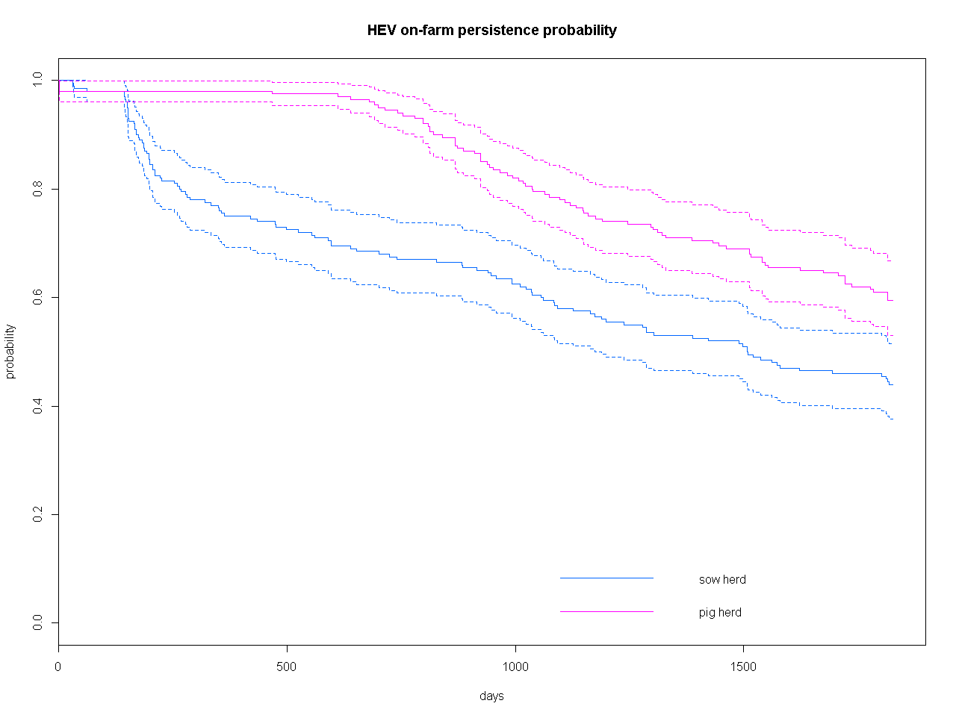
HEV on-farm persistence
Comparaison avec données de terrain :
No published data, but examples of herds becoming « spontaneously » free
Comparison with field data
Five years post-introduction, HEV persist in around 60% of simulations

Slide 18
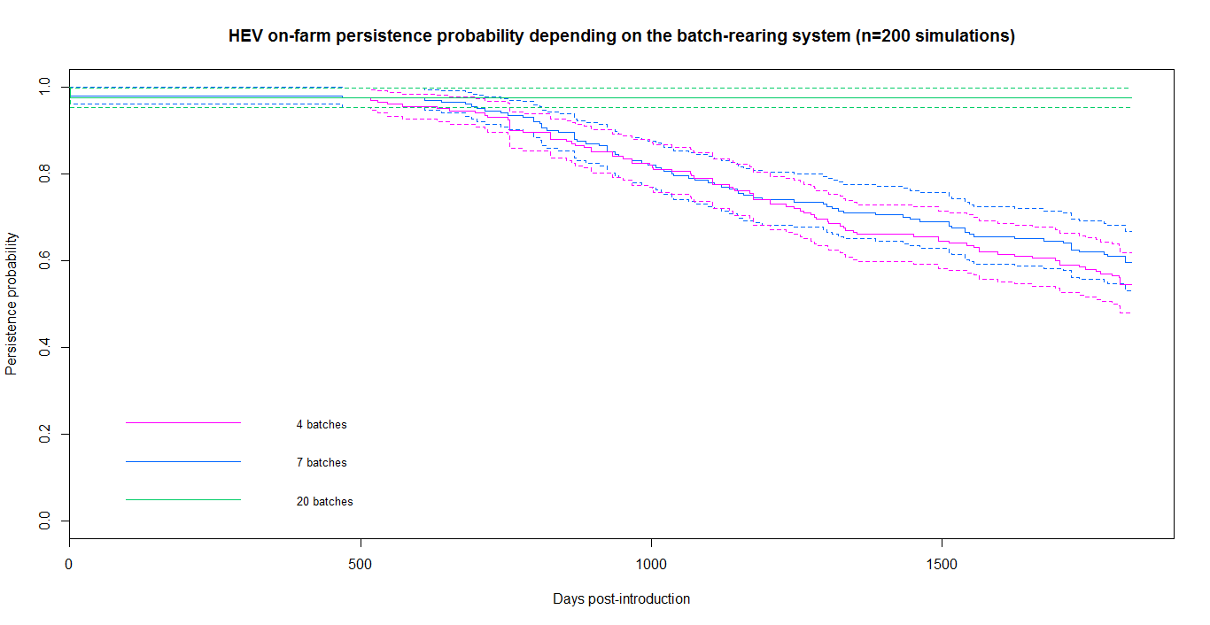
Impact of the batch-rearing system
20-BRS farm: difficulty in containing HEV spread once the virus is introduced, with a low fade-out probability
Notes:
Expliquer que c'est du à un renouvellement plus fréquent de la population avec des tailles de populations plus grandes.

Slide 19
Impact of farming practices & health management
Housing sows in smaller groups (6 sows/pen) reduces HEV persistence (60% → 0) and HEV prevalence at slaughter age (2.9% → 0.1%) compared to large gestation facilities
Limiting cross-fostering and mingling at weaning decreases HEV prevalence at slaughter (3.9% → 2.6% and 3.5% → 2.4%, respectively).
Vaccinating sows against immunomodulating pathogens reduces HEV persistence (60% → 34%) and prevalence at slaughter age (2.9% → 1.7%)
Lower efficacy when the herd is conducted with a 20-BRS

Slide 20
Combining control measures

Slide 21
Take home messages
First dynamic HEV model representing HEV spread on a farrow-to-finish pig farm and integrating interactions with immunomodulating pathogens.
Realistic representation of HEV spread, consistently with literature data.
Effective control strategies to mitigate the risk, combining farming practices and herd health management.
Using indirect ways to control HEV and considering animal and public health in an integrated manner is relevant.

Slide 22
What’s next?
Coupling this model with pig movement data would make it possible to explore HEV spread all along the pig production chain.
Control strategies could then be evaluated at national scale.
Technical and socio-economic feasibility of an HEV control plan will finally be assessed.
Final aim: designing an effective and feasible HEV control plan to mitigate the risk of human exposure through pork products

Slide 23
Thanks for your attention! Any question?
morgane.salines@anses.fr

