Slide 2
Modeling poultry production and distribution networks in Bangladesh to address epidemiological risks
Marie-Cécile Dupas
Université Libre de Bruxelles, Belgium
Dupas MC¹, Pinotti F², Semel J¹, Raghwani J⁵, Moyen N, Joshi M⁴, Joshi C⁴, Gilbert M¹, Damer B⁵, Tomley F⁵, Fournié G^{3,5}
Université Libre de Bruxelles, Belgium
University of Oxford, United Kingdom
Royal Veterinary College, London, United Kingdom
Gujarat Biotechnology Research Centre
INRAE

Slide 3
context: high increase of poultry production

Slide 4
One health poultry hub
Joint social and biological science
Notes:
To achieve this, our interdisciplinary team is considering the biological processes occurring in these different production systems, as well as the socioeconomic processes and behaviours that underlie the different intensification models.

Slide 5
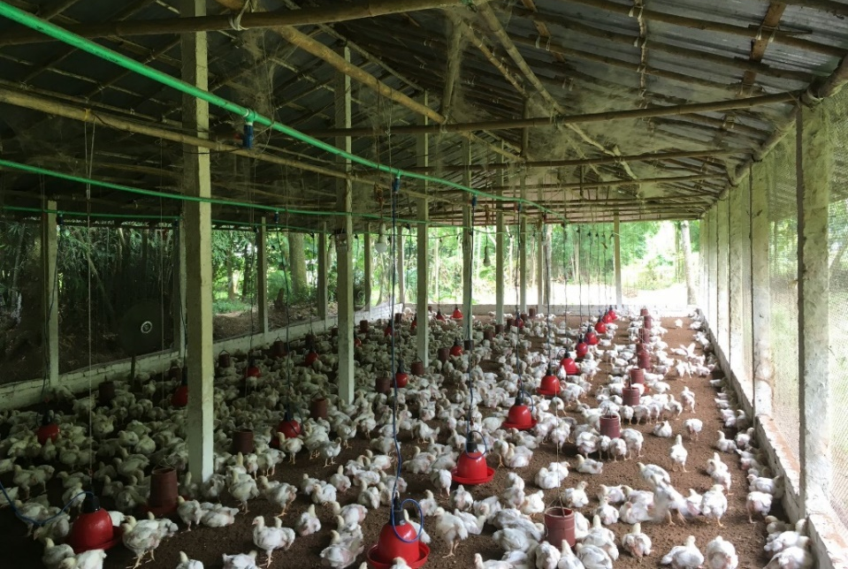
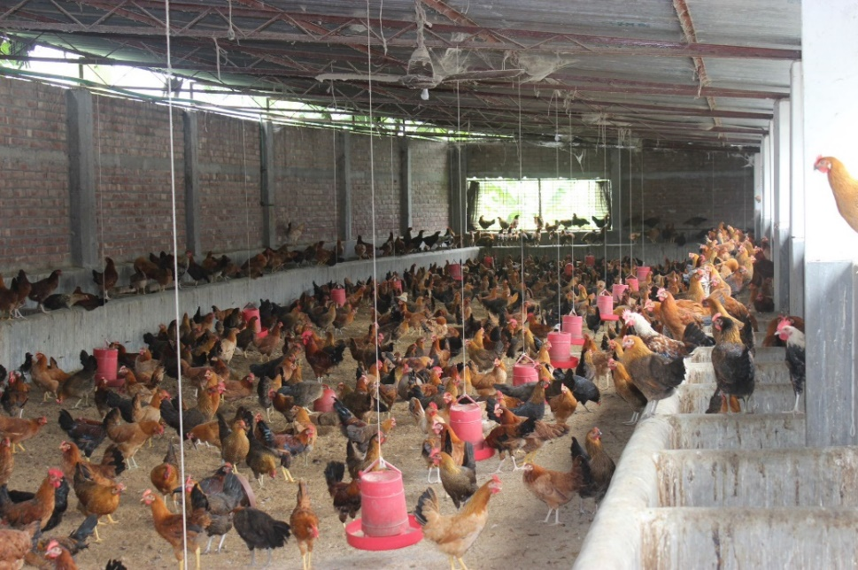
Poultry production systems
Modelling the spatial distribution of poultry farms

Slide 6
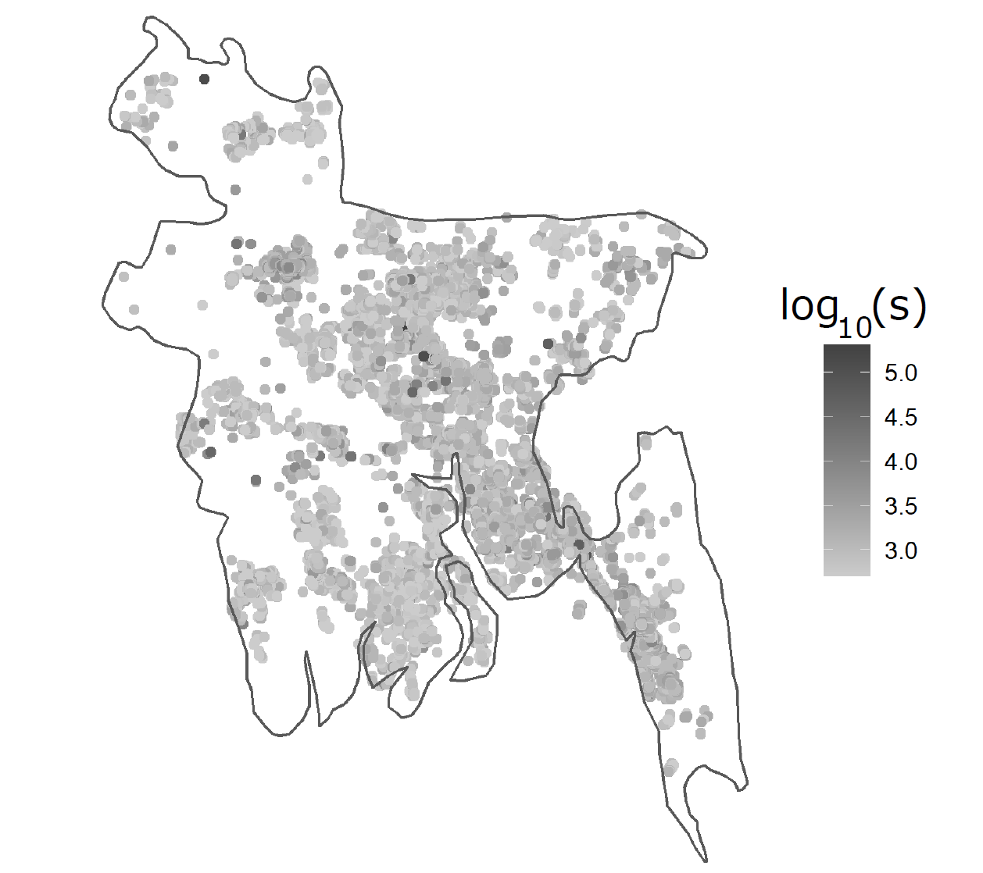
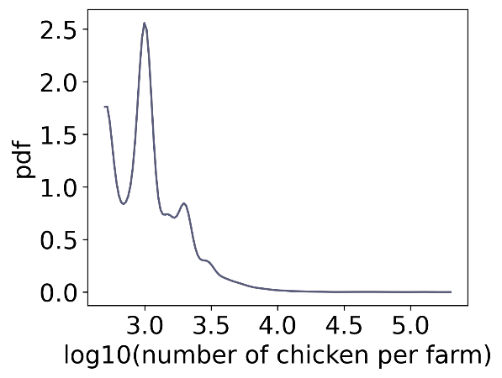
POULTRY PRODUCTION SYSTEM IN BANGLADESH
Farm distribution (broilers chicken)
27,000 farms
170 million inhabitants
1237 inhabitant/km²
Pictures from the team

Slide 7
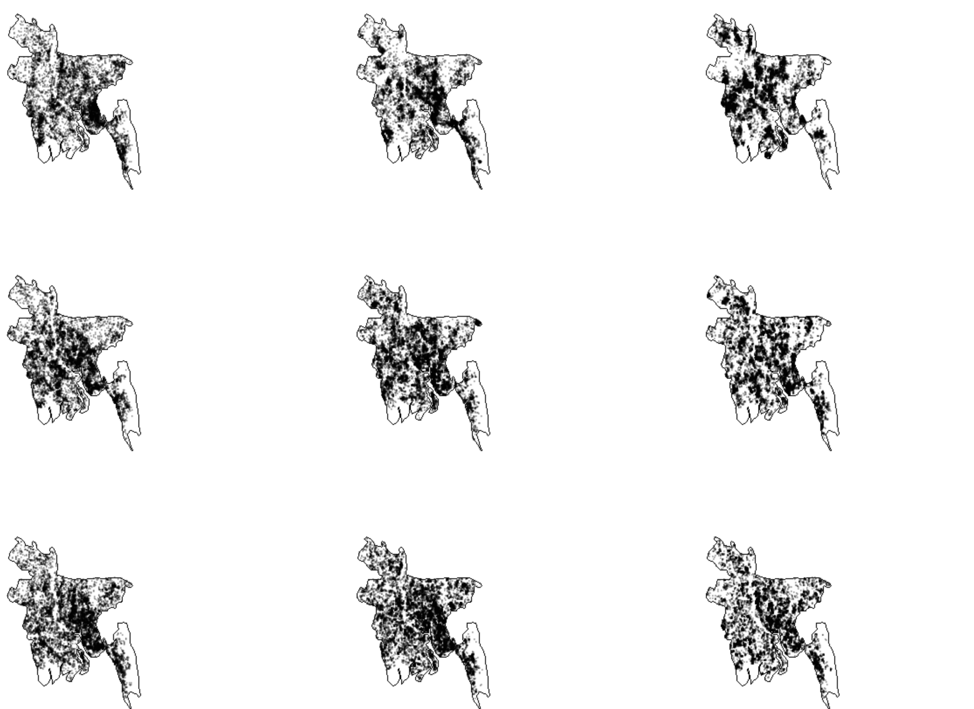
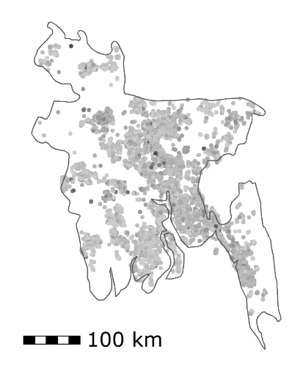
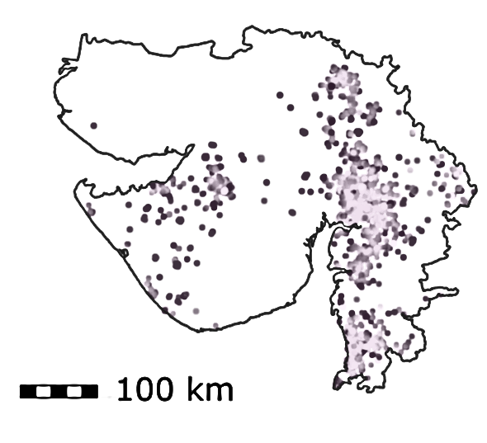
Why modelling the spatial distribution of farms?
Simulations for data-poor regions or countries
Testing different transition scenarios
Spatial autocorrelation
?
Clustering
Pauline Borguet, Master student, ULB

Slide 8
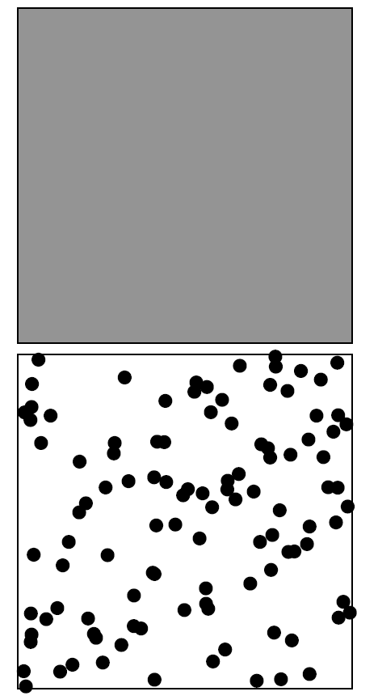
Point pattern processes
Intensity function
Points pattern
Homogeneous
Poisson process
Notes:
Among point processes, the most common is an homogeneous Poisson process that will place points uniformly on a surface.

Slide 9
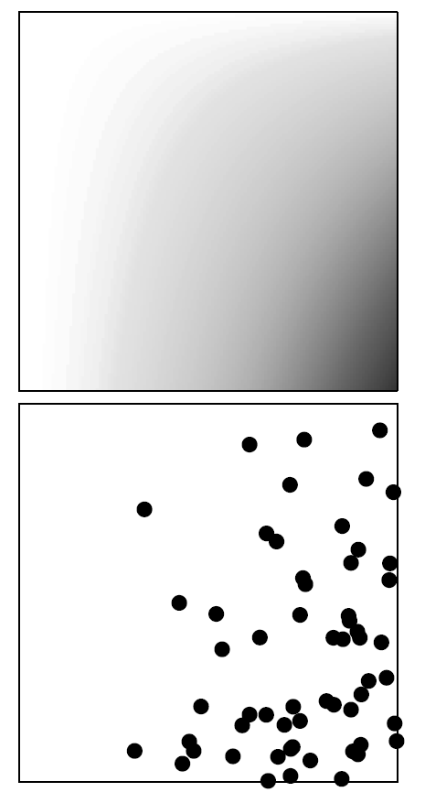
Point pattern processes
Intensity function
Intensity function
Points pattern
Points pattern
Homogeneous
Poisson process
Homogeneous
Poisson process
Notes:
This model can be adjusted with a non uniform intensity function that will allow to place points accordingly;

Slide 10
Point pattern processes
Intensity function
Intensity function
Intensity function
Points pattern
Points pattern
Points pattern
Homogeneous
Poisson process
Homogeneous
Poisson process
Inhomogeneous
Log Gaussian Cox Processes

Slide 11
Point pattern processes
Log Gaussian Cox Process (LGCP)
Intensity function
$$λ\left(u\right)=\exp\left(β_{0}+β_{1}{pred}_{1}+β_{2}{pred}_{2}+…+β_{k}{pred}_{n}+ ∈(x)\right)$$
Where $u$ is any location in the study, $β_{0}$, $β_{1}$…, $β_{k}$ are the parameters to be estimated, $pred$ the predictors and $n$ the number of predictors.
$∈(x$) : Gaussian process
Intensity function
Points pattern
Inhomogeneous
Log Gaussian Cox Processes
Notes:
Cette approche permet de capturer des effets complexes et des dépendances spatiales qui ne peuvent être expliquées uniquement par les prédicteurs spatiaux

Slide 12
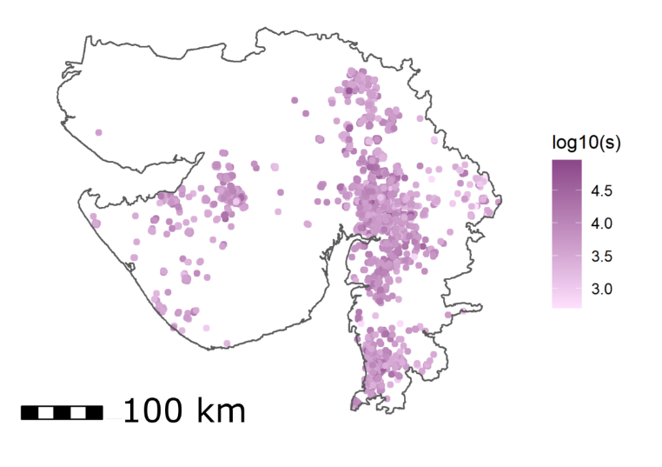
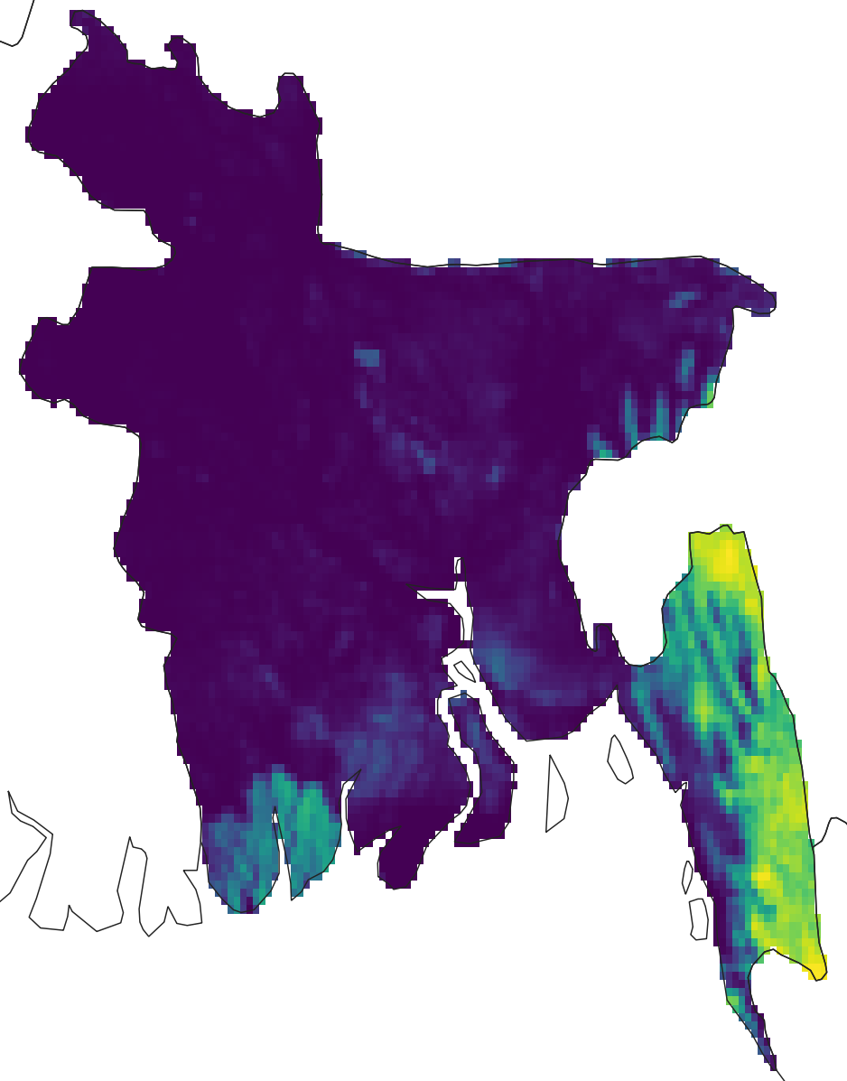
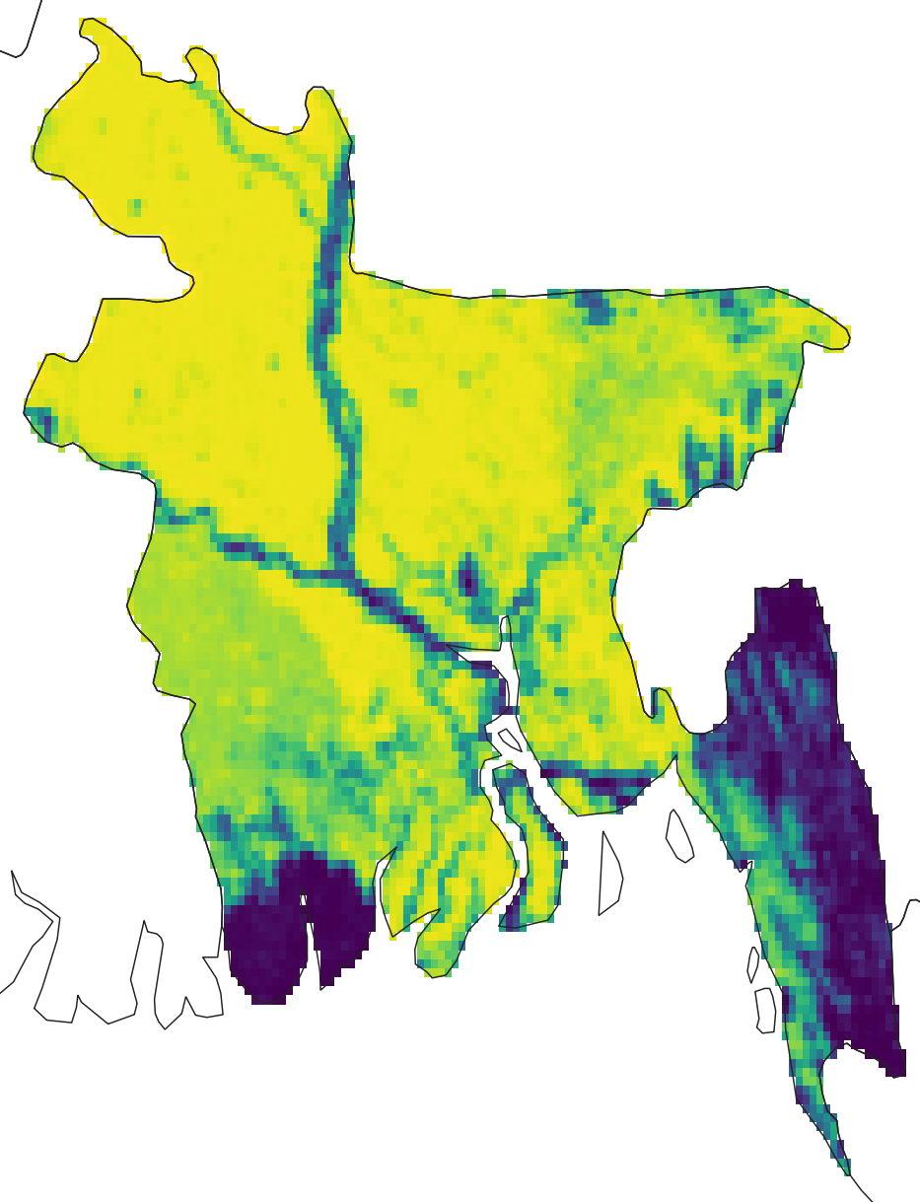
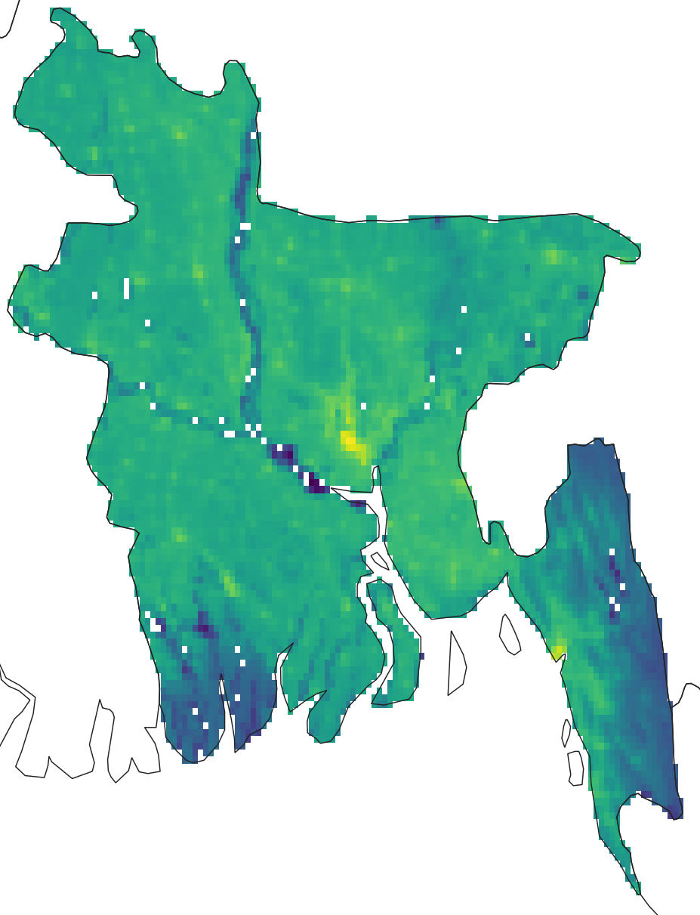
data
Farm distribution
Predictors (n = 10)
Anthropogenic characteristics (pixel of 1km)
Human population density
Access (proximity to roads, ports, city)
landscape characterictics (pixel of 1km)
Tree cover
Land cover
Slope
chicken population density from GLW model (pixel of 10kms)
Bangladesh (n = 22,159 farms)
Gujarat (n = 2,611 farms)
Intensive productions systems: > 500 chicken farms
Broiler chicken
Tree cover
Crop
Human pop

Slide 13
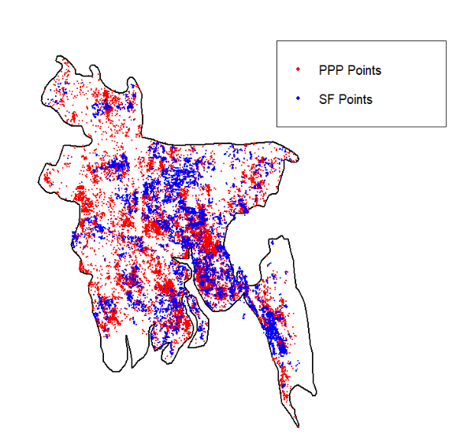
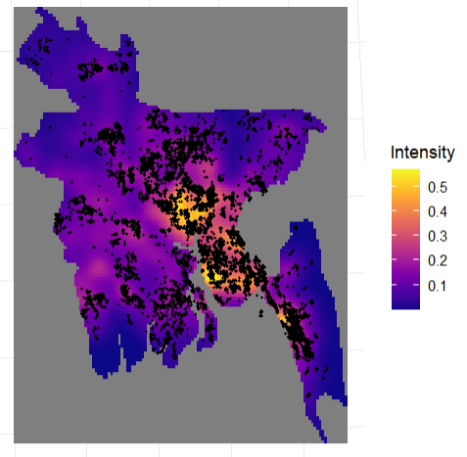
SIMULATIONS IN BANGLADESH
The different validation tests of the LGCP model are presented in the preprint
Simulation
Observation
Mean intensity of 100 simulations
LGCP allows to reproduce partially the clustering patterns and the locations of clusters.
Preprint: Spatial distribution of poultry farms using point pattern modelling: a method to address livestock environmental impacts and disease transmission risks

Slide 14
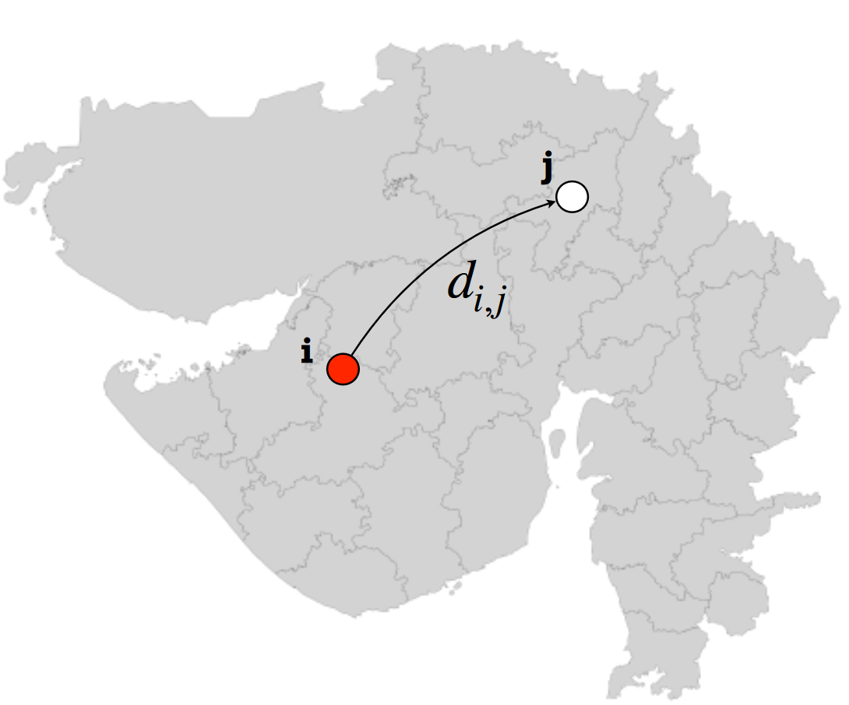
Spatial epidemic spread
λ μ
S
I
R
$λ_{i →j} = β ∙ N_{i}^{q}∙$ $N_{j}^{q′} ∙ K(d_{i,j})$
Transmissibility
Farm size
Spatial distance
Francesco Pinotti, University of Oxford

Slide 15
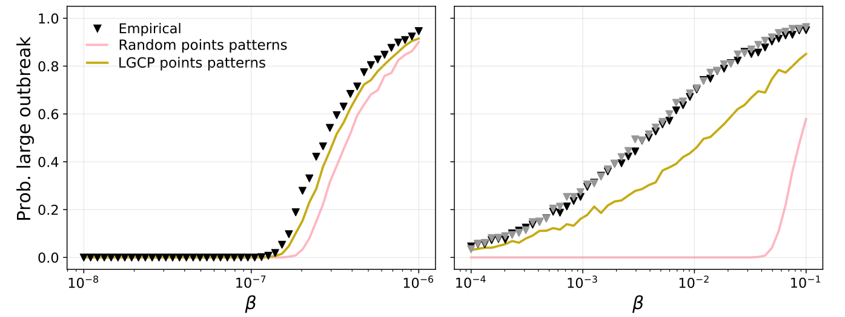
Outbreak size
Long-ranged kernel
Short-ranged kernel
LGCP can more accurately predict the probability of a large outbreak compared to using a random pattern

Slide 16
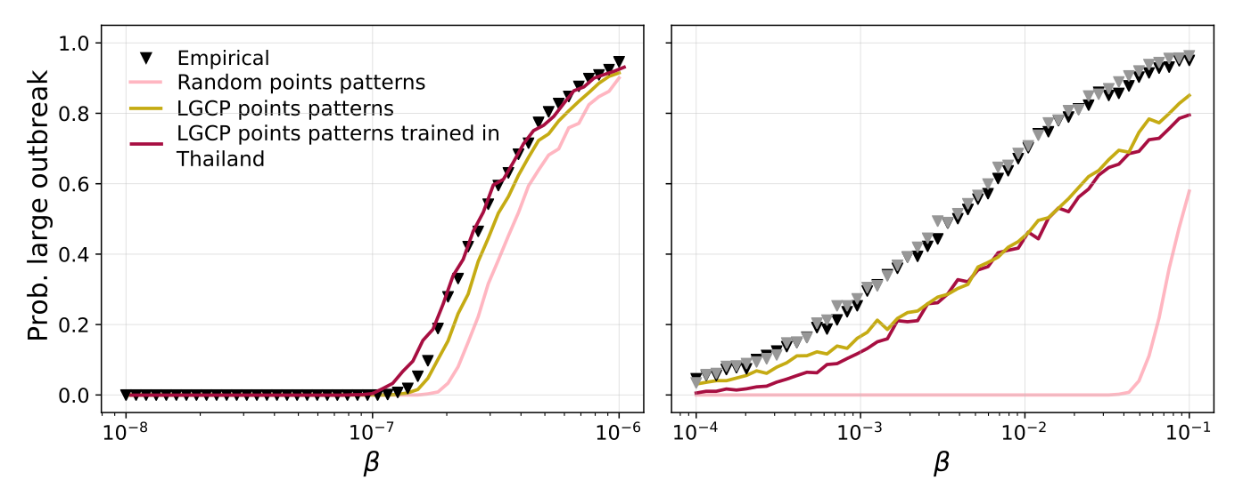
Outbreak size
Long-ranged kernel
Short-ranged kernel
LGCP can more accurately predict the probability of a large outbreak compared to using a random pattern, even when the model is trained on data from another country

Slide 17
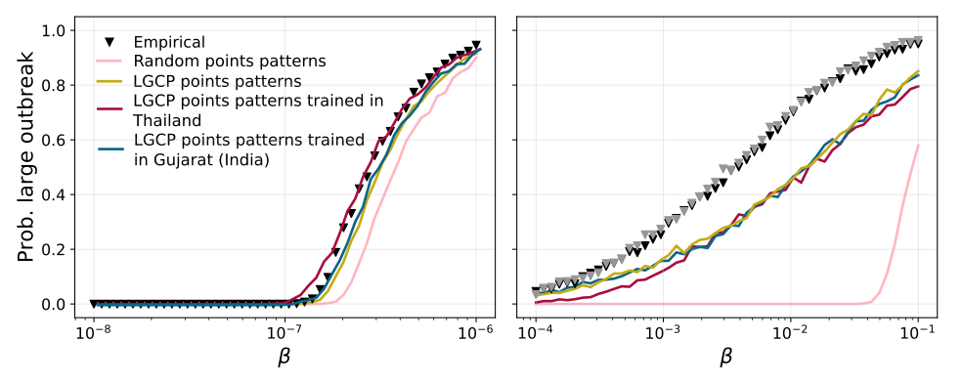
Outbreak size
Long-ranged kernel
Short-ranged kernel
LGCP can more accurately predict the probability of a large outbreak compared to using a random pattern, even when the model is trained on data from another country

Slide 18
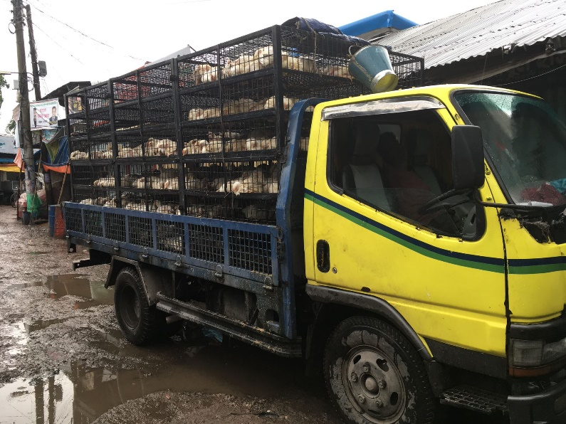
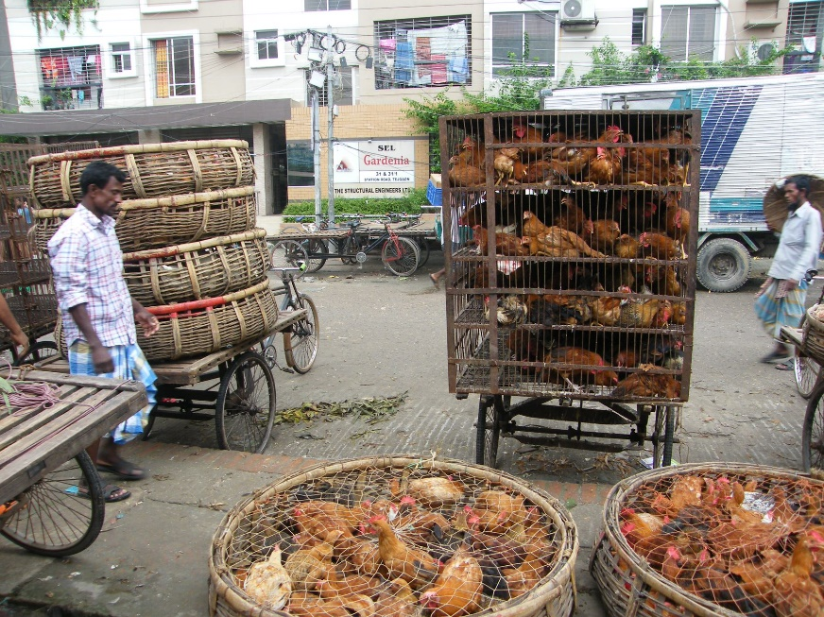
Network distribution systems
Modelling the live poultry flows from farm to markets

Slide 19
Link tracing study for capturing catchement areas
From endpoints (markets) to farms
BALZAC STUDY
Data collected between March 2015 and July 2016: the quantity and types of poultry sold in Dhaka (50 LBM) and Chittagong (16 LBM) and originating from each upazila in Bangladesh (Moyen, 2019)

Slide 20
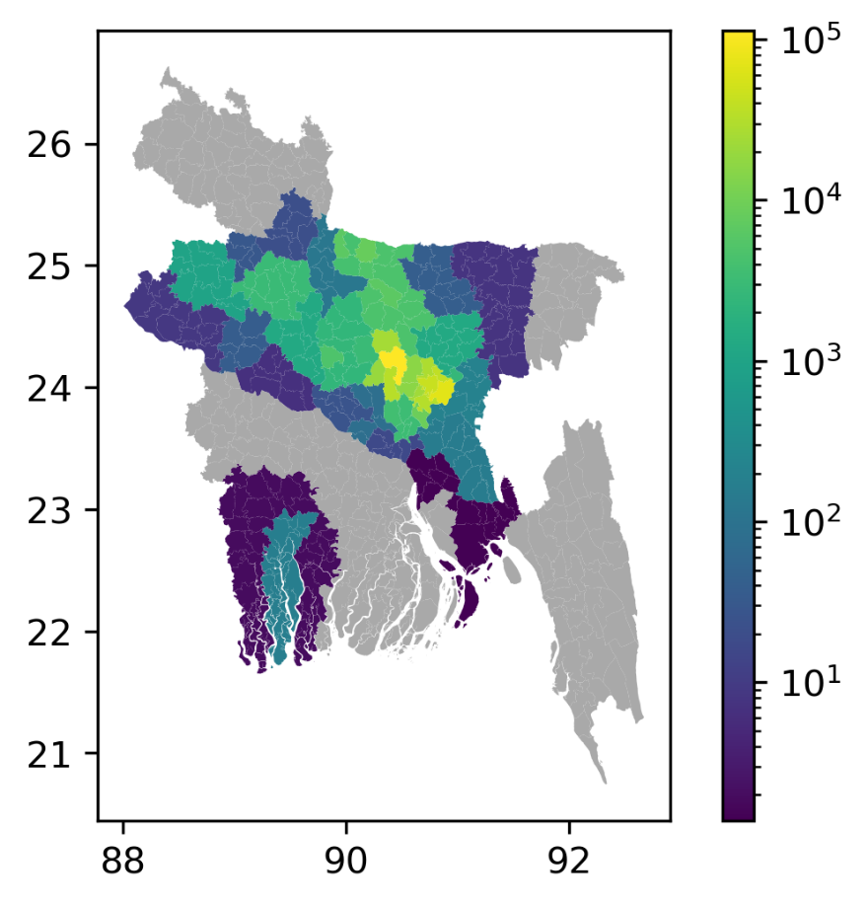
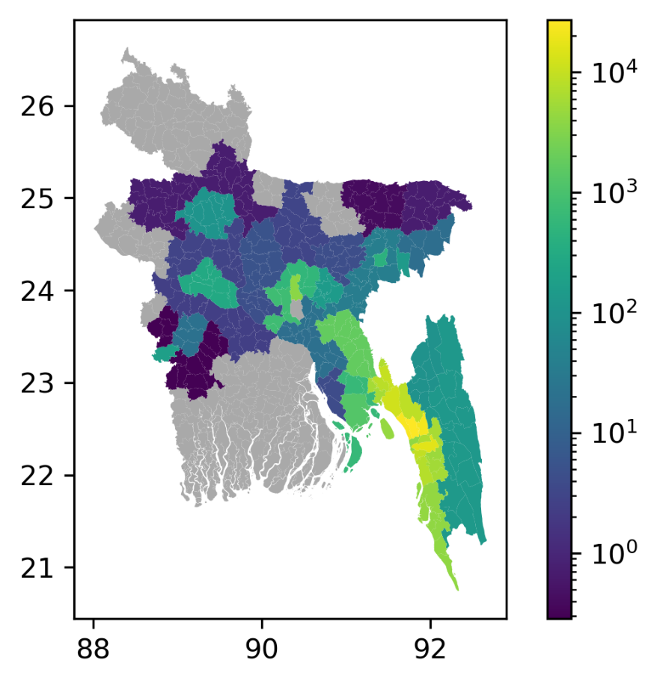
Link tracing study for capturing catchment areas
Dhaka
Number of broilers sold in markets over a week
Chattogram
Number of broilers sold in markets over a week

Slide 21
« Gravity » models
Model | Predictors |  |  |  |  |  |  |  |  |  |  |  |  |  | RMSE | R² Log10(Actual) vs Log10(Predicted) | R² Actual vs Predicted
 | Road distance (km) | Travel time (min) | Broiler population at origin | Broiler farms at origin | Urban pop at origin | Urban pop at destination | Poverty pop at origin | Poverty pop at destination | % rate_poverty at origin | attractor_index_urb_pop | Chickenmeat consumption | Mean chicken meat conso | total chicken meat conso_j | conso_mean_j
Linear | ✔ | ✔ |  |  | ✔ | ✔ |  | ✔ |  |  |  |  | ✔ | ✔ | 0.932 | 0.505 | 0.285
Random Forest | ✔ | ✔ | ✔ | ✔ |  |  |  |  | ✔ | ✔ | ✔ | ✔ |  |  | 0.534 | 0.837 | 0.600
Gradient Boosting | ✔ | ✔ | ✔ | ✔ |  |  | ✔ |  | ✔ | ✔ | ✔ |  |  |  | 0.456 | 0.881 | 0.680

Slide 22
« Gravity » models
Model | Predictors |  |  |  |  |  |  |  |  |  |  |  |  |  | RMSE | R² Log10(Actual) vs Log10(Predicted) | R² Actual vs Predicted
 | Road distance (km) | Travel time (min) | Broiler population at origin | Broiler farms at origin | Urban pop at origin | Urban pop at destination | Poverty pop at origin | Poverty pop at destination | % rate_poverty at origin | attractor_index_urb_pop | Chickenmeat consumption | Mean chicken meat conso | total chicken meat conso_j | conso_mean_j
Linear | ✔ | ✔ |  |  | ✔ | ✔ |  | ✔ |  |  |  |  | ✔ | ✔ | 0.932 | 0.505 | 0.285
Random Forest | ✔ | ✔ | ✔ | ✔ |  |  |  |  | ✔ | ✔ | ✔ | ✔ |  |  | 0.534 | 0.837 | 0.600
Gradient Boosting | ✔ | ✔ | ✔ | ✔ |  |  | ✔ |  | ✔ | ✔ | ✔ |  |  |  | 0.456 | 0.881 | 0.680

Slide 23
« Gravity » models
Model | Predictors |  |  |  |  |  |  |  |  |  |  |  |  |  | RMSE | R² Log10(Actual) vs Log10(Predicted) | R² Actual vs Predicted
 | Road distance (km) | Travel time (min) | Broiler population at origin | Broiler farms at origin | Urban pop at origin | Urban pop at destination | Poverty pop at origin | Poverty pop at destination | % rate_poverty at origin | attractor_index_urb_pop | Chickenmeat consumption | Mean chicken meat conso | total chicken meat conso_j | conso_mean_j
Linear | ✔ | ✔ |  |  | ✔ | ✔ |  | ✔ |  |  |  |  | ✔ | ✔ | 0.932 | 0.505 | 0.285
Random Forest | ✔ | ✔ | ✔ | ✔ |  |  |  |  | ✔ | ✔ | ✔ | ✔ |  |  | 0.534 | 0.837 | 0.600
Gradient Boosting | ✔ | ✔ | ✔ | ✔ |  |  | ✔ |  | ✔ | ✔ | ✔ |  |  |  | 0.456 | 0.881 | 0.680

Slide 24
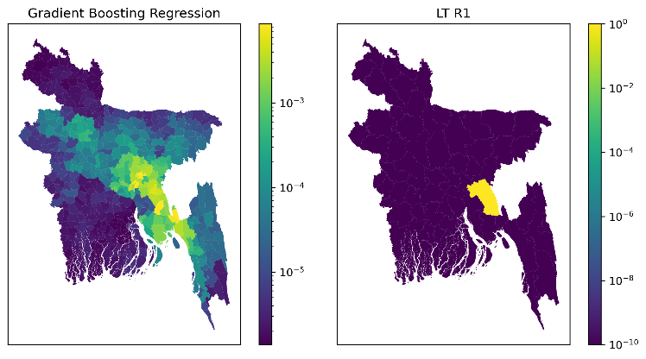
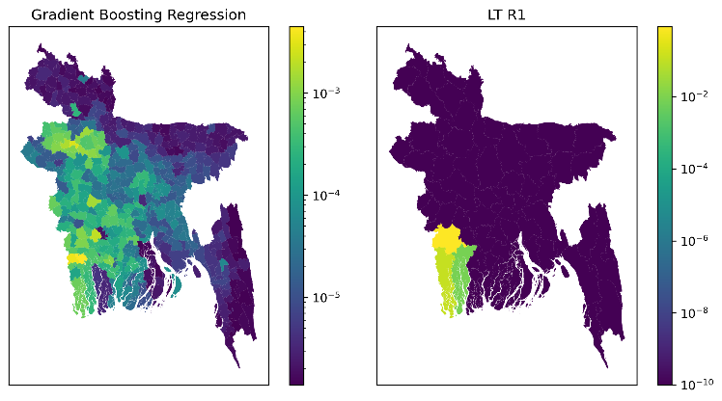
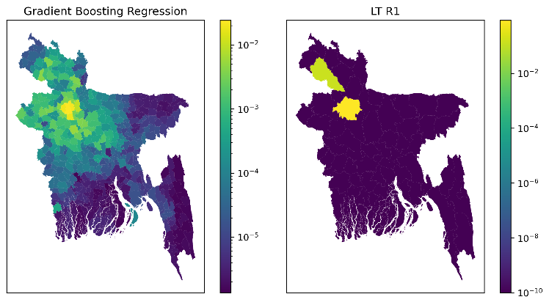
PREDICTIONS IN OTHER CITIES
Cumilla
Jashore
Bogura

Slide 25
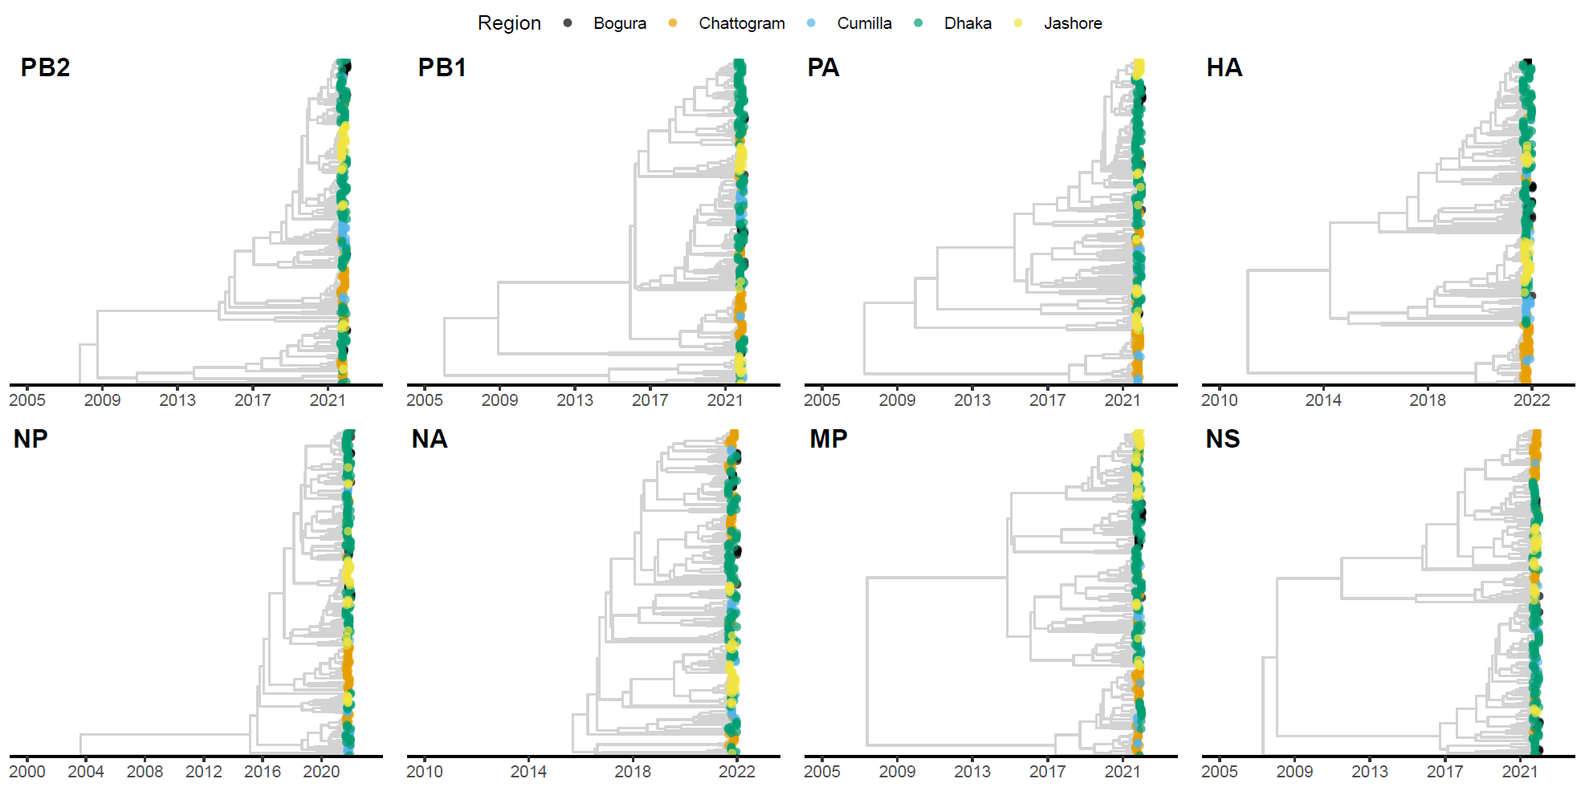
PREDICTIONS IN OTHER CITIES
Phylodynamic analysis H9N2
Cumilla
Jashore
Bogura
Jayna Raghwani, Royal Veterinary College

Slide 26
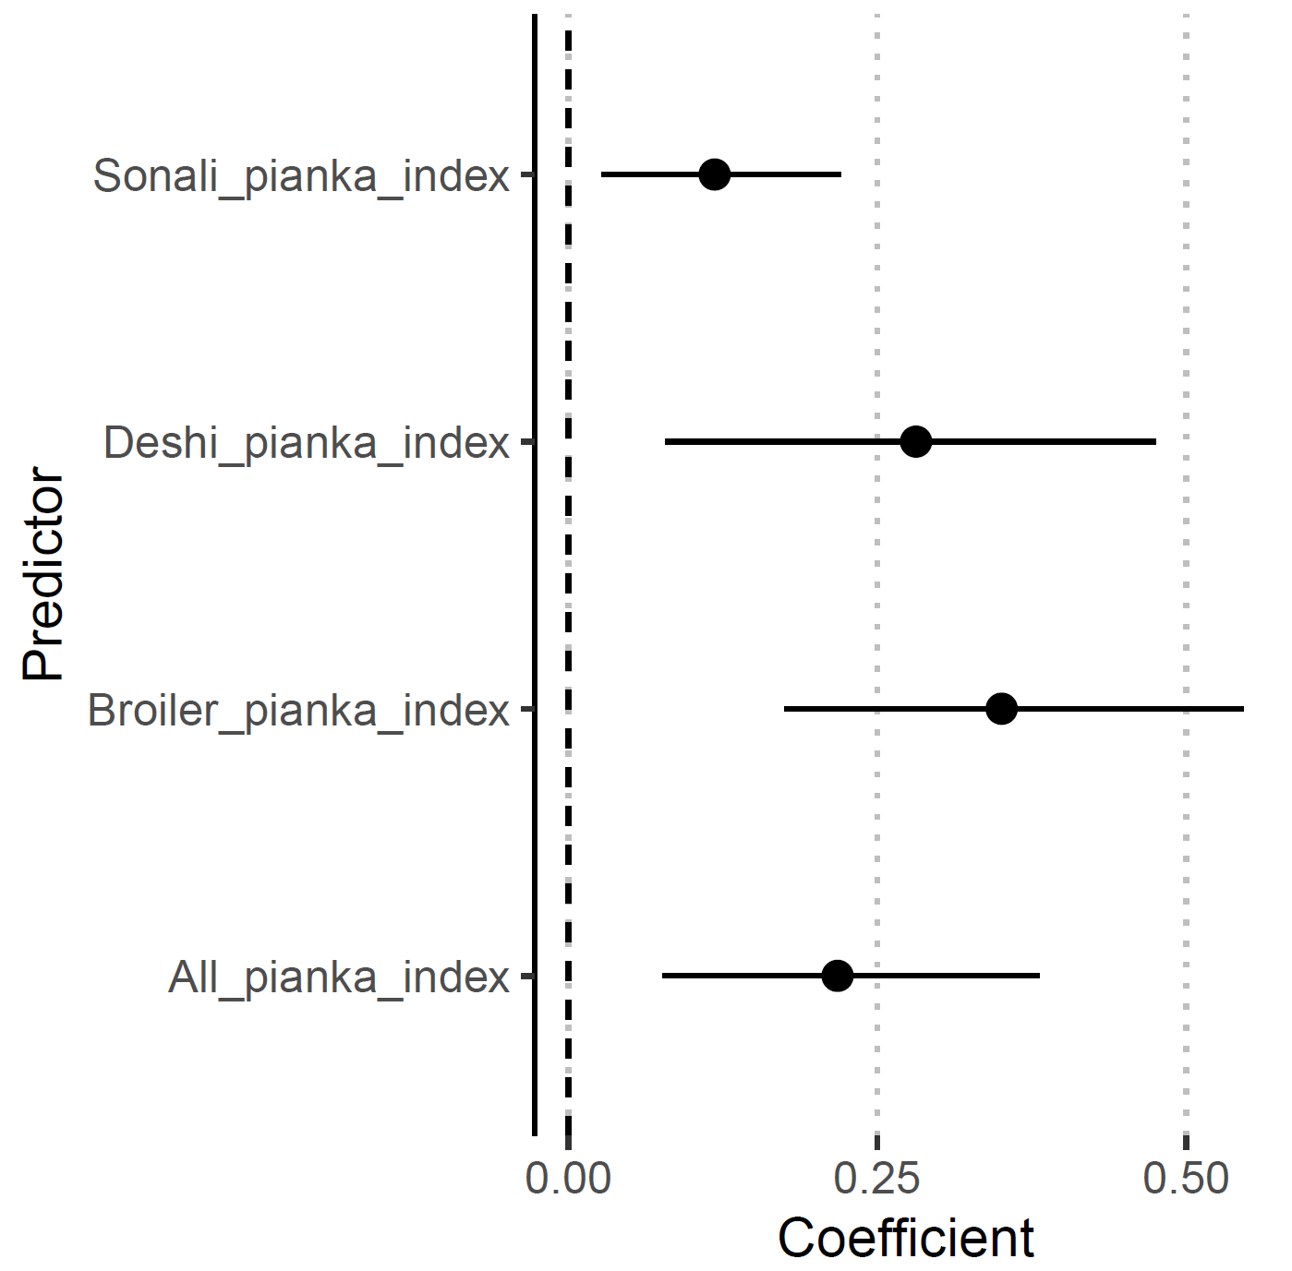
PREDICTIONS IN OTHER CITIES
Phylodynamic analysis H9N2
Cumilla
Jashore
Bogura
Virus movements between cities are associated with overlapping catchment areas.
Jayna Raghwani, Royal Veterinary College

Slide 27
Conclusion
Intensification scenarios
Log Gaussian Cox Process
Production systems
Epidemic model
Gravity model
Distribution systems
Phylodynamic analysis

Slide 28
Marius Gilbert
Université Libre de Bruxelles,
Spatial Epidemiology Lab
Francesco Pinotti
University of Oxford
Madhvi Joshi
Gujarat Biotechnology Research Centre
Guillaume Fournié
Royal Veterinary College &
INRAE Lyon
Jeremy Semel
Université Libre de Bruxelles,
Spatial Epidemiology Lab
Jayna Raghwani
Royal Veterinary College
Chaitanya Joshi
Gujarat Biotechnology Research Centre
Thank you !
dupas.mc@gmail.com
@mcdupas

Slide 29
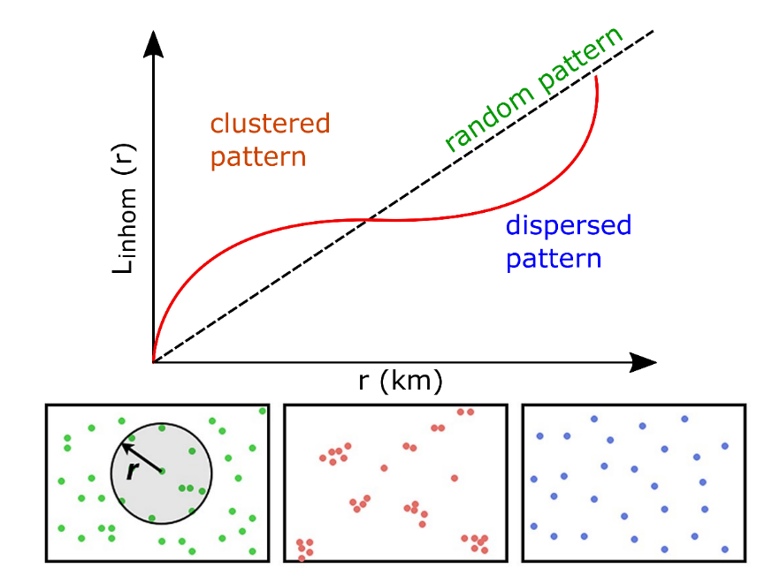
Validation tests of the model
L-function: clustering behaviours
spatial analysis method used to describe how point patterns occur over a given area of interest

Slide 30
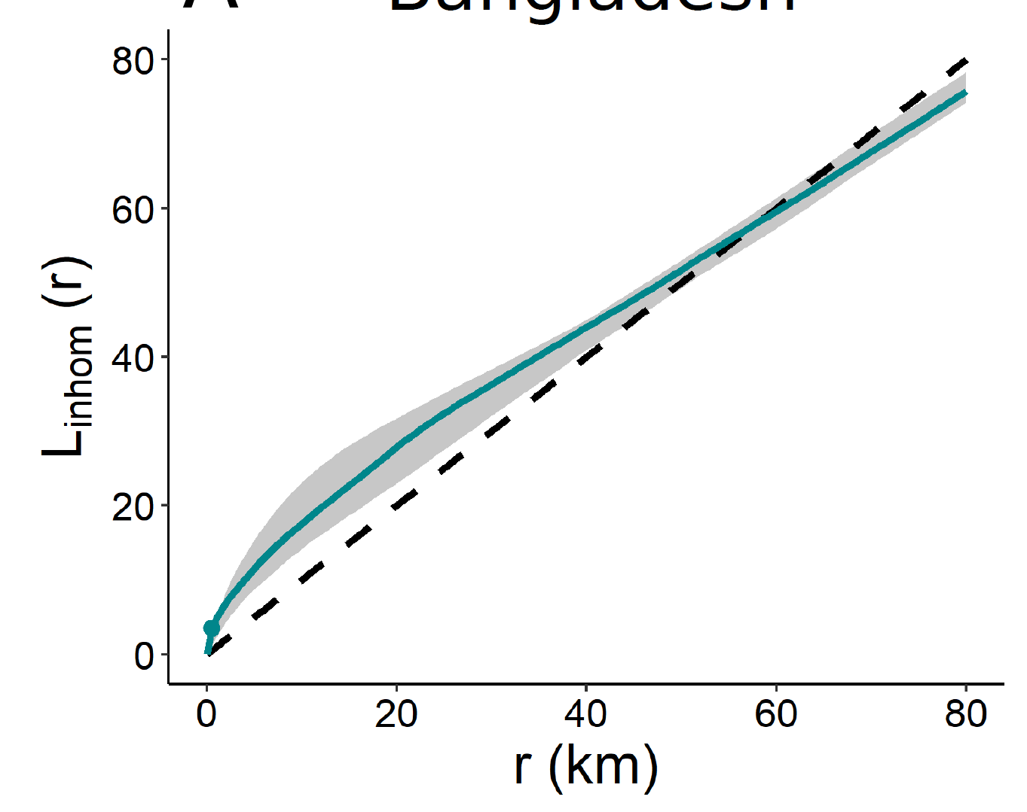
Validation tests of the model
L-function: clustering behaviours
spatial analysis method used to describe how point patterns occur over a given area of interest

Slide 31
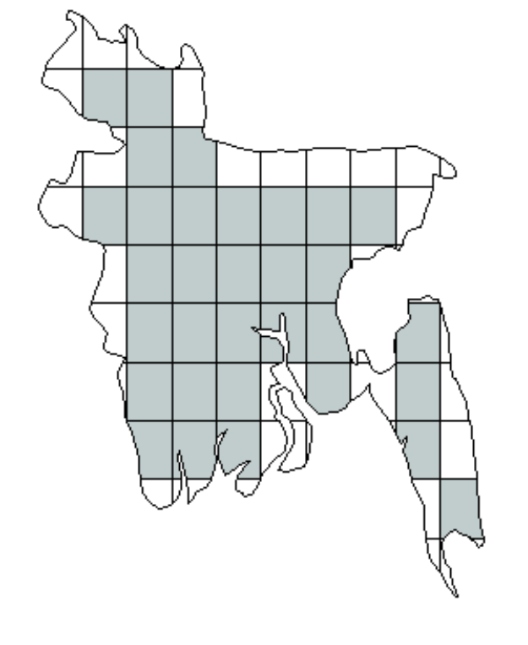
Validation tests of the model
L-function: clustering behaviours
spatial analysis method used to describe how point patterns occur over a given area of interest
Quadrat count test
Correlation coefficient between the numbers of points per quadrat in observed and simulated points pattern.

Slide 32
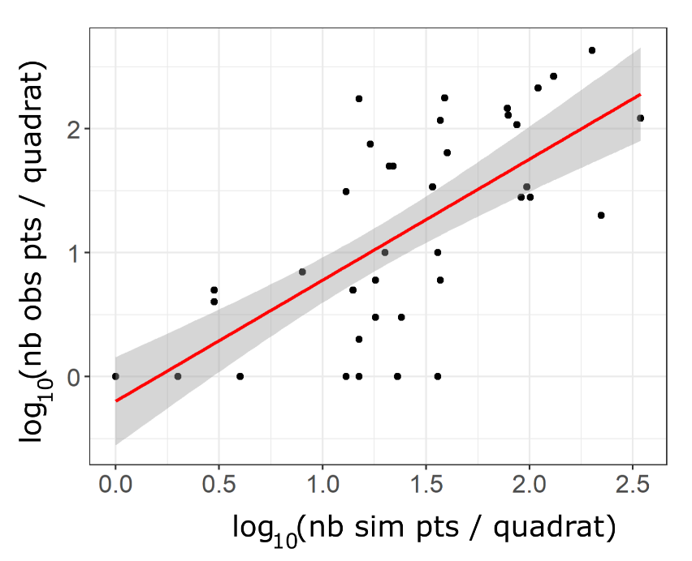
Validation tests of the model
L-function: clustering behaviours
spatial analysis method used to describe how point patterns occur over a given area of interest
Quadrat count test
Correlation coefficient between the numbers of points per quadrat in observed and simulated points pattern.
R = 0,82

Slide 33
Thank you

Slide 34
Supplementary materials

Slide 35
Farm Distribution Model (FDM)
Farm locations
point pattern model : Log-Gaussian Cox Processes (LGCP) with spatial predictors
intensity function:
$$λ\left(u\right)=\exp\left(β_{0}+β_{1}{pred}_{1}+β_{2}{pred}_{2}+…+β_{k}{pred}_{n}\right)$$
Where $u$ is any location in the study, $β_{0}$, $β_{1}$…, $β_{k}$ are the parameters to be estimated, $pred$ the predictors and $n$ the number of predictors.
Notes:
We built at farm distribution model which is a two steps model: 1st we predict farm locations with a point pattern process and then we compute the farm size based on random forest model
We used a Log-Gaussian Cox Processes (LGCP) which models clustered distribution of points. This model is based on intensity function which is calibrated in function of spatial predictors, $pred$, by the parameters $\beta$.
Spatial predictors are included in the LGCP so that the intensity of points could be modelled according to landscape and anthropogenic characteristics.
This intensity field is used to parameterize a Poisson point process that represents a stochastic mechanism for placing points in space.
The size farm modelling is described later in this presentation.

Slide 36
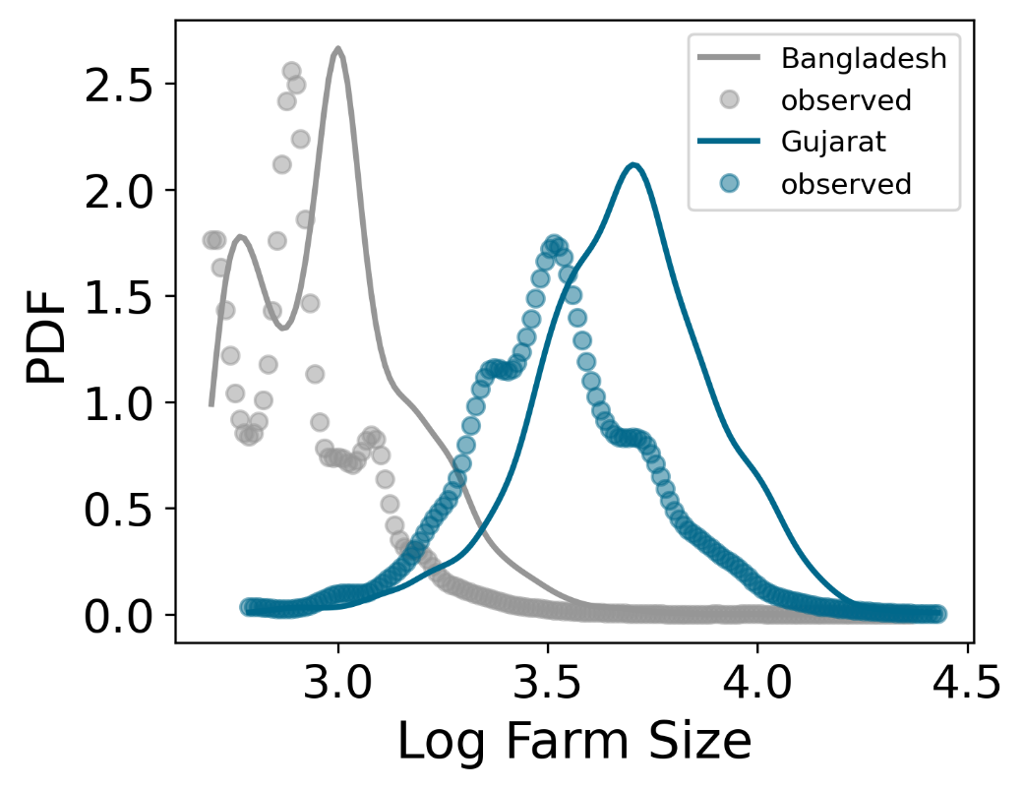
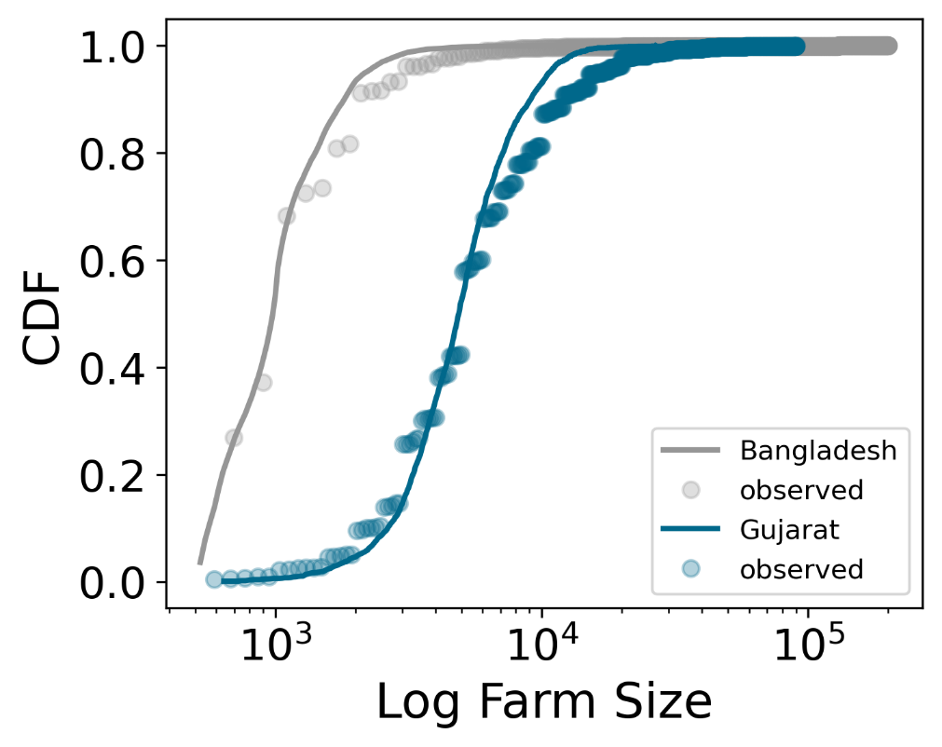
Farm size model (random forest model)
Weighted mean of predictor in a buffer zone around each farm (5kms)
Rescaling training data (log transformation)
Correlation coefficient between observed and predicted values = 0.83
Notes:
The second part of the farm distribution model allows to predict the farm size. We compute the weighted mean of predictor in a buffer zone around each farm, so we have one value per predictor per farm.
Before training the model, we rescale the training data because farm size distribution is very skewed, With rescaling the data we obtain a distribution close to normal.
Finally, the random forest model has a correlation coefficient of zero point eighty three and it allows to reproduce the farm distribution for Bangladesh (in grey on the plots) and Gujarat (in blue) , but it overestimates the peak of farm size

Slide 37
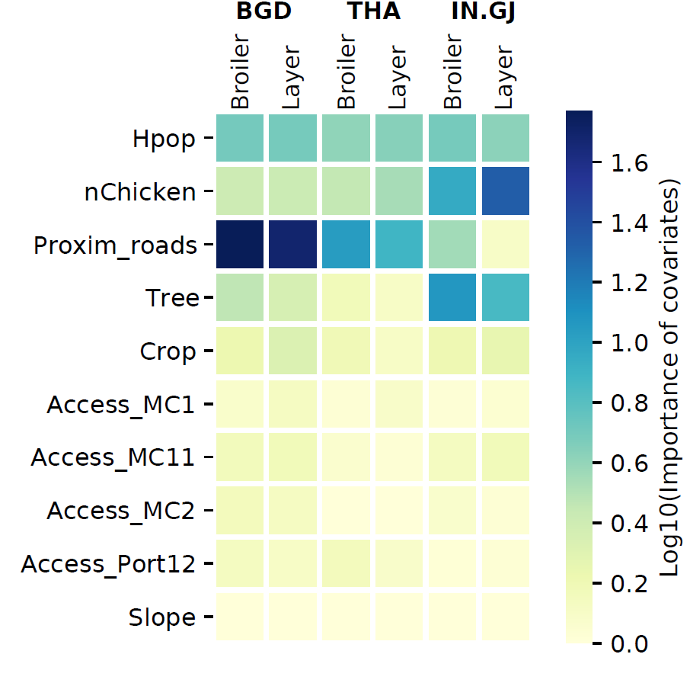
Importance of spatial predictors
To estimate the importance of covariates: all predictors for accessibility are transformed
→ « time travel » in minutes replaced by 1/time travel (min⁻¹)

Slide 38
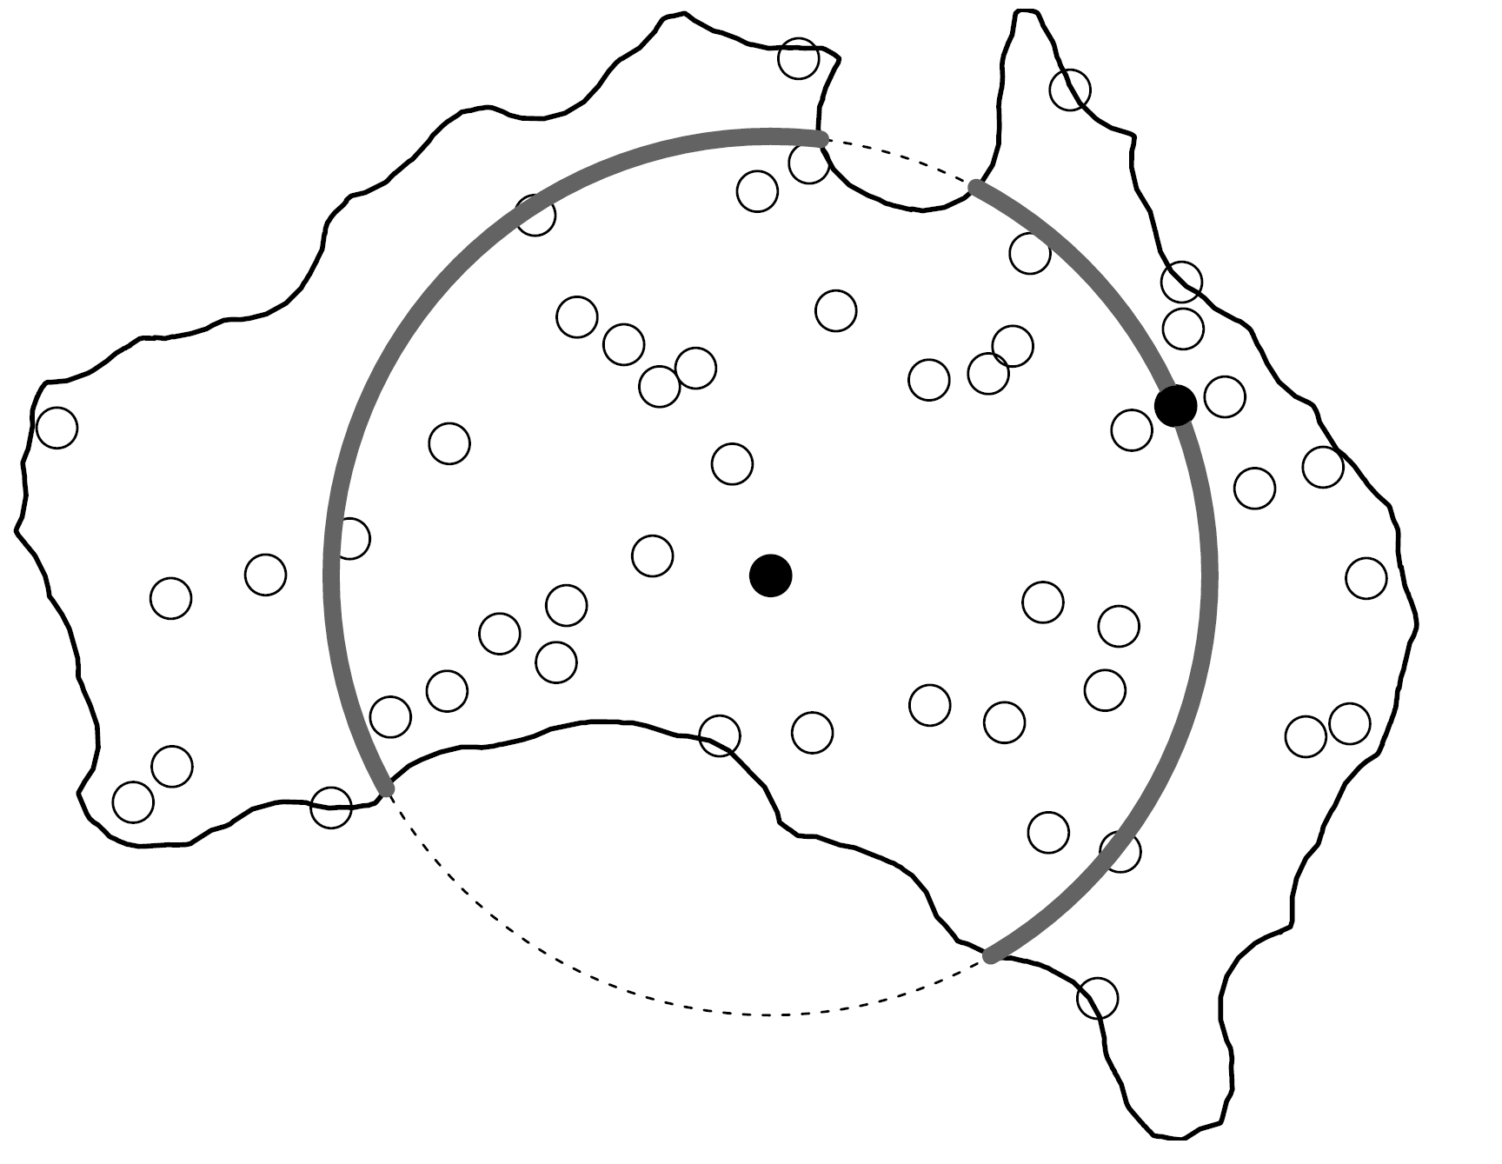
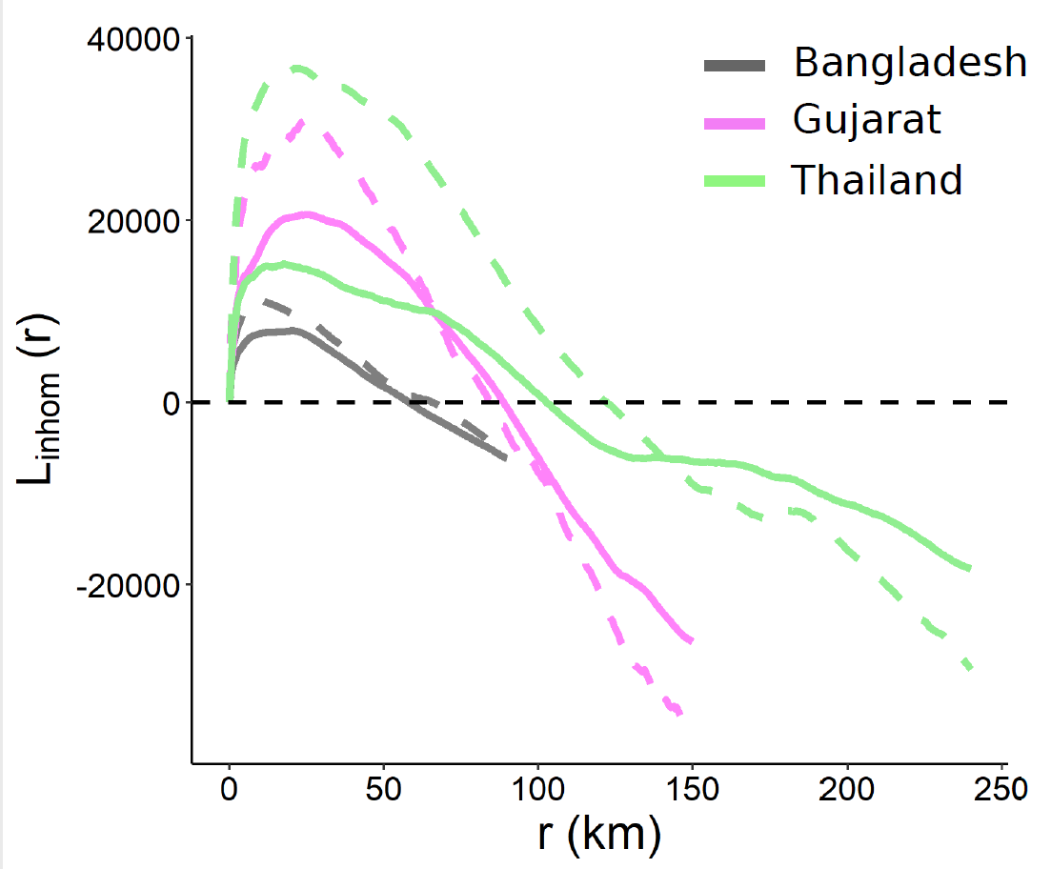
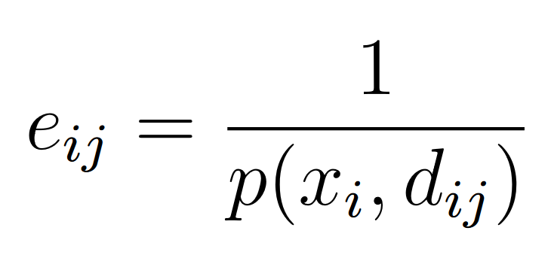
Sample biases correction of Linhom function
Isotropic correction
We calculate the probability of the second point x’ is inside the window W as:
Finally, the edge correction is:

Slide 39
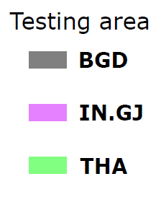
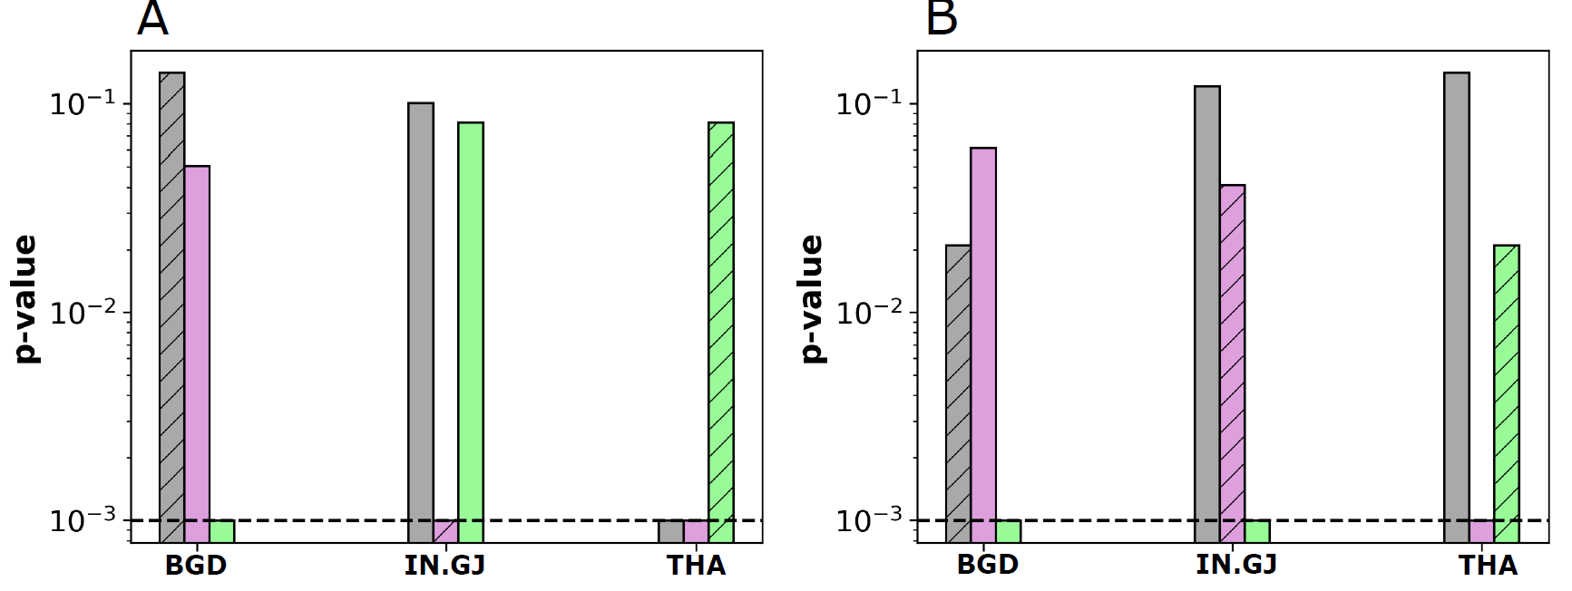
Results
p-value of the global envelope test
Broilers
Layers
Training area

Slide 40
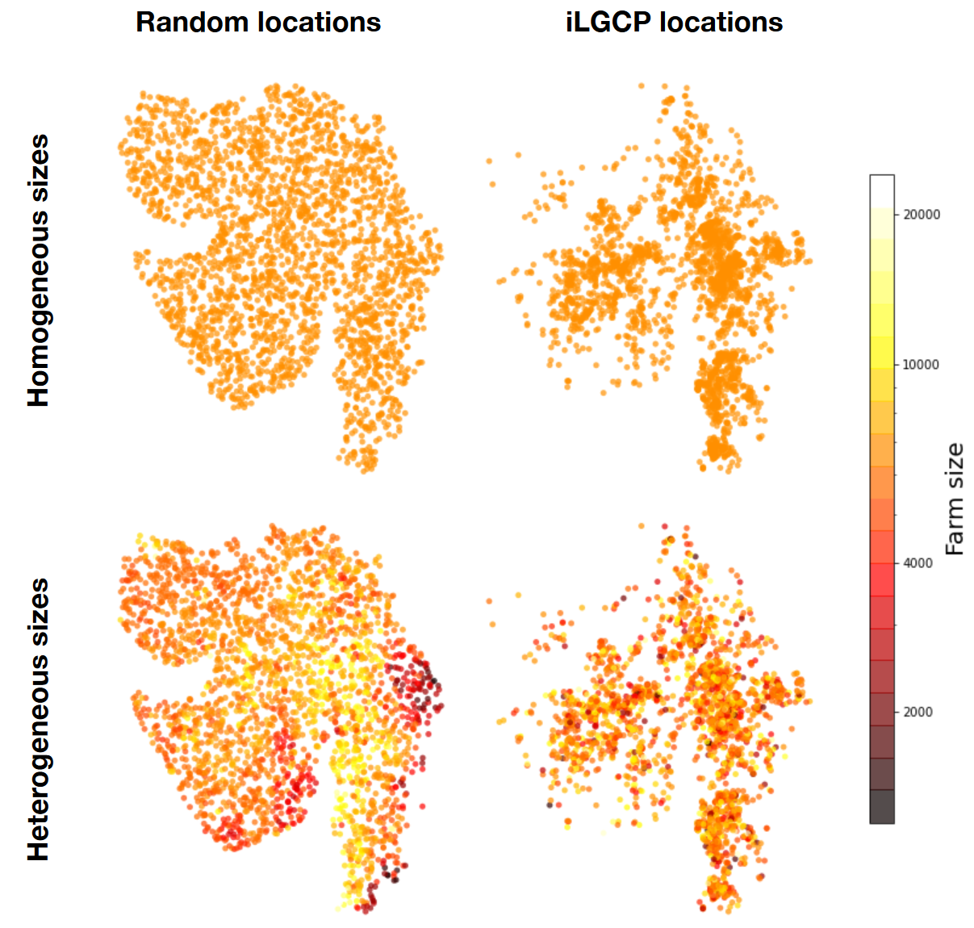
Assessing the role of spatial clustering and farm sizes on epidemic spread
Different configurations:
Random vs modelled (LGCP) farm locations
Homogeneous vs heterogeneous (RF) farm sizes
2000 simulations per configuration
Change of the farm distribution (40 spatial points patterns per configuration)
Change of the initial infectious farm (50 simulations per farm configuration)
Notes:
We considered several kind of spatial distributions on which we simulated epidemics spread; first of all we consider the Empirical distribution of farms used as a reference scenario
Then, we have four configurations
we ran 2000 independent simulations per configuration
For each configuration, we have 40 samples where we ran 50 disease spreading simulations
At the beginning of each simulation we chose a random farm and set it to infectious;

Slide 41
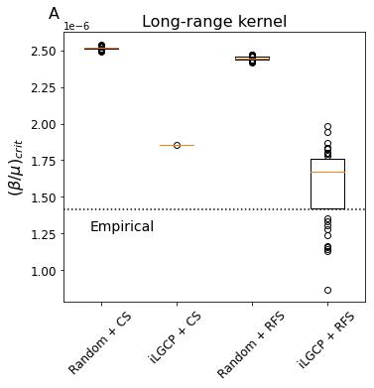
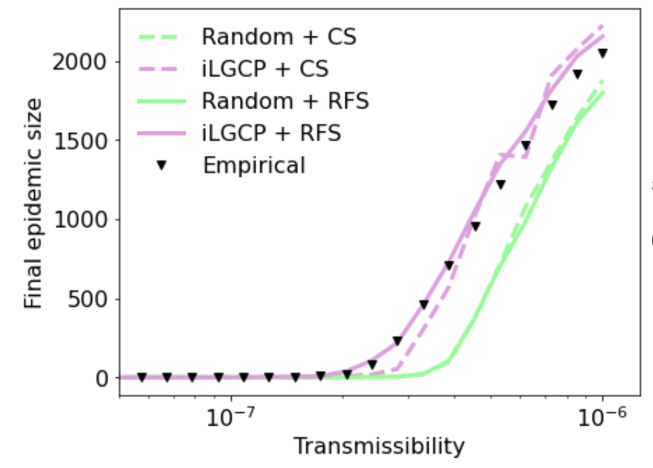
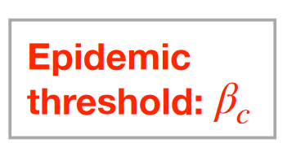
Outbreak size and vulnerability to epidemics
$M_{i ,j} = N_{i}^{q}∙$ $N_{j}^{q′} ∙ K(d_{i,j})$
$β_{c} =μ/ρ(M)$ Intrinsic vulnerability of a farm configuration
Notes:
The epidemic threshold is defined as the critical value of the transmissibility; below which it is not possible to have large scale outbreak so that the final epidemic size is zero or very small
Around the epidemic threshold, it is possible for an epidemic to reach a large number of farms, which increases with transmissibility.
in the right plot, we caracterize the epidemic threshold (it is a property not only on the pathogen but also of the spatial distribution of farms)
as you can see from both panels, the distribution modelled with the FDM provides a better match to the empirical value of the epidemic threshold and
interestingly, we find that compare to other simpler model, the FDM yields farm configurations with variable epidemic threshold
This means that different spatial point patterns simulated with the FDM do not have the same importance of epidemic vulnerability.,
We also observe that clustered point patterns configurations are more susceptible to epidemic than random farms distribution
differences in epidemic vulnerability are very important because it dictates not only the average epidemic size but also the epidemic speed and potentially all other epidemic properties

