Slide 1
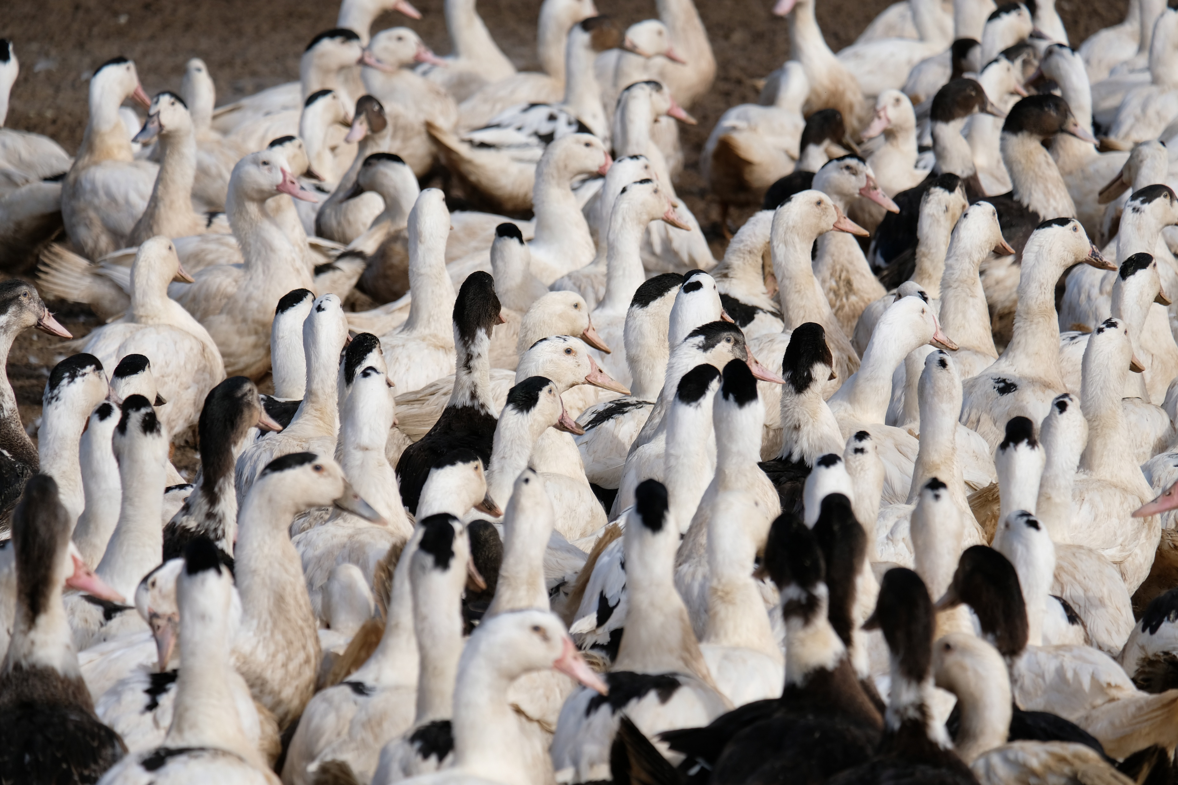




Picture: C. Le Gall
MODELLING AVIAN INFLUENZA
TO SUPPORT POLICY:
A COLLECTIVE EXPERIENCE
Sébastien LAMBERT et al.
Host-Pathogen Interaction Unit (IHAP), Veterinary School of Toulouse (ENVT) /
French Research Institute for Agriculture, Food and the Environment (INRAE)

Slide 2


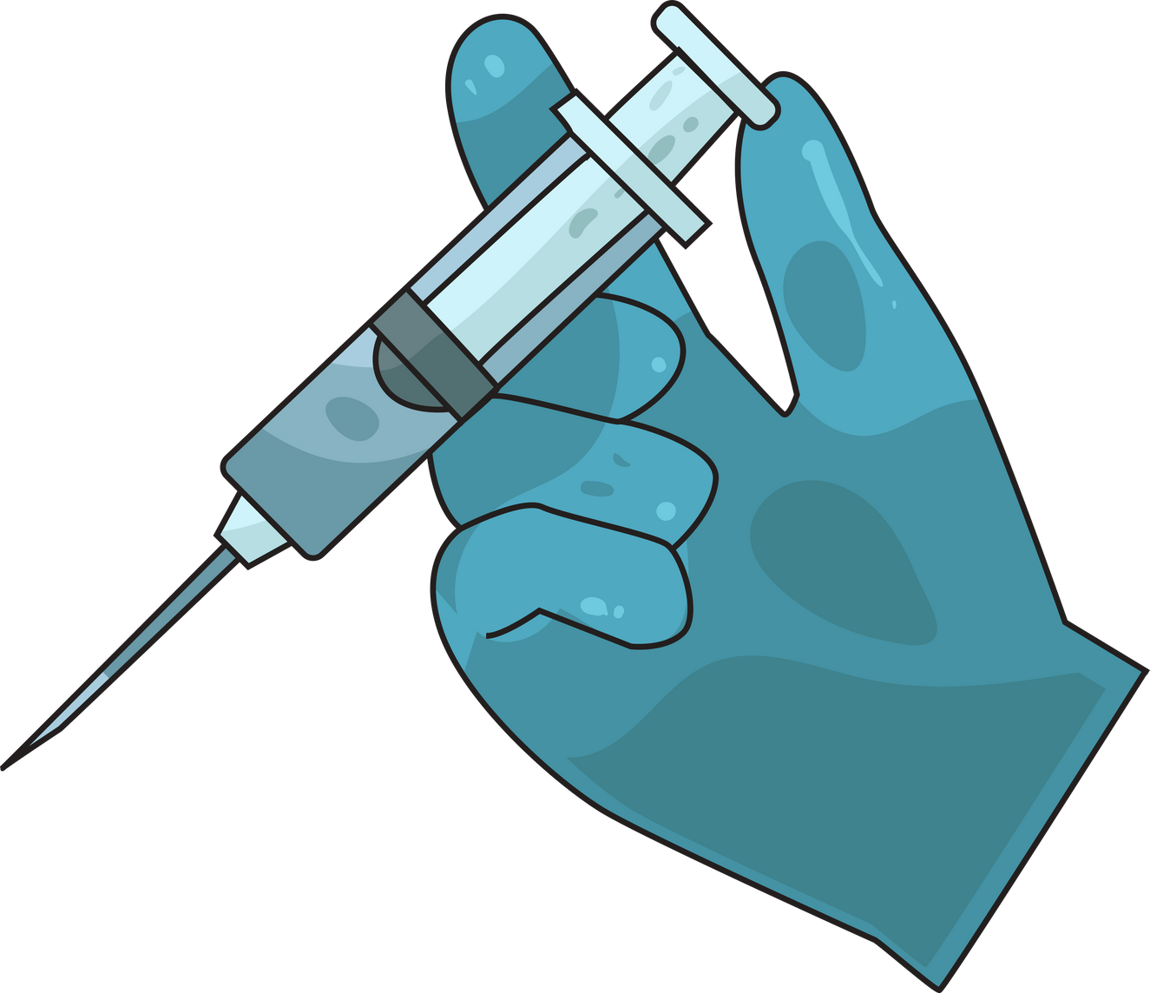
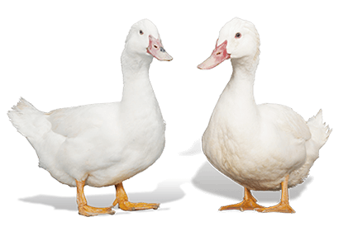
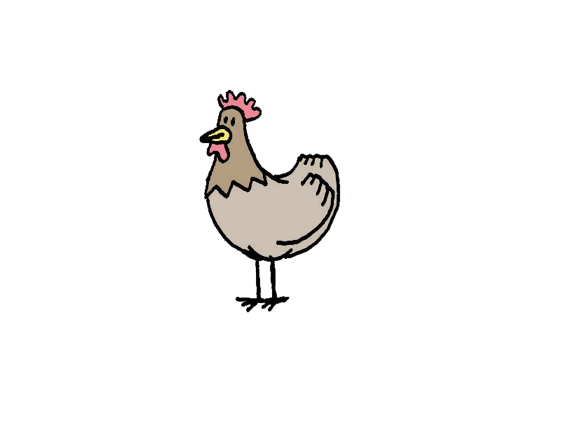
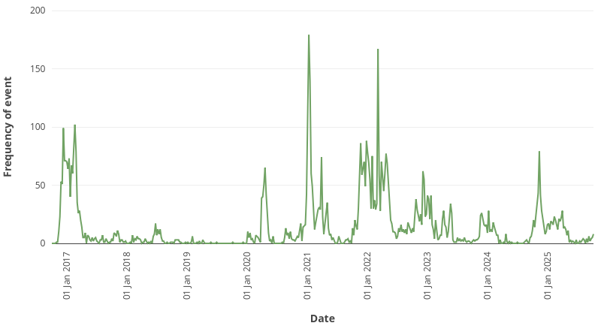
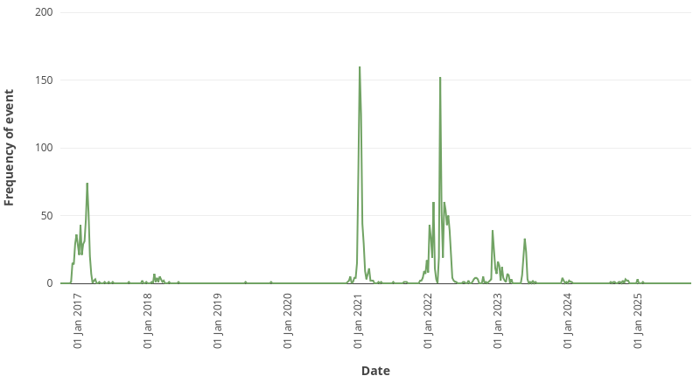
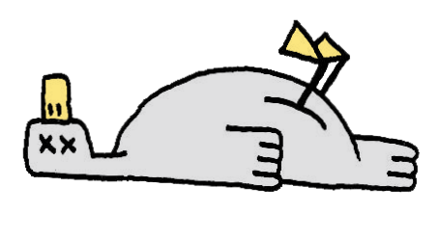

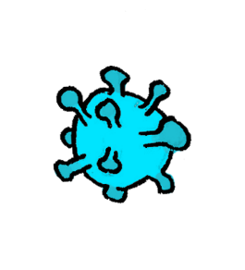
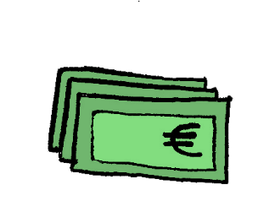
HPAI epidemics in European poultry
1386
2808
492
1374
1218
777
484
1317
396
390
15
11
Recurrent epidemics of highly
pathogenic avian influenza (HPAI)
Subtype H5 clade 2.3.4.4b
~19 millions birds culled
1 billion euros
Sources: DGAL, Empres-I, EFSA, ESA, ITAVI

Slide 3
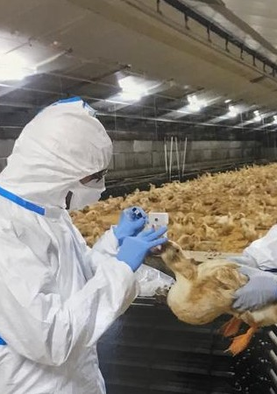
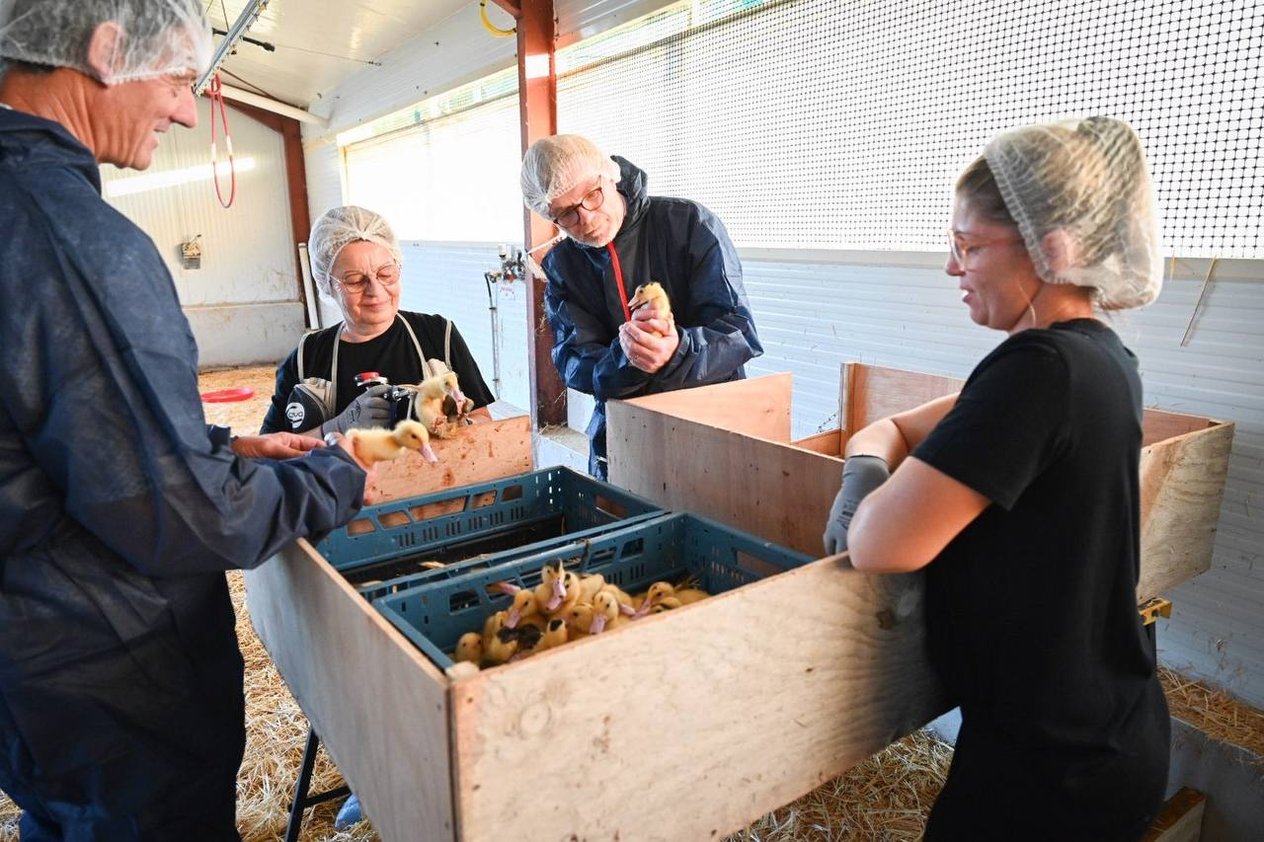
2016-2023
2023-2025
Picture: J.-L. Guérin
Picture: Ministère de l’Agriculture

Slide 4
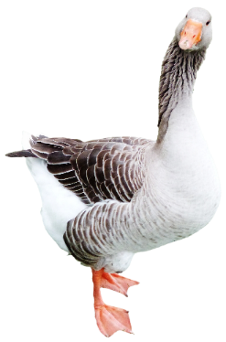
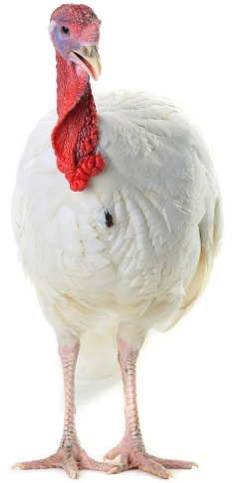
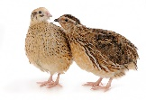
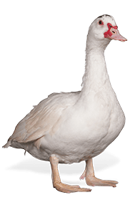
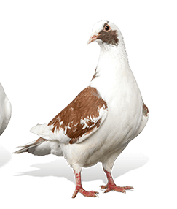
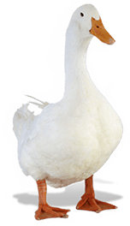
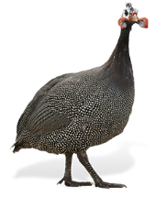
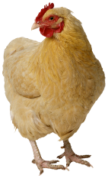
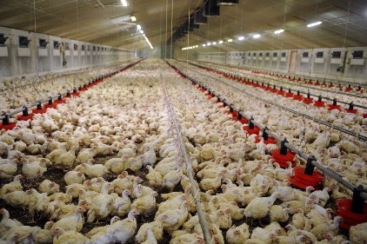
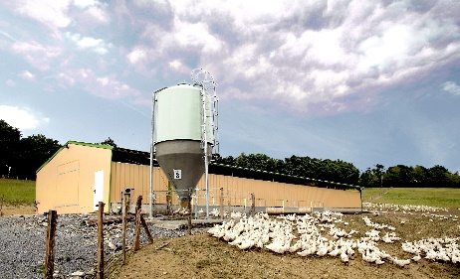
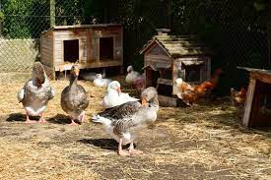
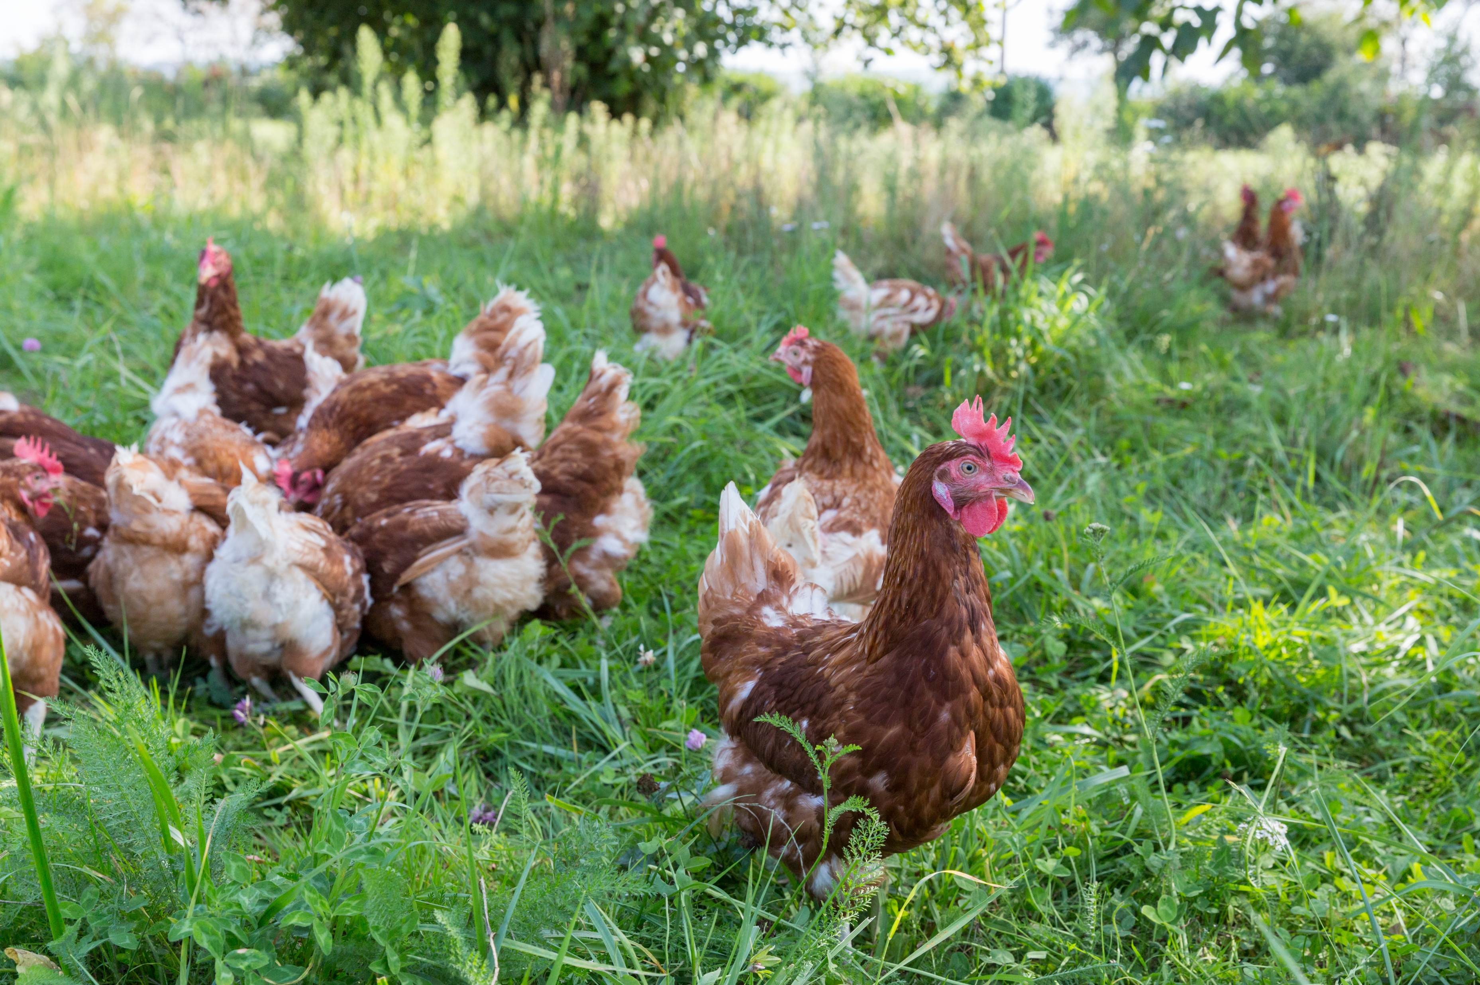
The French poultry sector
Diversity of species…
Chickens, Turkeys
Pekin ducks, Muscovy ducks and mule ducks
Geese, quails, guinea fowl, pigeons…
… and of production systems
Chicken layers/broilers
Broiler ducks/ducks for foie gras production
Commercial/backyard
Indoor/Outdoor
Integrated/Independent…

Slide 5
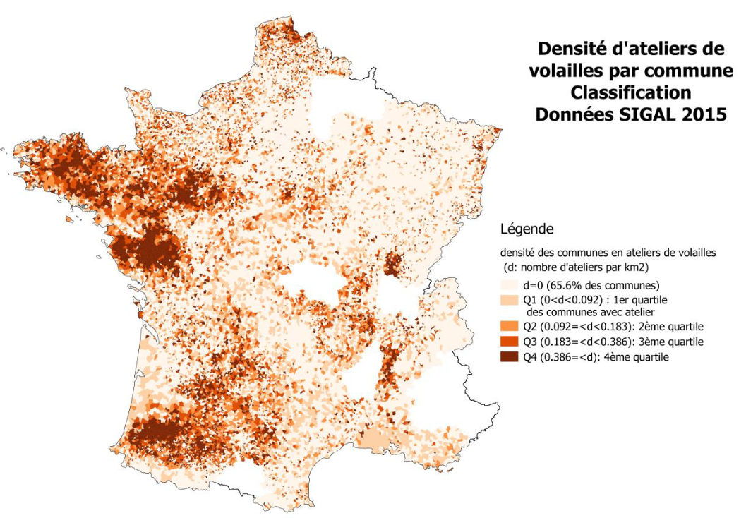
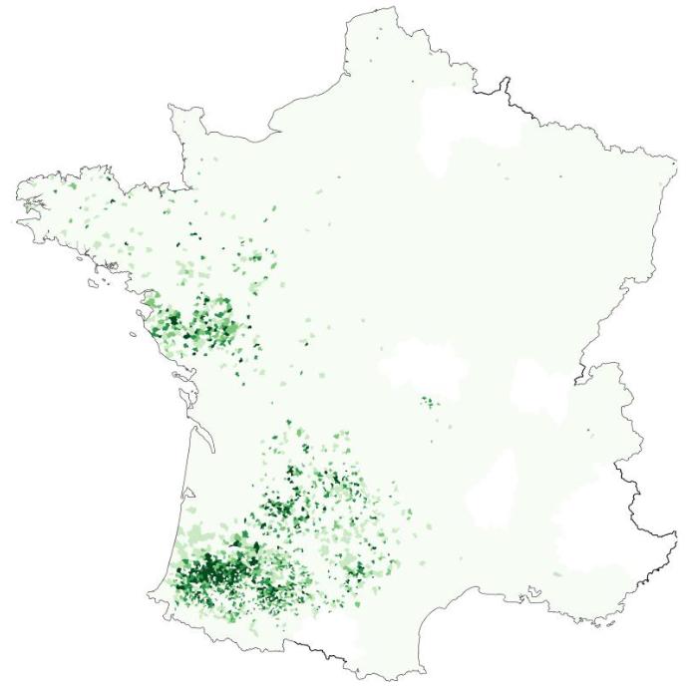





The French poultry sector
Strong spatial heterogeneity
Densely populated poultry areas
Spatial distribution varies between species
Density of poultry
houses (d: number/km²)
Source: Anses (2017)

Slide 6
2016-2023
2023-2025
Picture: J.-L. Guérin
Picture: Ministère de l’Agriculture

Slide 7

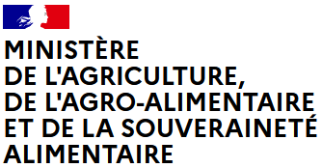
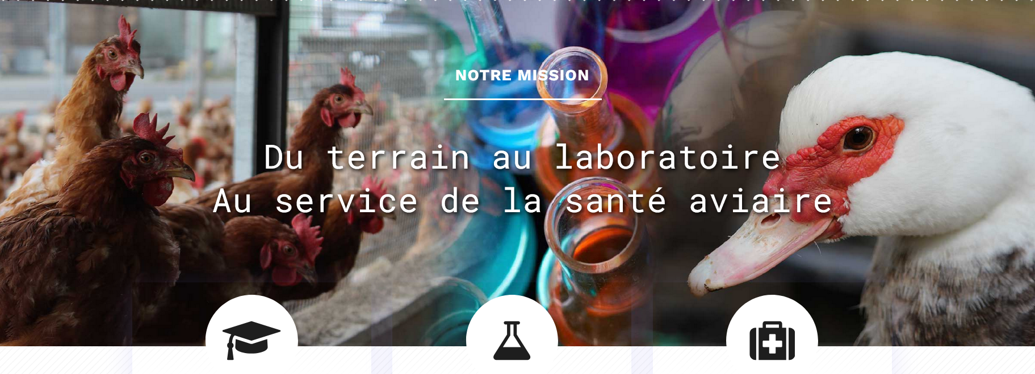
How it started: the 2016-17 epidemic
An unprecedented epidemic…
484 poultry outbreaks
Mainly (>80%) duck farms (south-west)
6.8 million birds culled with huge economic losses
Source: Guinat et al. (2018) Eurosurveillance
… which triggered modelling studies
Within the framework of the
pre-existing chair of avian biosecurity
Clinicians, virologists and epidemiologists
Partnership with public authorities and professional organisations (farmers, vets)
Teaching & Training
Research
Diagnostic & Investigations

Slide 8
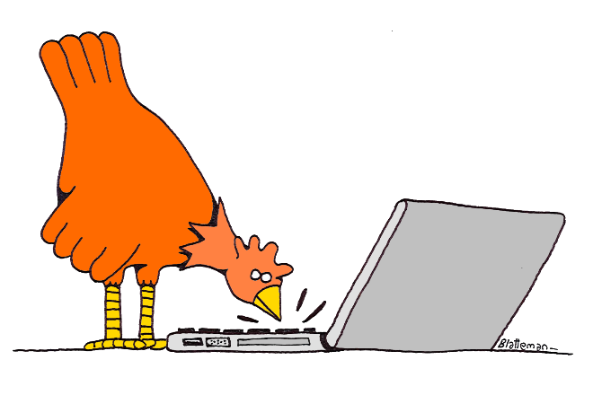
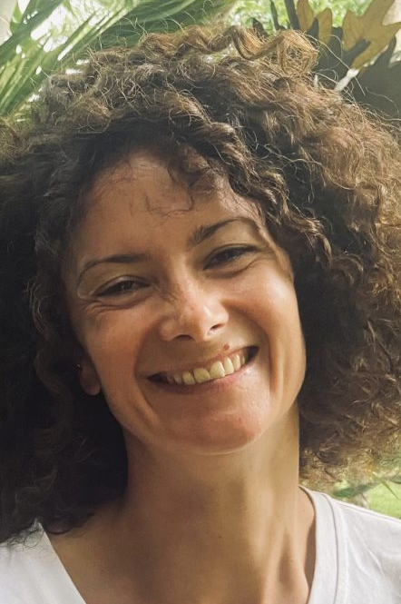
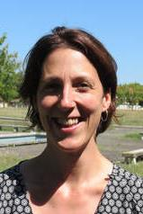
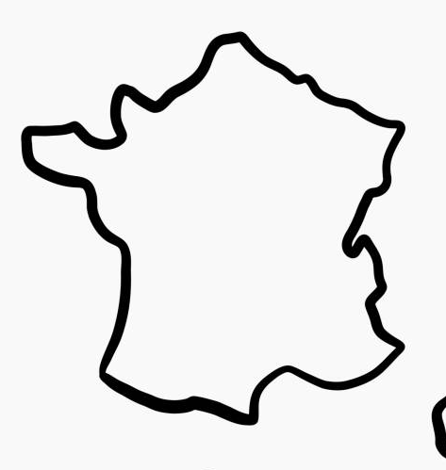
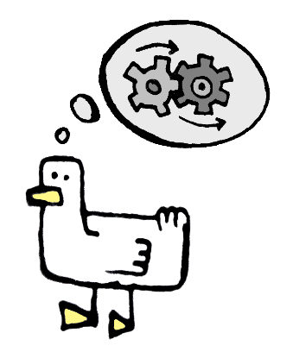
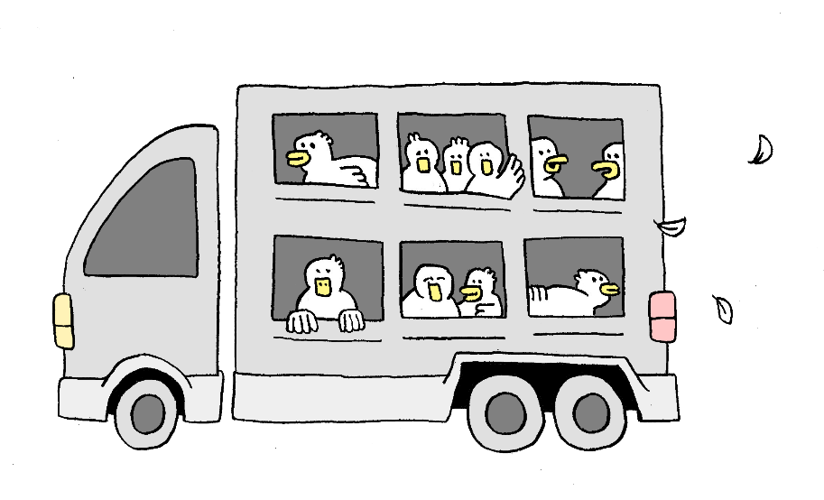
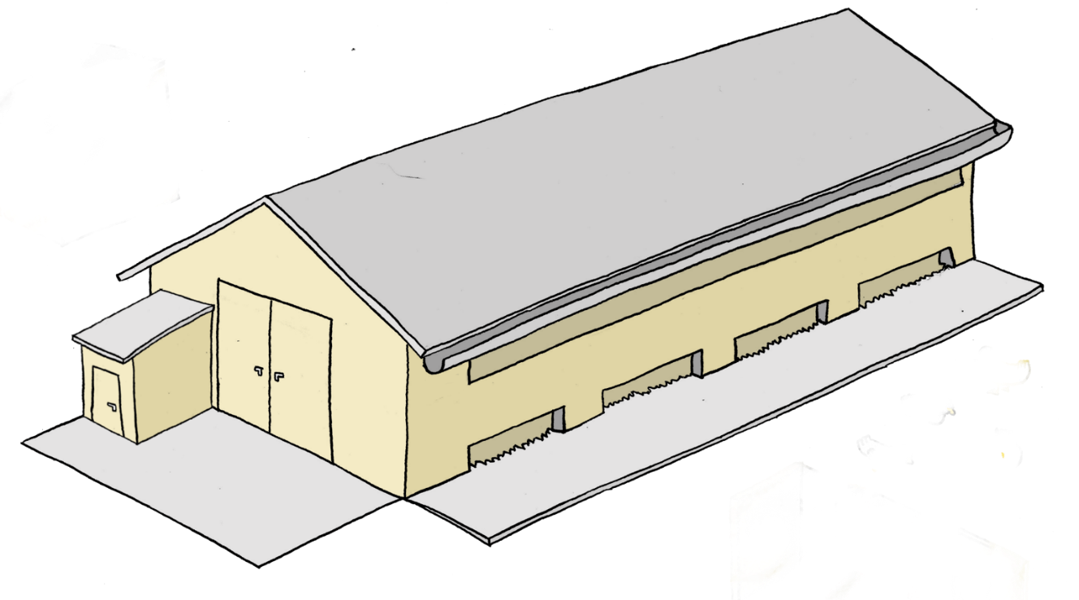
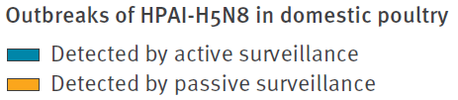

Spatial risk modelling
Any relevant risk factors?
Density of outgoing fattening duck movements
Density of fattening duck farms
Density of waterways
?
Density of incoming fattening duck movements
$$\sim$$
Density of broiler duck farms
Density of outdoor fattening duck farms
Density of chicken farms
Density of human population
Source: Guinat et al. (2019) Sci. Rep.

Slide 9
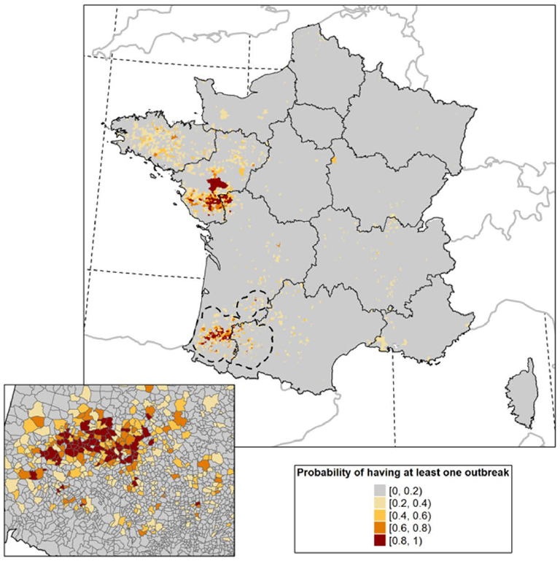

Spatial risk modelling
Any relevant risk factors?
$→$ Density of fattening duck farms & movements
Density of outgoing fattening duck movements
Density of fattening duck farms
Density of waterways
Density of incoming fattening duck movements
$$\sim$$
Density of broiler duck farms
Density of outdoor fattening duck farms
Density of chicken farms
Density of human population
Source: Guinat et al. (2019) Sci. Rep.

Slide 10


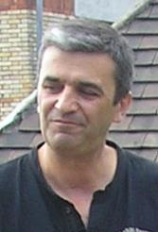
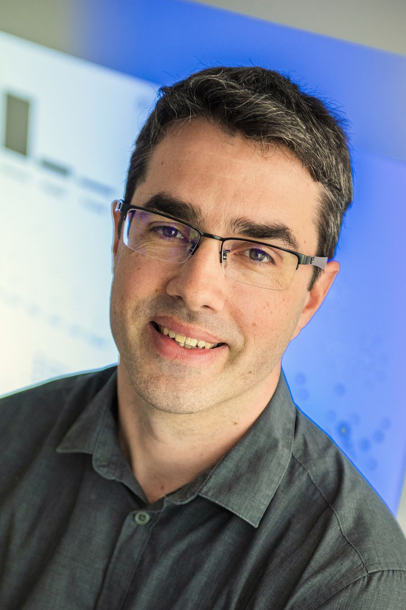
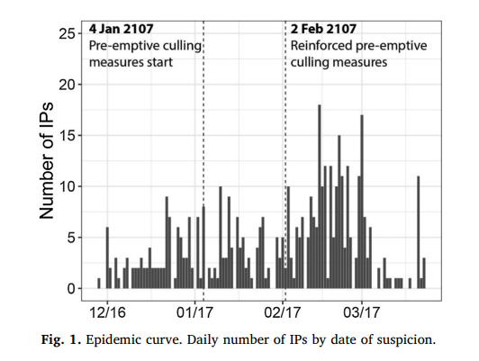
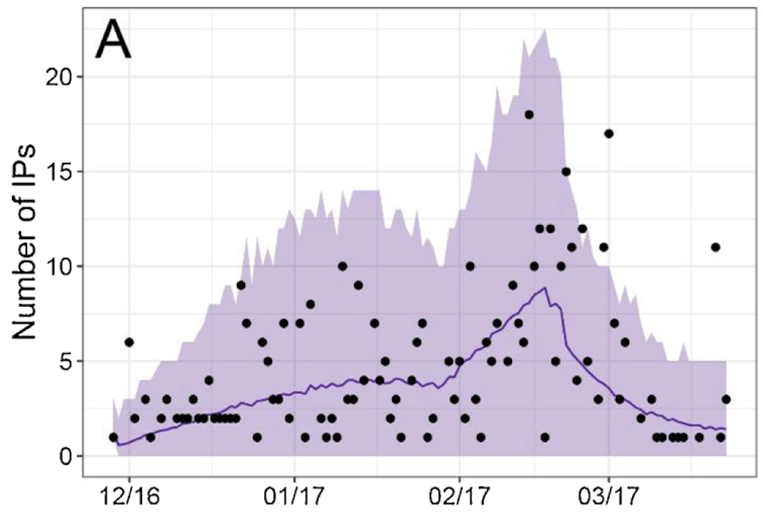
Mechanistic modelling
Relative contribution of different species?
Duck farms were
2.5 times more infectious than chicken farms
Duck farms were
5.0 times more susceptible than chicken farms
Source: Andronico et al. (2019) Epidemics

Slide 11

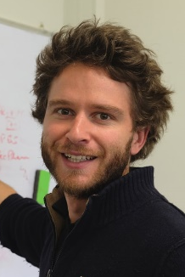
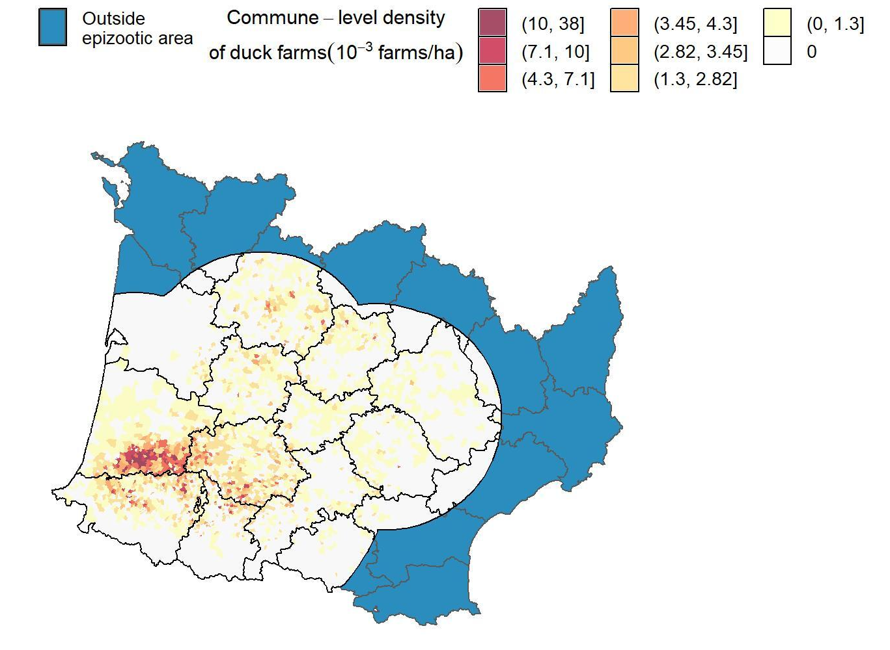
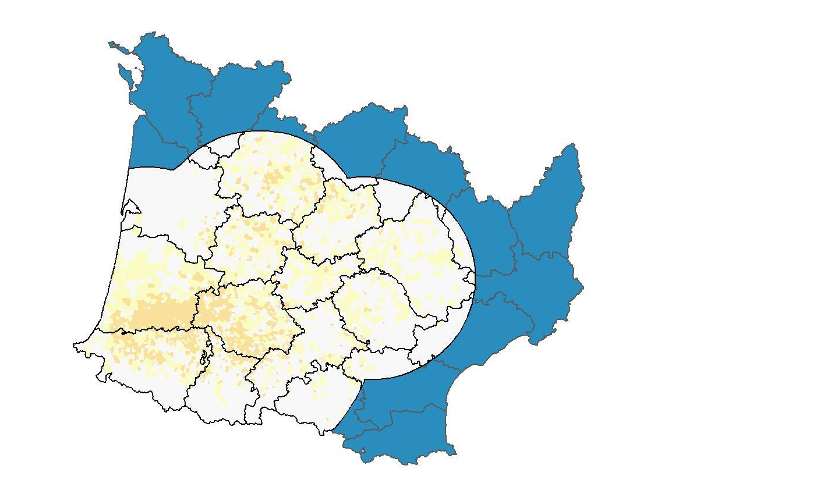
Mechanistic modelling
Duck farm density: what-if scenarios
Baseline
(8379 chicken & duck farms)
Alternative scenario
Reduction of duck farm density in the 20% densest communes
Removal of 825 duck farms
Source: Bauzile et al. (2023) Vet. Res.

Slide 12
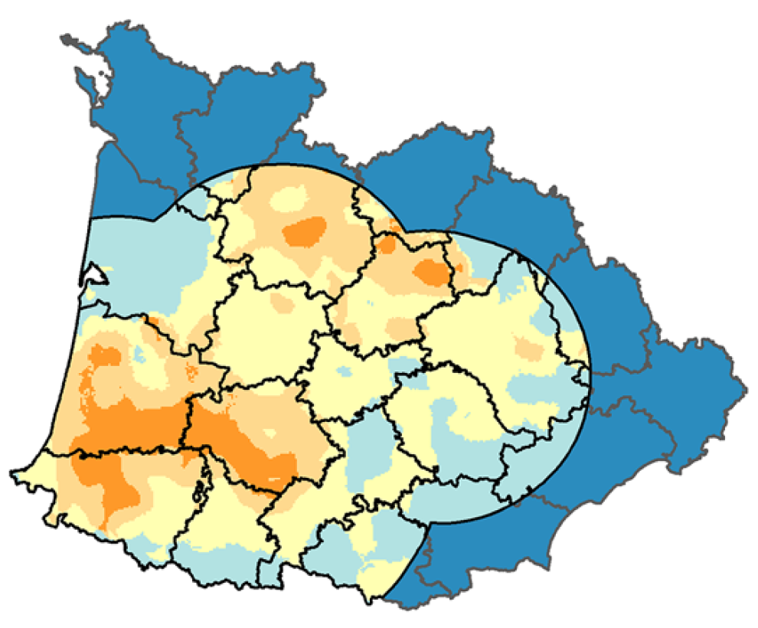
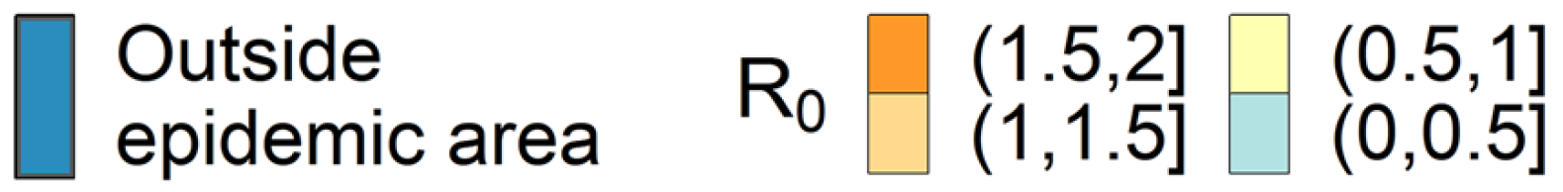
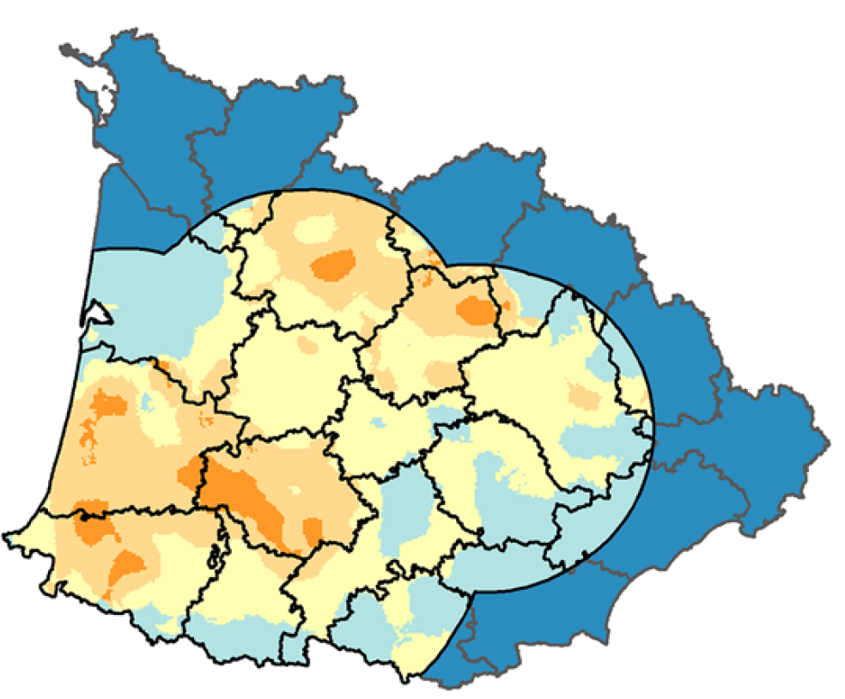
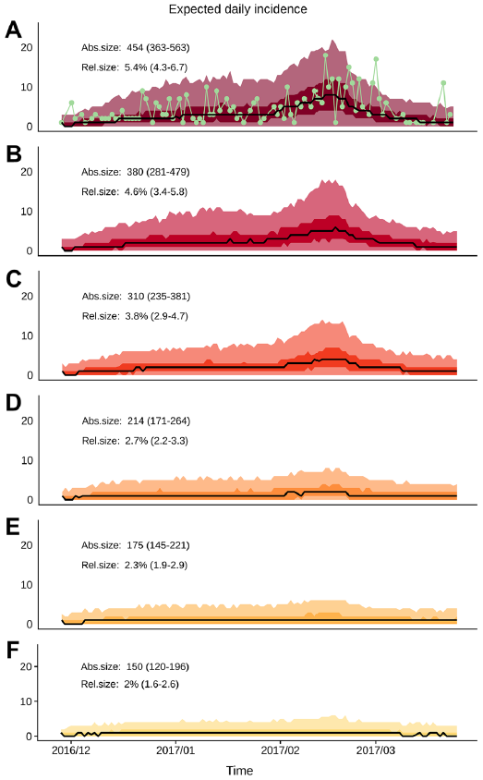
Mechanistic modelling
Duck farm density: what-if scenarios
Baseline
Alternative scenario
Predicted epidemic size: 454 [363-563]
Predicted epidemic size: 150 [120-196]
Source: Bauzile et al. (2023) Vet. Res.

Slide 13
Summary
What have we learned from the 2016-17 epidemic?
At-risk zones are characterised
by high density of duck farms
Duck farms are more susceptible and
more infectious than chicken farms
Reducing duck farm density in the highest-density
zones can be a useful tool to manage HPAI epidemics

Slide 14

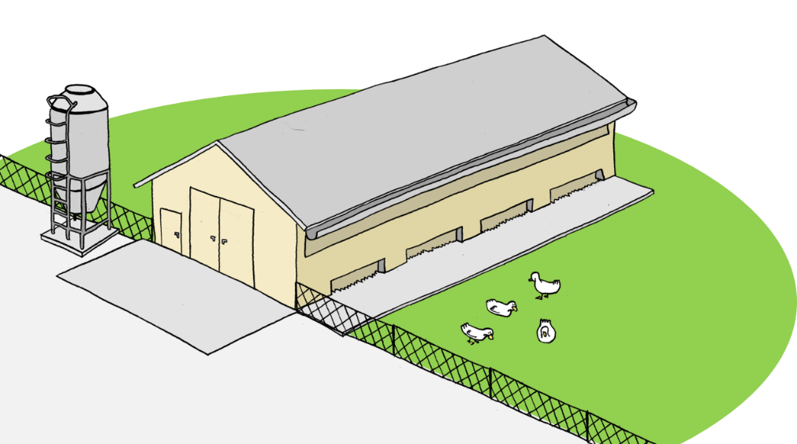
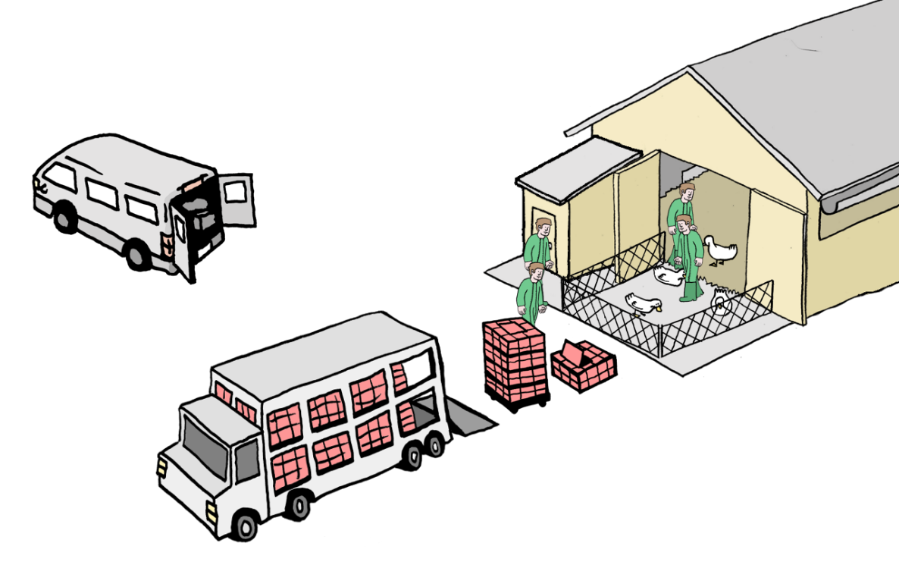




From risk mapping to policy
2020-21 epidemic: very similar to 2016-17
Sep. 2021: definition of regulated high-risk zones
Sources: Guinat et al. (2019) Sci. Rep.; DGAl (2021)

Slide 15


From risk mapping to policy
2020-21 epidemic: very similar to 2016-17
Sep. 2021: definition of regulated high-risk zones
2021-22 epidemic: outbreaks not only in the south-west
2020-2021 epidemic
81% in high-risk zones
83% in duck farms
2021-2022 epidemic
68% in high-risk zones
59% in duck farms
Source: Lambert et al. (2022) TBED

Slide 16






From what-if scenarios to policy
2021-22: professional poultry organization agreed to slightly reduce
fattening duck farm density during the at-risk period
$→$ reduction of the number of outbreaks in the south-west
from 375 in 2020-21 to 284 in 2021-22
2022-23: professional poultry organization created the “Plan Adour” to reduce poultry farm density in highly dense communes from 15 Dec. to 15 Jan.
The Ministry of Agriculture approved and supported the strategy
$→$ only 20 outbreaks in the south-west during winter 2022-23
85 outbreaks in May 2023
after repopulation
Picture: Maïsadour
Sources: Lambert et al. (2022) TBED; Scoizec et al. (2024) Viruses; Ben Salem et al. (2025) Front. Vet. Sci.

Slide 17
2016-2023
2023-2025
Picture: J.-L. Guérin
Picture: Ministère de l’Agriculture

Slide 18

Oct. 2023: launch of the vaccination campaign
492
1374
484
396
15
11
The EU lifts the restrictions on poultry vaccination
The French Minister of Agriculture vaccinates the first duck
Picture: Ministère de l’Agriculture

Slide 19



The French vaccination strategy
Preliminary vaccination trials in ducks
Two doses necessary
Significant reduction of the levels and duration of shedding
Reduction of direct transmission (R₀<1) and absence of airborne transmission in experiments in 7 weeks-old ducks
Preventive vaccination in ducks
Mandatory vaccination of all ducks at the production stage (~60 million ducks/year)
Strict surveillance protocols:
monthly samples on live ducks by vets
weekly samples on dead ducks by farmers
Picture: T. Vergne
Sources: DGAl (2023); Grasland et al. (2023a, b)

Slide 20







Mechanistic modelling
Continuous improvement of the vaccination strategy
Antibody levels start decreasing in 11 weeks-old ducks
Transmission experiments in 11 weeks-old ducks shows
less benefit of vaccination than in 7 weeks-old ducks
Burning question: should we use a 3rd booster dose and where?
$→$ Calculation of the relative reduction of $R_{0}$ based on Andronico et al. (2019)
Two doses
Three doses in mule ducks
Sources: DGAL/SDSBEA/2023-773; Lambert et al. (unpublished)

Slide 21


Mechanistic modelling
Comparison of surveillance strategies
Sensitivity (%)
Adaptation of an existing within-flock model
to include vaccination and surveillance strategies
Relative reduction of ~90% of outbreak
probability and of ~99% of outbreak size
Sampling dead ducks is
more sensitive and timely
than sampling live ducks
In parallel: similar results from EFSA
with a different modelling approach
<
Sources: Planchand et al. (2025) EID; EFSA AHAW Panel et al. (2024) EFSA Journal

Slide 22




Statistical modelling
Impact of vaccination vs lower infectious pressure?
1386
Adaptation of an existing within-flock model
to include vaccination and surveillance strategies
1374
2808
492
1218
777
484
1317
396
390
15
11

Slide 23



Statistical modelling
Impact of vaccination vs lower infectious pressure?
314–756 outbreaks averted in
2023-24 (96-99% relative reduction)
Reductions in other European countries were nowhere near
$→$ Results suggest strong
impact of vaccination
Source: Guinat et al. (2025) EID

Slide 24
Summary
What have we learned after the start of vaccination?
Efficacy of a 3rd dose in mule ducks
in communes of the high-risk zones
Sampling dead ducks is more effective
than sampling live ducks for surveillance
Vaccination showed very promising
results in 2023-24 in France

Slide 25

From modelling to policy
How the vaccination strategy evolved?
Decision to implement a 3rd dose in communes of the
high-risk zone a few months after vaccination started
Vaccination was reconducted
in 2024-2025 (and 2025-26)
2024-25: surveillance evolved to include
5 dead or sick ducks to improve observance
+

Slide 26
2016-2023
2023-2025
Picture: J.-L. Guérin
Picture: Ministère de l’Agriculture

Slide 27








From science to policy
Builds on close ties with public authorities & professional organizations
Close collaborations with other
research institutes (e.g. Anses)
Connections with policymakers
and professional organizations
Facilitates transmission of
information, data sharing, and
formulating research questions
Complementarity of modelling
with field and experimental studies
Research
Teaching & Training
Diagnostic & Investigations
Policymakers
Farmers’ organizations
Veterinarians

Slide 28

Different methods, different time frames
Trade-off between time and complexity
Statistical models
Pre-existing
mechanistic models
Spatial risk models
Compartmental
mechanistic models
Individual-based
mechanistic models

Slide 29





Perspectives
WORK IN
PROGRESS
Ongoing work
Update of mechanistic model from Andronico et al. (2019)
to fit new epidemics $→$ role of outdoor farming?
Update of spatial risk modelling using data from
2020-2023 $→$ redefining high-risk zones?
Use of mechanistic models in a vaccination context
$→$ refining vaccination strategies

Slide 30









THANK YOU FOR YOUR ATTENTION!
Collaborators
Projects
Funders
Drawings
Mattias
Delpont
Sébastien LAMBERT et al.
Host-Pathogen Interaction Unit (IHAP), Veterinary School of Toulouse (ENVT) /
French Research Institute for Agriculture, Food and the Environment (INRAE)

