Slide 1
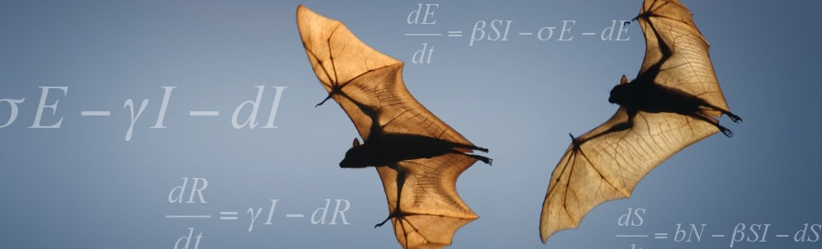

The ghost in the flying machine:
inferring Hendra virus dynamics in bat populations from field data
Olivier Restif
Batonehealth.org
Veterinary Medicine

Slide 2







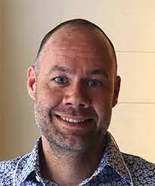








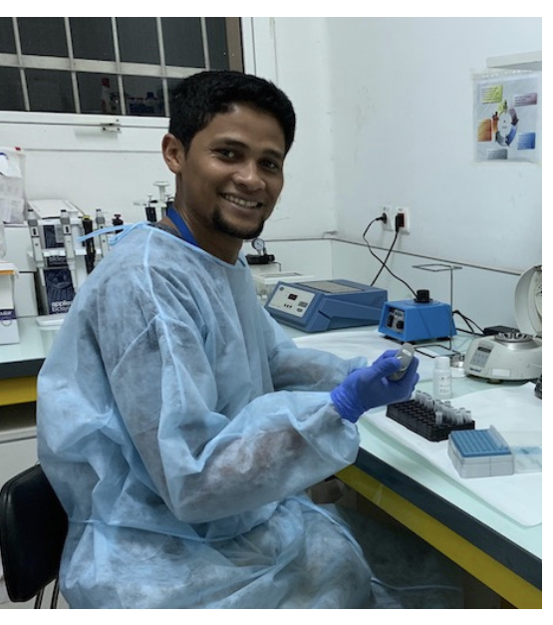
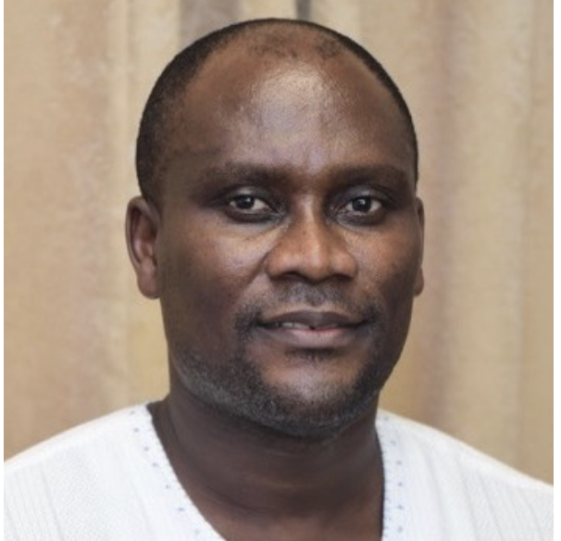


Batonehealth.org
Elisa Fesce
UK:
Cambridge University
Institute of Zoology
USA:
Montana State University
NIH Rocky Mountains Lab
UCLA
Colorado State
Penn State
Johns Hopkins
Cornell
Texas Tech
Raina Plowright
Bangladesh: ICCDRB
University of Ghana
Alison Peel
Peggy Eby
Madagascar
Australia:
Griffith University
Queensland University
Macquarie University
NSW University
Tamika Lunn

Slide 3
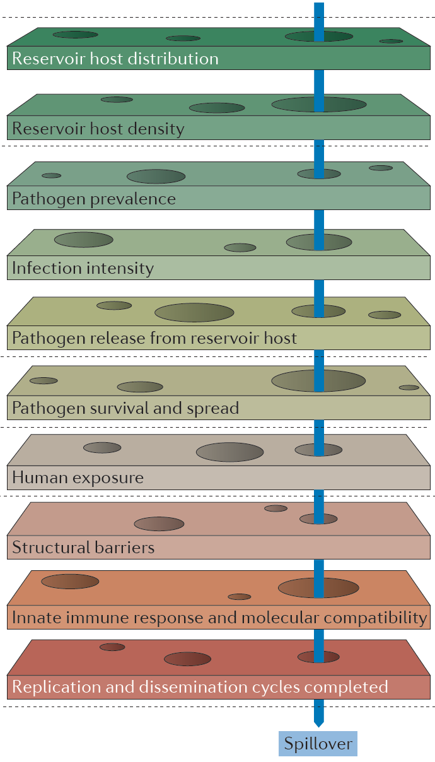
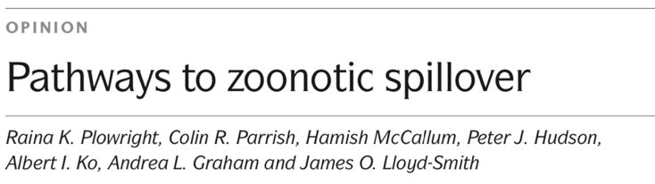
Nature Reviews Microbiology (2017)
Opening the lid on the reservoir:
ecology, epidemiology, immunology in bat populations.
Lack of data on bat-virus dynamics.
How much virus transmission is there among bats?
Do bats clear infection or remain persistently infected?
Estimate environmental drivers of infection and immunity

Slide 4
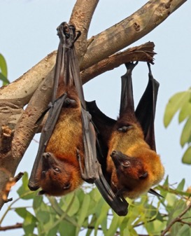
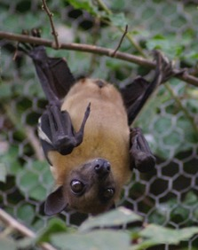
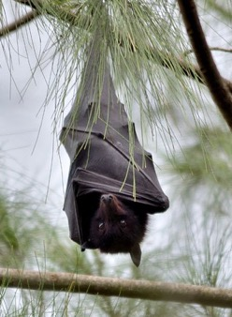
Henipaviruses from fruit bats
Nipah (humans, pigs)
African henipaviruses
(?)
Hendra
(horses, humans)
Eidolon helvum
Map from Kessler et al (2018)
Top: Pteropus medius by Charles Sharp (Wikipedia, CC BY-SA) Bottom: Pteropus alecto by James Niland (Flickr, CC BY)

Slide 5
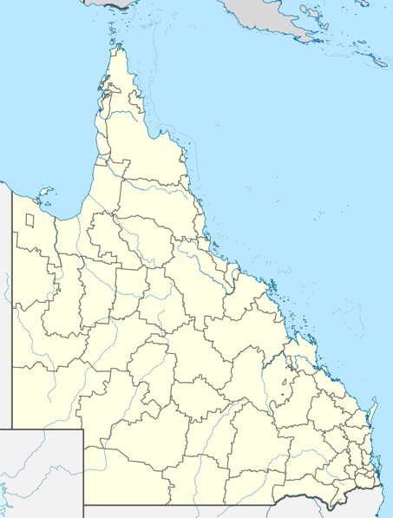
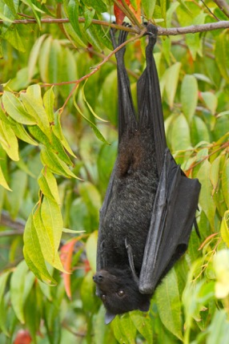
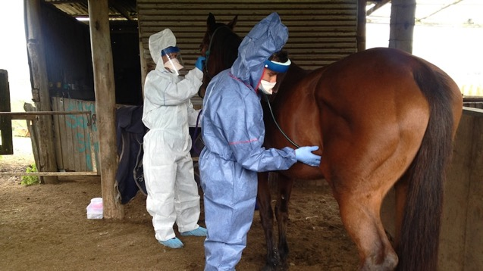
Hendra virus emergence
Queensland (Australia) 1994
September 1994, Hendra: 13 horses and their trainer die
2000: isolation of Hendra virus from Pteropus bats
Sporadic outbreaks, with sudden surge in 2011-2012
As of 2022: 50 spillover events, around 100 horses infected, 90% fatal
Seven human cases, 4 deaths.
Equine vaccine available since 2012, but low uptake.
Hendra •
• Brisbane
Pteropus alecto
(Wikimedia)
Vets exaining a suspected Hendra virus case
(source ABC News)

Slide 6
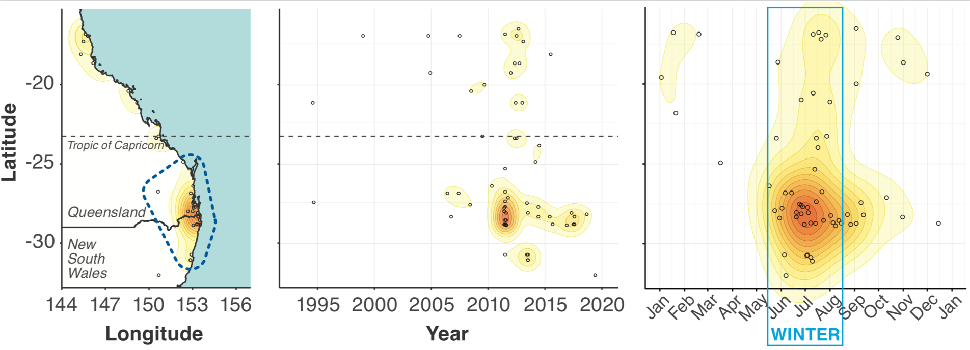
Clustering of spillover events
Eby et al (2022)

Slide 7
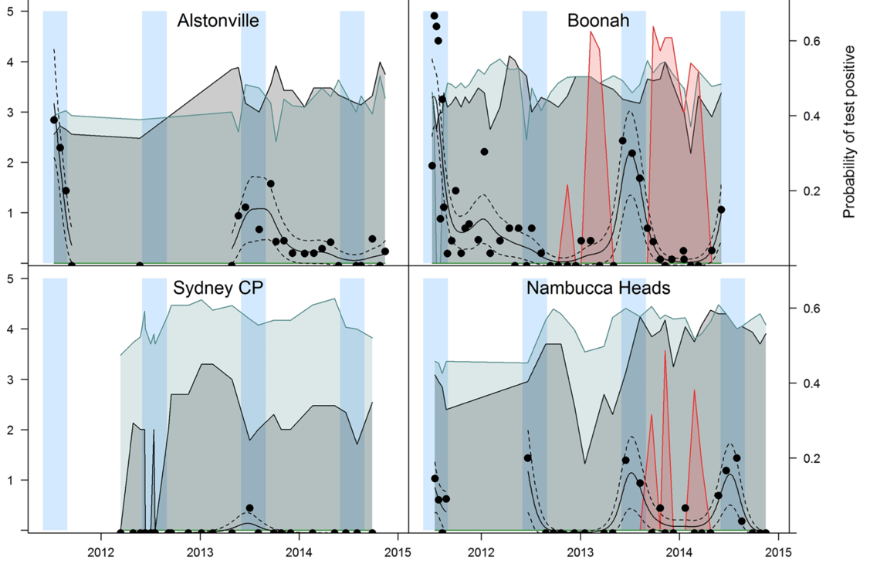
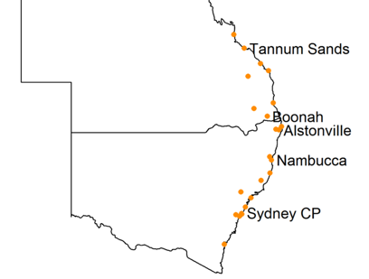

Australian flying foxes
Virus detection in urine collected under roosts shows seasonal patterns in multiple locations : Winter peaks
Bat numbers (log10)
— Black
— Grey
— Little Red
• Proportion of HeV positive samples
Winter
Field et al (2015)

Slide 8
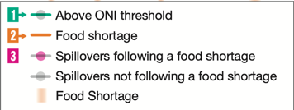
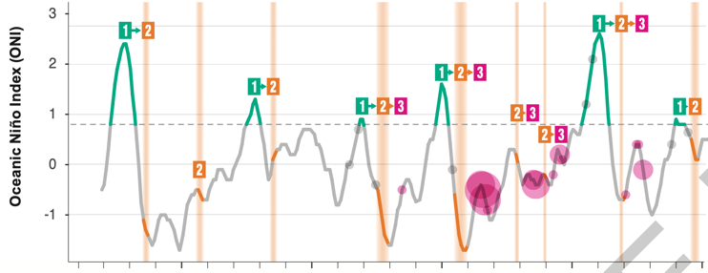
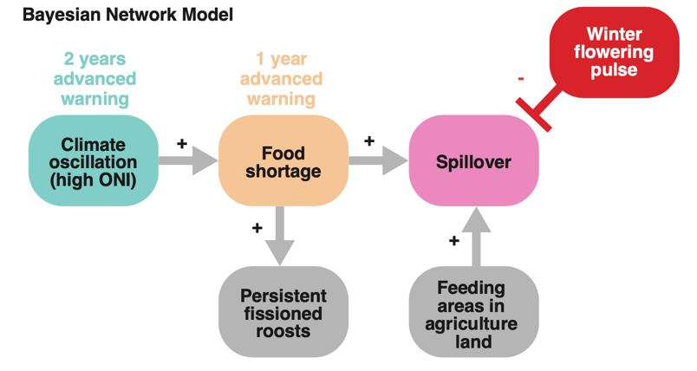

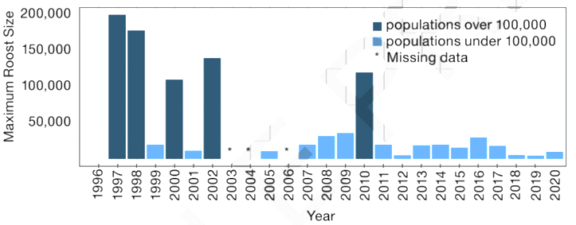
Climatic drivers of spillover events
Eby et al (2022)

Slide 9
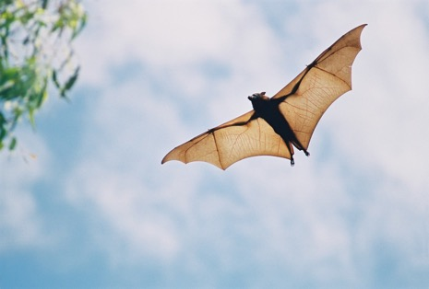
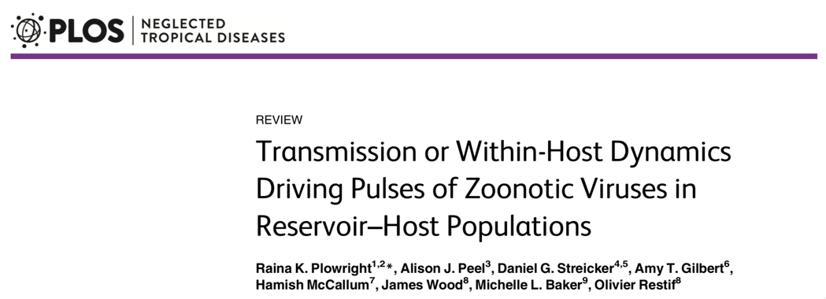
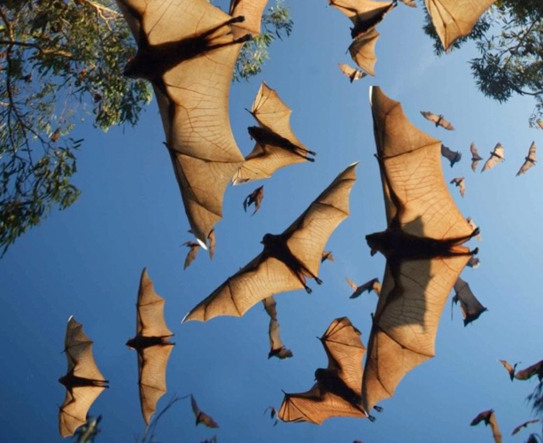
What causes seasonal shedding of Hendra virus in bats?
Seasonal pulses of shedding
No repeated testing of wild-caught bats
Long-lived, migratory species
Evidence of persistent infection with Hendra virus

Slide 10
What mechanisms link environmental stressors to virus dynamics?
Environment
Immune response
Infection
Transmission
Serum antibody quantification
Viral RNA from individual bats
Viral RNA from pooled urine samples
Assay
Data
Seroprevalence
Prevalence
Proportion positive samples

Slide 11
Analysis of historical Australian data
(Daniel Edson, Hume Field and collaborators)
Specific subset: Boonah roost, linked to 2011 spillover event nearby.
Serology data detecting antibodies
Individual PCR data detecting viral RNA
Pooled under roost PCR data detecting viral RNA
Extensively studied roost with established colonies
Field et al 2015, Edson et al 2015

Slide 12
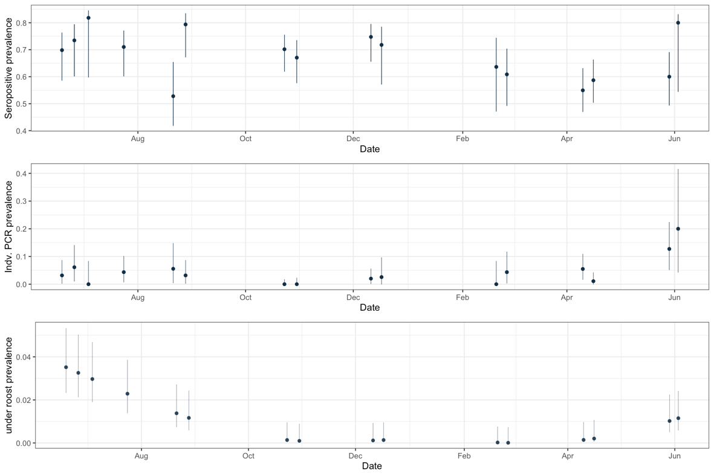
One year of data from Boonah
Seroprevalence
🦇💉
Virus prevalence
🦇🧪
Under-roost urine
🦇🦇🦇
🧪
Winter
2013
2014
Winter
Births

Slide 13
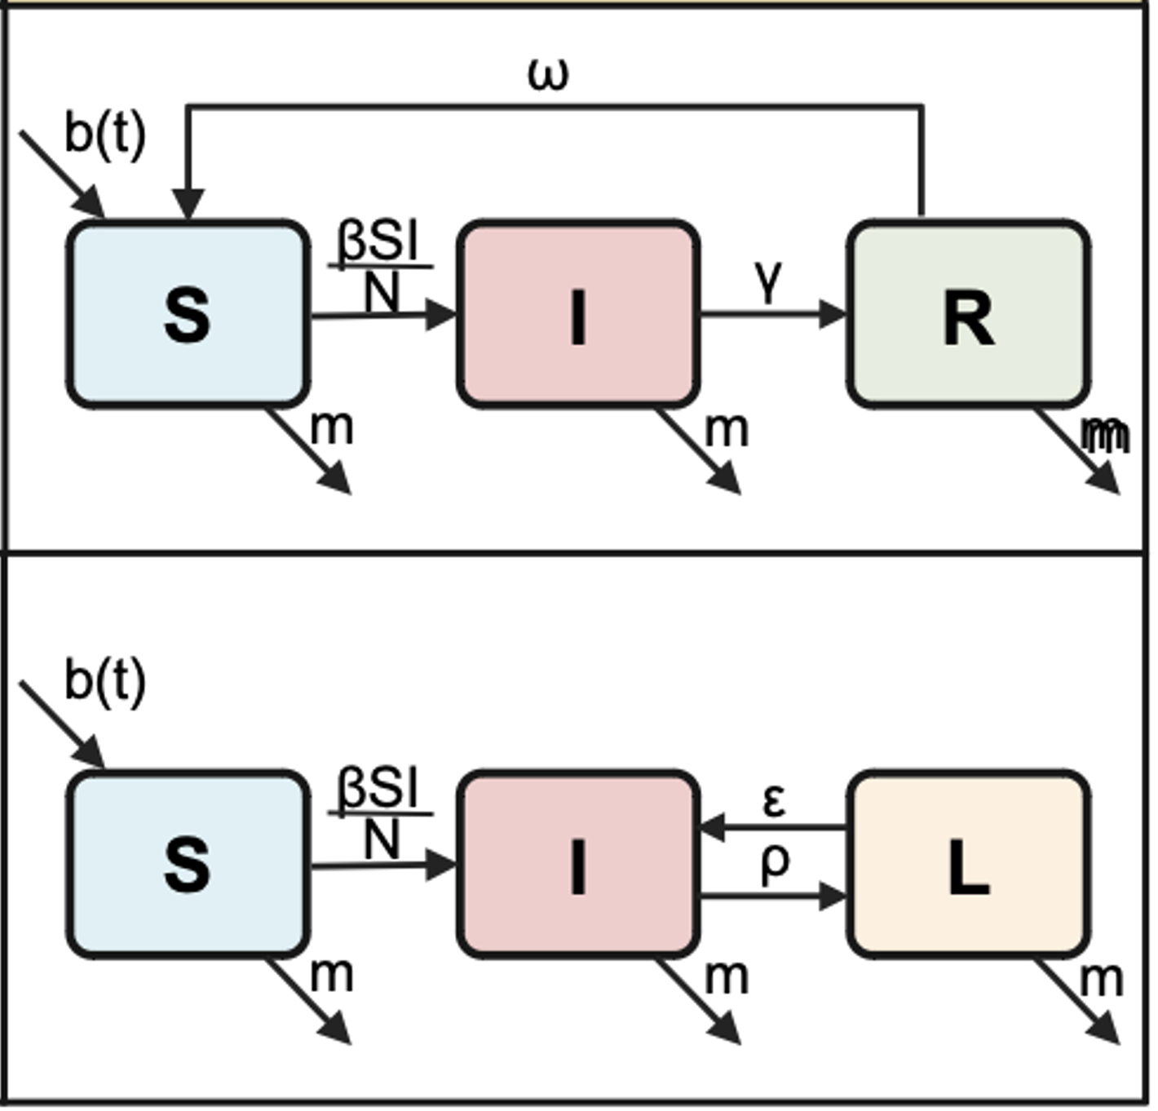
Dynamic models of infection
S = susceptible
I = infectious
L = latent infection
R = recovered immune
Loss of immunity
Elisa Fesce
Assumptions: I, L and R bats are seropositive.
Only I bats are PCR positive.
Birth pulse in October.
Hypothesis: there is an additional seasonal driver underlying infection dynamics
Reactivation

Slide 14
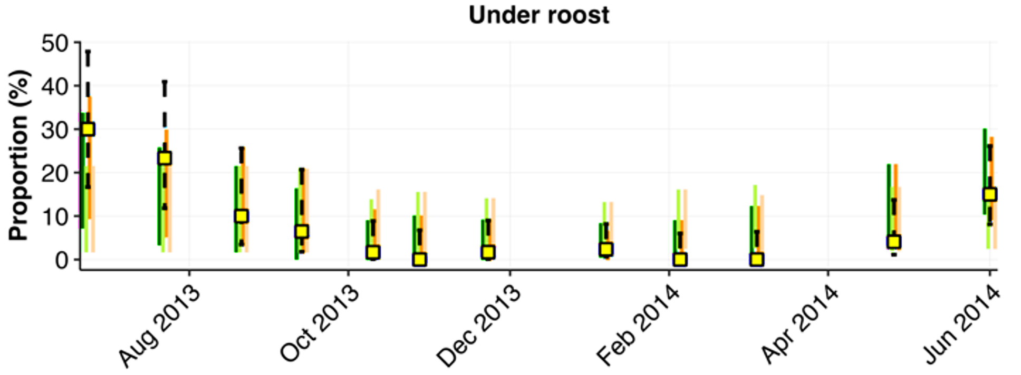
Results: model comparison
1. SIRS with seasonal loss of immunity (AIC 213)
2. SILI with seasonal reactivation rate (AIC 224)
3. SIRS with constant loss of immunity (AIC 272)
4. SILI with constant reactivation rate (AIC 277)
PCR+
Birth pulse
⬇️
Data (95% CI)

Slide 15
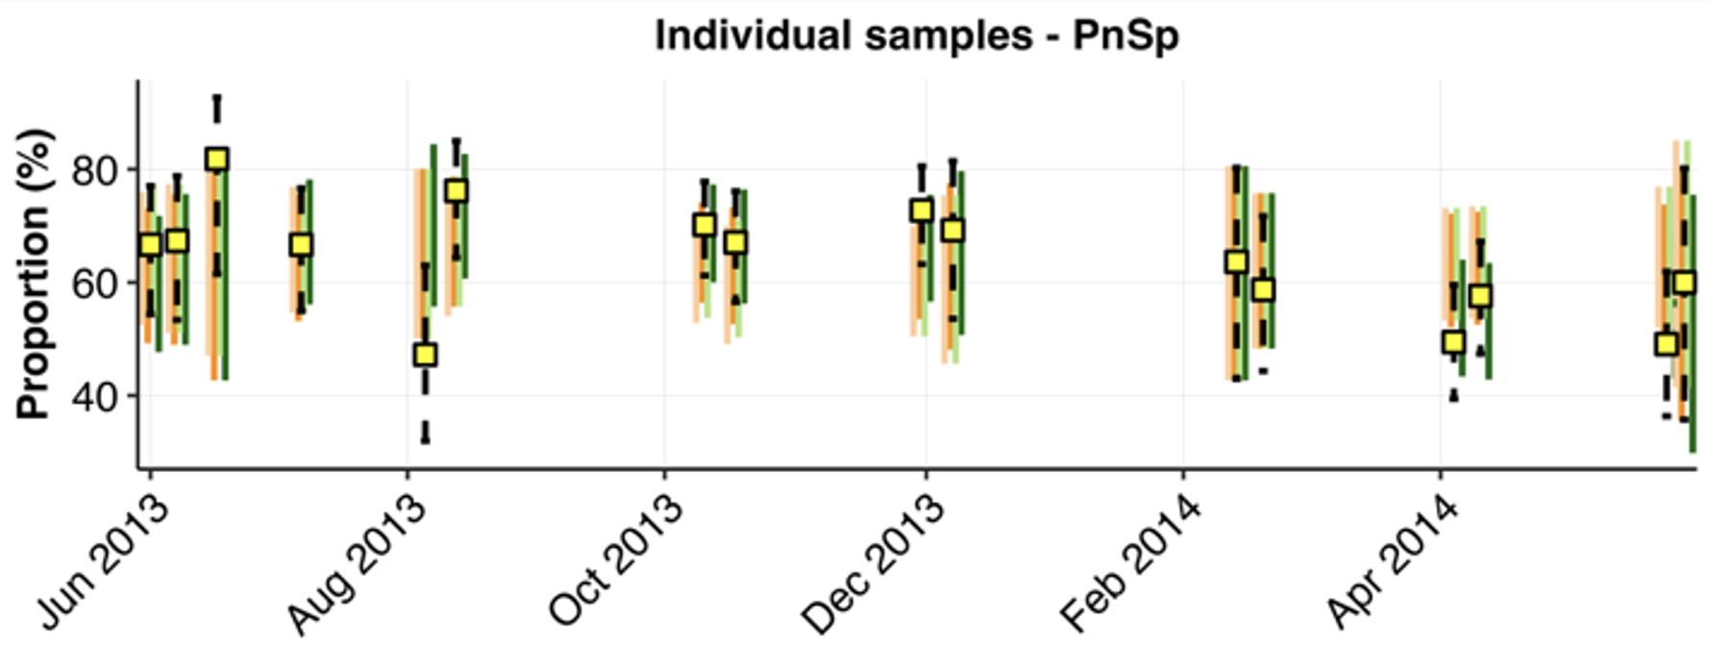
Results: model comparison
1. SIRS with seasonal loss of immunity (AIC 213)
2. SILI with seasonal reactivation rate (AIC 224)
3. SIRS with constant loss of immunity (AIC 272)
4. SILI with constant reactivation rate (AIC 277)
Individual samples: PCR- Ab+ (L or R compartment)
Birth pulse
⬇️
Data (95% CI)
Birth pulse
⬇️

Slide 16
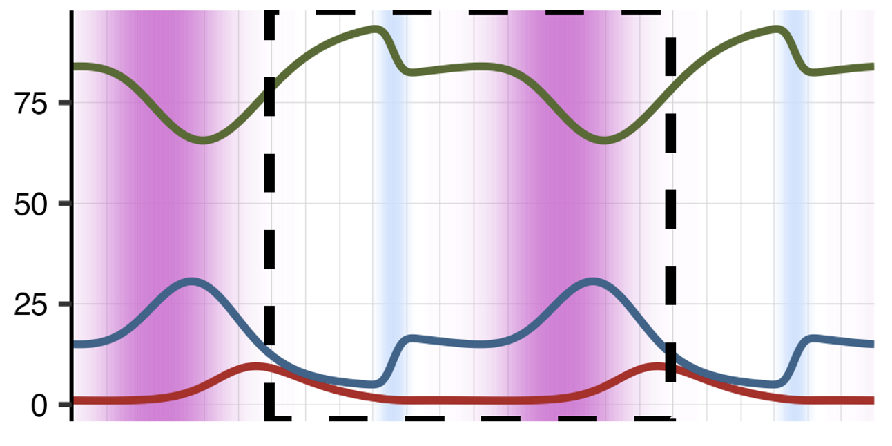
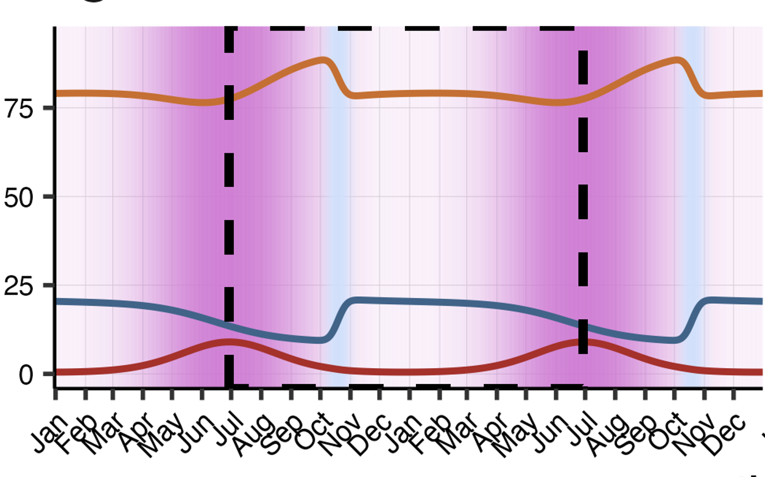
Loss of immunity
Births
R
Loss of immunity
S
I
L
Reactivation
S
I

Slide 17
Conclusions
batonehealth.org
Field dynamics are best explained by models with seasonal loss of immunity.
Limited difference between SIRS and SILI dynamics, but testable predictions.
Next step: new dataset spanning 2+ years.
Future developments: viral diversity

