Slide 1

THE NATIONAL ANIMAL AND PLANT HEALTH SURVEILLANCE PLATFORMS
Céline Dupuy (Plateforme ESA – ANSES – Unité EAS)
And
Lucie Michel (Plateforme ESV - INRAE- BioSP - Equipe OPE)
celine.dupuy@anses.fr
lucie.michel@inrae.fr

Slide 2
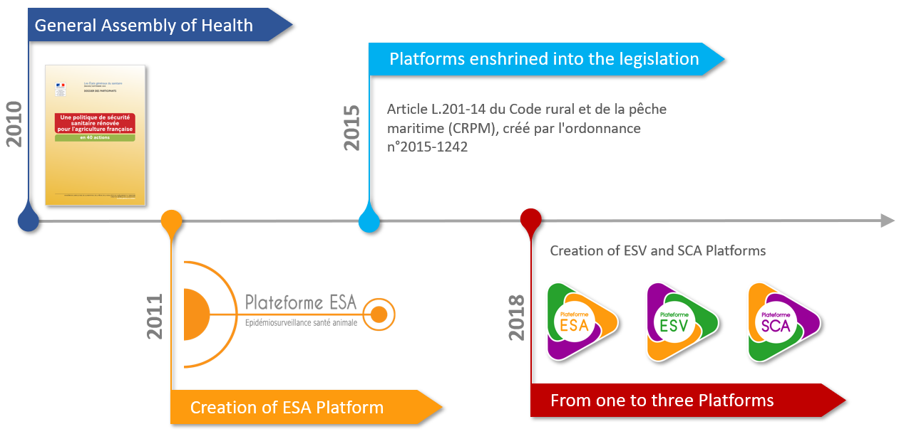
ORIGIN
Notes:
Following the, « Etats généraux du sanitaire » (General Assembly on Health) which aimed to bring together the various stakeholders in animal and plant health for a joint reflection on the assessment and future prospects of the French health system, in order to anticipate upcoming negotiations at the European Union level on the future Animal Health Law and a new Community strategy in the plant health sector. It also sought to improve France’s health safety policy.
These discussions led to several proposed actions, including the creation of the Animal Health Surveillance Platform. Having demonstrated its usefulness, the ESA Platform’s agreement was renewed in 2018, and two other platforms were established in the fields of plant health and the food chain.

Slide 3
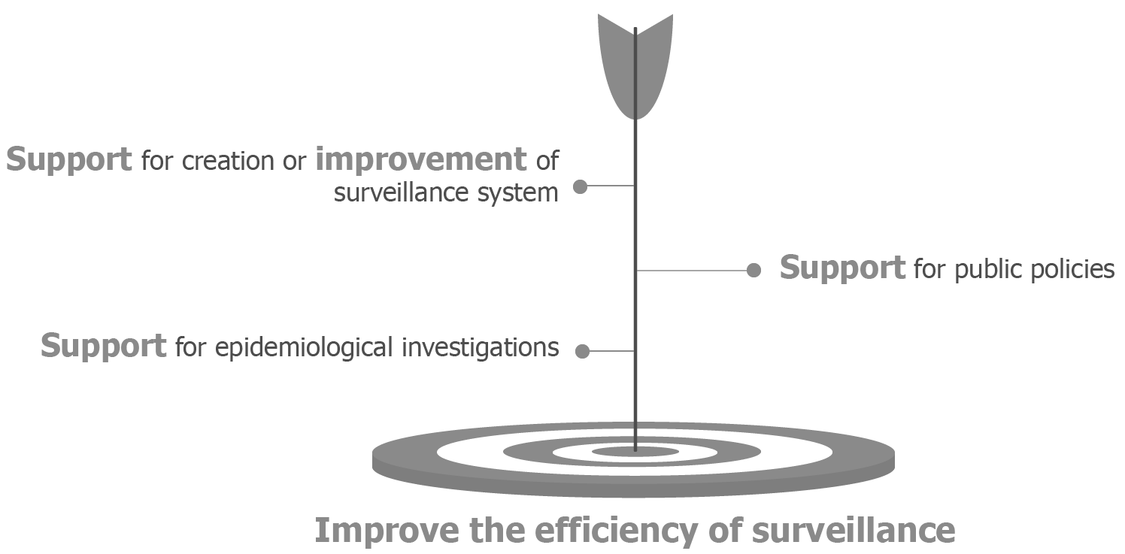
GOALS AND MISSIONS
Notes:
The three epidemiological surveillance platforms, each in their respective field, aim to improve the efficiency of surveillance in order to enable more effective control and prevention.
This involves to support for creation or improvement of surveillance system, support for public policies and support for epidemiological investigations.
Céline: avec le temps et à force de faire des présentations j'ai modifié le texte des 3 branches horizontal par le texte mis en gras dans le commentaire sous slide car c'est plus englobant et ça permet de prendre en considération l'aspect appui aux investigations qui n'apparaissait pas précédemment J'ai demandé à Laura de faire la mise à jour mais si tu préfères qu'on garde l'ancien on peut et dans ce cas je rajouterai à l'oral le volet investigation

Slide 4
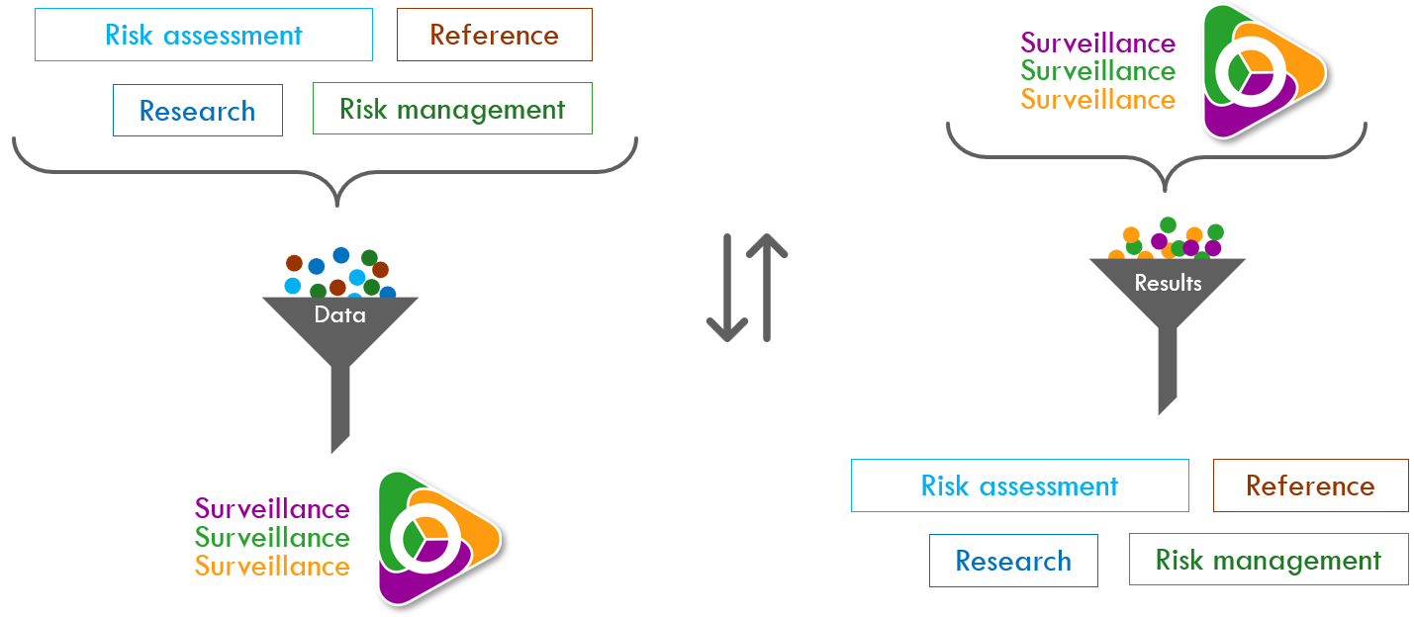
SCOPE: SURVEILLANCE
Notes:
Epidemiological surveillance platforms focus on the field of surveillance but work in close connection with the fields of research, reference, risk management, and risk assessment.
These Platforms can therefore serve as a source of data and information that can be used and enhanced by research. Research, in turn, carries out work that can help identify possible improvements to be implemented in surveillance.
Surveillance must be carried out in order to enable the implementation of appropriate management measures (prevention, control, or other actions). It also helps assess the relevance of the management measures put in place.
Surveillance can provide data for risk assessment and, in return, is informed by the results of that assessment.

Slide 5
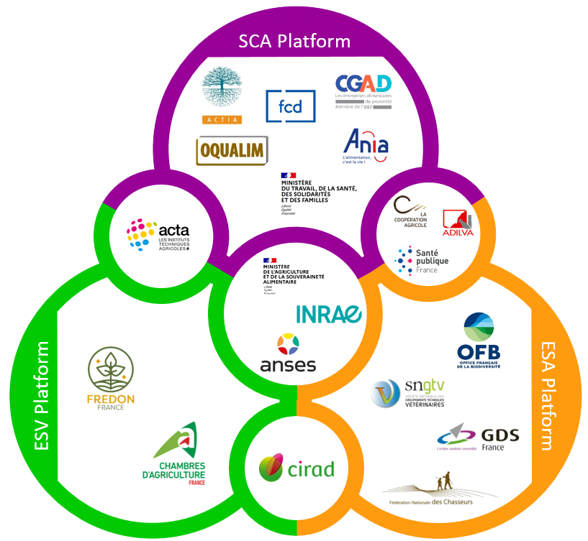
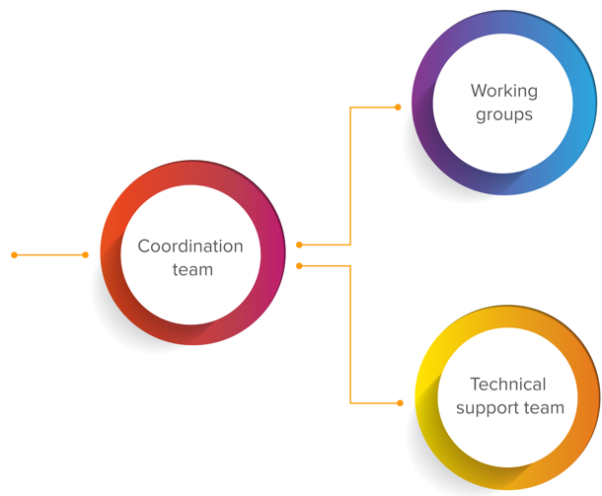
ORGANISATION
Shared governance between the public and private sector
One steering committee for each Platform but some institutions are common to two or three Platforms
Notes:
A steering committee representing both the public and private sectors= shared governance
Some institutions are are common to tw or three Platforms. The work carried out within the Platforms is based on three concepts:
consensus-building among participants
fostering collaboration
embracing interdisciplinarity
Each proposal designed to improve surveillance is jointly developed by all the stakeholders involved, thereby ensuring its sustainability and acceptability among stakeholders

Slide 6
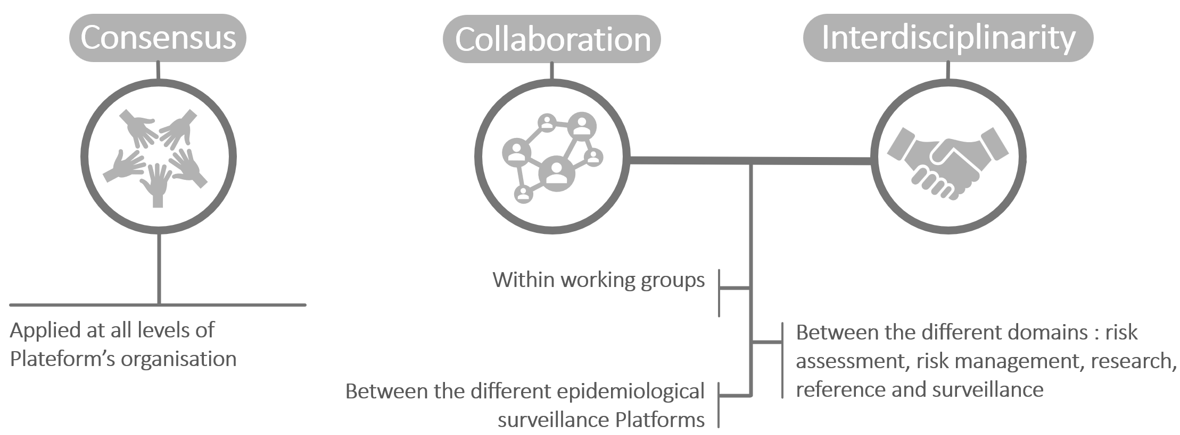
ORGANISATION
Based on 3 concepts
Notes:
A steering committee representing both the public and private sectors= shared governance
Some institutions are are common to tw or three Platforms. The work carried out within the Platforms is based on three concepts:
consensus-building among participants
fostering collaboration
embracing interdisciplinarity
Each proposal designed to improve surveillance is jointly developed by all the stakeholders involved, thereby ensuring its sustainability and acceptability among stakeholders

Slide 7
THREE PLATFORMS
COMMON WORK

Slide 8
DATA QUALITY WG
Objective: Develop a common methodology and vocabulary on surveillance data quality
How? A collective, multi-stakeholder and multidisciplinary approach, based on feedback from 3 Platforms works
Notes:
An inter-platform working group worked to develop a common methodology and vocabulary on data quality for surveillance.
The issue was present across the three platforms, so we adopted a collective, multi-partner, and multidisciplinary approach based on feedback from experiences conducted on the platforms or by their partner members.

Slide 9
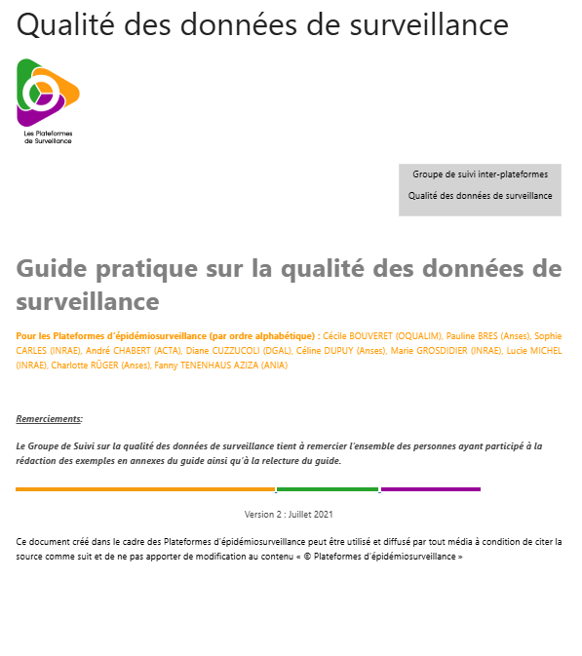
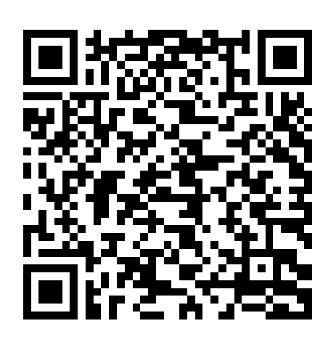
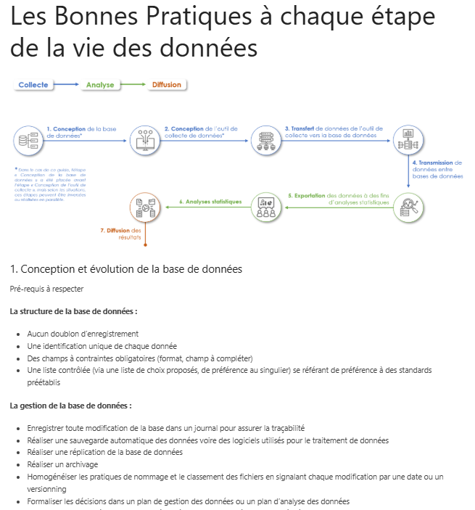
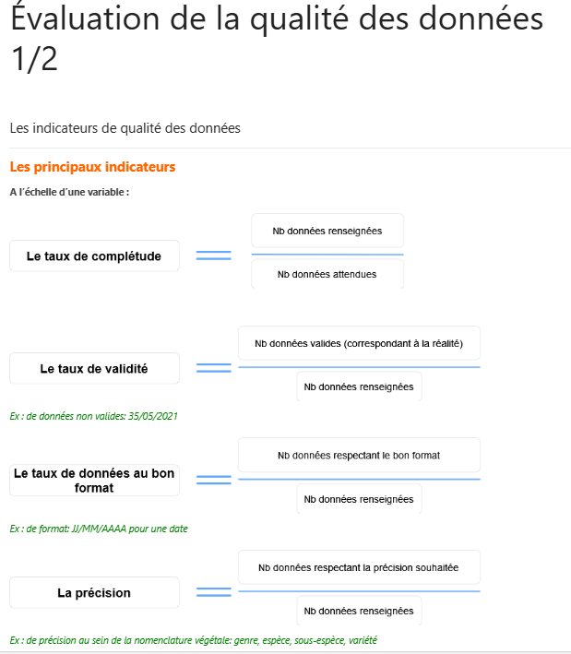
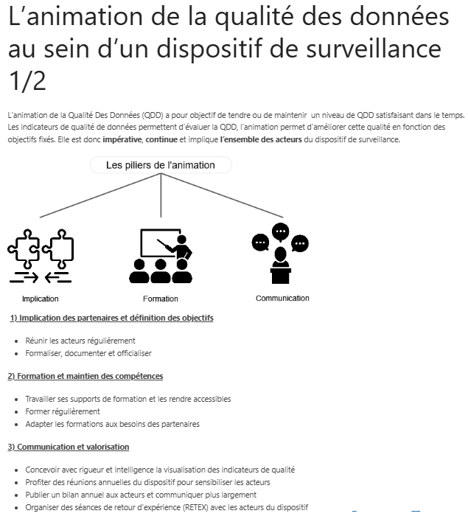
DELIVERABLES
Practical guide to monitor data quality
Summary sheets
Notes:
Several deliverables were produced, including a practical guide that brings together definitions of data quality and its components, good practices for all stages of the data life cycle, and finally, a chapter on continuous improvement of data quality. Numerous examples illustrate this guide.
We also created summary sheets of the guide that bring together the key information.

Slide 10
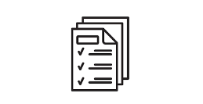
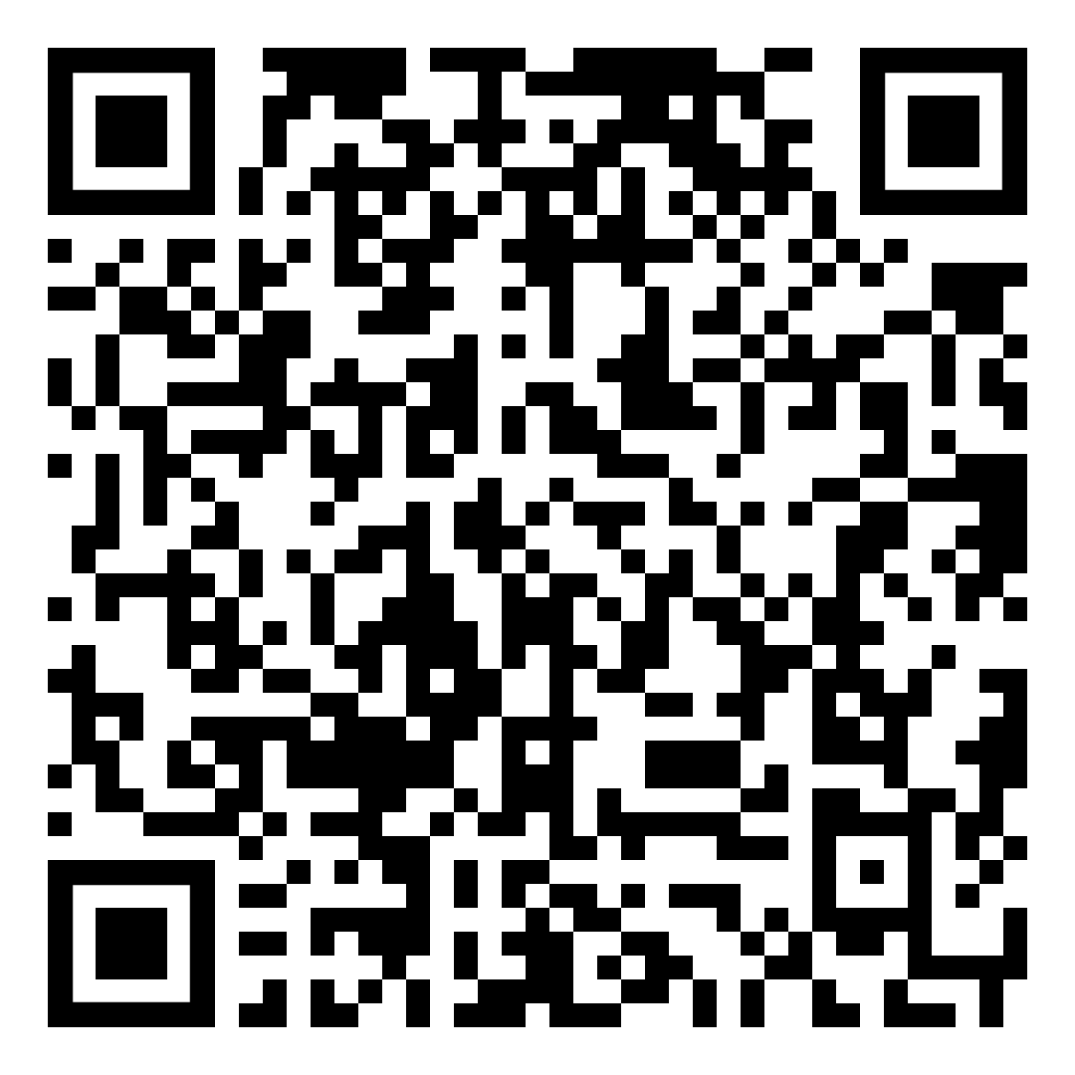
DELIVERABLES
R package {qdd} : Data quality and cleansing
Functions to control data quality:
Completeness: quality of a dataset with no missing values
Validity: consistency between the collected data and the actual value
Consistency: logical organization or absence of contradiction among several related data points
Functions to clean data:
Homogeneity
Interoperability
Reliability
Quality report
Clean dataset
Plateforme ESV, ESA et SCA (2025).
{qdd} : Data quality and cleansing
support package
Notes:
Finally, an R package for data quality was developed.
Several functions in this package are available with the completeness,
The validity An example of data validity is if the data represents the weight in kilograms of a 2-year-old male cow and the recorded value is 1, then the data is not valid. The consistency, an exemple to illustrate this : if in a “date” column you have 21/10/2025, but in the “year” column you have 2024, there is a contradiction.
It serves several purposes: first, technical, to clean datasets and obtain a clean dataset ready for use; and second, to provide feedback to partners and raise awareness through a quality report. This package is now available as open source via the INRAE code hosting platform.
The working group is now closed, but the package will continue to be updated and to evolve.

Slide 11


NATIONAL ANIMAL HEALTH SURVEILLANCE PLATFORM
NAHSP steering commitee institutions
Avec l’appui de Laura Gonzalez Tapia pour les représentations graphiques

Slide 12
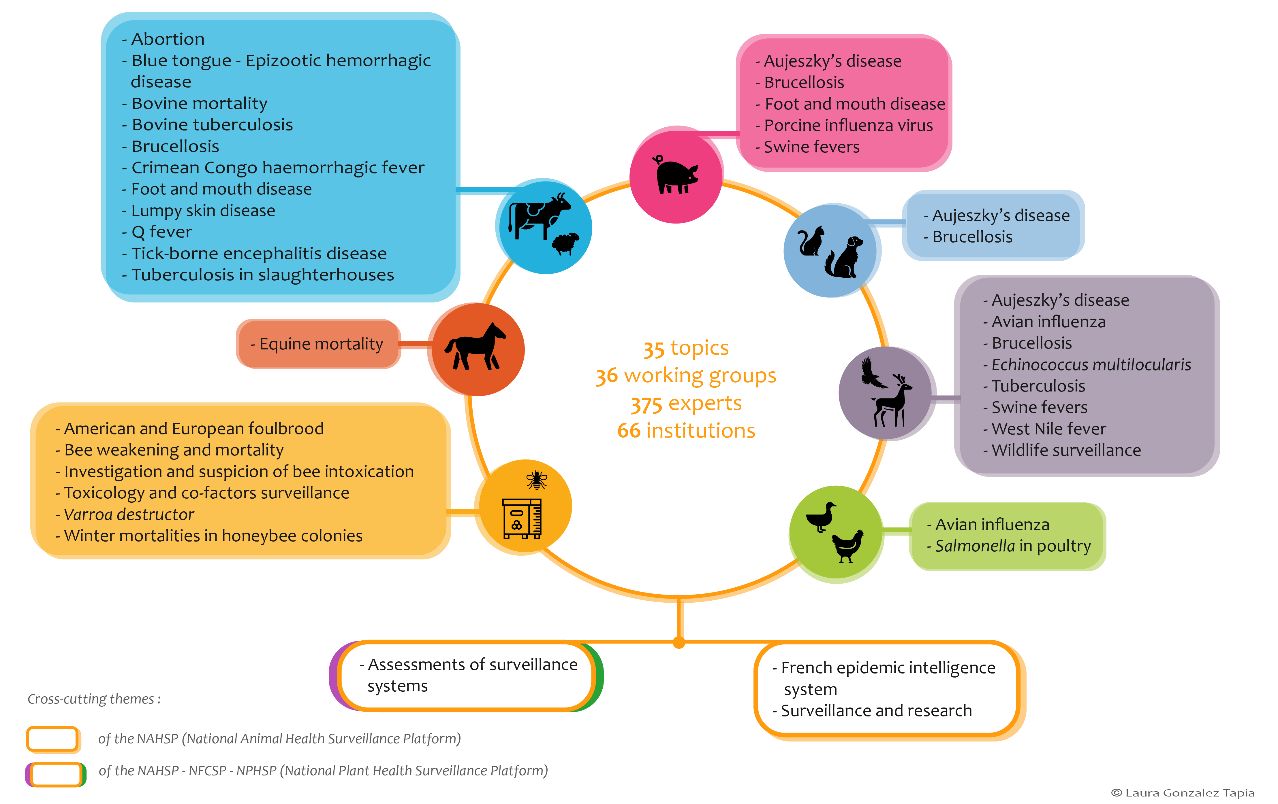

Slide 13
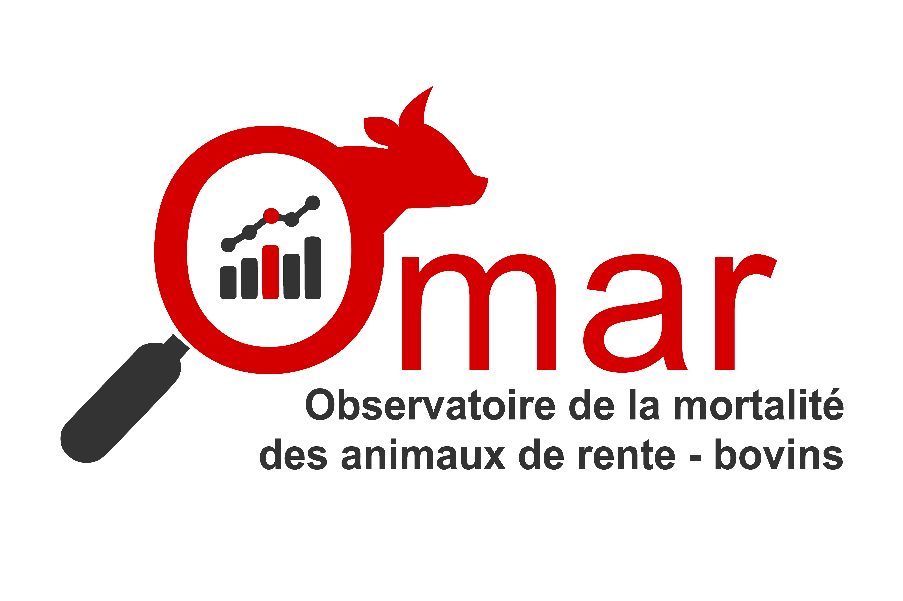



Omar-bovins: a Syndromic surveillance system
Céline Dupuy, Carole Forfait, Emmanuel Garin, Guillaume Gerbier, Carole Sala
Governance
Technical support

Slide 14
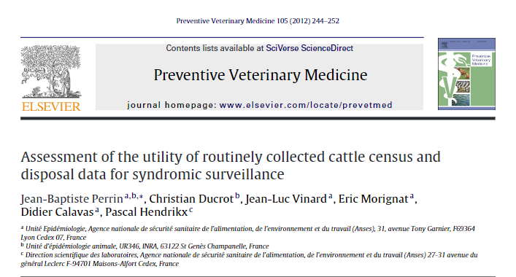
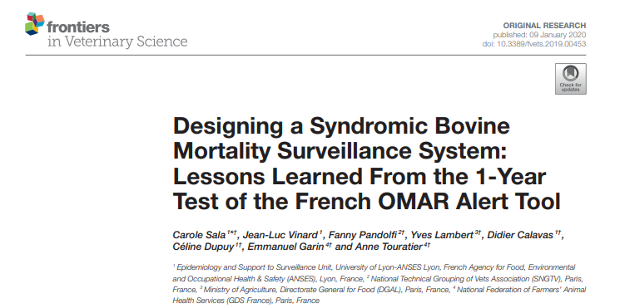
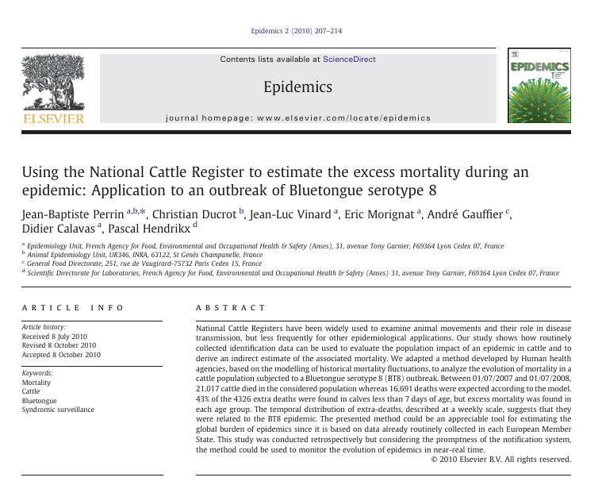
synergy between surveillance and research
To a concrete syndromic surveillance system for animal health emerging detection with the support of NAHSP
Co-construction with a dedicated WG
Several tools including SyS system
From a research project

Slide 15
Data sources
Based on fallen stock data (daily transmission) and national cattle register (quarterly transmission) from 2011
Already collected for other purposes
Compliance with UE regulation on traceability
Used for payment of rendering fees

Slide 16
Data analysis
Automated weekly analysis of the weekly number of cattle deaths within spatial units (>11,000 for France)
Creation of cleaned baselines
GLM selection: test of several formulae with a minima sinusoidal annual seasonality (other variables tested: linear trend and autoregressive components over the last 4 weeks)/ Selection of the best model based on AIC/ Poisson family / Generalized Poisson family tested to take into account over dispersion/Quasi Poisson and negative binomial glm also used if necessary
Outliers removal: Observed values above predicted values are lowered to the 95% CI value
Calculation of the expected mortality

Slide 17
Data analysis
Detection of excess mortality
5 detection algorithms with 7 detection limits for each one
Holt-Winters algorithm
“historical limits” algorithm from the Center for Disease Control
Shewhart algorithm
Exponentially weighted moving average (EWMA)
CUSUM
Classification of alarms in 4 categories of severity
Number of algorithms in alarm
Signal score for each algorithm for the week considered
Change in signal score over the last 4 weeks
Level of excess mortality and its change over time
Able to detect both sudden increase and slow deviation in mortality

Slide 18
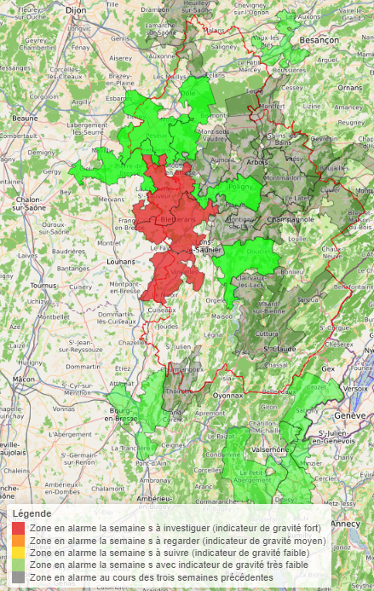
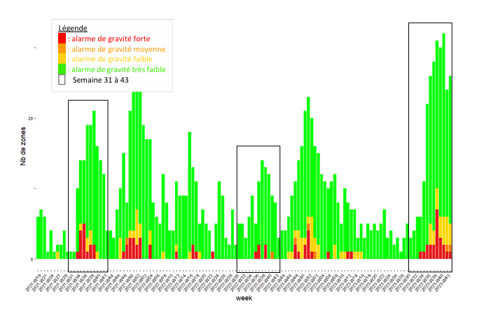
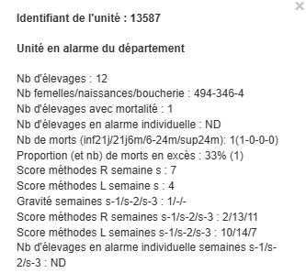
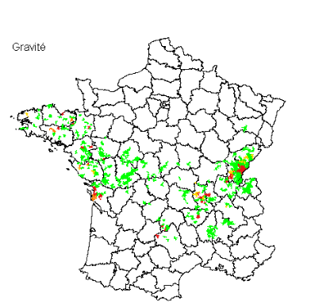
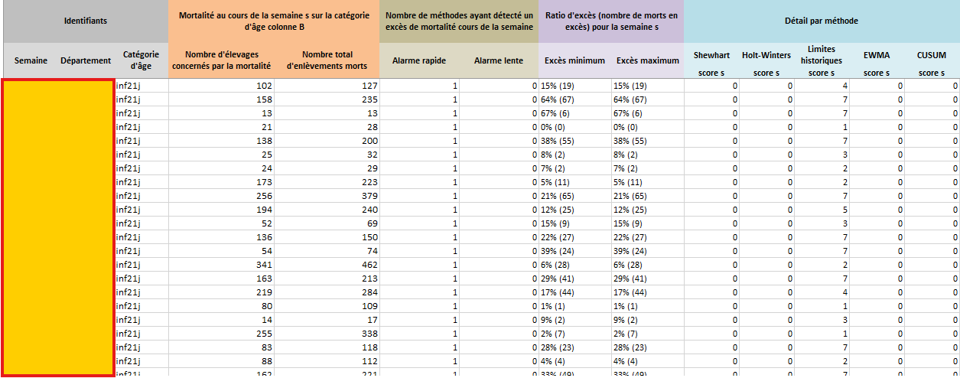
Results for end users
Specifications for each area in alarm
Time series of alarms
Table of indicators to help interpretation and further investigations
Alarm mapping at local level
Alarm mapping at national level

Slide 19







UTOPIA - User Tool for Outbreak Prevention and Introduction Assessment
Céline Dupuy, Servane Bareille, Julien cauchard, Guillaume Gerbier, Viviane Hénaux, carlène trevennec
French ministry of Agriculture

Slide 20






custom and practical tool for NAHSP epidemic intelligence team
When a foreign country declares the emergency of an animal disease, we want to assess if animals or products of animal origin potentially carrying this pathogen have been imported into France
Investigation of trade movements using the regulatory European database TRACES-NT
Comprehensive and detailed data (only declared movements)
Complex
data structure
Laborious
querying
Error-prone analysis
(through misuse)

Slide 21




Steps for a valid and useful tool
Getting to grips with TRACES-NT (access granted in early 2023)
Discussing with future users
Discussing with French TRACES-NT users to better understand this database
Developing a rapid analysis tool for standardised TRACES-NT data
UTOPIA
User Tool for Outbreak Prevention and Introduction Assessment

Slide 22
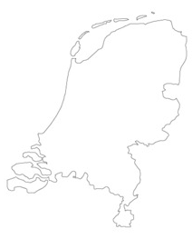
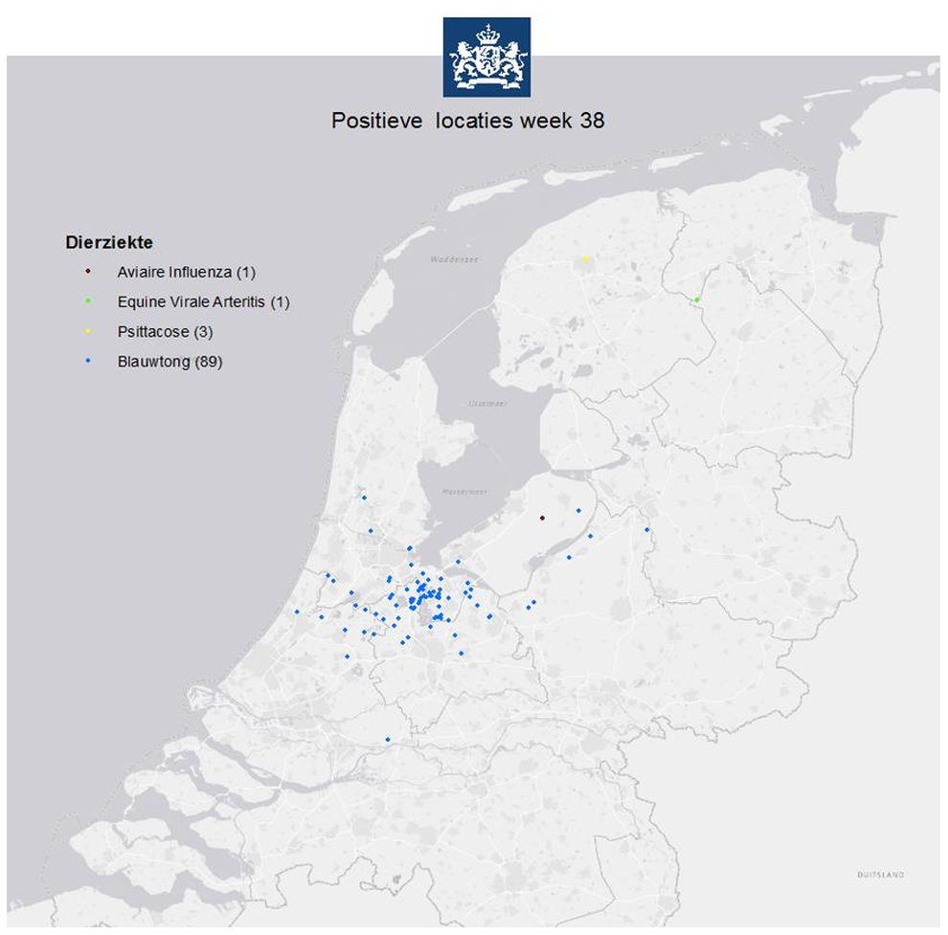


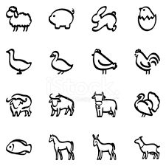

practical example – Bluetongue in the netherlands
French Epidemic Intelligence team
Was there a risk of bluetongue being introduced into France through animal trade in the two months prior to detection in the Netherlands?
Outbreaks of bluetongue serotype 3 detected in the Netherlands in September 2023
Source: NVWA

Slide 23
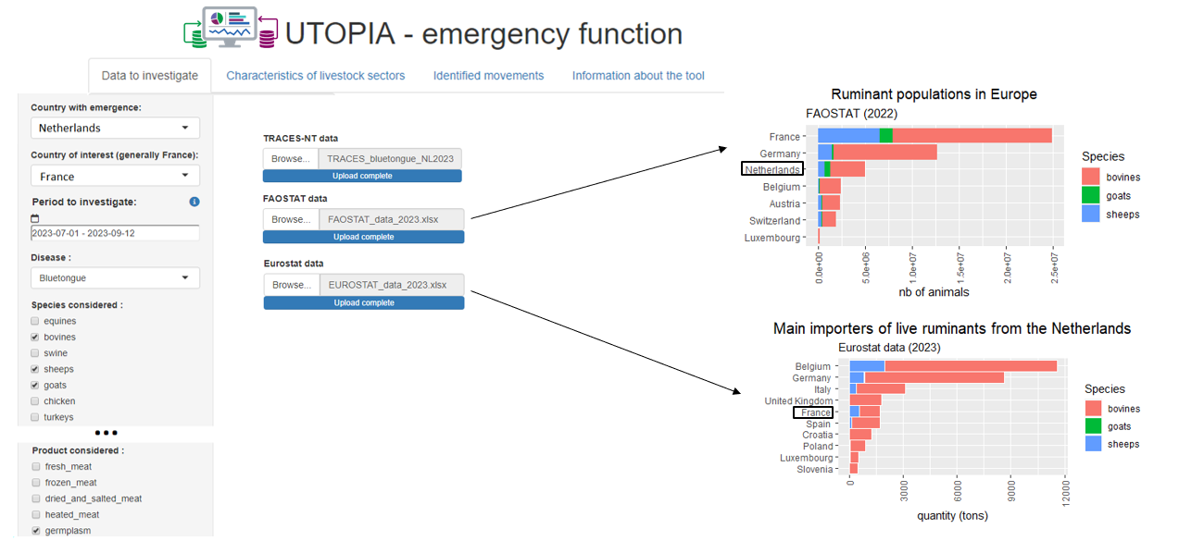
practical example – Bluetongue in the netherlands

Slide 24
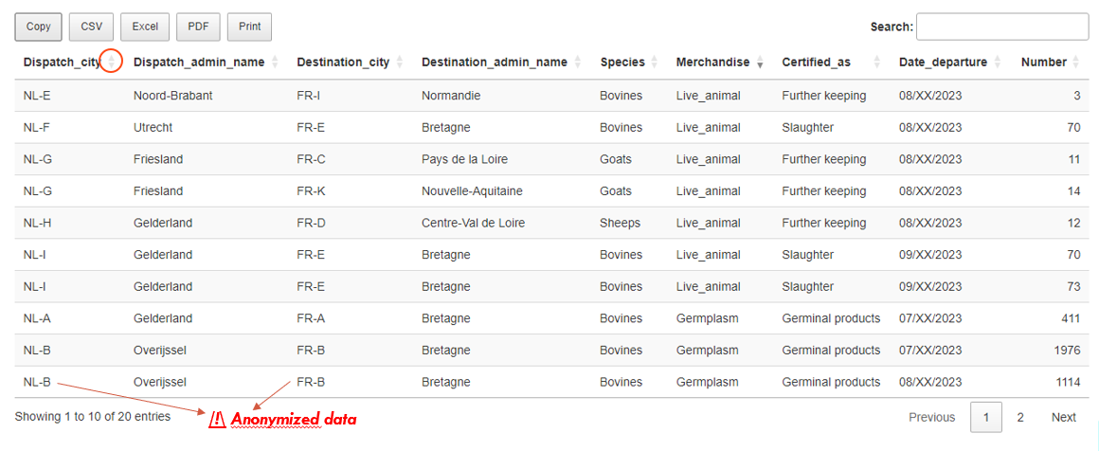
practical example – Bluetongue in the netherlands

Slide 25
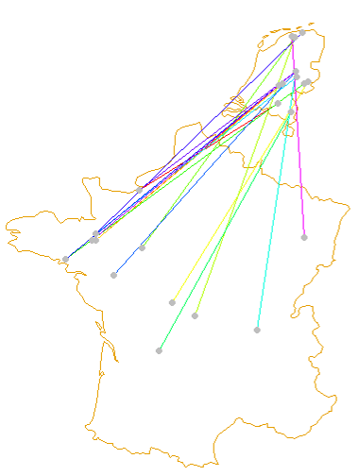
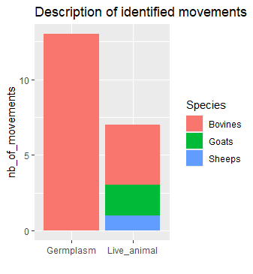
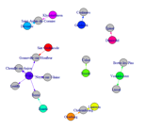

practical example – Bluetongue in the netherlands
/!\ Anonymized data
Departures located at least 100 km from reported cases
→ Risk considered very low
Semen collection centres test for bluetongue

Slide 26

Other practical examples
Other examples of requests to UTOPIA
Highly pathogenic avian influenza from Hungary (07-11/2023)
Foot and Mouth disease from North Africa (10/2023-01/2024)
Highly pathogenic avian influenza from North America (07/2023-07/2024)
Peste des petits ruminants from Greece and Romania then eastern Europe (06-07/2024)-(2025)
Foot and Mouth disease from Germany then Hungary and Poland (11/2024-03/2025)
Main exporters of ruminants for Bluetongue (2024-2025)
Wide range of possible requests
Customizable Investigation Period
Any animal disease
Any declared merchandise
Any country/group of countries
Usefulness of these requests
Rapid risk assessment
Possible investigation and surveillance of identified animals
To prioritize epidemic intelligence activities

Slide 27





Utopia retrospective tool
Support for risk assessment from around the world over one year
Risk prioritization (semi-quantitative scoring):
By disease
By route of transmission (Animals/Products)
By country of origin
WAHIS
World Animal Health Information System
Disease-related parameters
De Vos et al., 2022. Rapid risk assessment tool (RRAT) to prioritize emerging and re-emerging livestock diseases for risk management. Front. Vet. Sci

Slide 28
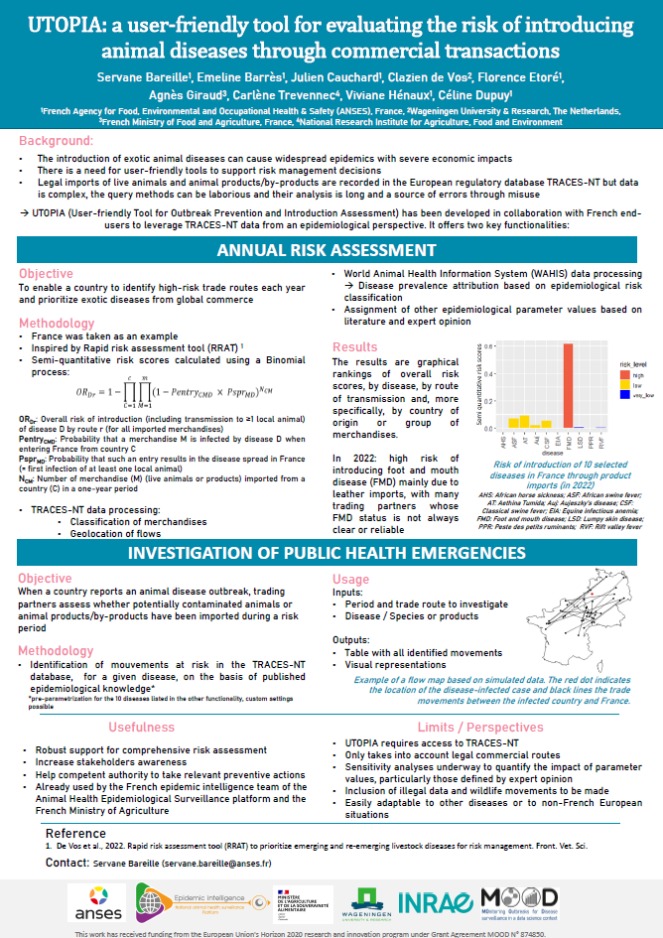
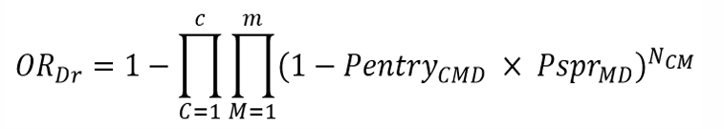
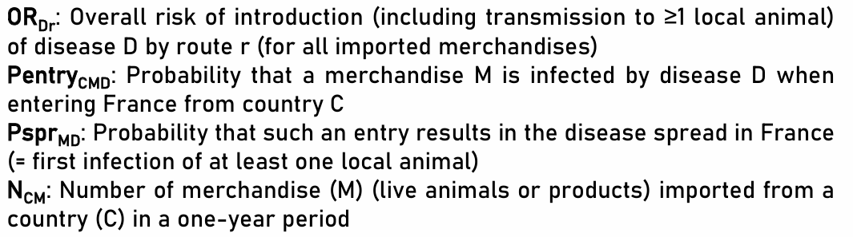
Semi-quantitative risk scores calculated using a Binomial process
https://svepm.org.uk/wp-content/uploads/2025/05/Bareille-UTOPIA-a-user-friendly-tool-for-evaluating-the-risk-of-introducing-animal-diseases-through-commercial-transactions.pdf
28

Slide 29
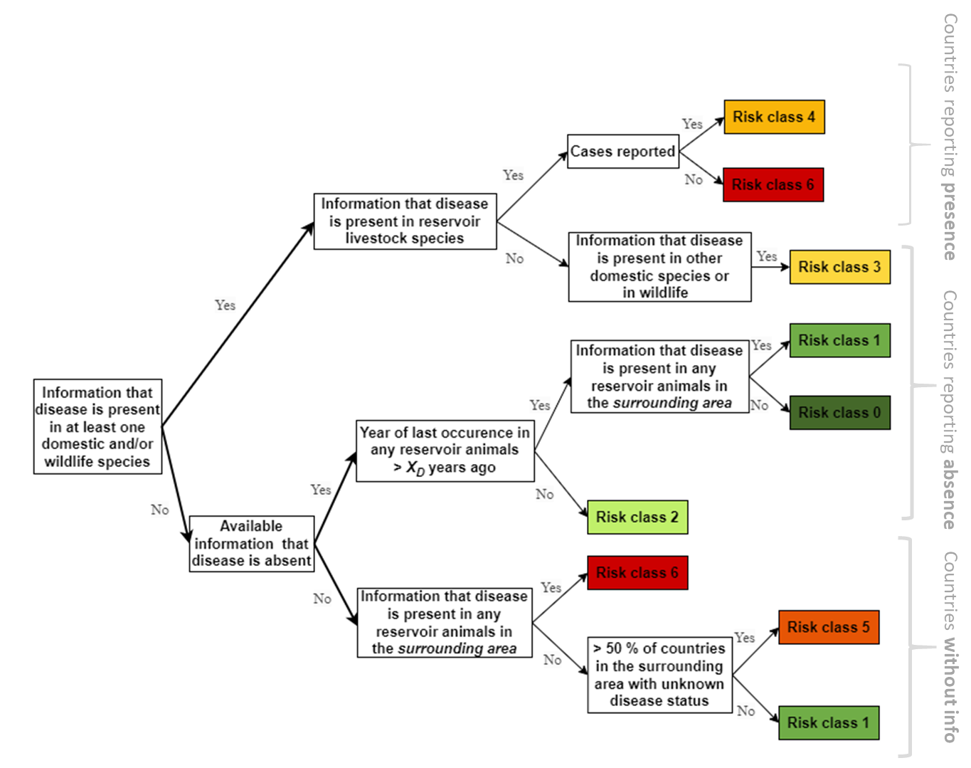

WAHIS
WAHIS data to build 6 country risk classes
Dedicated documentation to explain tools limits
Work still in progress …

Slide 30
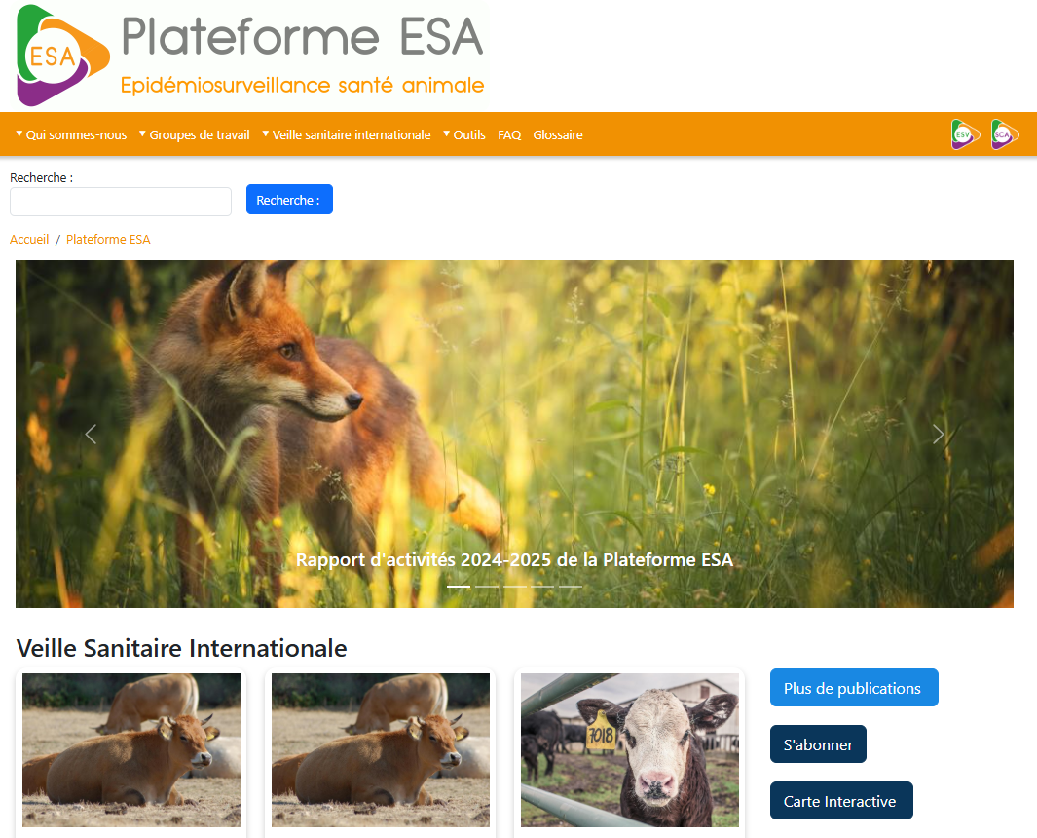
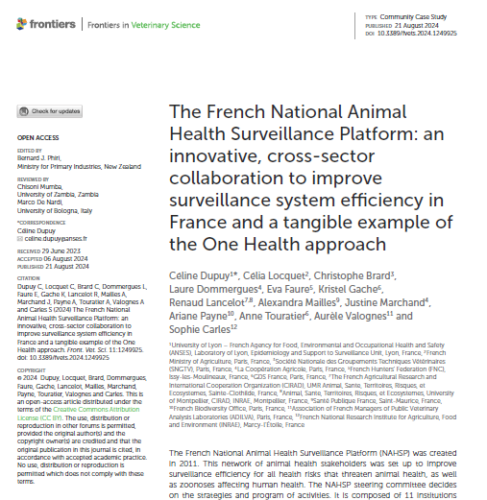

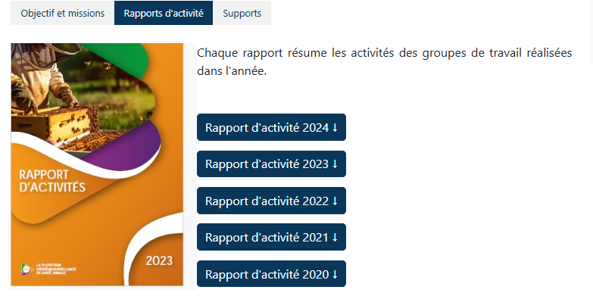
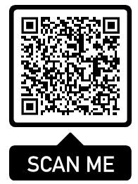
For more information
Website https://www.plateforme-esa.fr/
LinkedIn account
Activities reports
Subscribe to epidemic intelligence newsletter
Frontiers | The French National Animal Health Surveillance Platform: an innovative, cross-sector collaboration to improve surveillance system efficiency in France and a tangible example of the One Health approach

Slide 31









Slide 32
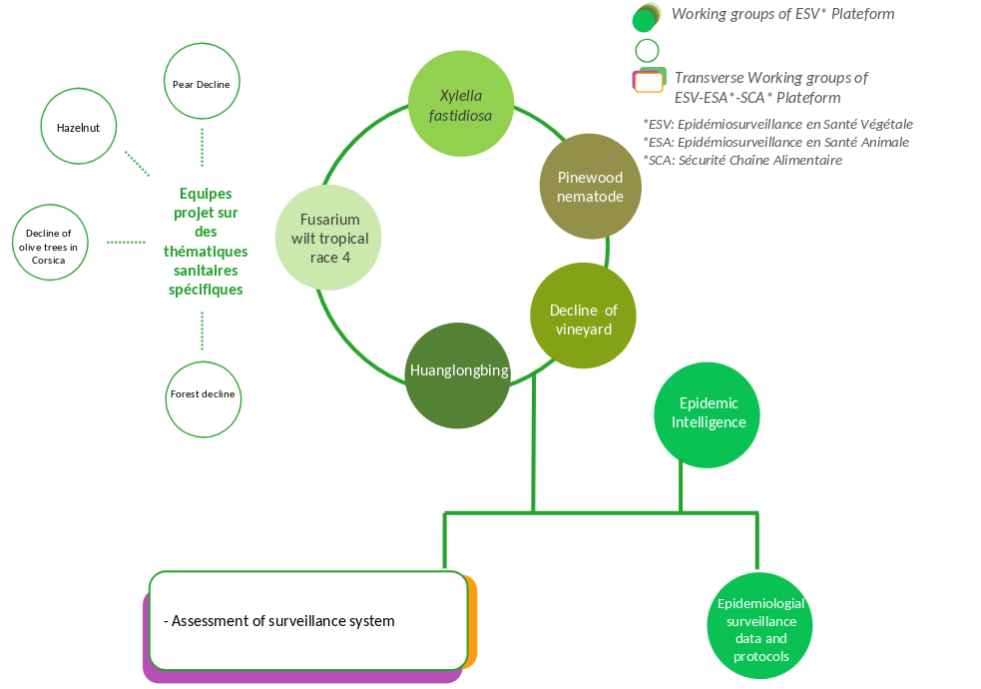
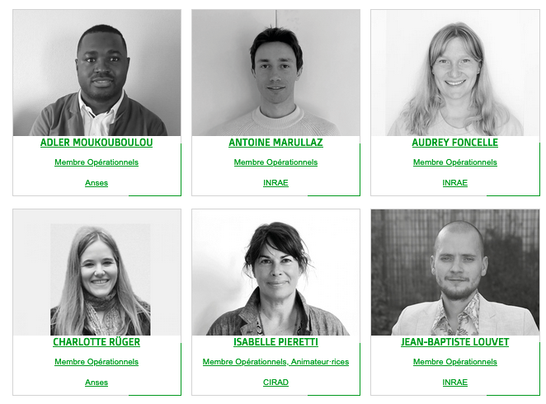
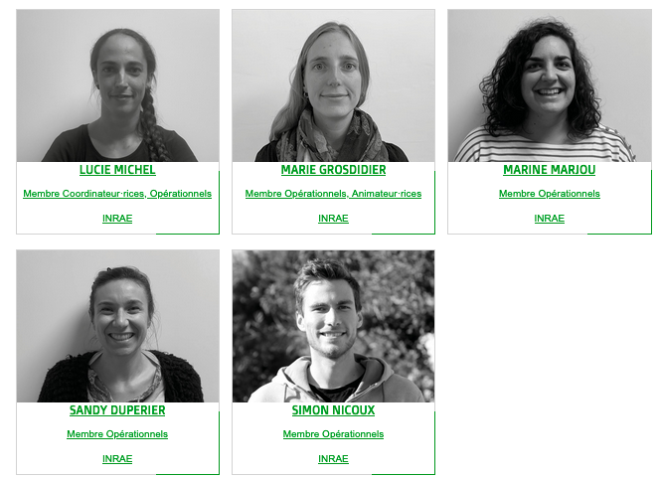

WORKING GROUPS AND TRANSVERSAL OPERATIONAL TEAM
Skills
Epidemiology
Statistics
Computer science
Communication
Notes:
The platform support actualy 7 working group with working group about specific pest like:
Surveillance of Xylella fastidiosa, Surveillance of pine wood nematode, Surveillance of vineyard decline, Surveillance of Fusarium TR4 or Surveillance of HunagLongBing.
There are also fast-reaction project-teams focused on specific themes, each addressing a precise question. This is the case, with the decline of olive trees in Corsica, the hazelnut sector, the pear decline, or the forest decline.
Transversal topics are also addressed by WGs such as the WG Epidemic intelligence of platforms.
The operational team is composed of staff from INRAE based in Avignon, from Cirad in Montpellier, and from Anses in Lyon. It includes computer scientists, statisticians, epidemiologists, and a communications officer.

Slide 33

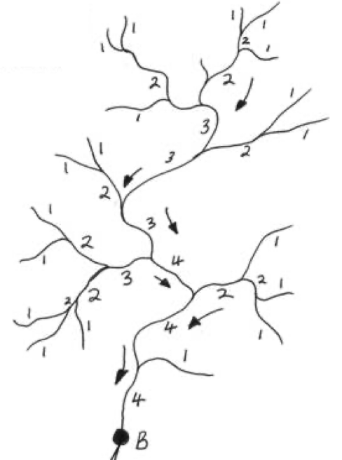


IMAGINE THAT PLANT HEALTH IS MONITORED LIKE A RIVER NETWORK …
Epidemic intelligence to develop
a global upstream vision of risks
What are the current actions
of the ESV Platform
to monitor the network?
Data science and
evaluation approaches
to analyze and improve
focused downstream
surveillance and quickly
detect new outbreaks
Tools for and design of
focused upstream
surveillance to anticipate
likely pest emergence and
favor early detection
Visibility and communication to
develop multi-actor awareness for
plant health issues
Illustration of the concept by Samuel Soubeyrand (INRAE)
Notes:
If we go back to the image of the water network to represent plant health: What are the current actions of the platform to monitor this network and contribute to its improvement?
Upstream, the International Plant Health monitoring helps develop an overall upstream view of potential risks.
Tools and approaches are used to anticipate the monitoring of specific pest (upstream): anticipate disease emergence and early detection.
Data science and evaluation approaches are applied to analyze and improve downstream surveillance, particularly for the rapid detection of new outbreaks.
Finally, targeted communication focuses on raising multi-stakeholder awareness of plant health issues.

Slide 34
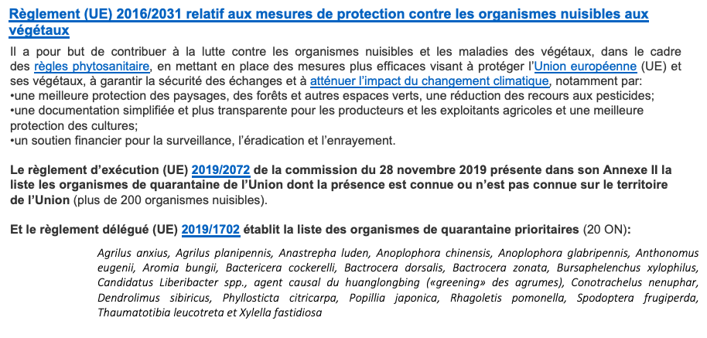
TOOLS FOR AND DESIGN OF GLOBAL UPSTREAM SURVEILLANCE: INTERNATIONAL PLANT HEALTH MONITORING
Why is it important ?
Stay up-to-date with the latest advances and knowledge
Detect weak signals
Monitor disease development
Support for risk managers
Regulation (EU) 2016/2031 on protective measures against pests of plants
Implementing Regulation (EU) 2019/2072 setting out the list of Union quarantine pests (including 20 priority pests).
Why our own tool ?
Existing tools or newsletters :
EIOS (ex Medysis)
PADI-Web Platform (CIRAD)
Onclusive Social (ex DigiMing)
EPPO Reporting Service
EUROPHYT
Plant Health Newsletter on Horizon sanning project (EFSA)
Newsletter DGAL
ProMED
CABI
—> Need a tool adapted to our needs, easily modifiable, without technical dependencies

Slide 35
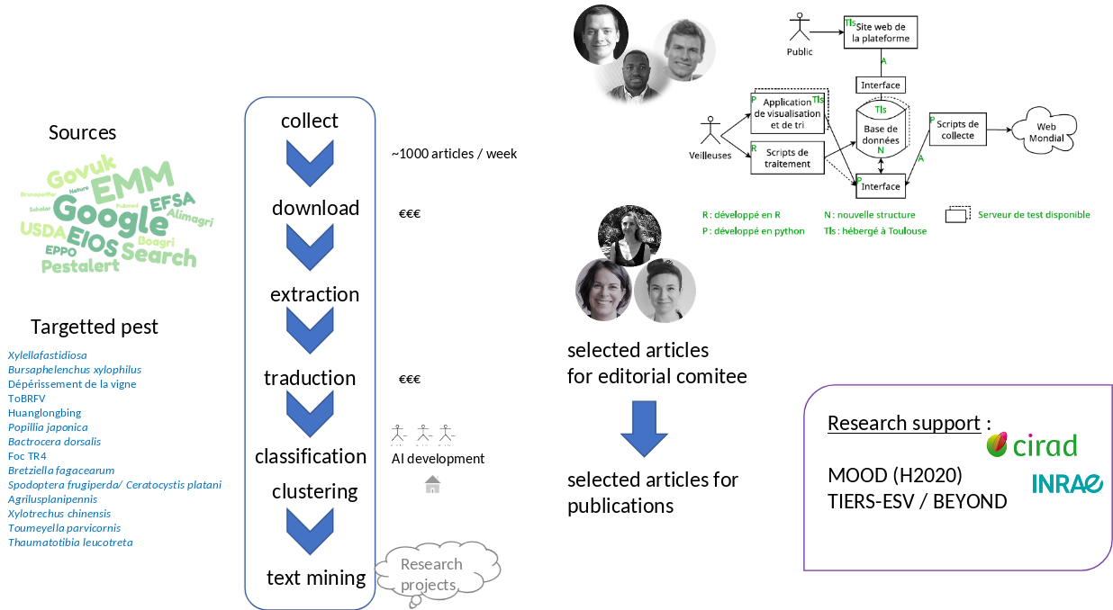
TOOLS FOR AND DESIGN OF GLOBAL UPSTREAM SURVEILLANCE: INTERNATIONAL PLANT HEALTH MONITORING
Methods and tools
Notes:
An example of work within the framework of upstream generalist monitoring is the international plant health monitoring.
The platform has developed a method and a tool that enables monitoring by targeting a number of sources (both official and unofficial) with specific plant pest(see list). With the help of computer specialists, we set up a pipeline that collects, downloads, extracts, translates titles and abstracts, and then classifies and clusters the articles. This method notably uses web scraping to collect articles and artificial intelligence techniques (machine learning and language models) for classification and clustering.
At the end of this pipeline, a monitoring team selects the articles of interest to be submitted to an editorial committee, which then chooses the articles to be published in the platform’s various outputs (bulletins, articles shared on the website). For all of this work, we are supported by research projects in text mining to automate the pipeline, save time, and consequently increase the number of pests that can be targeted.

Slide 36
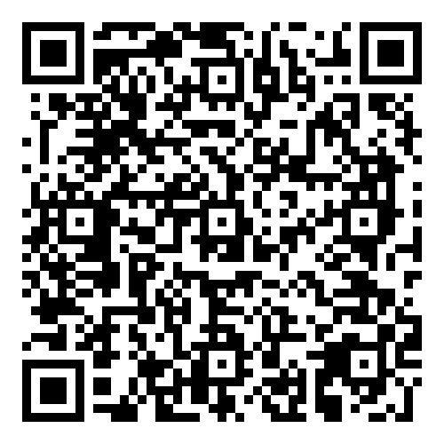

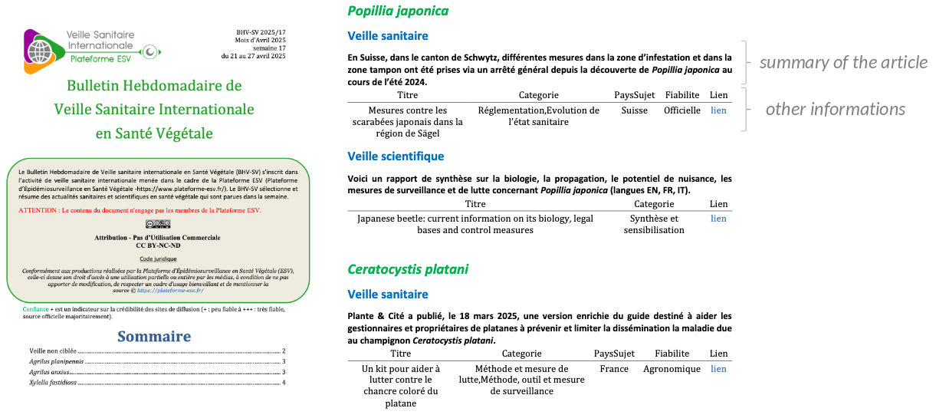
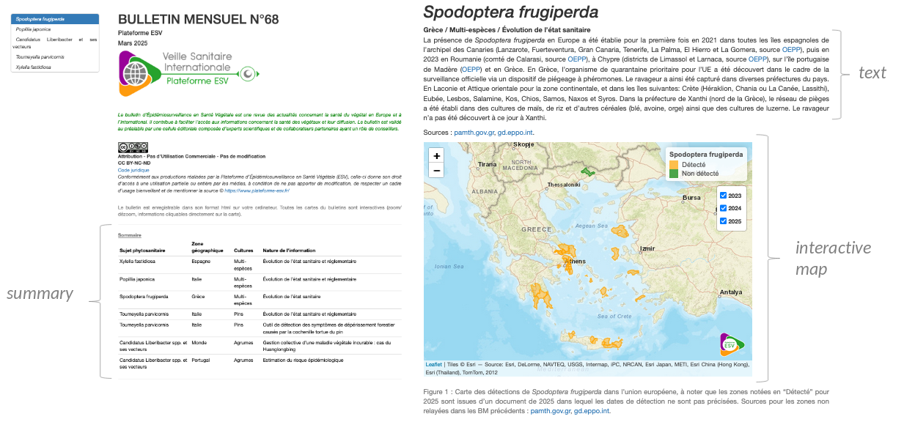
TOOLS FOR AND DESIGN OF GLOBAL UPSTREAM SURVEILLANCE: INTERNATIONAL PLANT HEALTH MONITORING
Productions
Weekly review of sanitary news with concise items
Monthly synthesis and interpretation of sanitary news
Notes:
The outputs produced from monitoring are weekly bulletins. The articles are classified according to the harmful organism and whether they concern public health monitoring or scientific monitoring, and then by whether they relate to regulations, changes in health status, control or surveillance methods, etc. Each article includes a summary as well as a link for further reference.
The other type of output consists of monthly bulletins, which provide a synthesis and interpretation of the latest sanitary news, including interactive maps.

Slide 37

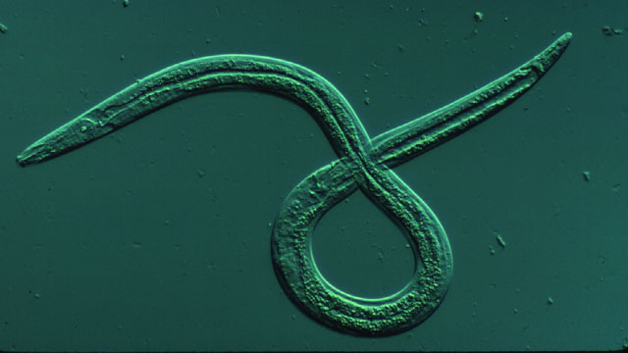
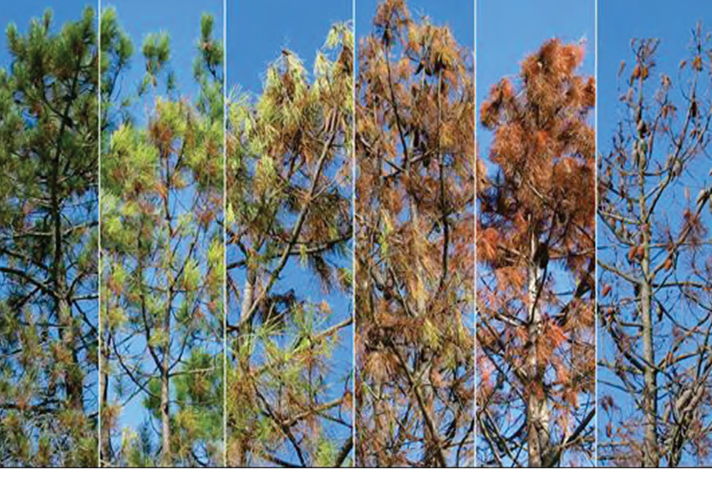


TOOLS FOR AND DESIGN OF FOCUSED UPSTREAM SURVEILLANCE: SURVEILLANCE OF PINE NEMATODE
Bursaphelenchus xylophilus
Bursaphelenchus xylophilus: Causal agent of Pine Wilt Disease (PWD)
Multiplication in the conductive vessels
Stop of the soap circulation
Infection
Wilt and death of the tree
Dispersion
An infected tree can die in a few weeks
Short distance: insect vector
Monochamus spp.
Long distance: wood contaminated by infected vector
Native to North America and transported to other continents
- Present in Asia (China, Korea), Europe (Portugal, Spain)
France is free from the pinewood nematode.
Notes:
An example of work within the framework of upstream specifict prior to the detection of the plant pest.
B. Xylophilus is the causal agent of pine wilt disease. It infects pine trees, multiplies in the conductive vessels, stops the circulation of sap and causes decline or even death of the trees. It is dispersed over short distances by an insect vector, M. galloprovincialis, and over long distances by wood contaminated by the insect vector. It originated in America and was transported to other continents.So, it is present today in Asia and Europe, but still absent from France.

Slide 38



TOOLS FOR AND DESIGN OF FOCUSED UPSTREAM SURVEILLANCE: SURVEILLANCE OF PINE NEMATODE
Improving pinewood nematode monitoring in France based on risk analysis
Entry
Risk factors :
Entry | Establishment | Disease expression
Air flow | Host area | Symptomatic, symptomatic with latency and asymptomatic areas --> based on temperatures (Gruffud et al.,2016)
Maritime flow
Rail flow
Road flow
Companies exhibiting or using wood | Forest fires
Supplying sawmills
Distance to the infested area
https://plateforme-esv.fr/sites/default/files/2023-11/Dasboard_PWN_Nov2023.html
Weights assigned by experts
Sampling plan - example of Trapping
Outputs INLA (ex: Corsica)
Multi-criteria analysis
Notes:
One of the objectives of the Pinewood nematode working group is to evaluate current surveillance system and strategy by strengthening risk analysis. So, we first perform a relative risk analysis which takes into account different risk factors separated into 3 stages: entry, establishment and expression of the disease. And for each factor we asked the experts to choose an associated weight to then carry out a multi-criteria analysis.
The relative risk analysis was conducted for the 3 stages and 2 spatiales scales : national and regional scales. This is the results for the entry stage.
The next step is therefore to propose more risk-based monitoring plans. Here, we present a proposal for trapping based on entry risk, maintaining the same resources, that is to say, the same number of quadrats monitored in 2023. The quadrats to be monitored are selected descendingly according to the relative risk value. The map shows what it can look like.
An additional step is added to this redefinition of the monitoring plan: the inclusion of the temporal dimension. Model outputs make it possible to estimate the quantity of Monochamus that can be captured over time. The example here is for two quadrats in Corsica.
All of this work will help improve monitoring in both space and time.

Slide 39




DATA SCIENCE AND EVALUATION APPROACHES FOR DOWNSTREAM SURVEILLANCE: SURVEILLANCE OF XYLELLA FASTIDIOSA
Bacterium that infects the xylem over 300 different plant species
First detected in France in 2015, after initial identification in Italy in 2013.
Classified as a priority quarantine pest by the European Union (EU).
Spread by xylem-feeding insect vectors (spittlebugs and sharpshooters)
Insect vectors transmit the bacterium from infected plants to healthy ones.
Causes leaf scorch, branch dieback, and can lead to the complete decline of the plant or tree.
=> Implementation of surveillance and demarcated zones upon detection of the bacterium.
Philaenus spumarius
Demarcated zones :
Around the Infected Zone (IZ): first 400 meters
Buffer zone : extends 2.5 km from the point of positive detection
Notes:
An example of work within the framework of downstream specifict after the detection of the plant pest.
Xylella fastidiosa is a bacterium that infects the xylem of more than 300 different plant species. It was first detected in France in 2015 and currently affects regions in southern France and Corsica. This bacterium is transmitted by piercing-sucking insects and causes …
It is classified as a priority quarantine organism by the European Union; therefore, France is required to monitor it annually and have an emergency plan. It is therefore important to implement surveillance and define demarcated zones following the detection of the bacterium.”

Slide 40



DATA SCIENCE AND EVALUATION APPROACHES FOR DOWNSTREAM SURVEILLANCE: SURVEILLANCE OF XYLELLA FASTIDIOSA
Risk score of Xylella in France
Exemple of demarcated zones
1- Assignment of a category to each quadrat
2- Identification of areas inaccessible to field personnel
3- Identification of quadrats sampled in previous field campaigns 4- Details of the number of quadrats per zone and category
5 - Determine the number of quadrats to be sampled in the different zones and typologies with RIBESS (tool from EFSA)
6- Select the quadrats to be sampled 6bis - Define “extra” quadrats in case of inaccessibility or absence of host plants
=> Go sampling
Production of a risk map with MESS (Multivariate
Environmental Similarity Surfaces) with selected variables. Rescale
risk between 0 and 1.
Notes:
Several studies have been carried out on Xylella, starting with the development of a risk map covering the whole of France, based on the similarity of areas where the bacterium has already been detected. Various variables were used for this purpose like: Precipitation, Solar radiation, altitude, …
This map can help guide surveillance efforts toward areas where the bacterium has not yet been searched for or detected.
On the other hand, work is being carried out to help monitor the areas surrounding outbreak sites — the demarcated zones — in order to track the spread of the disease or the emergence of new outbreaks. For this purpose, we used several geographic databases (land use and cadastral data), following several steps.
Step 2: They are identified in order to avoid sampling them.
Step 6: Quadrats that have never been sampled are given priority for the upcoming campaign.
Selection of quadrats: hexagonal-based sampling method (grid the territory, avoiding adjacent quadrats.

Slide 41

VISIBILITY AND COMMUNICATION
For improving and assessing
Fit-for-purpose operational tool (exemple: for evaluating forest decline monitoring)
Notes:
The ESV platform develops turnkey tools for plant health professionals, providing them with operational solutions to improve and assess their surveillance systems. It is committed to transparency in its methods: each application usually includes a dedicated section explaining the scientific reasoning and calculations performed.
Here is a newly developed application designed to assess forest decline monitoring in France.
Based on a species and an area, the indicators table allows the evaluation of the surveillance system by providing an estimate of the margin of error of decline in the forest stand compared to the monitoring carried out (number of plots and trees observed).

Slide 42






VISIBILITY AND COMMUNICATION
Favor education to plant health:
Easy-to-use visualization tools, pathogen pages, etc. to sensitize stakeholders and citizens to phytosanitary issues and to the invasion of harmful organisms
Notes:
In order to raise awareness among as many people as possible about plant health, we also develop numerous data visualization applications, pages dedicated to the plant pests we monitor on our website, as well as identification sheets. We thus share a wide range of information through our website and LinkedIn account to inform both stakeholders and citizens.

Slide 43



ADDITIONAL INFORMATION
ESA Plateform www.plateforme-esa.fr
ESV Plateform www.plateforme-esv.fr
SCA Plateform www.plateforme-sca.fr
Notes:
If you would like more information about our platforms and the one related to the food chain that was not presented today, you can visit our website.

