Slide 1
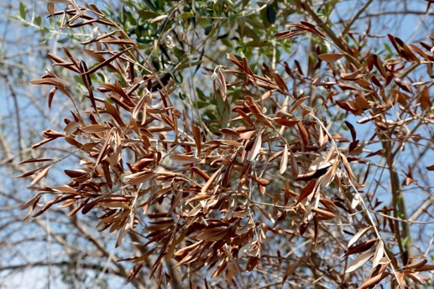
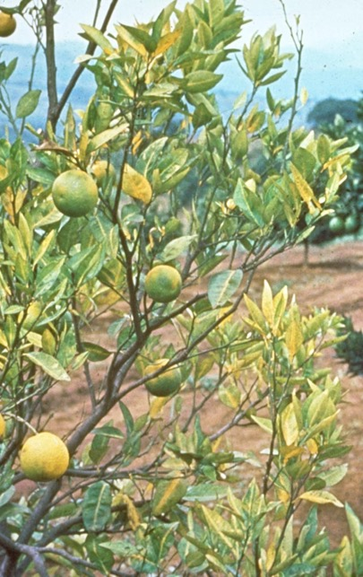

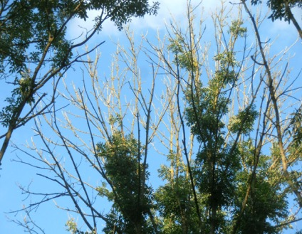
Informing surveillance for emerging plant diseases: bridging models & policy
Stephen Parnell^{1,2}
¹Warwick Crop Centre, ²Zeeman Institute for Systems Biology & Infectious Disease Epidemiology Research (SBIDER)

Slide 2
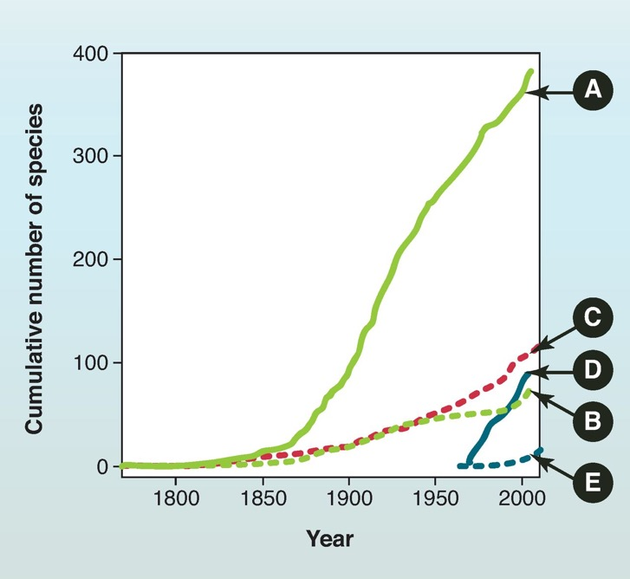
Increasing introductions of plant pests*
A. Non-native insects, US (1800-2006)
C. Non-native tree pathogens Europe (1800-2009)
D. Non-native insects, UK (1970-2004)
B. Non-native tree pests and diseases, US (1800-2006)
E. Non-native tree pests and diseases, UK (1965-2012)
Boyd et al (2012) https://www.science.org/doi/10.1126/science.1235773
*Plant pests = pathogens, vectors and herbivorous insects (ISPM5)
Notes:
Long term trend, continuing
In international plant health policy, deals with pests (both pathogens and insects)
Examples

Slide 3
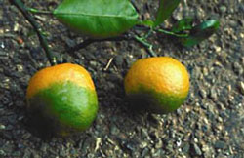
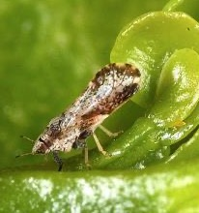
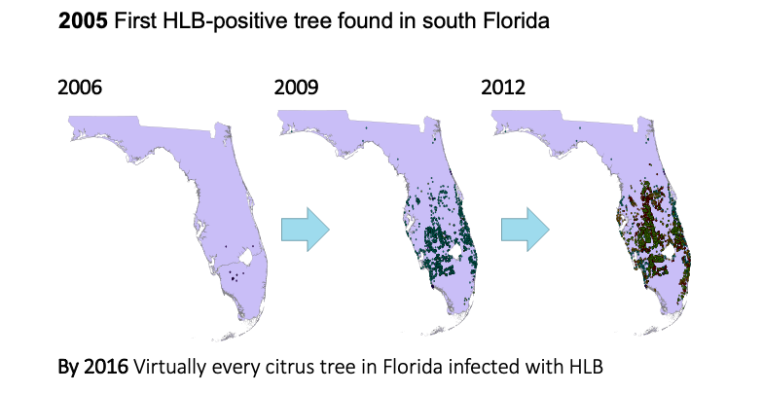
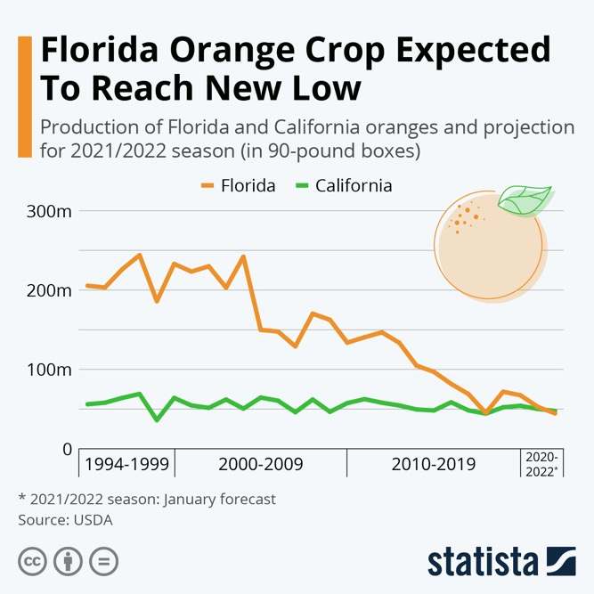
Citrus greening (syn. Huanglongbing – HLB)
Direct impact: Almost complete loss of citrus industry in Florida, significant constraint in Brazil, current threat to the EU.

Slide 4
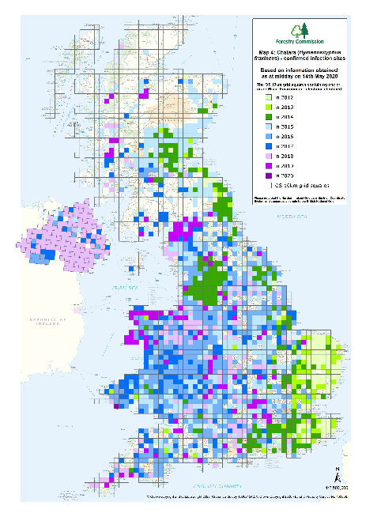
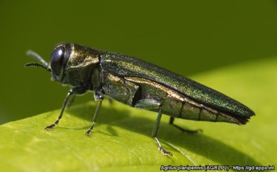
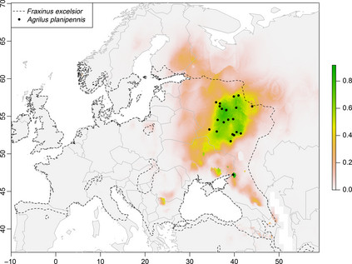
Emerald Ash Borer (EAB)
Tree health: Ash (Fraxinus spp.)
Ash Dieback Disease (ADB)
Photo from EPPO: Eduard Jendek
Impact: 80-90% of UK ash is set to be infected with ADB at cost of $15 billion (Bailey et al., 2014). Ash supports 955 species & provides important ecosystem services (Schrader et al., 2021).
Notes:
EAB found in Belarus this year, continuing spread west; impact in US
Not detected until already widespread despite, detections advancing toward UK = challenges with surveillance for early detection in plant health

Slide 5
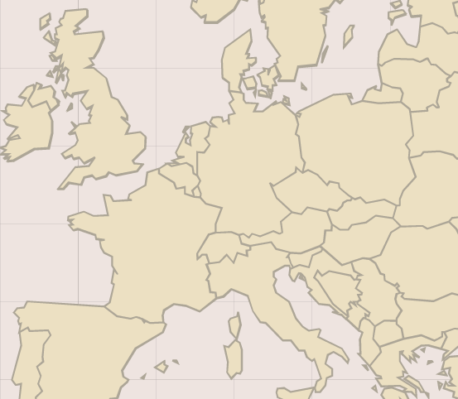
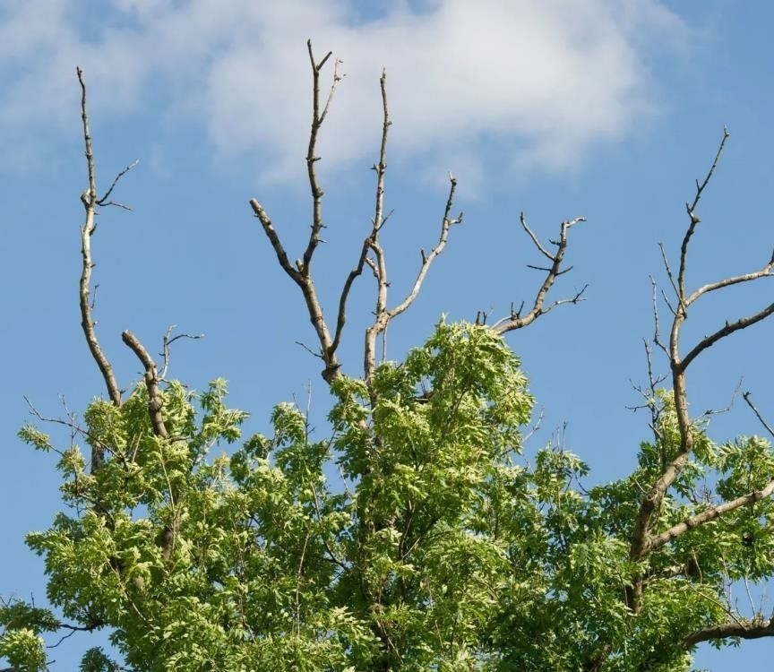
Surveillance for early detection of plant pests & diseases is challenging
In practice, early detection surveillance is difficult… and has failed for many plant diseases.
2012
1992
2002
2010
2007
2005

Slide 6
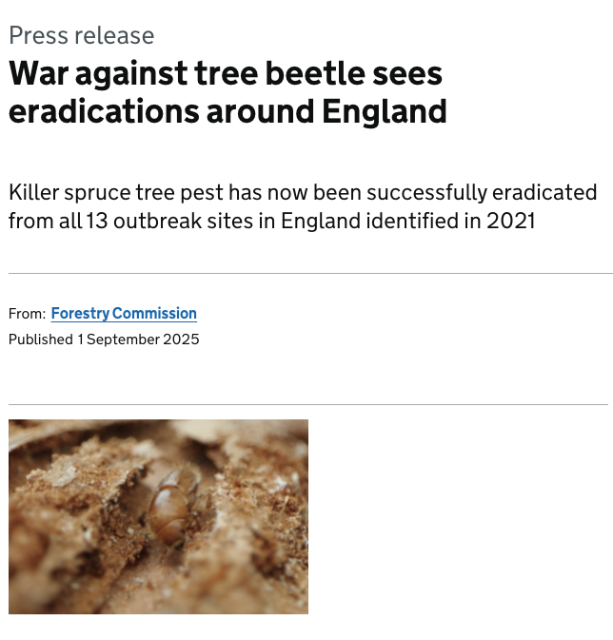
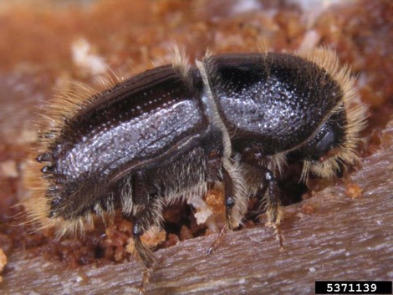
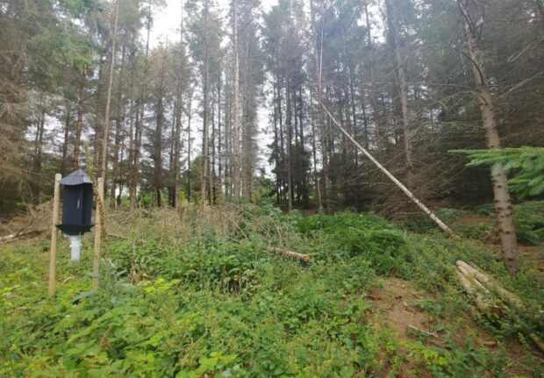
Surveillance for early detection of plant pests & diseases is challenging: Some success stories…
Bugwood.org
Forestry Commission

Slide 7
Surveillance for early detection of plant pests & diseases is challenging
Host populations
Detection and diagnosis
Surveillance systems
Disease ecology
Human factors
Limited passive reporting
Non-centralized, fragmented populations
Asymptomatic infection and latency
Symptom ambiguity
Diversity in host species
Diversity in pathogens and strains
Persistence in the environment
Non-strategic survey design
Low surveillance intensity
Sparse data, parameter uncertainty
Lack of awareness & engagement
Wild and cultivated hosts
Lack of data sharing & connectedness
Weak oversight of plant movements/ trade
Environmental sensitivity

Slide 8

Legal survey requirements
Practical implementation
European Commission, IPPC/FAO
European Food Safety Authority (EFSA)
Risk-based & harmonised surveillance
‘Detection surveys’ (annual for 20 “priority pests” multi-annual >300 regulated pests) – substantiate freedom, early detection
Pest not known to occur
Guidelines
Statistically and risk-based guidelines for plant pest surveys
Data & Info
Information and database on disease epidemiology and detection methods
Tools
Web-based statistical tools for survey design (RiPest, OptiPest)
‘Delimiting surveys’ to demarcate infected zones
First detection of a pest in a new area
‘Buffer zone surveys’ to detect spread from demarcated areas
Pest is under containment/ eradication
Member State Surveys & Reporting to Commission
Notes:
For handful of pests, legal requirement to use EFSA approach
Difficult to provide general framework given the wide variety of pests, hosts and contexts

Slide 9
Insights from models to help inform surveillance policy
Where to look and with which detection methods?
Hosts vs vectors
Visual inspections vs asymptomatic sampling
Harnessing citizen science
Spatially optimised surveillance
Surveillance under access constraints
Trade vs the environment
Notes:
Some examples from research
How can we gain insights from models that help inform surveillance; rather than predictive systems

Slide 10
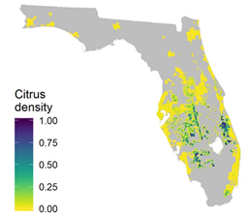
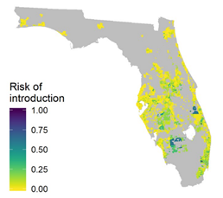
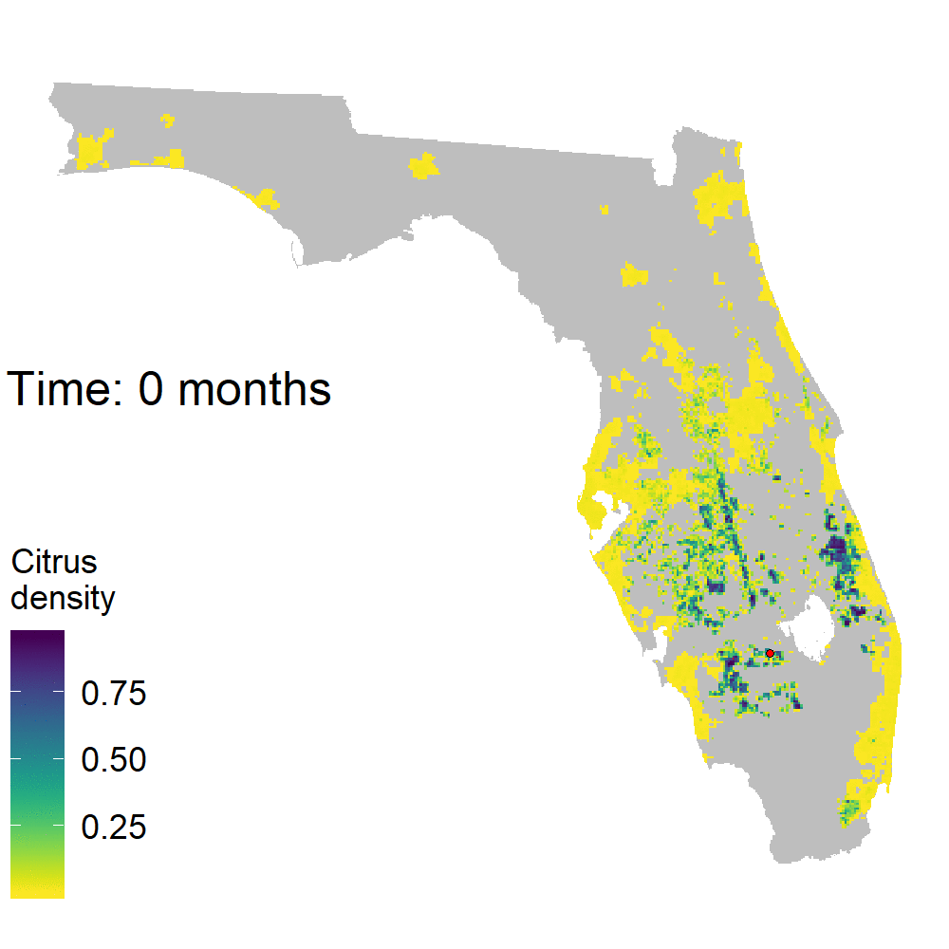

Spatially optimised surveillance
Optimal surveillance strategies for HLB disease in Florida
Data on citrus density in commercial and residential areas in Florida
Model for risk of introduction of HLB via people and trade
Use to model spread throughout the state (example of one model run)
Key publication:
Mastin et al (2020) PLOS Biology, https://doi.org/10.1371/journal.pbio.3000863

Slide 11
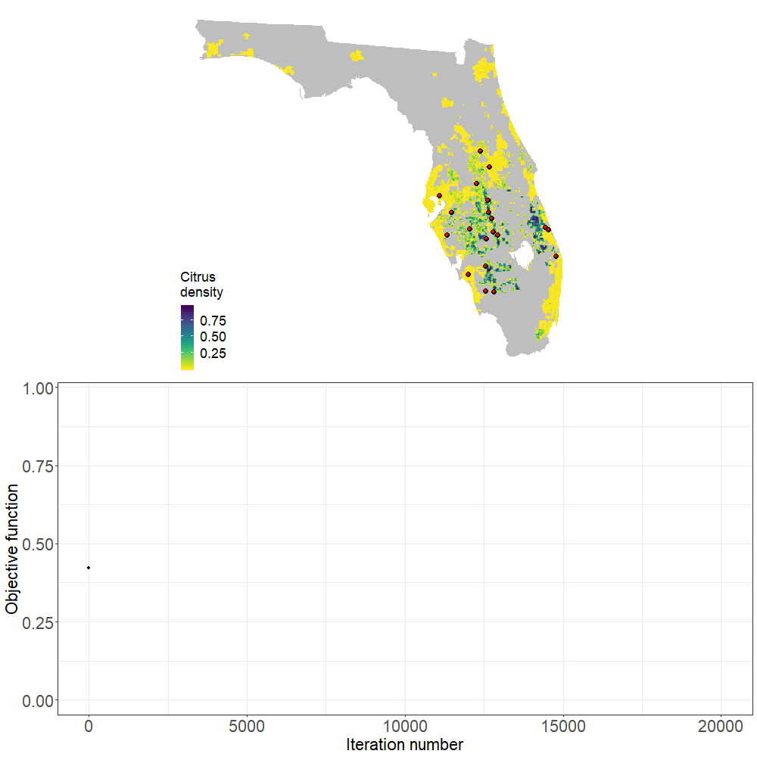
Spatially optimised surveillance
Optimisation to identify the locations that maximise detection probability
Combining entry & spread is the closest ‘rule of thumb’ strategy to the optimum
Mastin et al (2020) PLOS Biology, https://doi.org/10.1371/journal.pbio.3000863
Notes:
objective function; simulated annealing
Then use stochastic optimisation to find the best set of locations

Slide 12
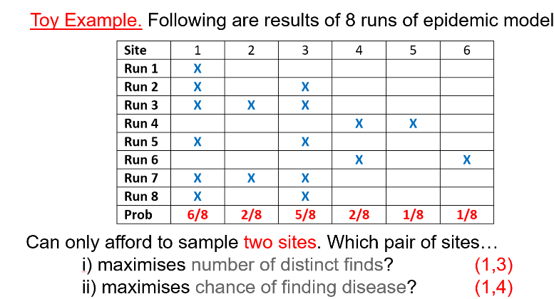
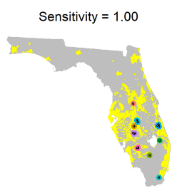
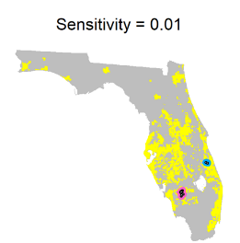
Spatially optimised surveillance
Early detection requires a “risk-diversifying” strategy
The sensitivity of the detection method determines the optimal survey pattern
Mastin et al (2020) PLOS Biology, https://doi.org/10.1371/journal.pbio.3000863
Notes:
Risk diversifying strategy if aim to find it once/early

Slide 13
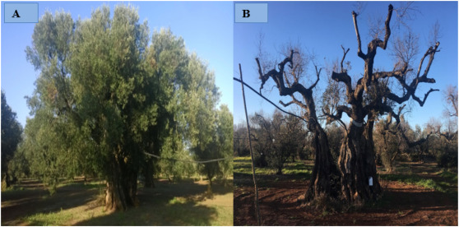
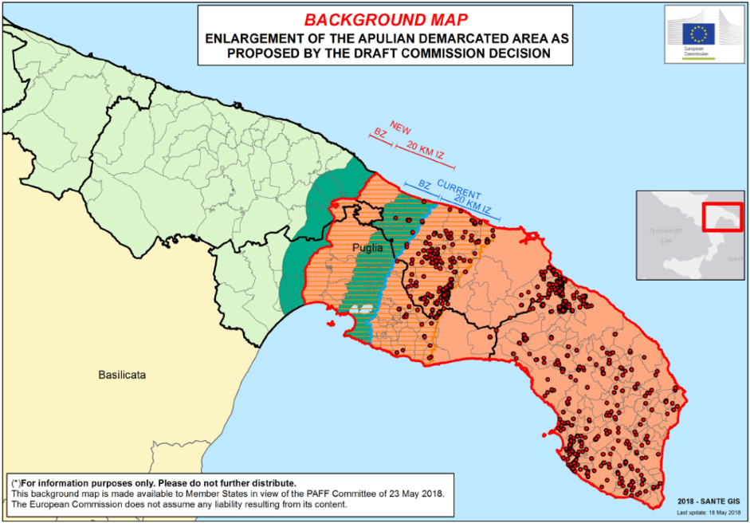
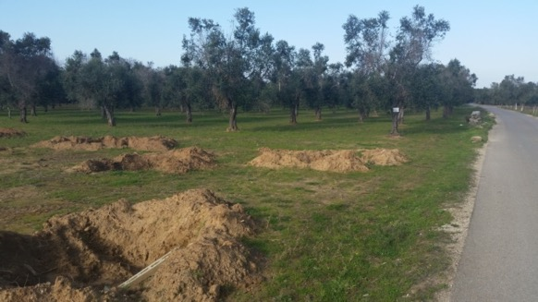

X. fastidiosa: where should sampling be targeted to detect new epidemics outside the demarcated zones?
?
Notes:
Explain Xylella,
One of biggest plant health emergencies in the EU

Slide 14
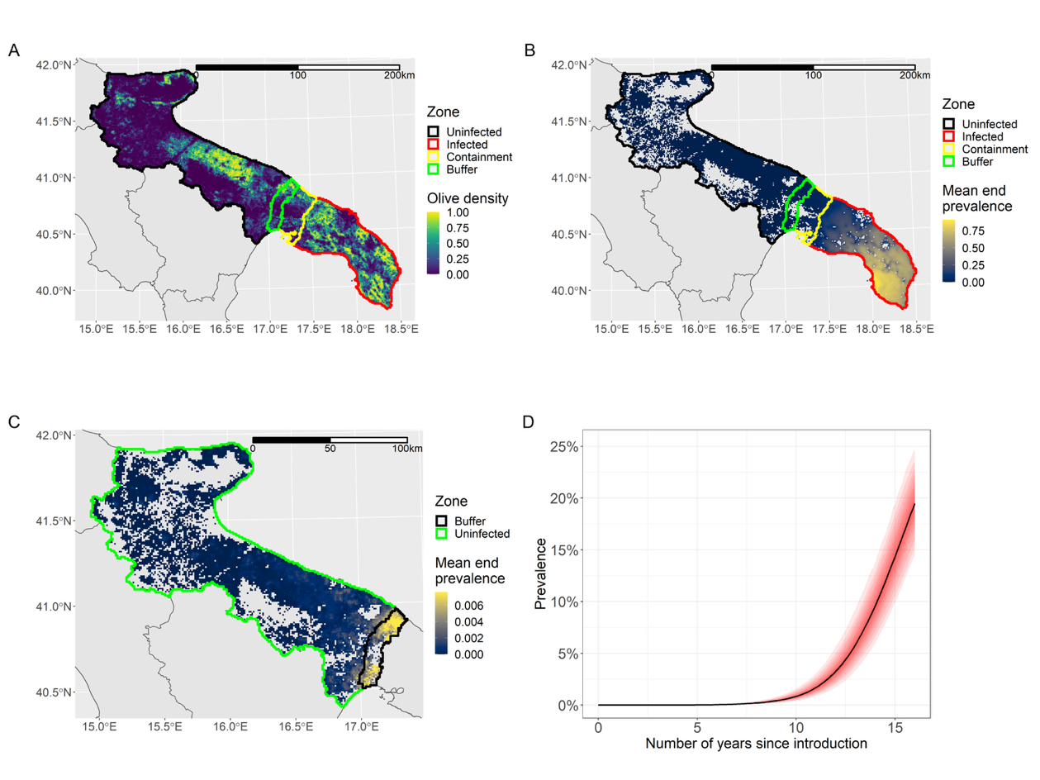
Spatially optimised surveillance
Host density
Disease risk, long-term
Disease risk, initial spread
Disease progress curve

Slide 15
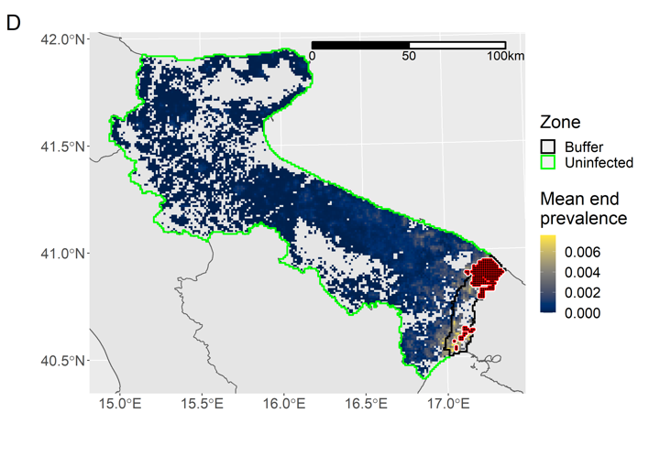
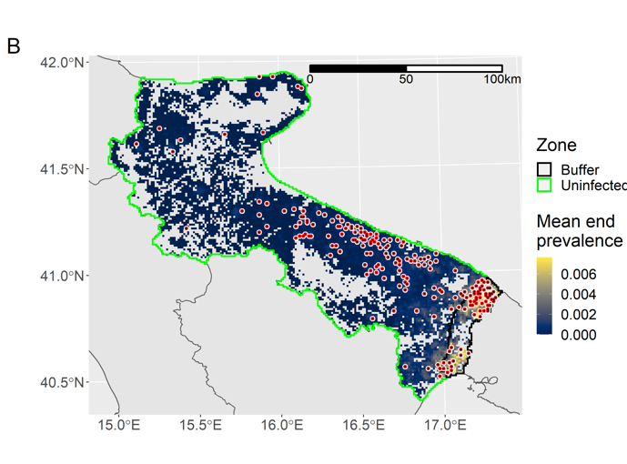
Spatially optimised surveillance
Significant shift in optimized surveillance pattern with just small amount of long-range jumps. Policy gap between detection and buffer zone surveys.
Optimal survey sites, natural spread only = focus on buffer zone
Optimal survey sites, rare long-range jumps = look much further afield
Notes:
Buffer zone strategy is main one, no prescribed surveillance beyond this
Message = policy gap between detection surveys and surveys around demarcated areas (buffer zone)

Slide 16
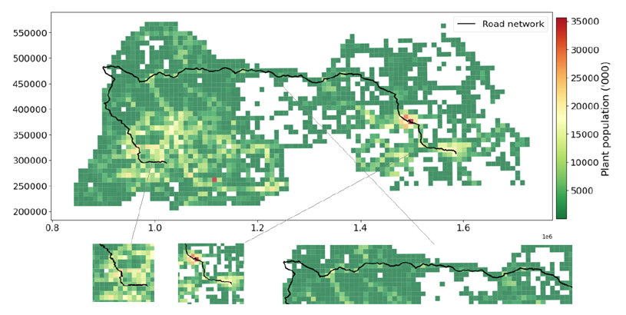
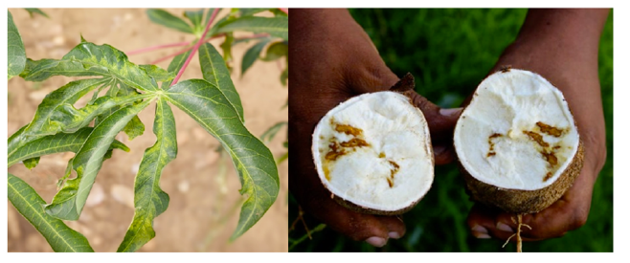
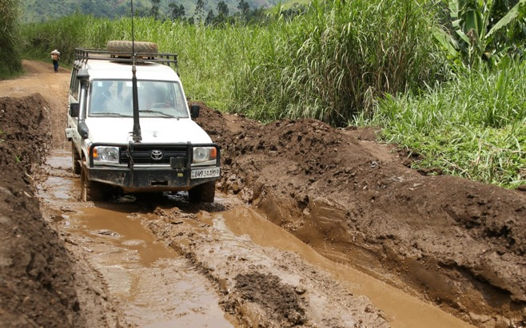



Spatially optimised surveillance
Access constraints
Detecting Cassava Brown Streak Disease (CBSD) in northern DRC
Survey area
CBSD presence

Slide 17
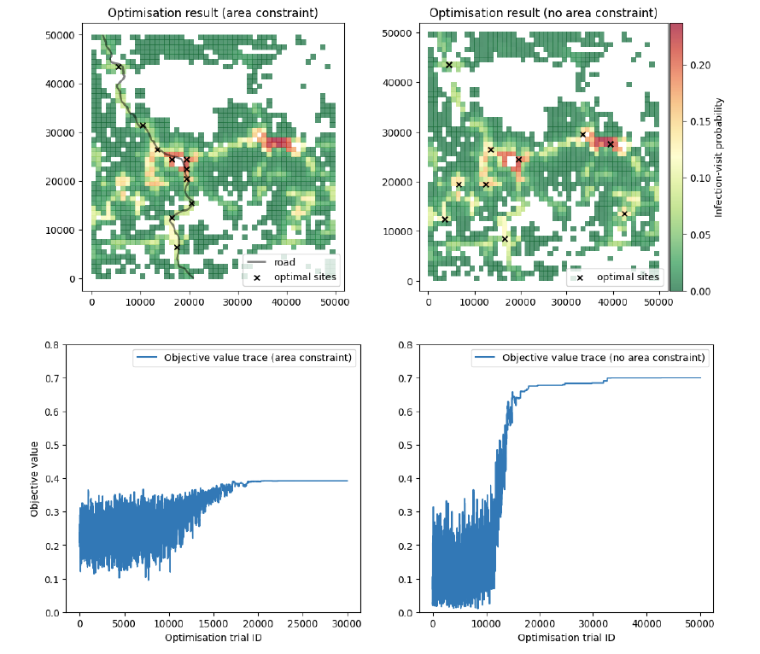
Spatially optimised surveillance
Access constraints

Slide 18
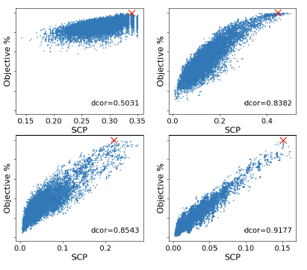
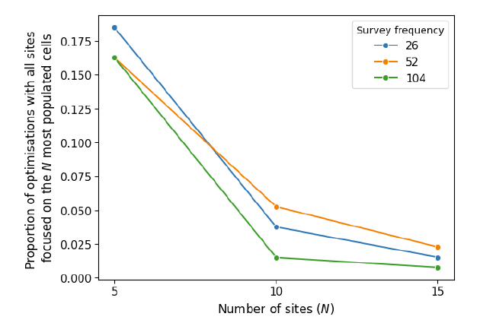
Spatially optimised surveillance
Access constraints
Metrics based on host density around accessible roads predict surveillance performance well
The “risk diversification” strategy is robust to situations where there are access constraints

Slide 19
Insights from models to help inform surveillance policy
Where to look and with which detection methods?
Hosts vs vectors
Visual inspections vs asymptomatic sampling
Harnessing citizen science
Spatially optimised surveillance
Surveillance under access constraints
Trade vs the environment
Notes:
Mechanistic/SIR type models

Slide 20
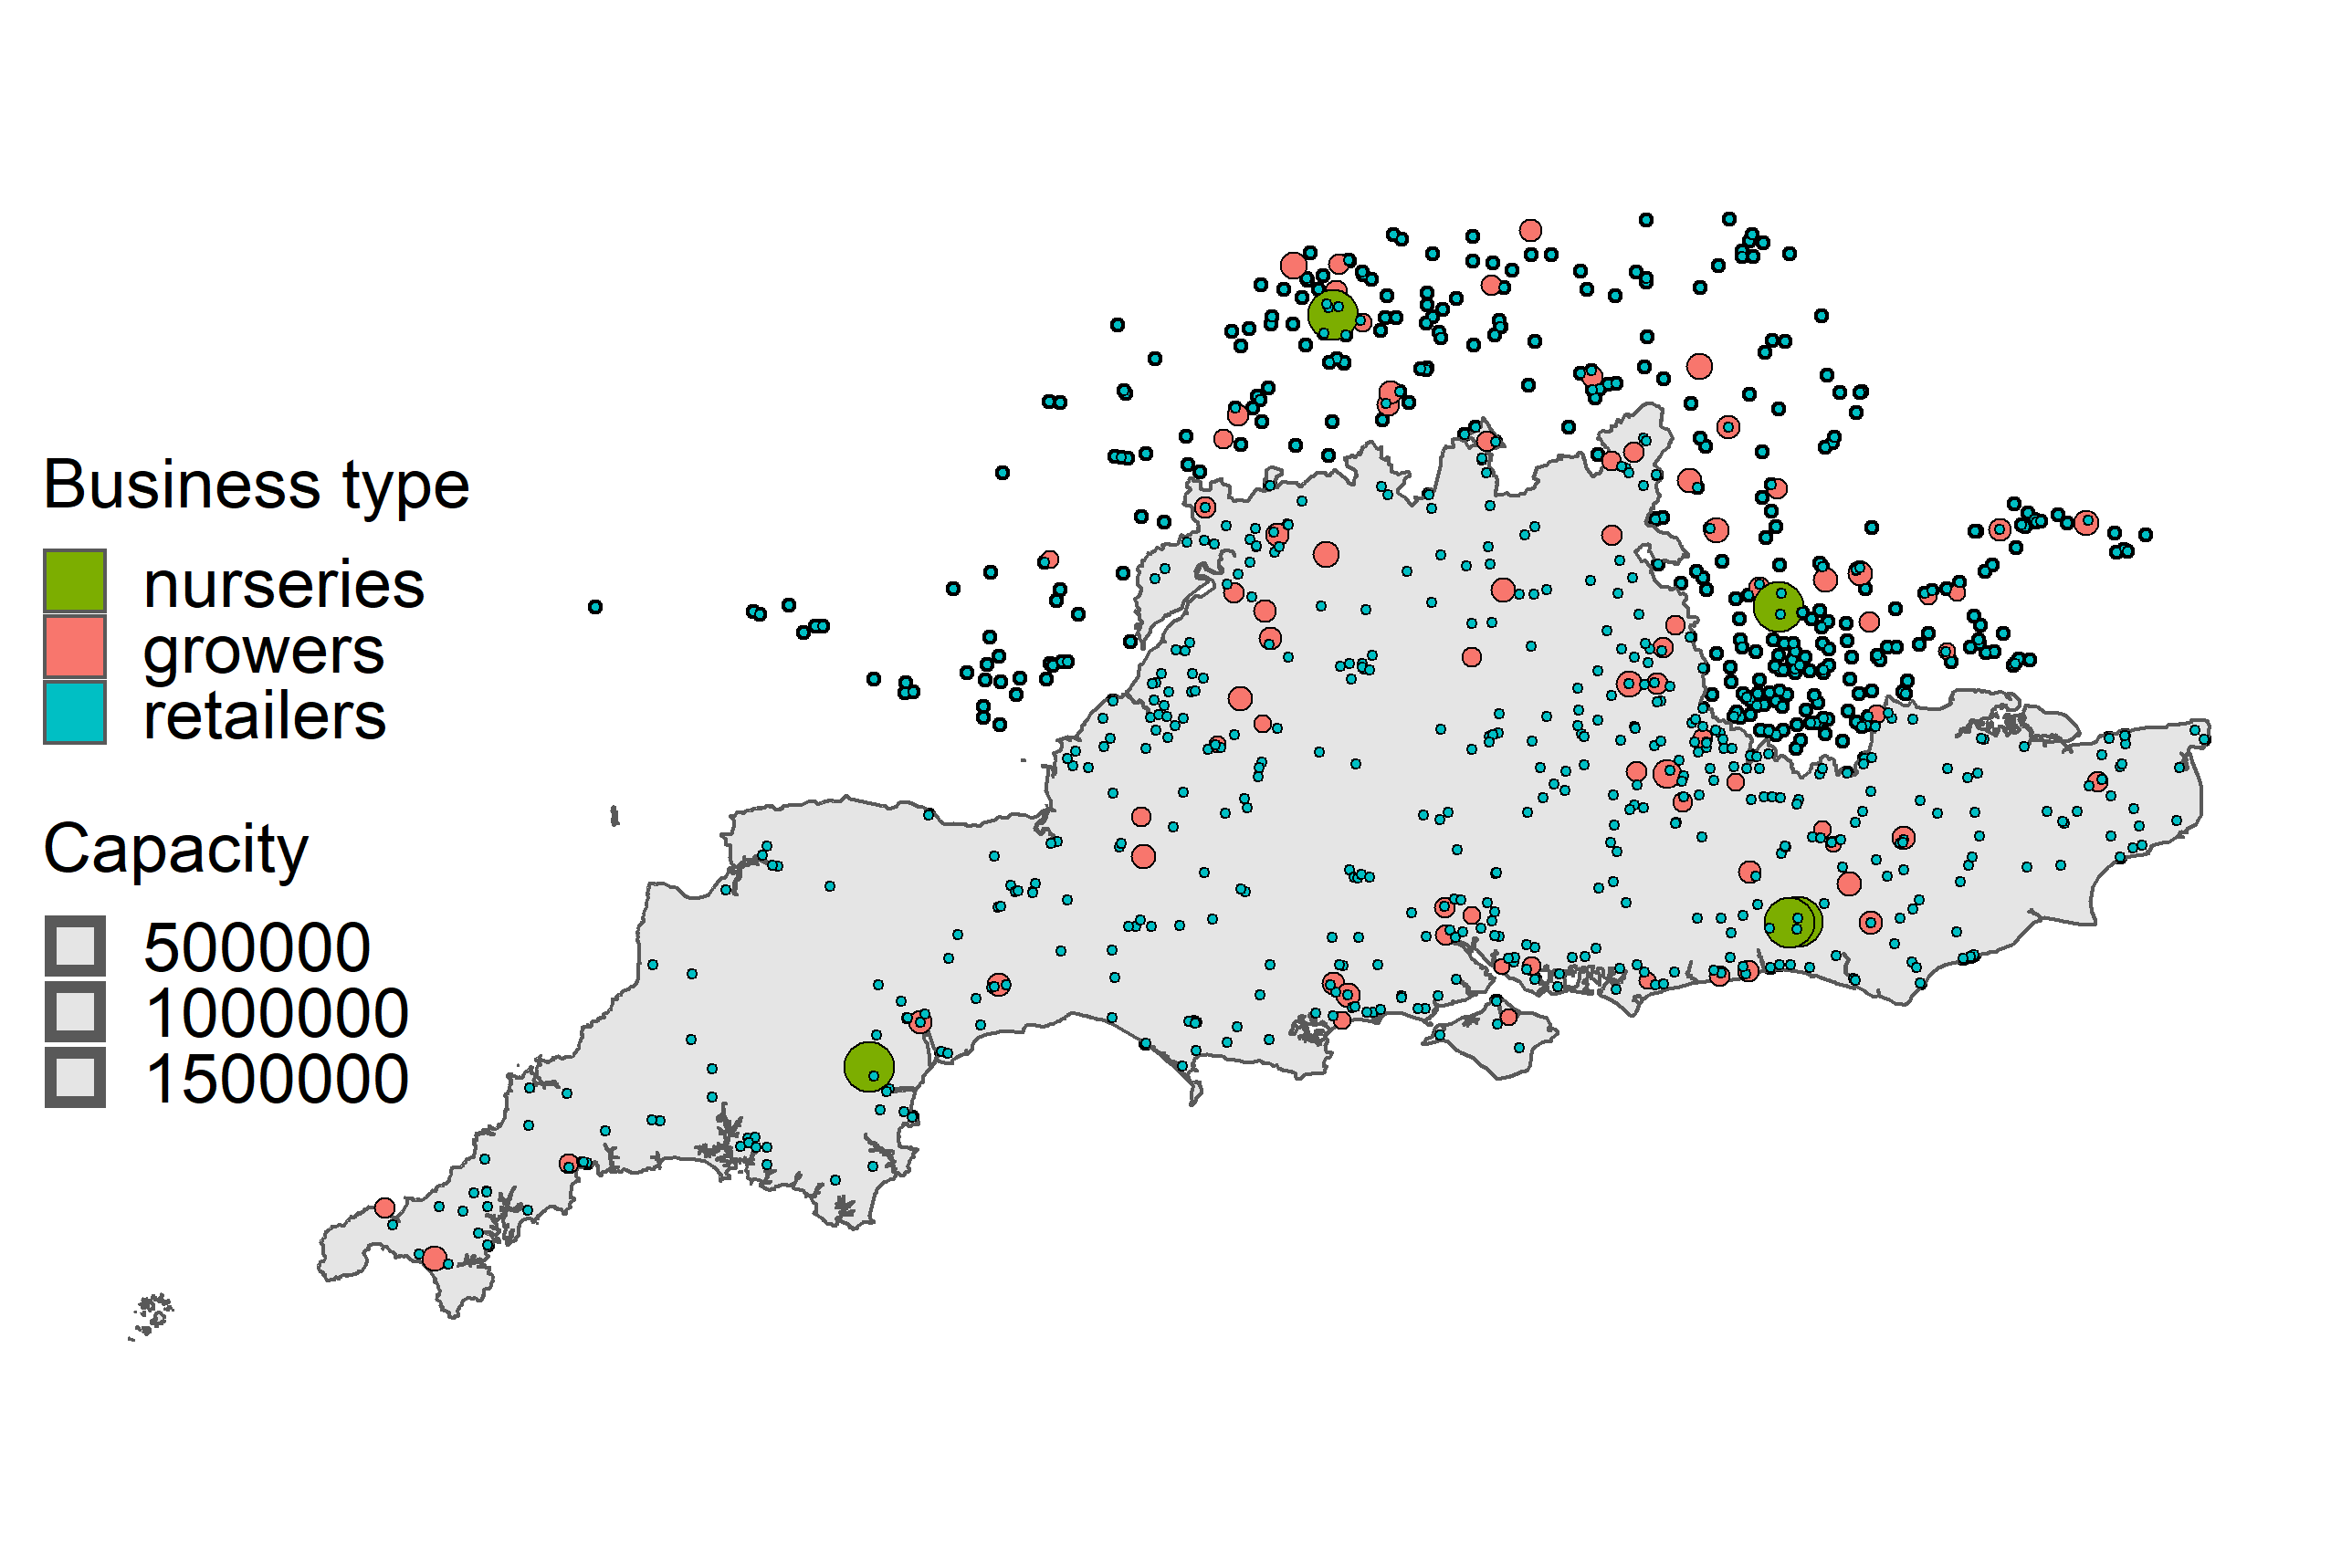
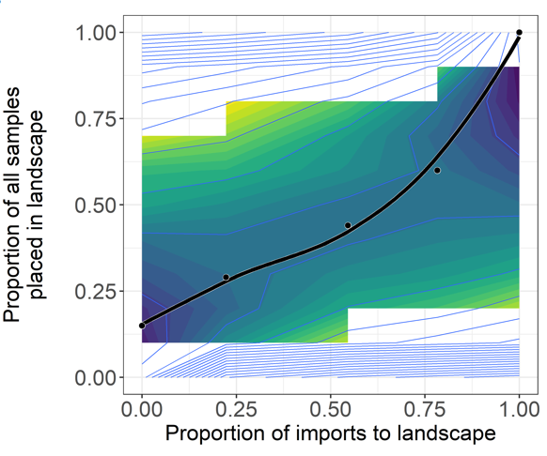




Balancing survey resources across trade and environment
Xylella fastidiosa spread in trade network versus the landscape
Xylella likely to enter via the UK horticultural trade.
Model for within-trade spread
Model spread between the landscape and the trade
Balance of survey effort between trade and the landscape is proportional to imports (data gap)
Notes:
For some diseases visual is ok, fo rsome it isn’t depending on epidemiology
Visualinspections works for some but not all, depending on epdiemiology
We can link the approach to a model of any pathosystems
If you do that and account for their different epidemiologes and asymptomatic periods, you get this quite startling graph
It shows the prevalence of visual signs and of true infection at the time of first detection of an epidemic.
Looked at this for a range fo pathosystems – for things link ash dieback (big problem in uk) – there isn’t a big disparity between prevalence of vis and prev of trun infection
HOWEVER, look at something like Xylella – on olve has asymtpmatic period of over a year and fast growth., if you detect when 5% of plants are showing symptoms, actually 75% are already infected but you cant see it yet
So we can extend to look at alternative detection methods….
f you look at this for Xylella – we developed an epidemic model of this host-pathogen systems.
Vecotr sampling shows greatest promise for early detection.
However, if you look at something like P. ramorum….

Slide 21
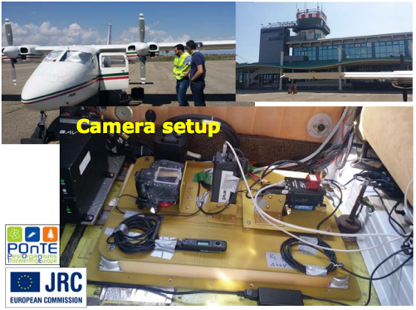
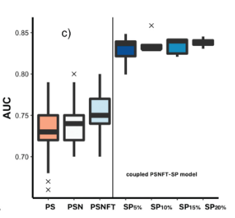
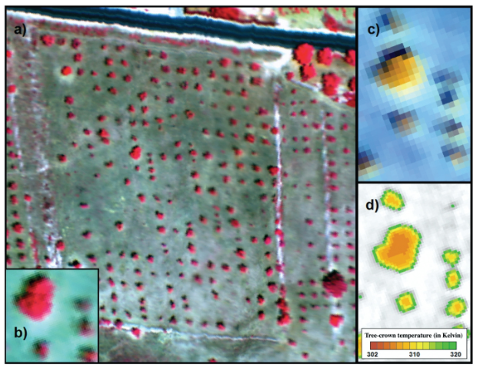
Remote sensing and epidemiological models for improved detection
Xylella-infected Almond orchards, Alicante
Hyperspectral and thermal imagery from a manned aircraft
Accuracy of remote sensing estimates improved with coupled epidemic model
Camino et al (2021) Remote Sensing of Environment; https://doi.org/10.1016/j.rse.2021.112420
Notes:
New detection technologies coming online – and can be inproved with consideration of epidemiology
Explain – example
However, in the main, plant health surveys are governed by visual inspectons of plants

Slide 22
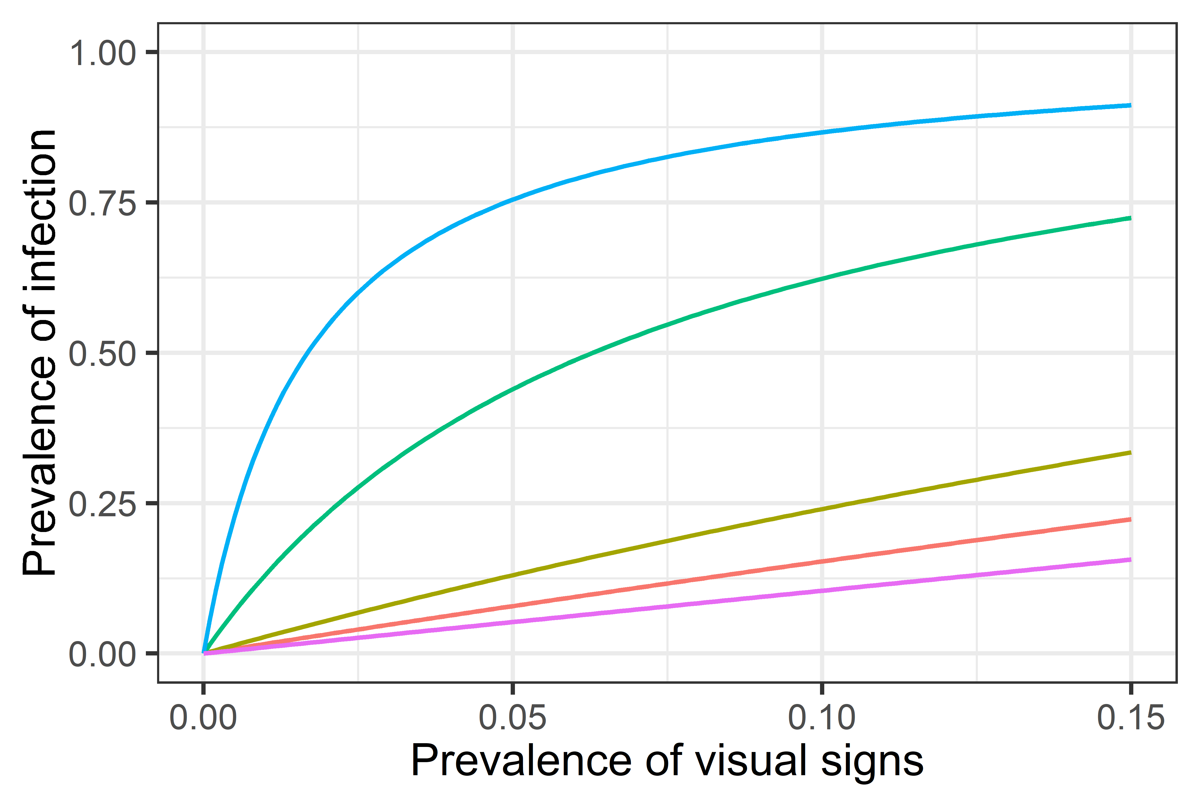
Visual inspection is the mainstay of plant health surveillance
Olive quick decline
(Xylella fastidiosa)
Huanglongbing
(Ca. Liberibacter asiaticus)
Citrus canker
(Xanthomonas axonopodis)
Ash dieback
(Hymenoscyphus fraxineus)
Sudden oak death
(Phytophtora ramorum)
Mastin et al (2022) https://www.nature.com/articles/s41598-022-13553-y
22

Slide 23
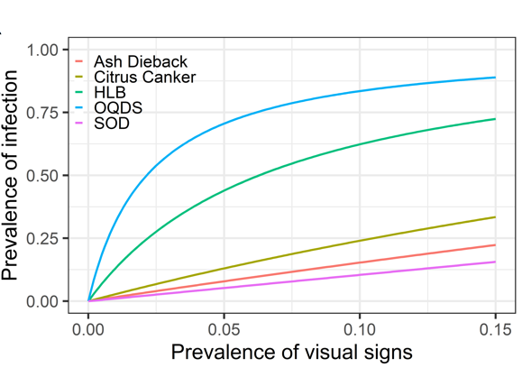
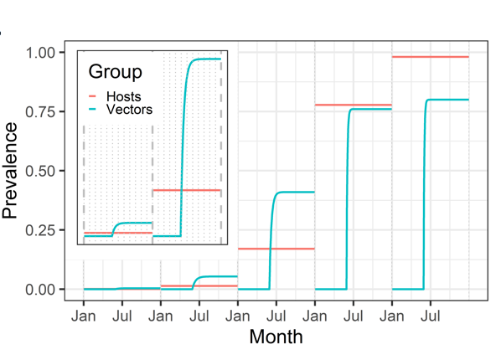
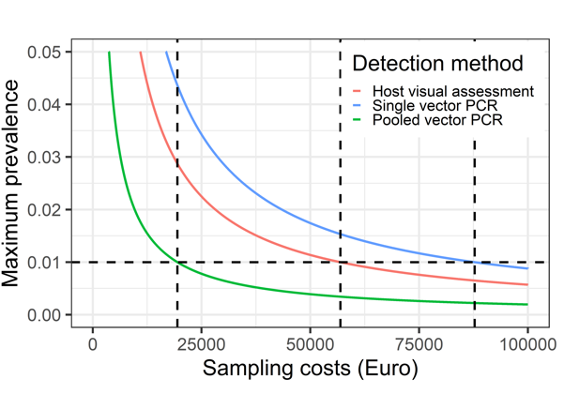
Evaluating the effectiveness of different detection methods
Visual inspection works for some but not others; depends on the epidemiology
In Xylella, prevalence in vectors higher than hosts early in epidemic
Sampling vectors is thus more cost effective for early detection of Xylella
Mastin et al (2022) https://www.nature.com/articles/s41598-022-13553-y

Slide 24
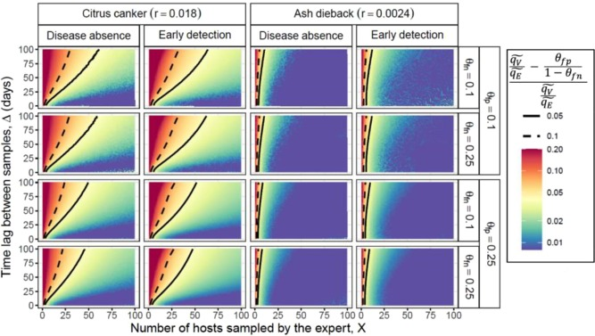
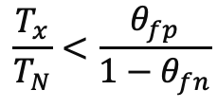
When is citizen science useful for plant health surveillance?
Need to balance benefit of citizen science reporting with cost of following up reports
Time needed to verify a citizen science report
False positive rate of citizen scientists
$$\frac{T_{x}}{T_{N}}<\frac{θ_{fp}}{1−θ_{fn}}$$
Time taken for an expert to take a sample
False negative rate of citizen scientists
van den Bosch et al (2023) Journal of Theoretical Biology; https://doi.org/10.1016/j.jtbi.2022.111385
24

Slide 25
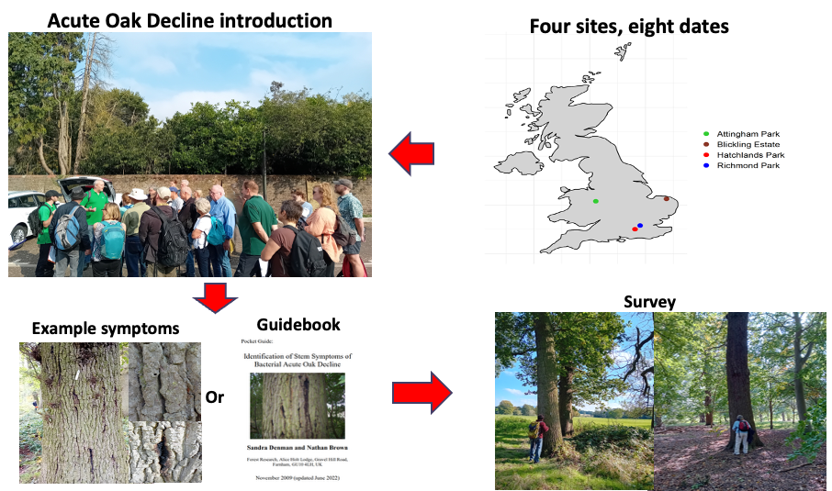
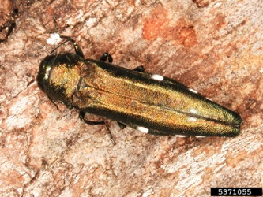

Determining volunteer sensitivity and specificity
Case study on Acute Oak Decline
Bugwood.org

Slide 26
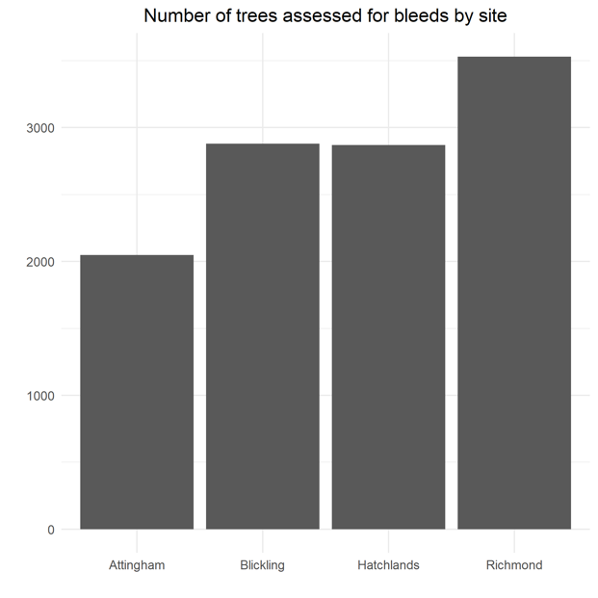
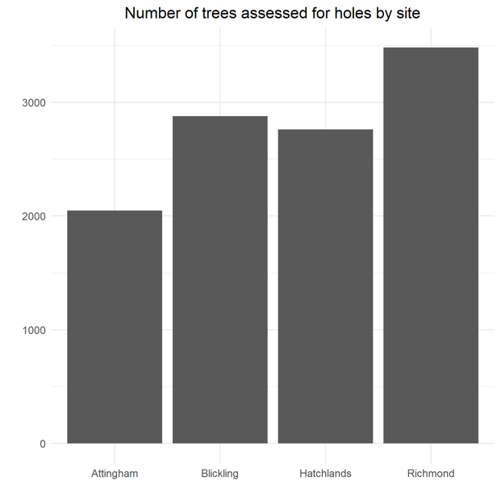
164 individuals; total of 11328 tree assessments for AOD associated symptoms

Slide 27

Notes:
First thing you can do with it is quantify se/sp and start to explore it for different factors

Slide 28


Estimating the sensitivity and specificity of visual inspections in the absence of a gold standard
Branscum AJ, Gardner IA, Johnson WO. Estimation of diagnostic-test sensitivity and specificity through Bayesian modeling. Prev Vet Med. 2005;68(2-4):145-63.
doi: 10.1016/j.prevetmed.2004.12.005.
Notes:
The second thing is to develop and test approaches to calcyaluet se/sp in absence of gold standard as for policy, that is the usual situation
Allows it to be generalized

Slide 29
Insights from models to help inform surveillance policy
Where to look and with which detection methods?
Hosts vs vectors
Visual inspections vs asymptomatic sampling
Harnessing citizen science
Spatially optimised surveillance
Surveillance under access constraints
Trade vs the environment
Notes:
Using models to help inform thinking on how we design surveillance and what we priortise

Slide 30







Epidemiological modelling to inform surveillance policy
Dr Joshua Koh
PDRA
Dr Matt Combes
PDRA
Nadine Aschauer
PhD Student
Elliot Vincent
PhD Student
Suzie Pearce
PhD Student
Biqing Wang
MSc Student
Notes:
Using models to help inform thinking on how we design surveillane and what we priortise

