Slide 1







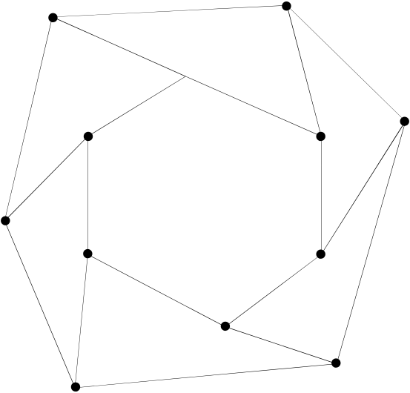
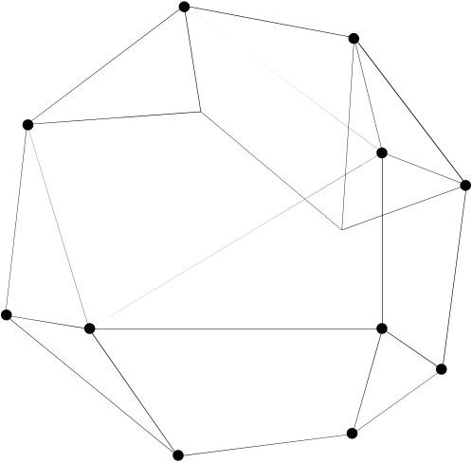
Improving PPR Surveillance System in Nigeria
Using network tools to describe propagation and estimate the effect of missing information
ModStatSAP Workshop
22/10/2025
Andrea Apolloni (on behalf of Asma Mesdour)

Slide 2









Acknowledgements
Asma Mesdour
Sandra Ijoma
Improving Control of PPR and NCD in Nigeria through integration of knowledges
Stephen Eubank
Mathieu Andraud
Mamadou Ciss
Eric Cardinale

Slide 3






Personal motivations (mobility in West Africa)
Sadness
Data quality and availability:
Difficult to collect;
limited in time and space;
What Can be done with this data?
What are the limitations?
How to optimise surveillance and data collection?
Envy
Cutting Edge Simulation tools coupling Mobility and Epidemics to inform surveillance activities
Fear/Rage/Skepticism
Use/ Abuse of centrality measures in Risk Analysis?
Do they tell the whole story?

Slide 4

Peste des Petits Ruminants (PPR)
Sorry, YOU GOAT SICK

Slide 5

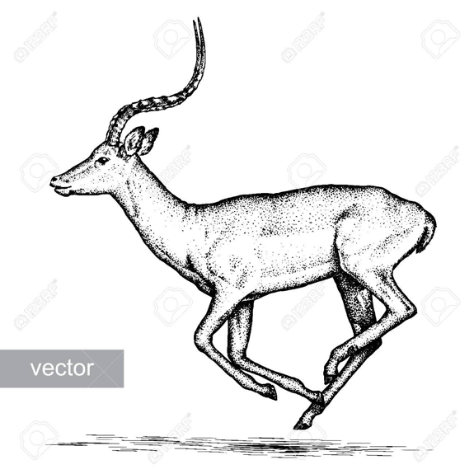
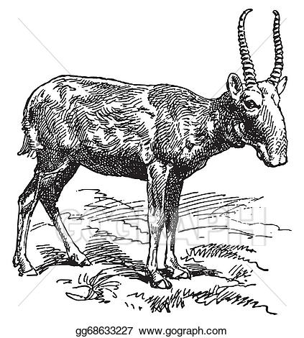

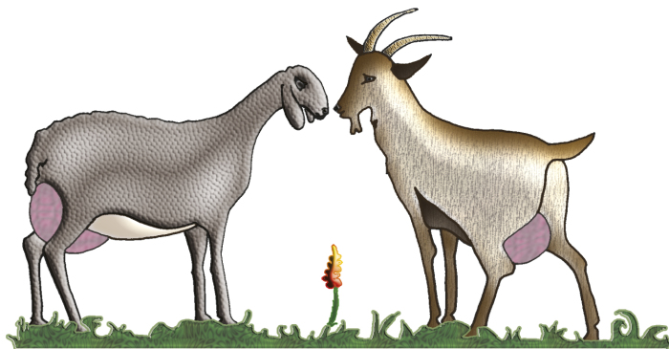

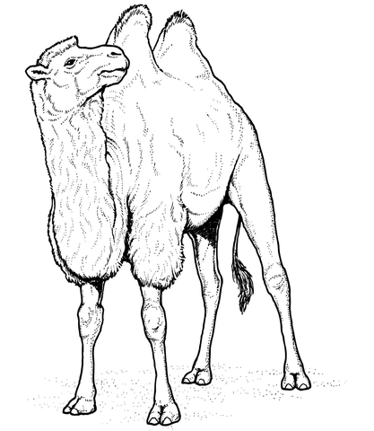
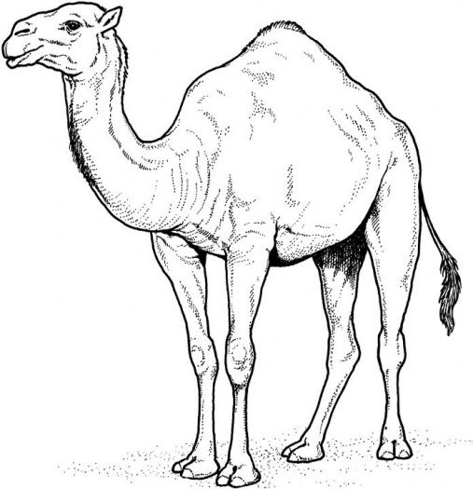
Peste des Petits Ruminants (PPR)
Water buffalo, antilopes, gazelles can be infected: Possible reservoir??
Camels susceptible and symptomatic: Possible long distance vectors
Cattle immunological response but not transmission (cul de sac)
Pigs: can transmit
Disease affecting domestic small ruminants (goats and sheep)
Direct Contact Infectious –Susceptible Animals

Slide 6
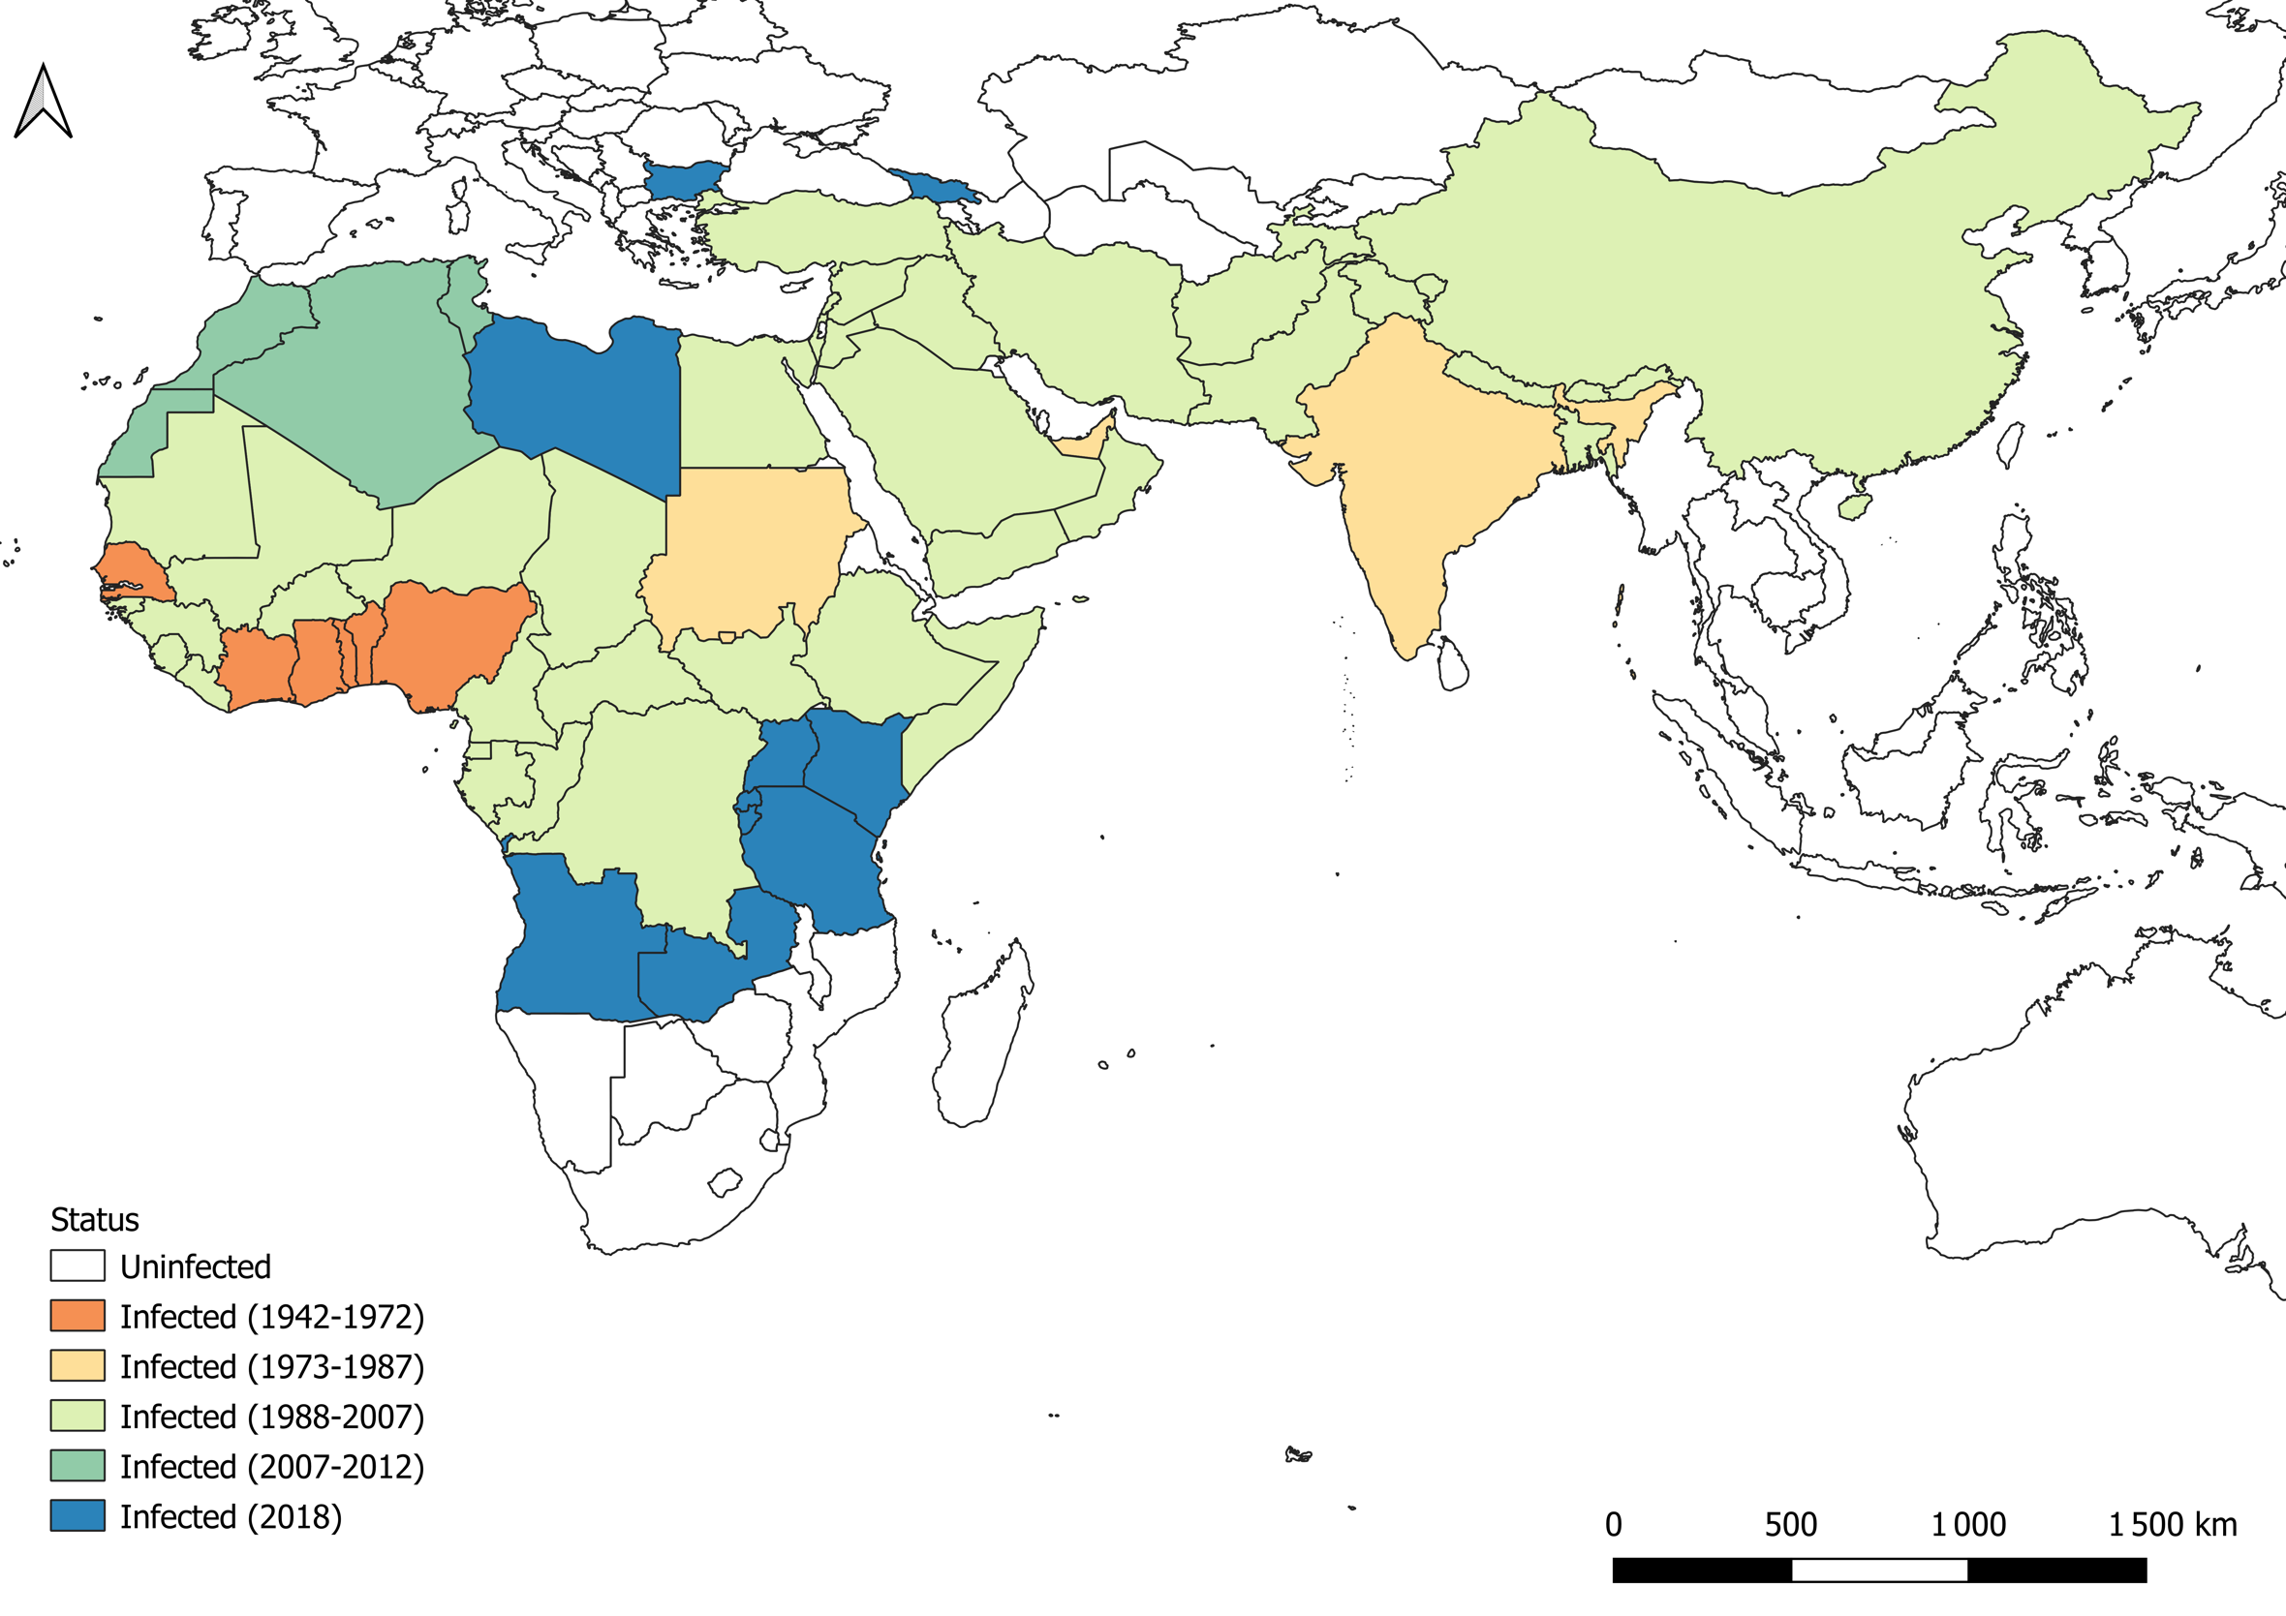
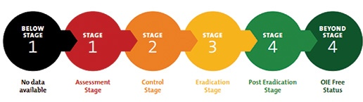
DISEASE + MOBILITY=
EXPANSION WOLRDWIDE
1 billion animal at risks
Several millions households at risk
Economic Losses: 1.2-1.7 billion US $
Eradication by 2030
Importance surveillance (risk based)
Vaccination main tool for control
Need to adapt to local context
O. Mthallah, 2022
Not anymore an African Disease :
2018: Bulgaria
2024: Greece Romania
2025: Hungary

Slide 7
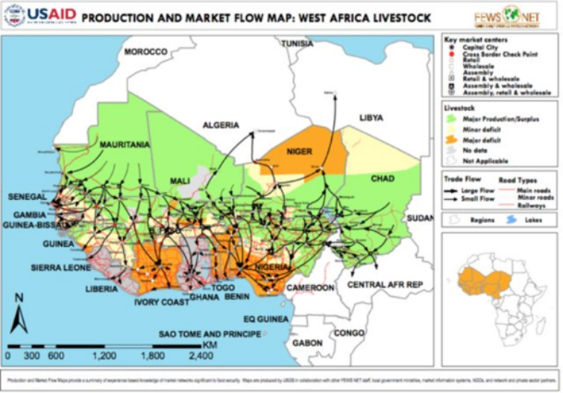
Context: Animal Mobility in Sub Saharan Africa
Mobility:One of the pivotal activities in the area for economic and production reasons
Transhumance : animal production, seasonal: looking for better grazing areas and/or to avoid damages to harvesting. Lasts several months (6-9) and could be international.
Trade: Solid market hierarchy; International and driven by religious and social events
Complex phenomena at different spatial and time scales
Possibility of integrating region
Mobility: one of the main factors contributing to diffusion of FAST diseases
Few data collected, centralised and harmonised (although..)

Slide 8
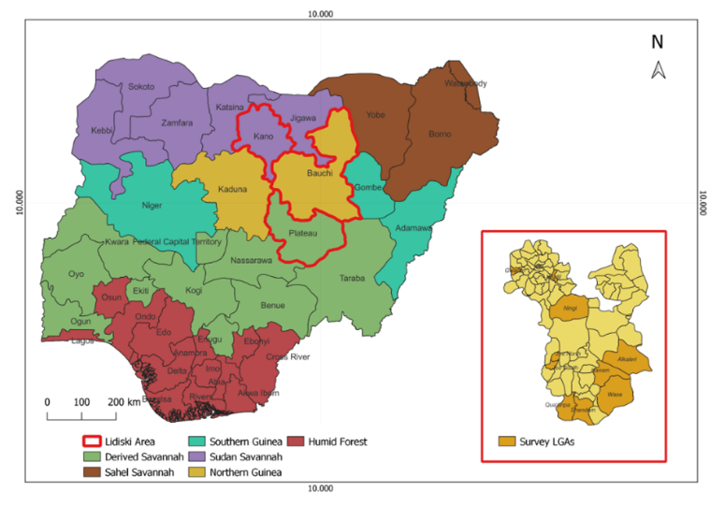
Nigerian Situation
More than 20 Mil heads of Small ruminants
No Infrastructure, animals sold alive
PPR endemic with seasonal outbreaks (beginning dry season)
Problem Vaccination Coverage
No mobility data collection and centralized
Lidiski Project
Monitor livestock diseases (PPR and NCD) through the integration of different sources of knowledge
Study Area:
State of Plateau
State of Bauchi
State of Kano

Slide 9
Our Contribution
Missing Mobility data-> Reconstruct network in Lidiski area
Data Collection
Network Analysis
Optimise resources->Tools to identify area at risk and control
Identification of Sentinel Nodes
Vaccination Strategies
Assess reliability of results
Network reconstruction
Impact of missing links
Inform next collection data

Slide 10
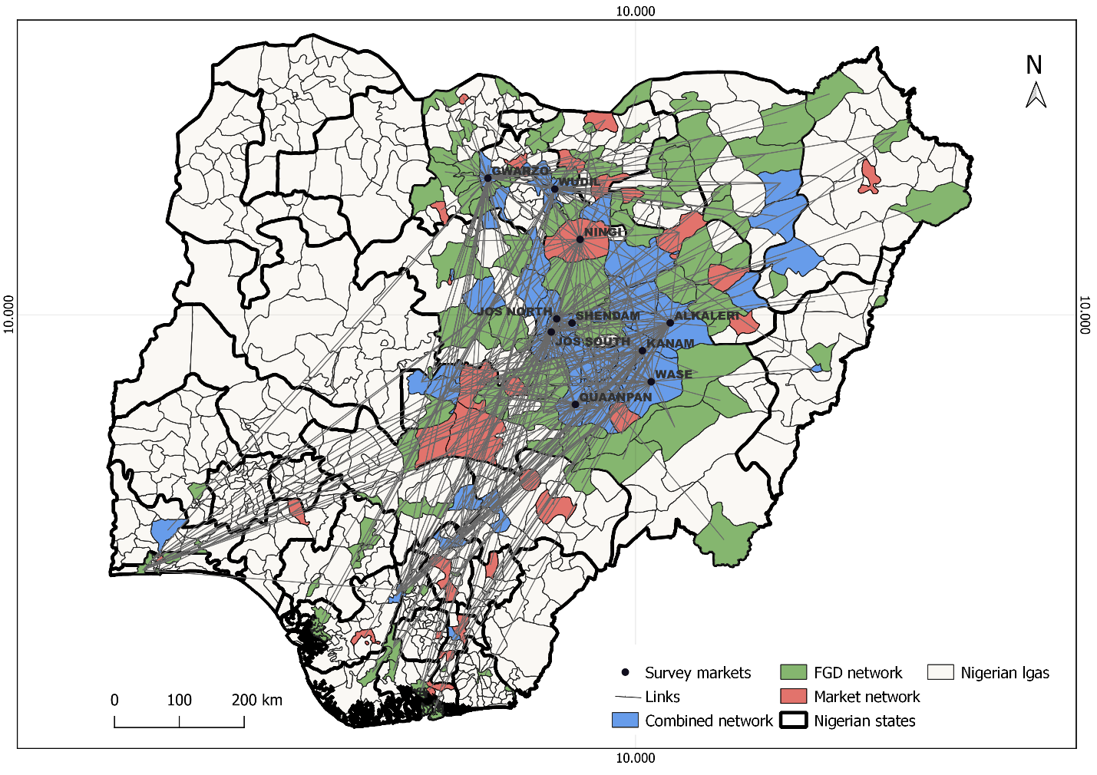
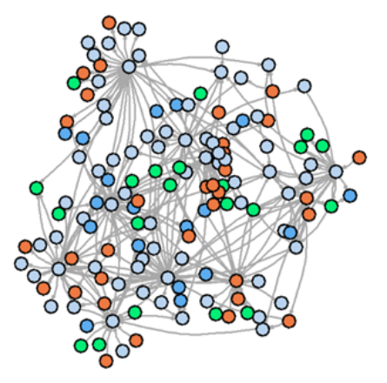
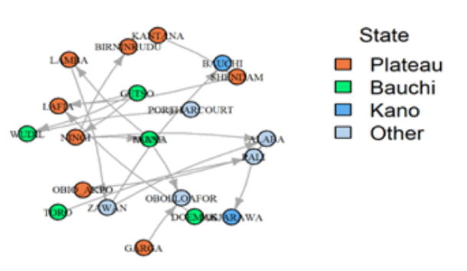
Network Characteristics
Survey in 10 Markets in 3 States +FGD
100 interviews, 1026 in total
Period: April-September 2022
Information collected:
Origin Destination and type
Date Frequency
Heads’ number and Species
Actor Characteristic
Data geolocalised at village/District level
Nodes | 135 | 27 States
Edges | 335 | 67% Outside Lidiski
Density | 0.03 | Mostly Weekly
Diameter | 6 | Single Component
In/Out degree Heterogeneity | 2.35/7.93
Ijoma et al.,2024

Slide 11
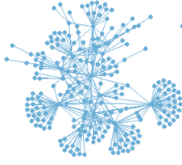
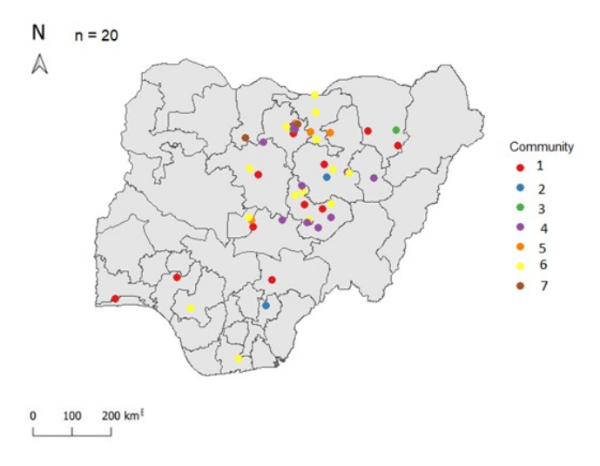
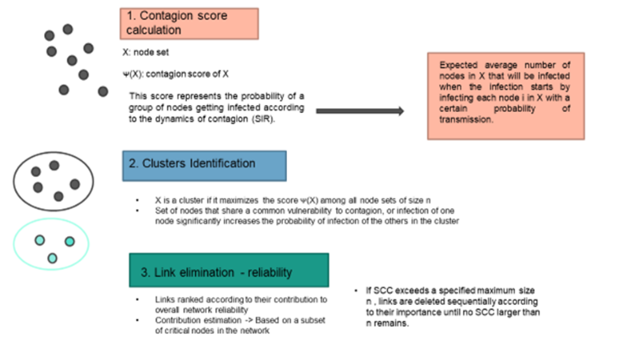
Network Characteristics: Who infects who?
5
Contagion clusters: subset of nodes that are most likely to mutually infect
Strongly connected component
Strong connectivity within-> each node could infect other members
COCLEA Algorithm (Nath 2019)
7 communities (3 to 16 nodes)
Spatially distributed-> PPR could spread everywhere

Slide 12
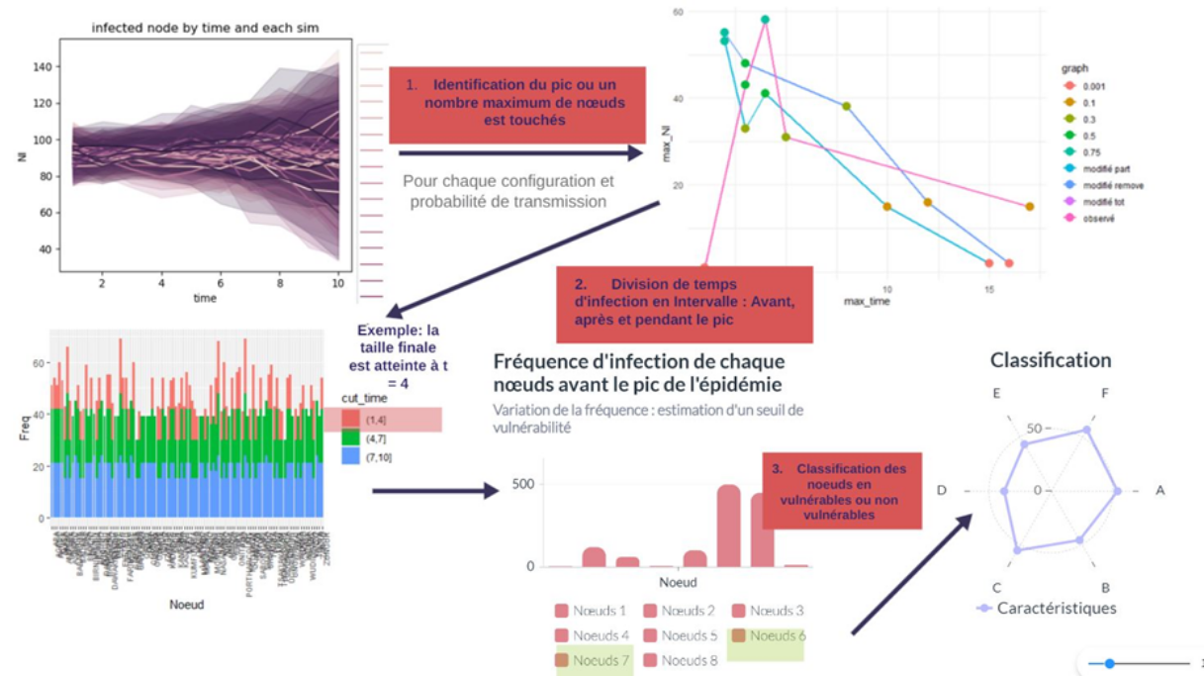
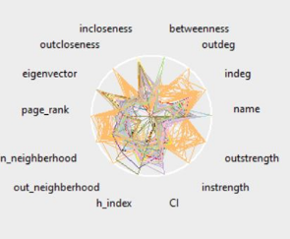
Sentinel Nodes
￼
1 SIR model: Numerical simulations and identification of peak time
Sentinel Nodes:
Nodes infected frequently and before the peak of epidemics
Provide information on status and useful for alert
Optimise personnel
Depend on
Disease characteristics
Origin of epidemics
Network structure
2 Identification of Before, Around and After peak intervals
3 Node frequency to be infected and when
4 Classification nodes based on their structural characteristics
Notes:
The preferred model is found to be thelognormal distribution. After fitting the lognormal distribution, estimated parameters—mean (μ) and standard deviation (σ ) arederived. The threshold selection relies on a quantile of the lognormal distribution, particularly the 75th percentile. Based on thisthreshold, three statuses were defined: if a node is affected before the epidemic peak with a frequency higher than the threshold,it is considered highly vulnerable. If a node is frequently affected more before than after the peak but with a frequency belowthe threshold, it is classified as lowly vulnerable. Lastly, if a node is frequently affected after the epidemic peak, it is consideredinfected but not vulnerable. Here, nodes identified as highly vulnerable are considered the best candidates for sentinel nodes.

Slide 13
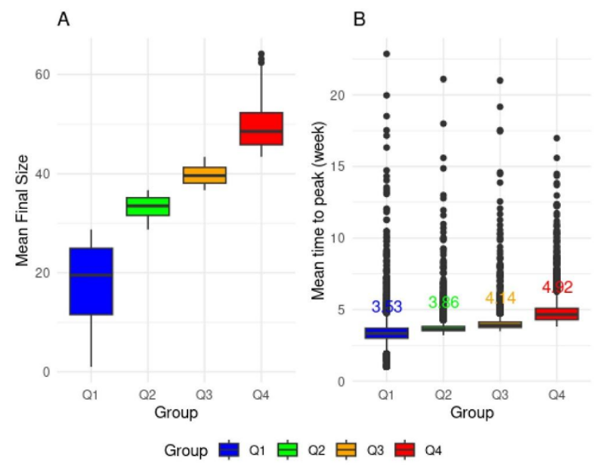
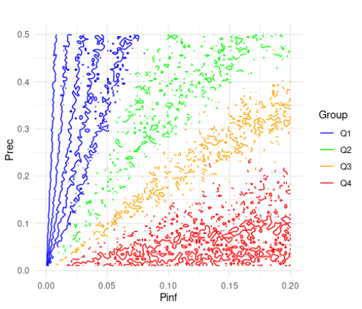
4 regions identified
Final size increases
Time to peak comparable but heterogeneity
Parameters explored
Pinf = c(0.01 : 0.2)
Prec = c(0.01 : 0.5)
Notes:
Simulations were run on aweekly time step for 50 weeks. We conducted a simple sensitivity analysis using contour plots to identify groups of parametercombinations that behave similarly regarding the final size of the epidemic. We applied quartiles to facilitate the comparisonbetween the parameter groups.

Slide 14
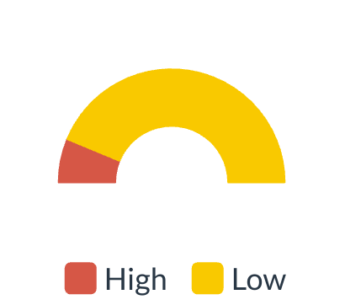
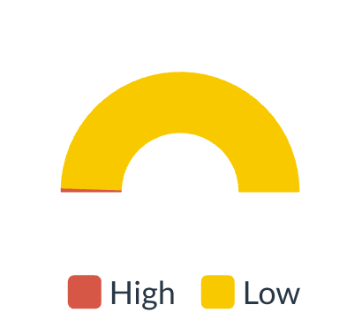
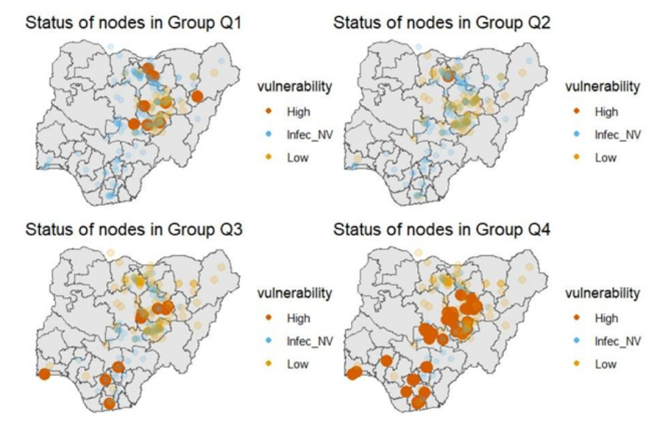
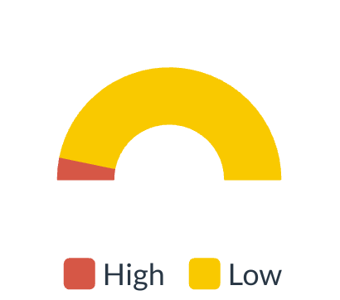
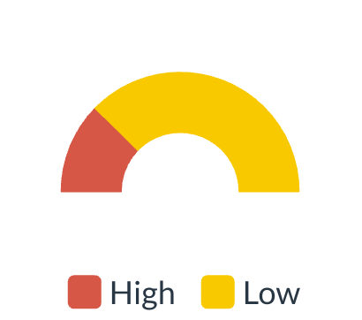
Sentinel Nodes Identification
Number of Sentinel Nodes vary from region to region, not linearly
Transition from local to global outbreak
For Q1 few nodes and mostly in the 3 Lidiski States
Q2 depends on seeder
For Q3 and Q4: similar nodes, wide geographical distribution
14 Locations candidates to be sentinel nodes

Slide 15
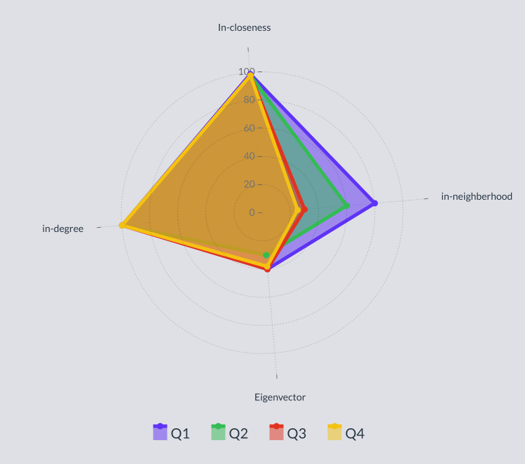
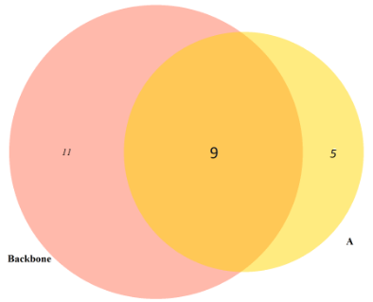
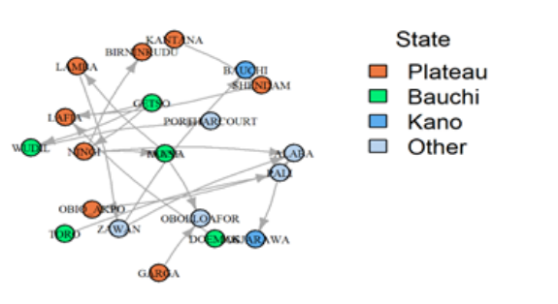
Sentinel Nodes Characteristics
14 candidate sentinel nodes
Regression Forest methods important characteristics: in-degree, in-closeness, in-neighborhood, eigenvector
Invariant among the regions
Depends only on network characteristics
Backbone Extraction:
20 locations
9 Backbone nodes are also candidates sentinel
Sentinel

Slide 16



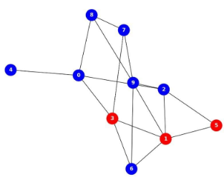
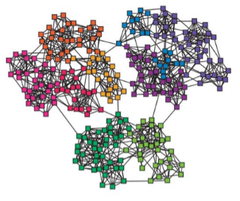

Are Sentinel Nodes Useful for control
Testing 3 control scenarios
Vaccinating sentinel Nodes
Vaccinating Backbone Nodes
Eliminating links among contagion clusters (Bridges)
Sentinel Nodes
Backbone
Bridge
X
X
X
X
X

Slide 17
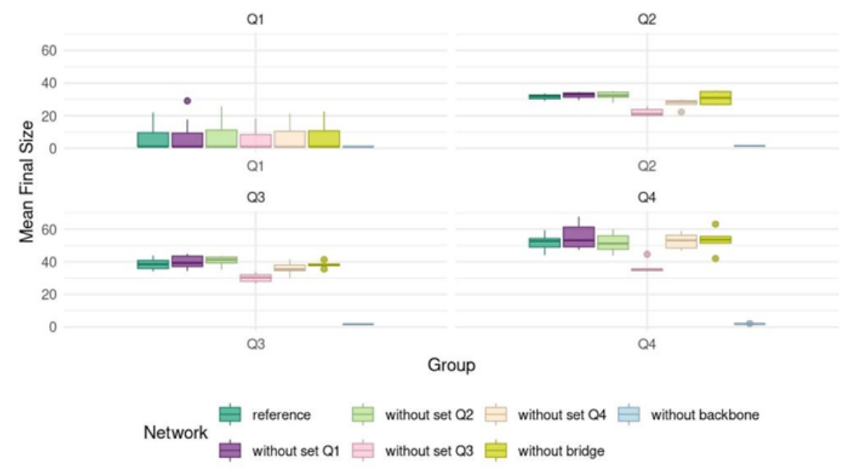
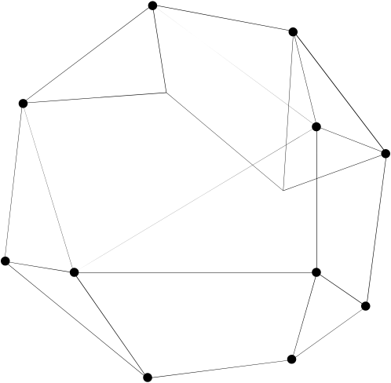
Results
Eliminating the backbone affects the final size of the epidemic.

Slide 18

Reliability: how relaible are our results?

Slide 19
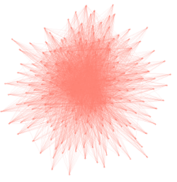
Reliability: how strong are our results?
Reconstructed
Original
Backbone
Vulnerability depends on structural characteristics
Data limited
What is the impact of adding links?
How many?
And Which?
Expanding
Reducing
Generate Networks
Extracting backbone and Sentinel Nodes
14 Sentinel Nodes,
9 on backbone
Vaccinating/control backbone-> largest impact
Add missing links
Effect of final size
Characteristic of Sentinel Nodes
Identity
Ad-hoc survey
Logistic limits
Limits in markets (no snowball)
Limits in sampling (not exhaustive)

Slide 20
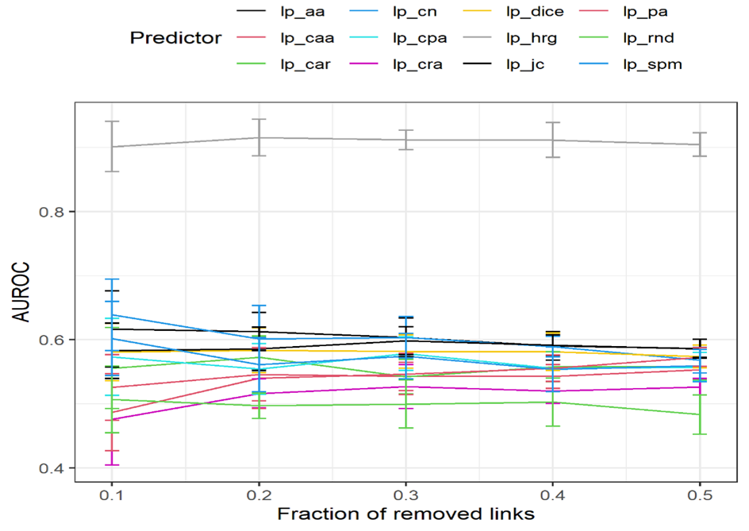
Prediction of missing links and their weights using a Hierarchical Random Graph (HRG) (AUC 0.9): Distance, human & animal population, rainfall, accessibility at Origin/Destination used as covariates;
Gradual addition of predicted links based on existence probability:
Bottom up: starting with less probable
Top Down: starting with most likely
PPR simulation on all generated networks
Village Or | Village Dest | Probability
A | B | 0.9
B | C | 0.4
C | D | 0.2
D | E | 0.1
E | A | 0.01
Notes:
We then simulated the propagation of the PPR on both the reference network and the predicted network. Using a simple weighted stochastic model SI. Nodes frequently reached before the epidemic peak were identified (as sentinel nodes). Next, we estimate basic centrality measures that are important in epidemiology, such as indegree, oudgree, etc. These measures are used to classify and characterize our sentinel nodes by applying Random Forest classification. We used these measures to classify and characterize our sentinel nodes by applying Random Forest classification.

Slide 21
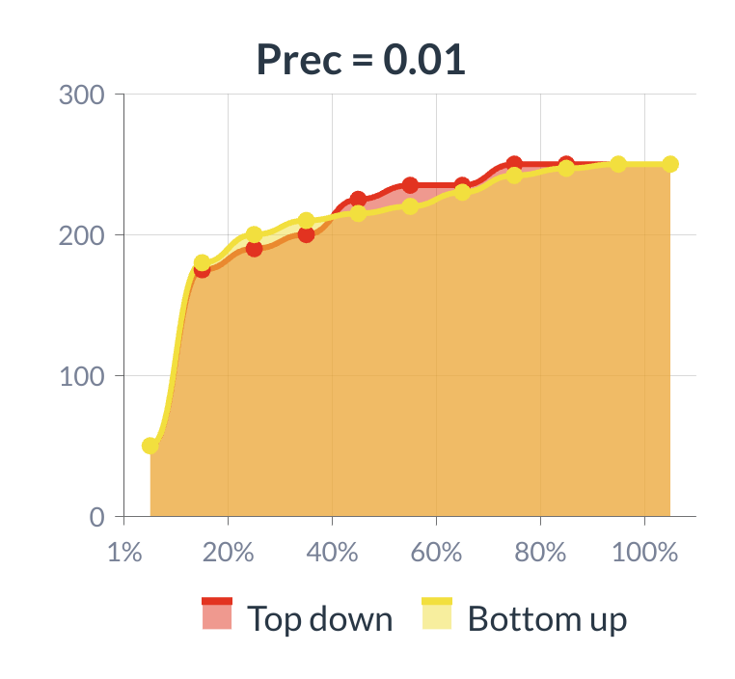
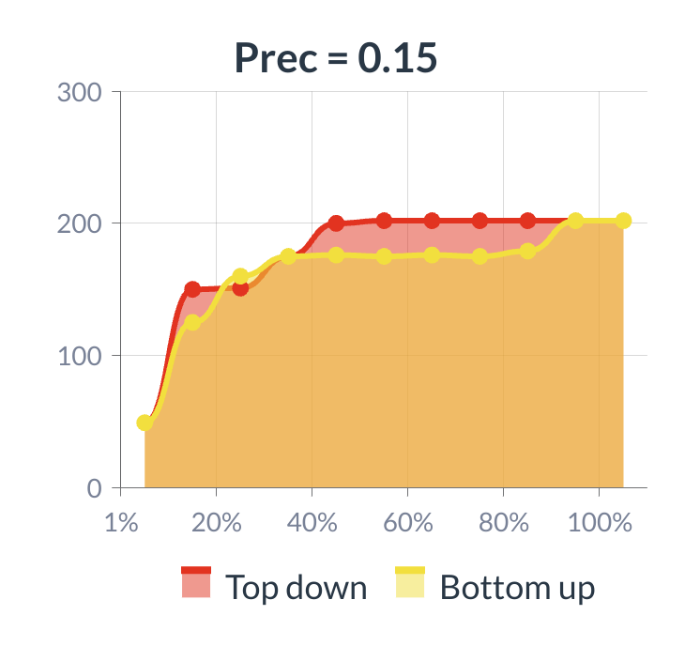
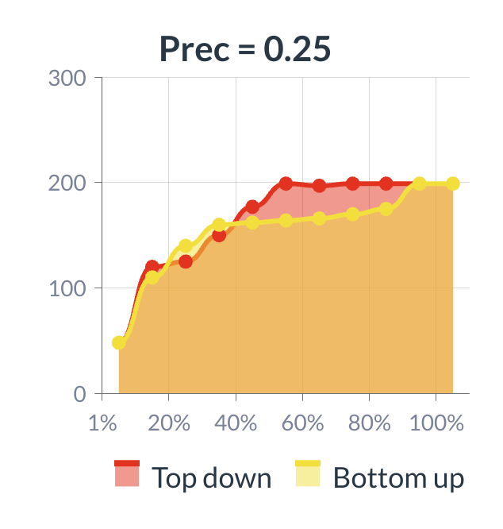
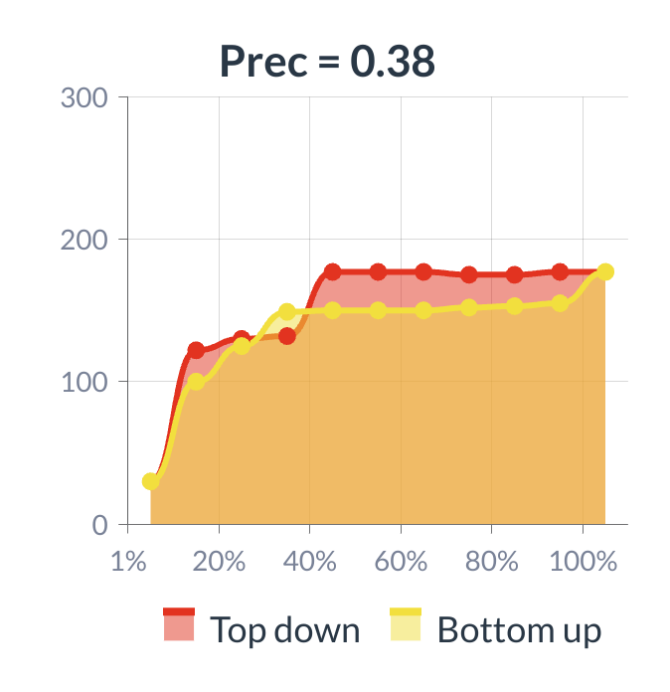

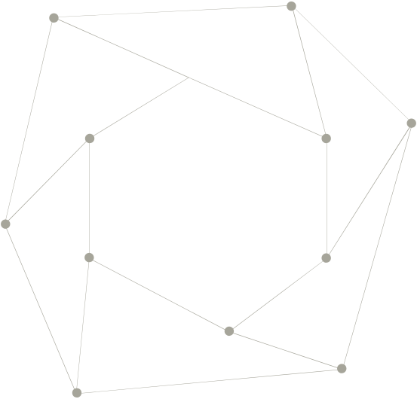
Effect of missing links
The final size always increases with new links
Not all the link has the same impact
Top Down : Final size stabilizes around 50% Bottom up : Final size stabilizes around 90%
Top Down: links that establish a well-organised hierarchical connection between nodes (a hierarchical structure).
Do these links exist-> Collecting Information

Slide 22
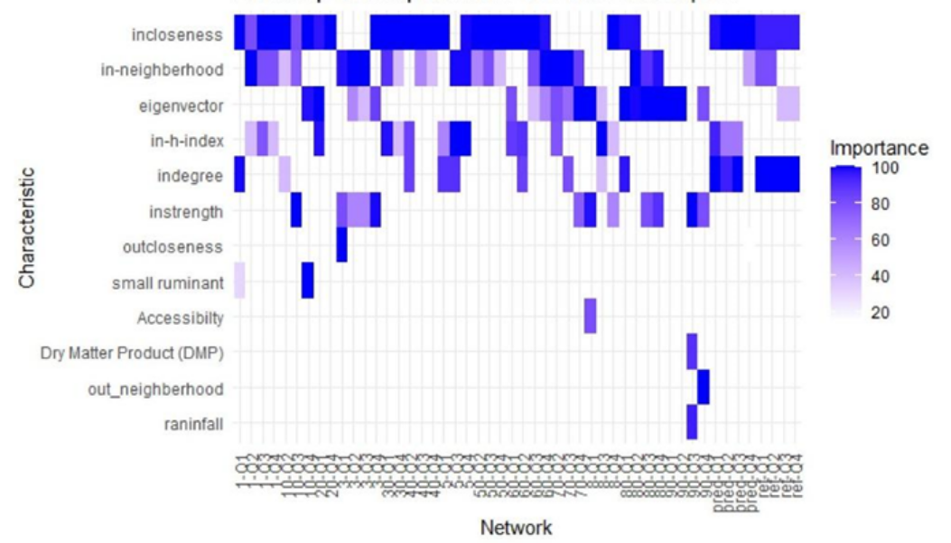

Characteristics of sentinel nodes
Number and identity of sentinel nodes change among configurations but
The most accessible nodes with diverse sources of incoming traffic are the most vulnerable.
12 Nodes common to all the configurations

Slide 23
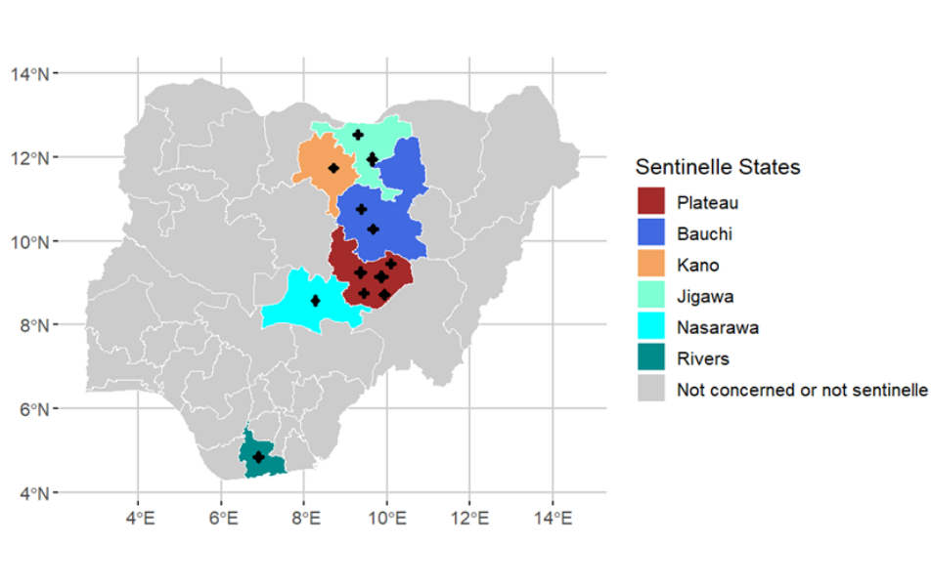
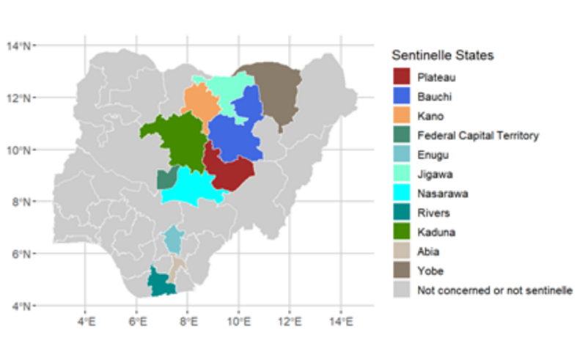
Conclusions
Characteristic of sentinel nodes appear to be related to just network structure
14 locations have been identified as possible sentinel nodes able to detect local and global epidemics
Among these 9 are on the backbone
Vaccinating Backbone nodes -> largest impact
Adding Missing link-> Impact on final size
Top Down:Adding 50% most probable stabilises final size
Needs to check if these links exist or not -> Focus next data collection and use of other data sources
12 locations are sentinel and reliable after the adding of links (6 are markets surveyed)
Yobe State at the frontier: several sentinel nodes
Reliable locations
Other Sentinel Nodes

Slide 24

Thank you for your attention

Slide 25



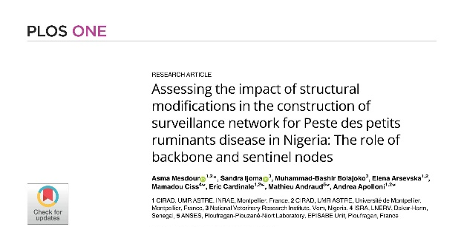
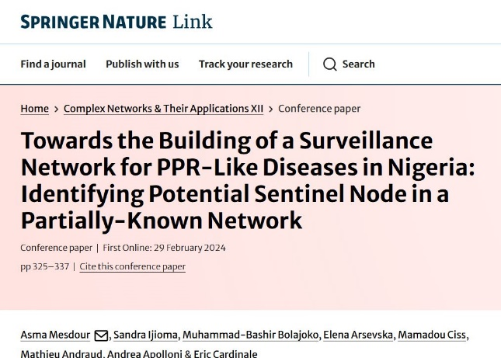
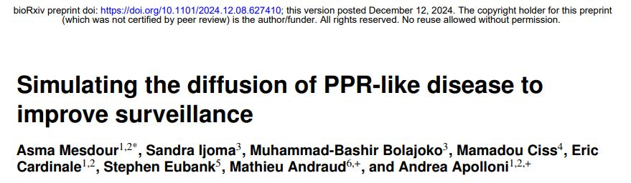


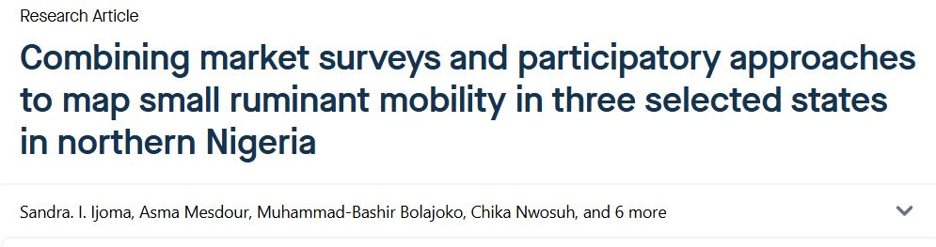
Data:
Network and sampling procedure

Slide 26
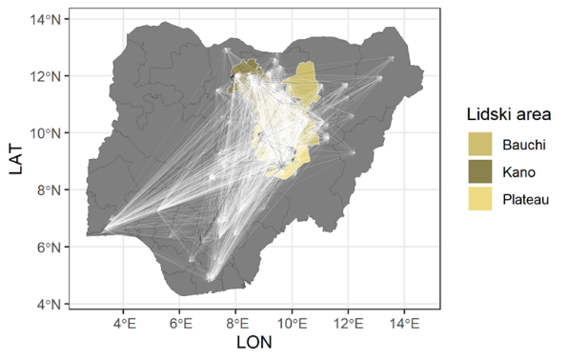

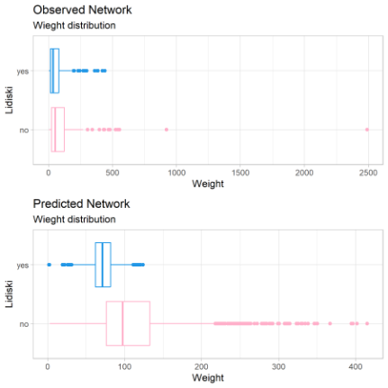
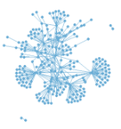

Résultats : Prédiction de liens
Model predicts more than 4000 links
 | Observed | Predicted
Liens | 355 | 4670
Or/Dest Lidiski | 171 | 1605
Or Lidiski / Dest Other | 136 | 876
Or Other / Dest Lidiski | 9 | 1245

Slide 27



Transmitted through close contact
Seasonal character: Demography ; Mobility
Vaccine exists but Logistical Constraints
Super-Acute | Acute | Sub-acute | Sub-clinical
Incubation 3 days Infection 5-6 days | Incubation 5-6 days Infection 5-10 days | Incubation 5 days Infection 1-2 days | Duration 10-15 days
Mostly Goats 4-12 Months old | All species | All species | Sahelian Sheep
High Fever Mucosa Congestion Ocular discharge | High fever Congestion Bloody diarrhea Oral lesions Possible abortions | Fever (39°-40°) Other symptoms unnoticed | No clinical symptom, detected by serological analysis Open doors to other infection
~90% Mortality | ~70-80% Mortality | ~No mortality | No mortality

