Slide 1
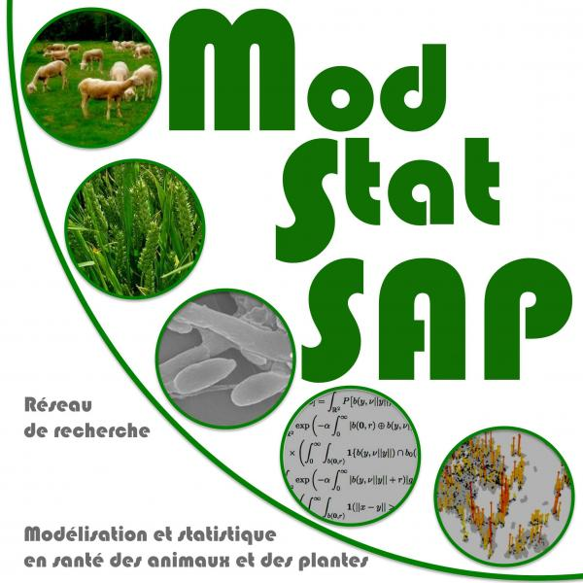

Leveraging surveillance data for inferring the spread of diseases and pests Samuel Soubeyrand, INRAE, BioSP
Paris, Oct. 21-22, 2025

Slide 2
Health surveillance data
Primary use
Inform sanitary status of territories (including early detection, delimitation, prevalence estimation…)
Issue alerts
Trigger control actions
Alternative use
Serve as inputs for modeling spatiotemporal dynamics of diseases and pests
Important to account for surveillance data characteristics during inference for avoiding perception bias
Notes:
Conçu comme un cours d’introduction

Slide 3

Health surveillance data
Primary use
Surveillance data
Sanitary situation
Risk level
Control measures
Alternative use
Enhanced assessment of sanitary situation and risk level, and implementation for control measures
Disease / pest spread model
Leveraging surveillance data for modeling and inferring disease and pest spatiotemporal dynamics,
and producing knowledge
Environmental data
Notes:
Conçu comme un cours d’introduction

Slide 4

Various types of surveillance data
Standard methods for monitoring the health of plants:
Human vision (direct observation)
Molecular diagnostic tests (targeted or general; PCR, Illumina, Nanopore, PacBio, etc.)
Serological diagnostic tests
Insect traps and air sensors
More innovative methods:
Images from smartphones, drones, and satellites
Sound sensors
Entomological radars
Monitoring international databases (iNaturalist, GBIF, NCBI, GenBank)
Monitoring media and social networks
Surveillance of volatile substances associated with pest insects (e.g., pheromones)
Diagnosis using dogs’ sense of smell
Monitoring specific strains, variants, or genetic/functional groups
Anomaly detection
…

Slide 5
Various types of surveillance matrices
Possible matrices to monitor
The plant: agricultural or forest plot of interest
The plant: reservoir populations
Sentinel plants
Insect vectors
Generalist macro-organisms (e.g., carnivorous ants, ground beetles), as well as pollinators and spider webs
Generic environments: air, water, soil
Social media, grey literature, scientific literature, official communications (health monitoring)
Social networks (for anomaly detection)
Matrices used for environmental, biodiversity, and animal/human health monitoring -> One Health
…

Slide 6
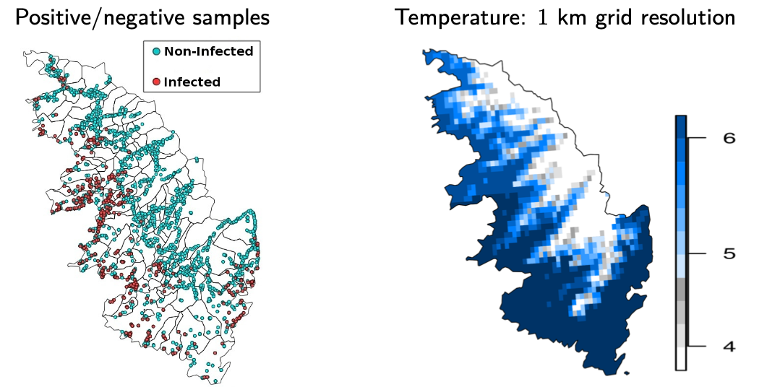
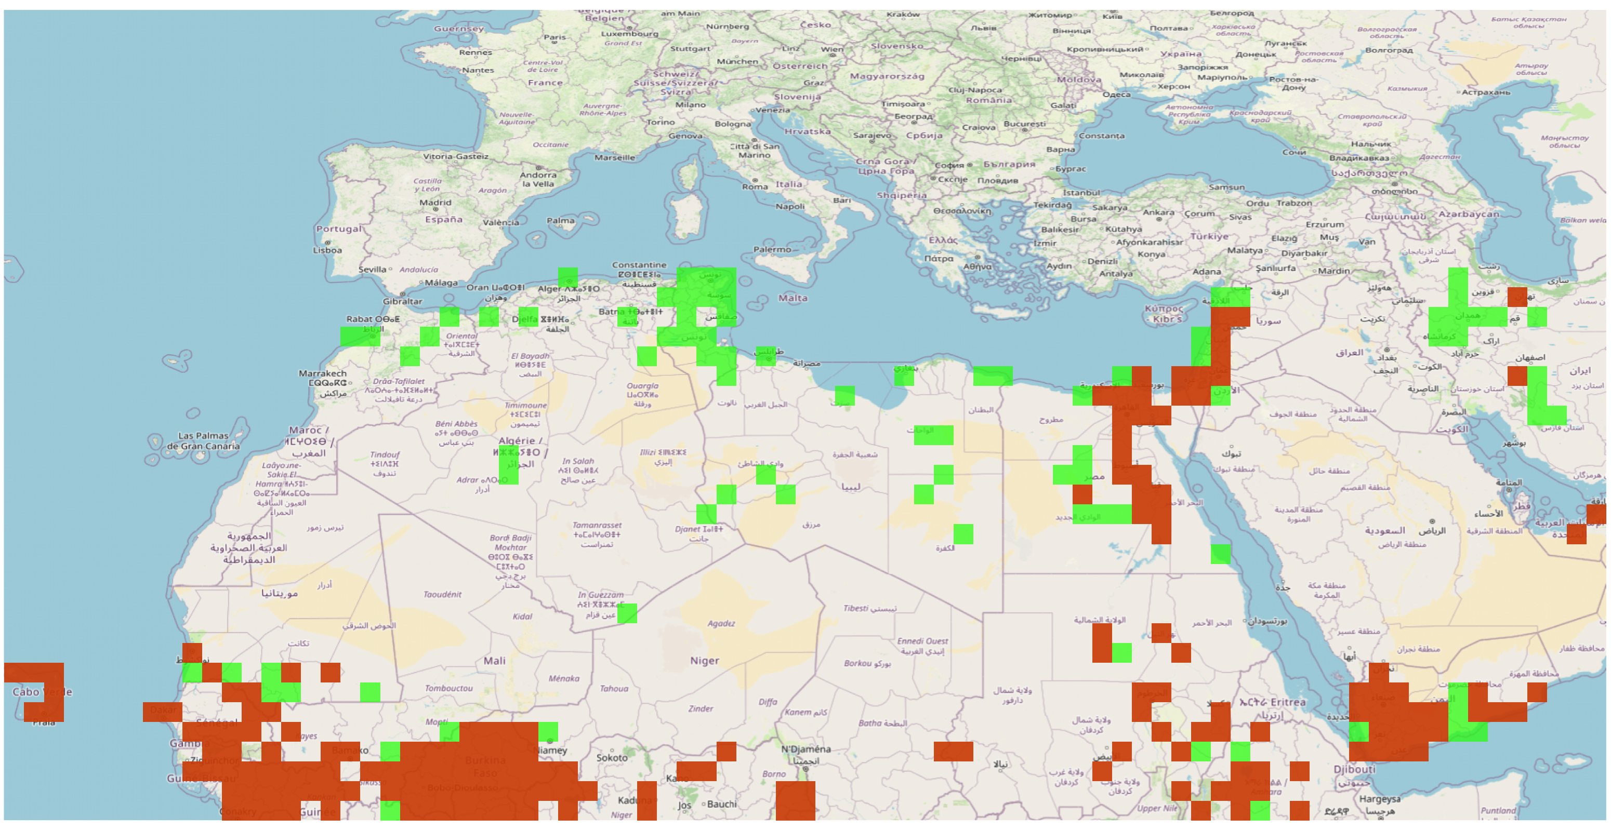
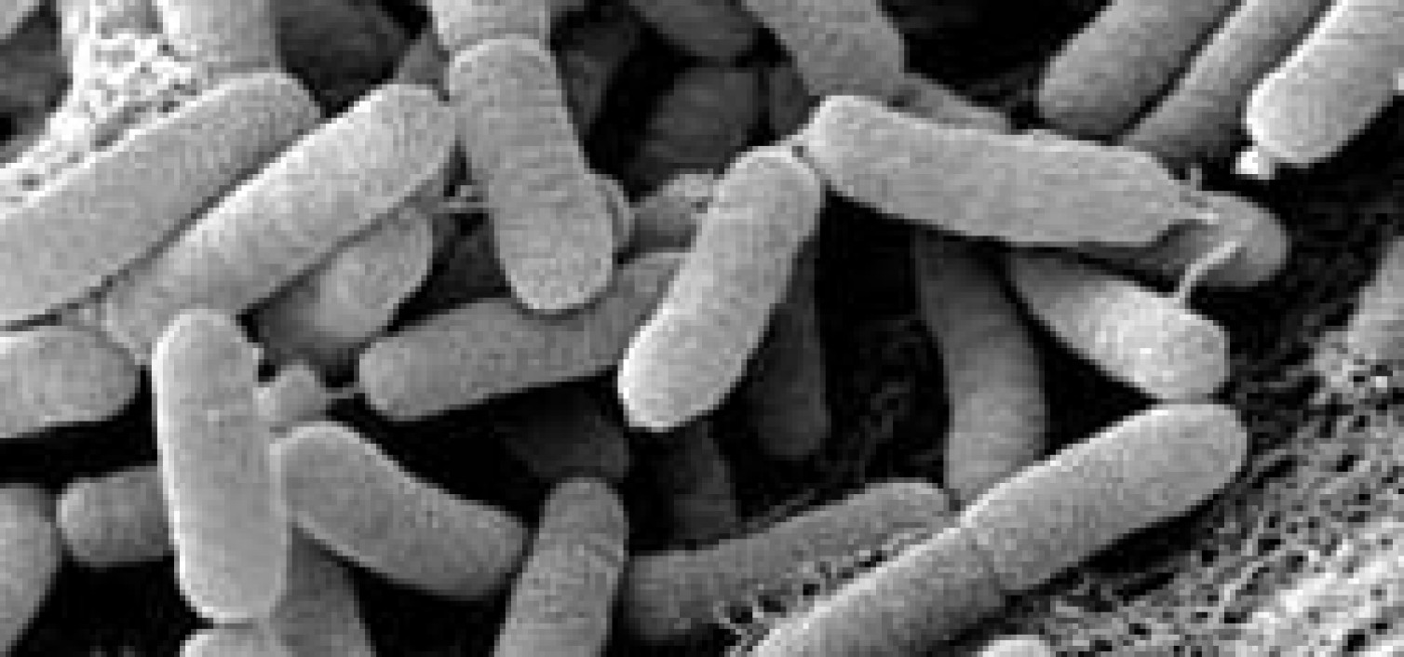
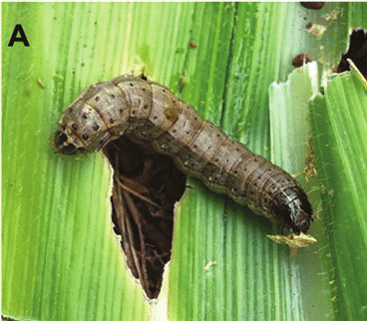
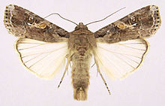
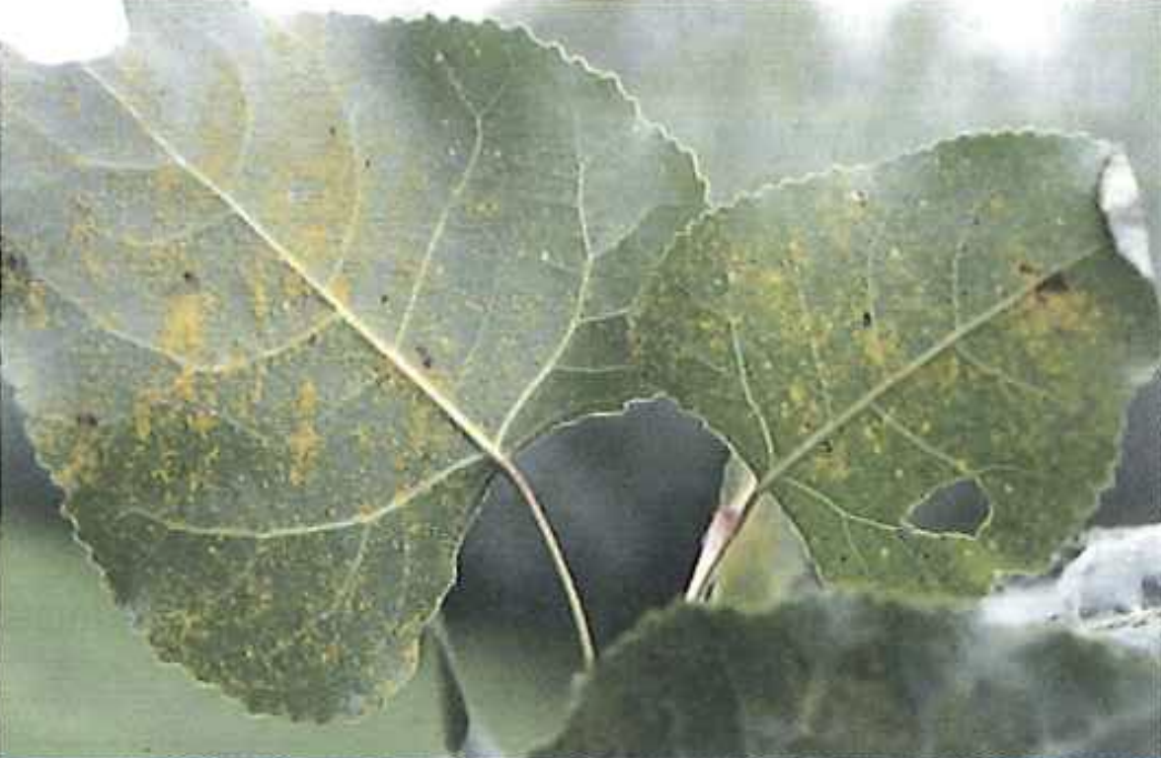

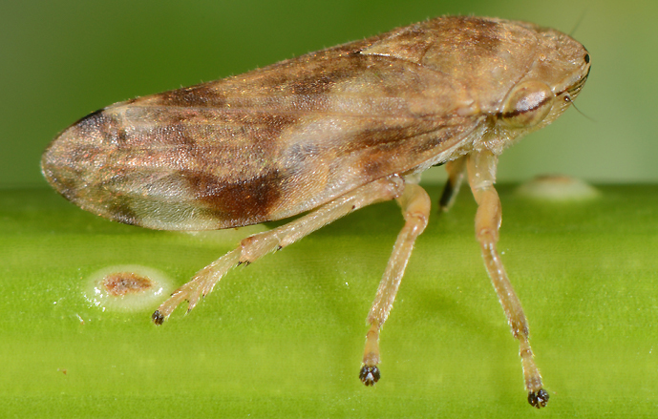
Three illustrative case studies
Topic of this talk: inferring the spread of such diseases and pests
Poplar rust
Xylella fastidiosa
Fall armyworm

Slide 7
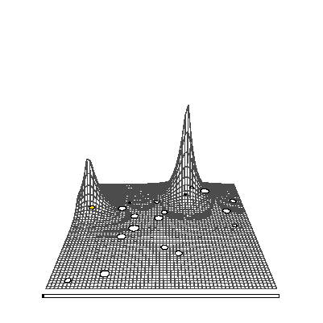
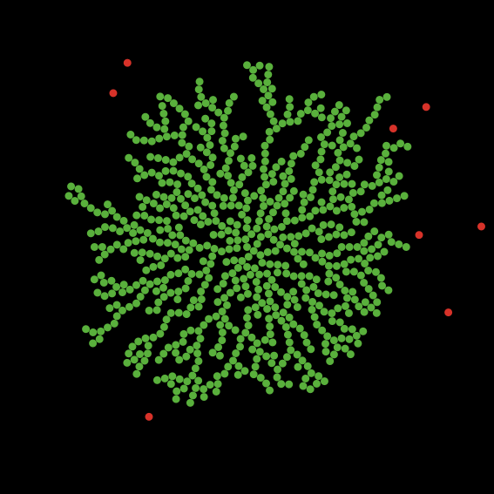
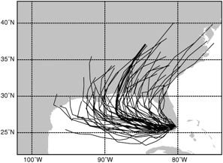
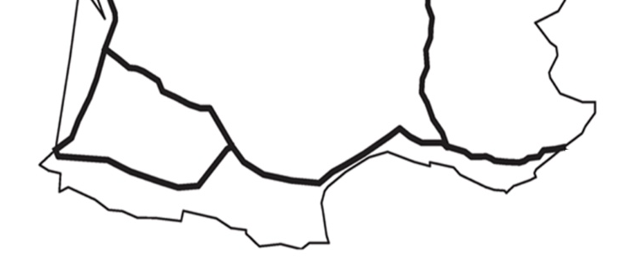
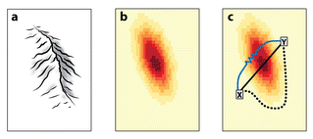
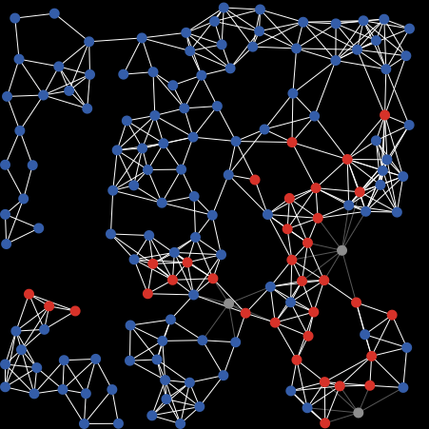
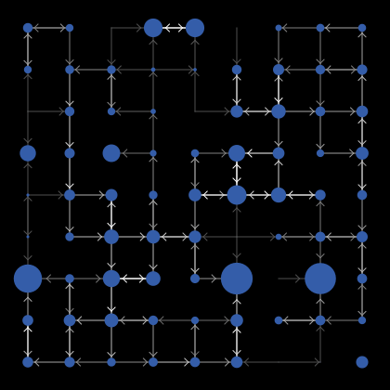
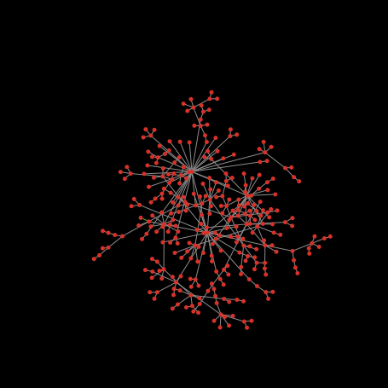
Various ways to represent or model dispersal
Dispersal kernels
Diffusion models
Trajectories
Contact networks
Weighted lines, Least-cost paths,
Resistance distances
Notes:
connectivity-soubeyrand-OSSP-2022.pdf
Plenty of ways to model dispersal. In the following we will focus on the coupling of atmospheric dispersal and contact networks.

Slide 8
Challenges related to methodology and application
When dispersal is non-stationary
When observations and model outputs differ
When long-distance dispersal is significant
When distinct data types must be fused
Spread modeling and Statistical inference
When the model is uncertain
When significant processes are hidden
When data do not cover the pest introduction
When the epidemic initiation is unknown
Notes:
Conçu comme un cours d’introduction

Slide 9
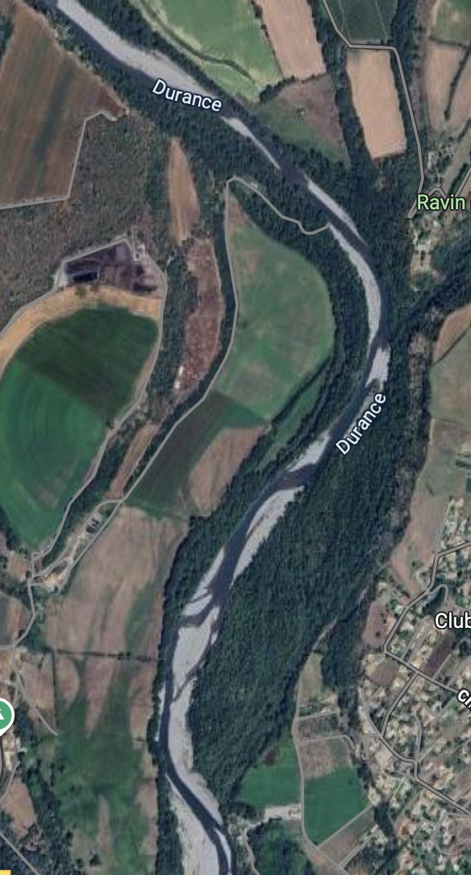
Poplar rust, a fungal plant disease
Symptoms
Vector
An annual epidemic wave along the Durance river valley forming a corridor
Host distribution
Notes:
Conçu comme un cours d’introduction

Slide 10
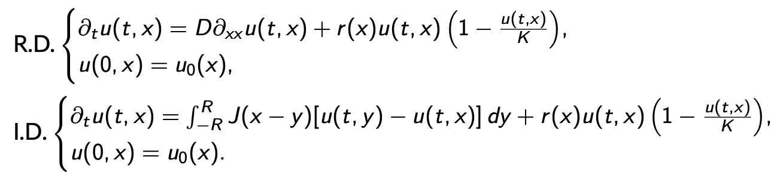
Mechanistic-statistical approach
Dispersal kernel J:
- Gaussian
- Exponential
- Fat-tailed Exponential-power
Class of deterministic, mechanistic invasion models
Conditional stochastic model to handle micro-scale fluctuations
Prevalence
Saubin et al. (2024)
Corridor
Notes:
Conçu comme un cours d’introduction

Slide 11
Mechanistic-statistical approach
Class of deterministic, mechanistic invasion models
Mechanistic process
Conditional stochastic model to handle micro-scale fluctuations
Leaf-scale data:
Hidden habitat suitability:
Conditional model for the two-type observation process
𝜃
u(t,x_{i})
Tree-resolution data
Negative-binomial distribution
= Gamma-Poisson
Obs. process
𝜎
Twig-resolution data
Gamma-binomial distribution
Notes:
Conçu comme un cours d’introduction

Slide 12
Efficiency of model selection
Simulation study
Maximum likelihood estimation
AIC-based model selection
Fat-tailed Exponential-power
Exponential

Slide 13
Poplar rust case study: model selection and invasion front
Selection of the fat-tailed kernel
Frequent long-distance dispersal events
Accelerated invasion front
Notes:
Conçu comme un cours d’introduction

Slide 14
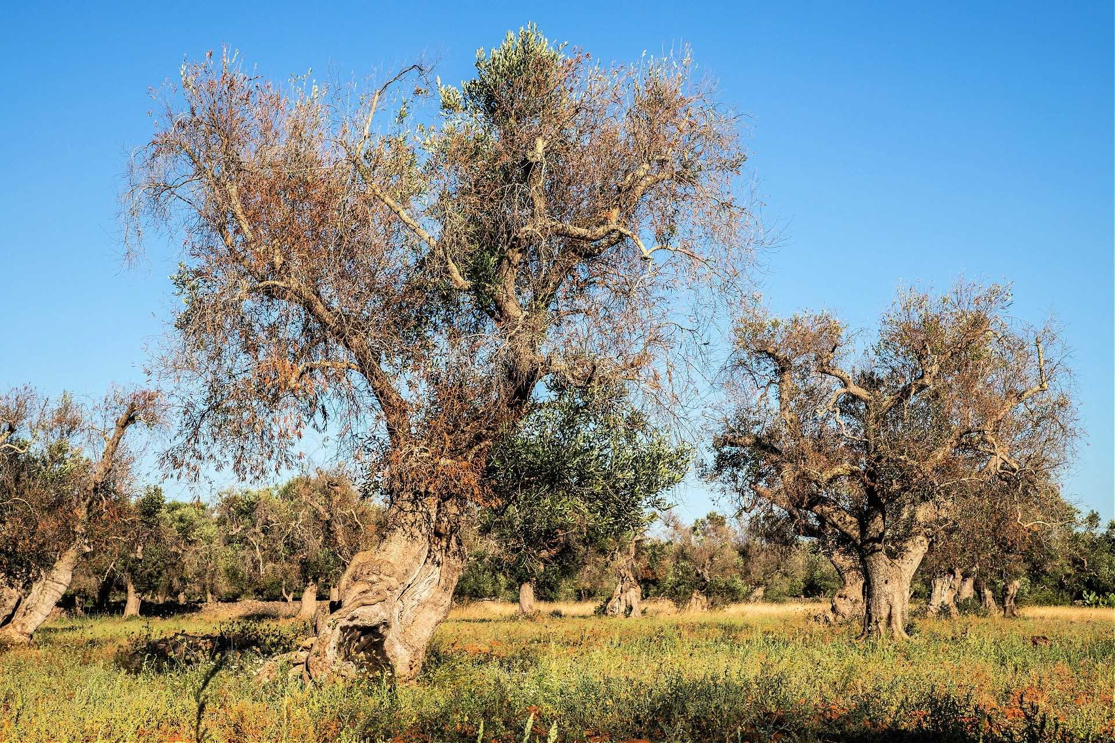
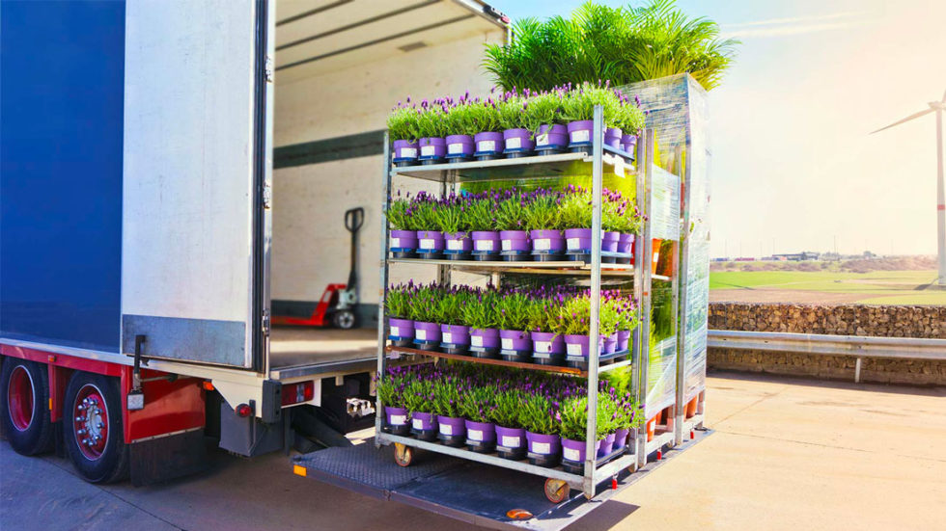
Xylella fastidiosa, a bacterial plant pathogen
Pathogen
Vector
Impact
First detected in-field in Europe in 2013
First detected in Corsica in 2015
Notes:
Conçu comme un cours d’introduction

Slide 15
Surveillance of Xylella fastidiosa (Xf) in South Corsica and question about its emergence
Initial question: Where and when Xylella emerged in South Corsica?
From a population-dynamics perspective:
The answer depends on how fast the pathogen spreads and what are the spatial limits of the spread
Abboud et al. (2019, 2023)
Data from August 2015 to May 2017

Slide 16
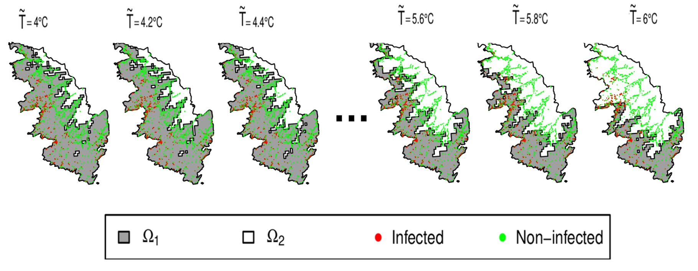
Mechanistic-statistical approach
A process model with three main components
A single significant introduction in space-time => when and where?
A diffusive spread of the pathogen => what speed?
A winter-temperature threshold hampering the diffusion => what threshold?

Slide 17
Mechanistic-statistical approach
A simple data model:
An adaptive multiple importance sampling algorithm for parameter estimation

Slide 18
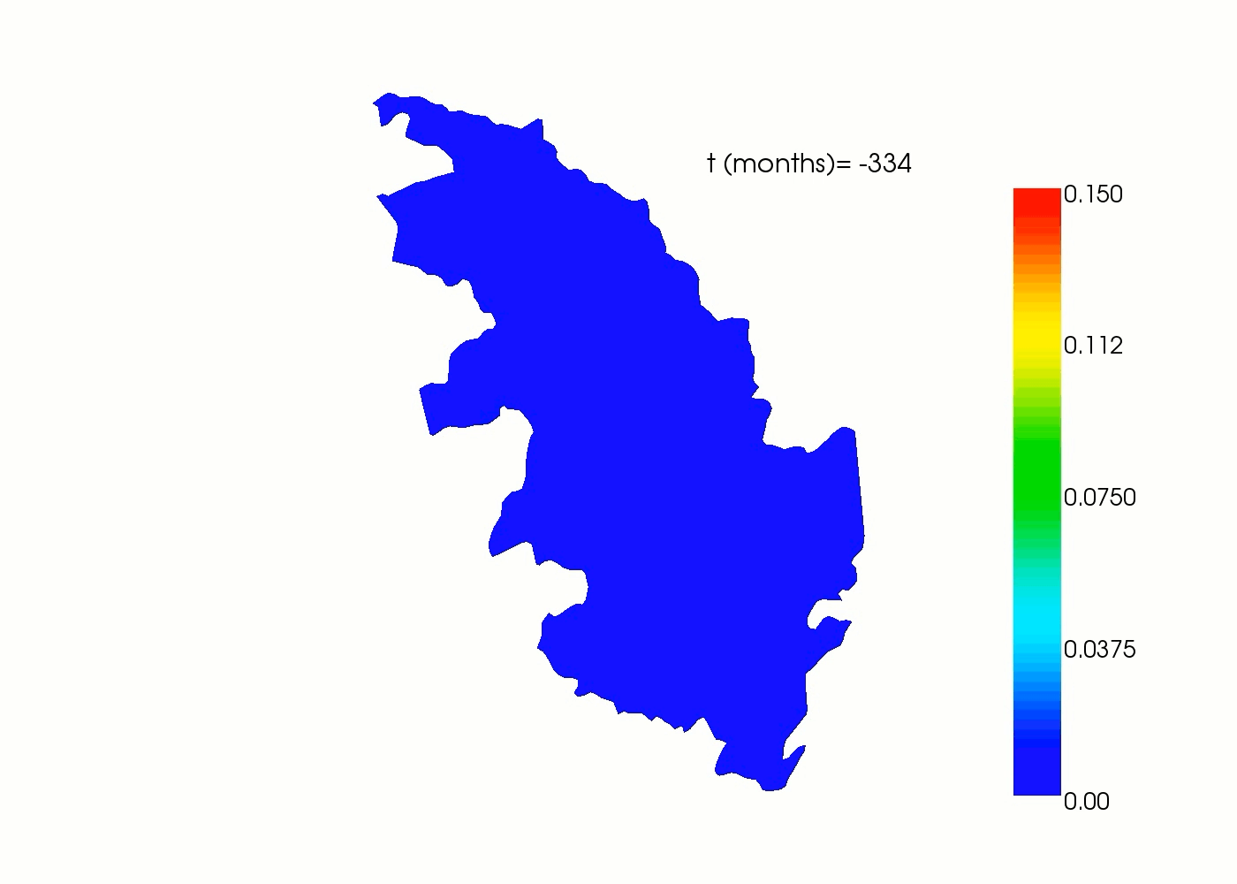
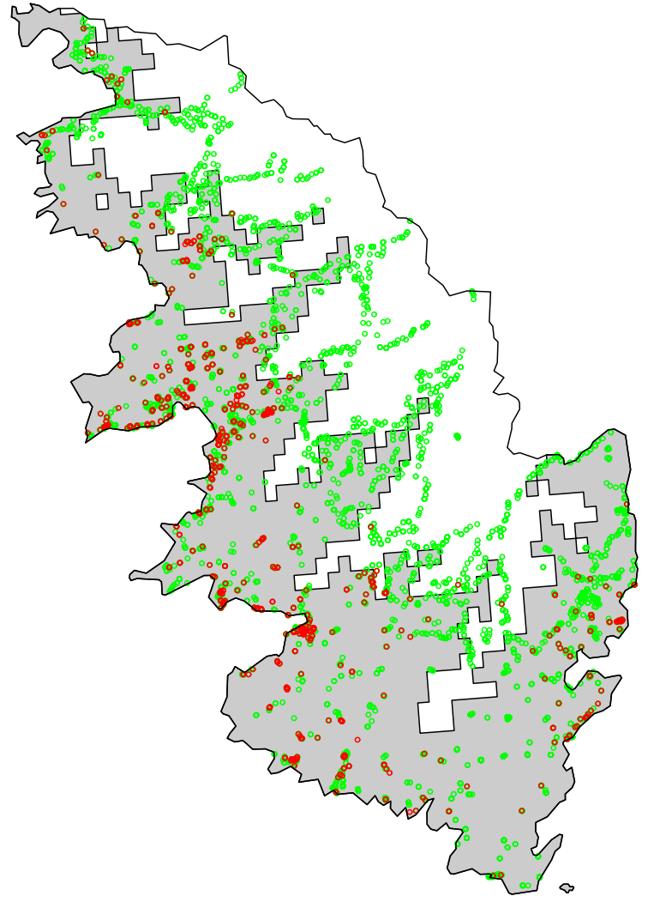
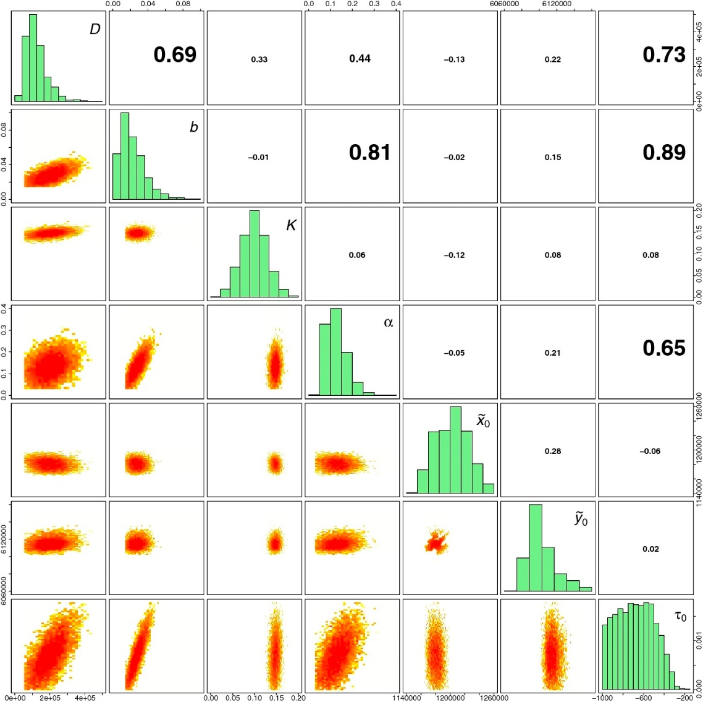
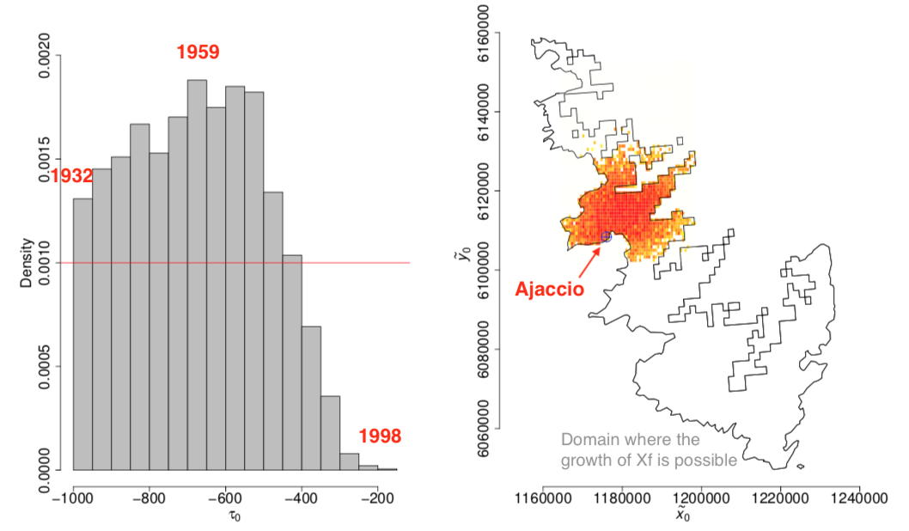
Threshold selection and Bayesian inference
Selected threshold winter
temperature: 5.4°C
(from 5.0 to 5.6°C depending on
the selection criterion)
Estimated length of a straight line move of the pathogen : 155m/month (standard deviation: 27)
=> Almost 2km/year

Slide 19
What if the model is uncertain?
Model selection versus (Bayesian) model averaging (or model ensemble)
Competing models
Homogeneous vs heterogeneous growth
Homogeneous vs heterogeneous diffusion
Various temperature thresholds

Slide 20
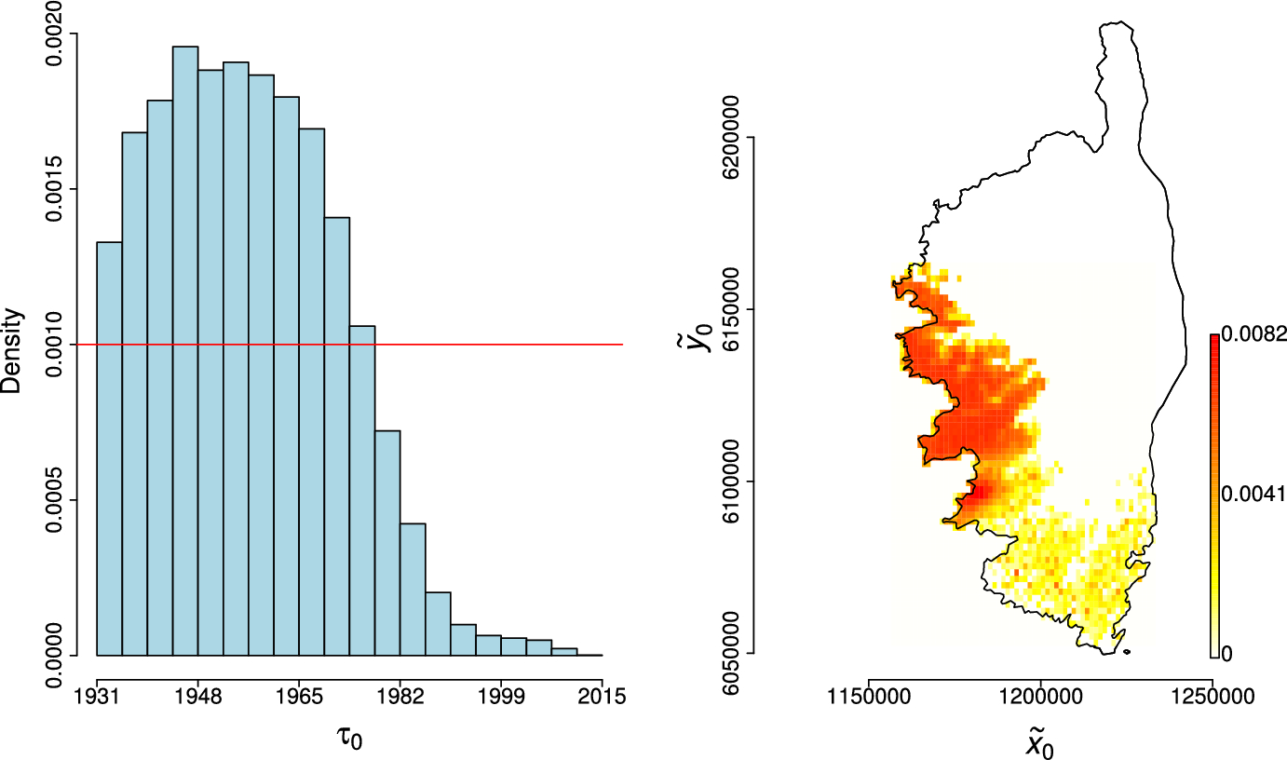
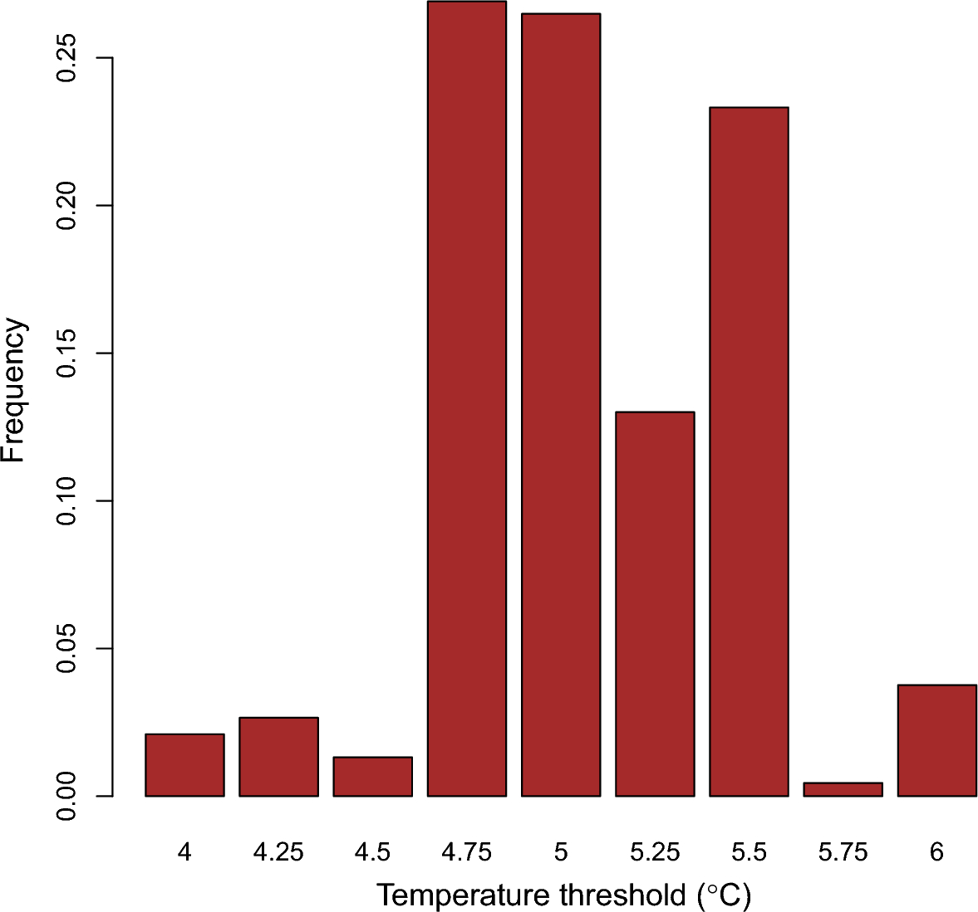
Results obtained with model averaging
Posterior distributions

Slide 21
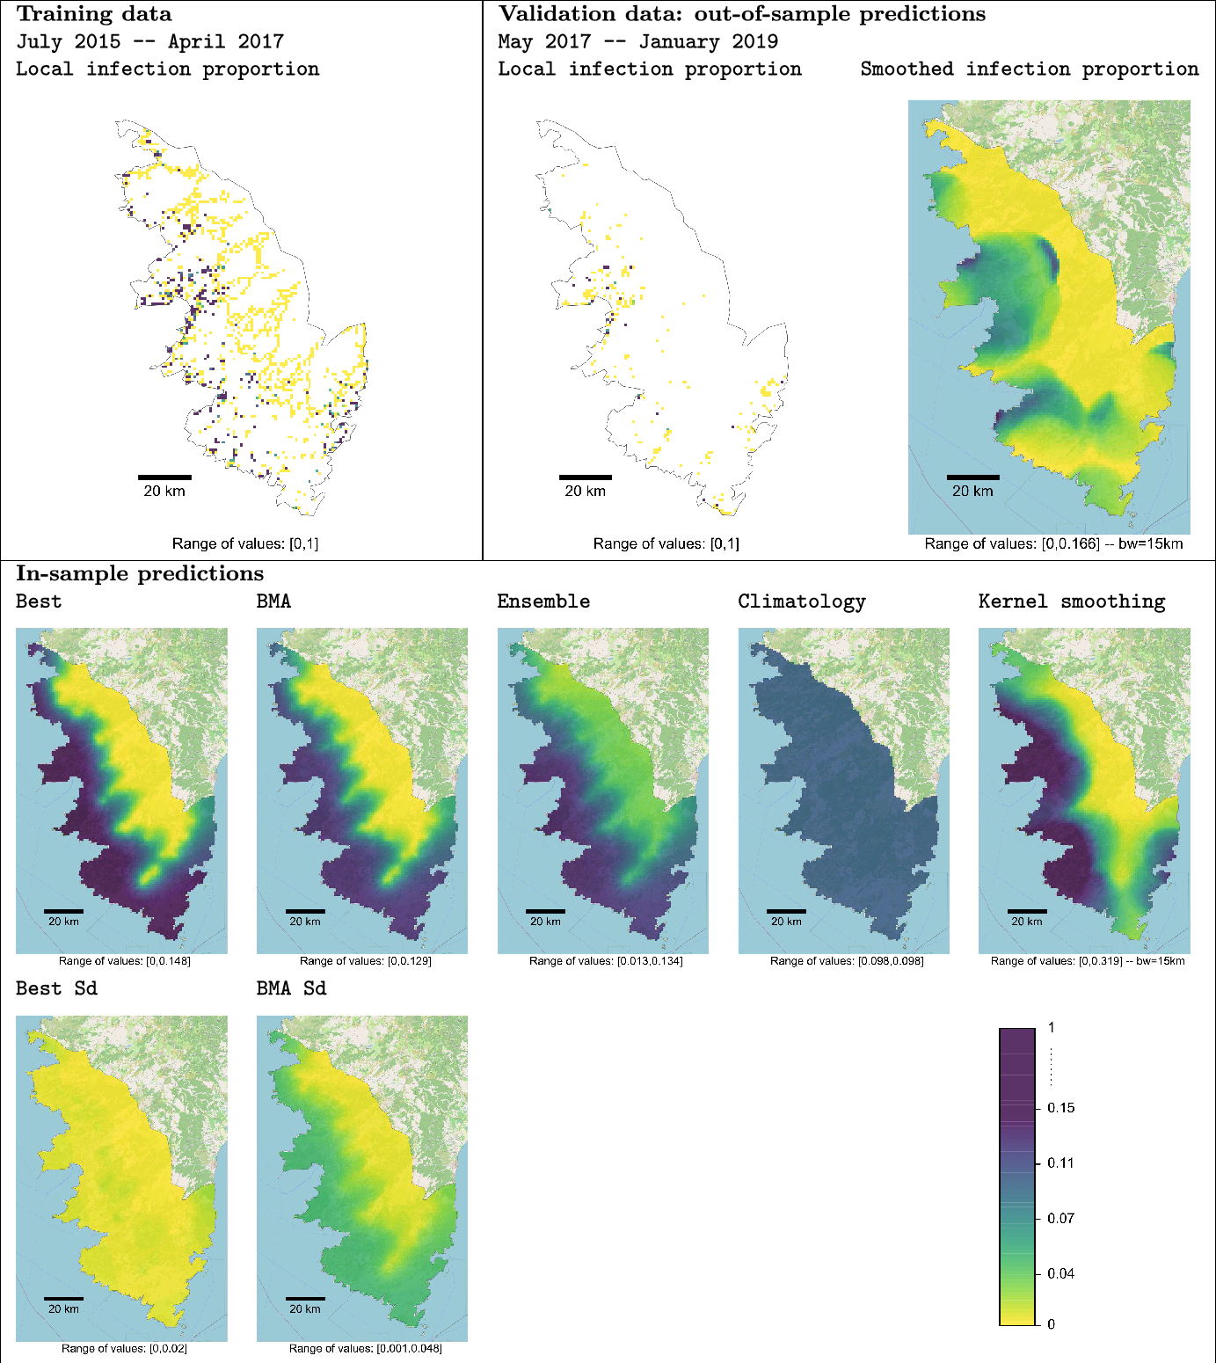
Results obtained with model averaging
Prediction performance

Slide 22
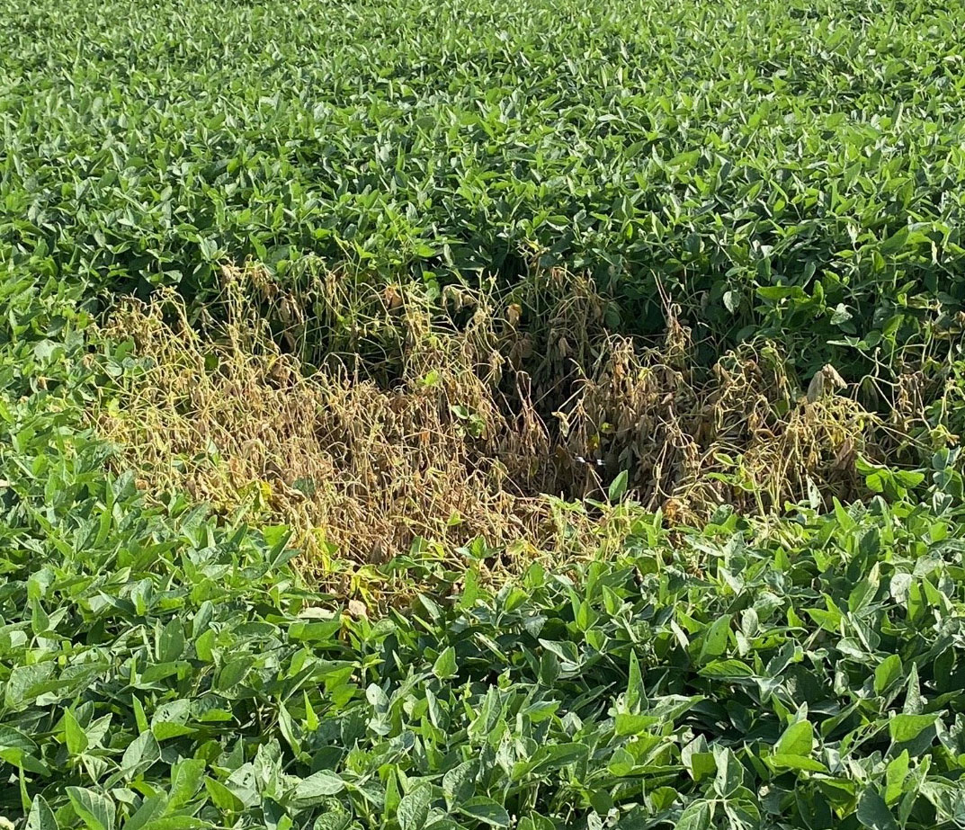
Spodoptera frugiperda, an insect pest of plants
Pest
Vector
Impact
A migratory pest invading recently Asia and Africa, and detected in south-eastern Europe since 2023
Notes:
Conçu comme un cours d’introduction

Slide 23
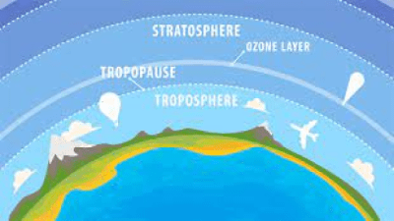
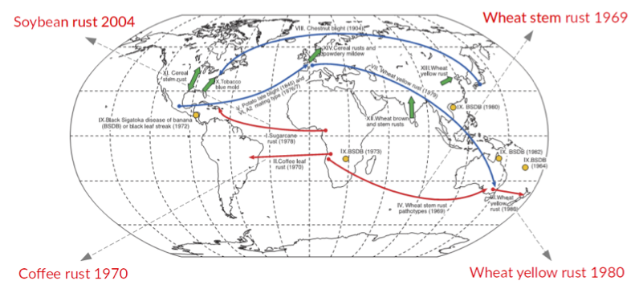
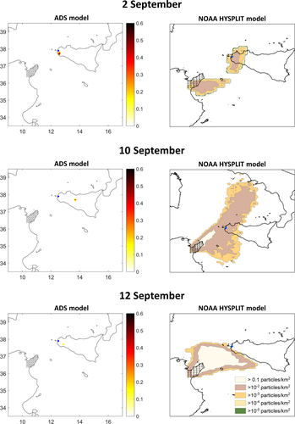
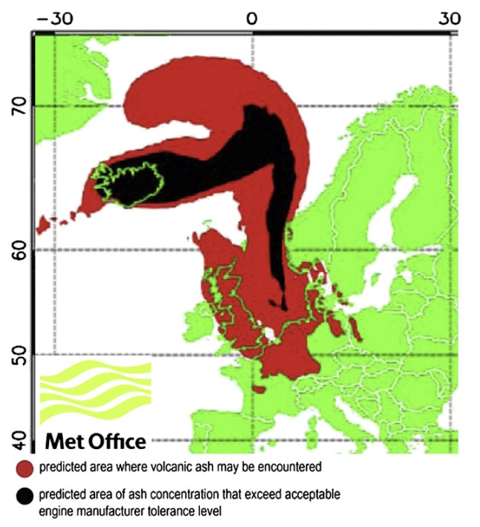
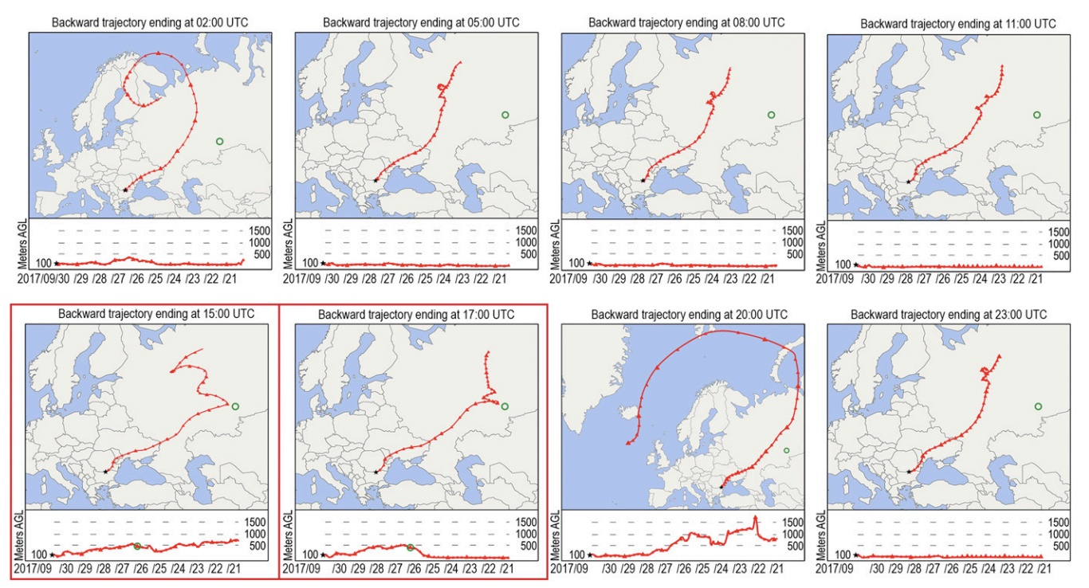
What’s going on in the troposphere?
Plenty of particles and small organisms circulate in the troposphere
Notes:
Brown & Hovmoller (2002); Weber et al. (2012); Masson et al. (2019); Aguilar-Vega et al. (2019)
OK, let’s now consider the example of tropospheric contact networks.
What is the troposphere ?
The troposphere is the lower layer of the atmosphere, from the ground to 10 to 18 km of altitude, depending on the latitude and the season, and carries a lot of particles and small organisms we are interested in.
These pictures illustrate the transport in the atmosphere of fungal spores, midges, volcanic ashes but also radioactive elements from Russia to Europe

Slide 24
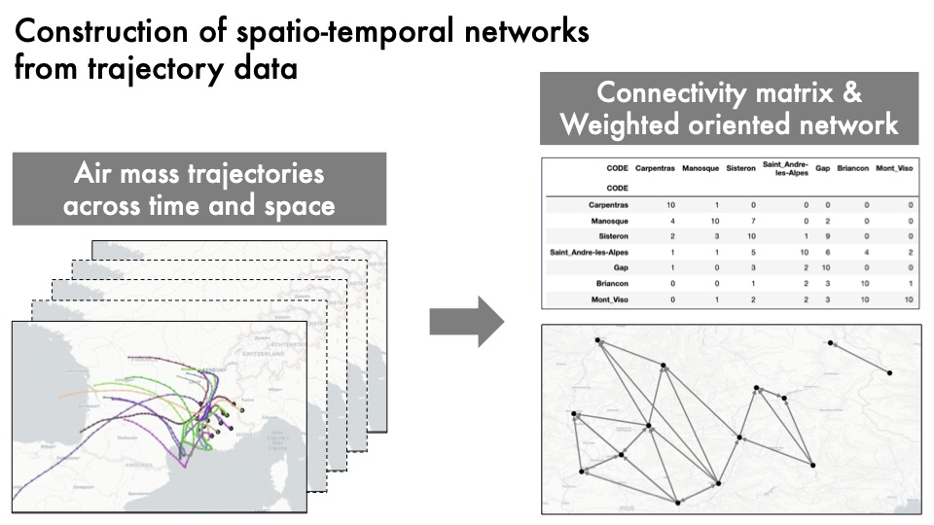
Tropospheric networks
From possible dispersal events to dispersal probabilities
Notes:
Choufany et al. (2021a, 2021b)
Thus, we have air-mass trajectories, starting from somewhere and going elsewhere.
When you compute trajectories for many dates and for many points in space, you can compute how frequently trajectories starting from point A go through point B, that is to say how frequently point A connect with B via air mass movement.
If you do that for a series of sites, you obtain a network, more precisely a tropospheric contact network.
Hence, you shift from dispersal events on the left to dispersal probabilities on the right

Slide 25
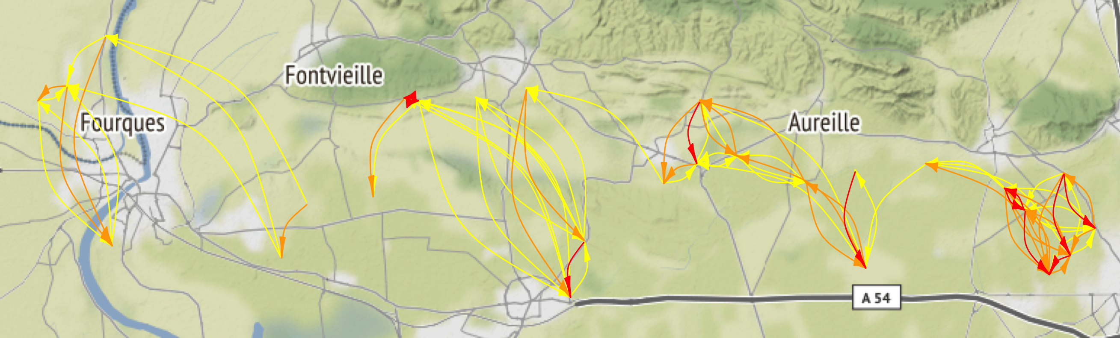
Weighted oriented contact networks
Non-stationary dispersal: When dispersal characteristics depend on the location of the source of dispersing entities
Notes:
Here you can see what a weighted oriented network looks like: the probability to go from A to B and the reverse probability to go from B to A are very specific to each pair (A,B).

Slide 26
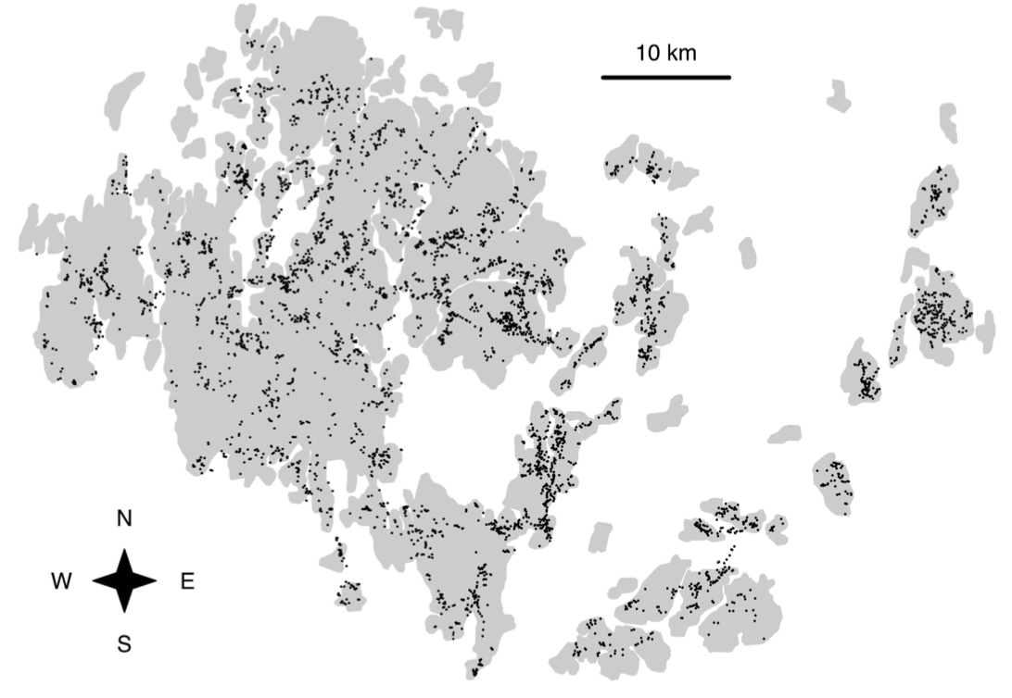
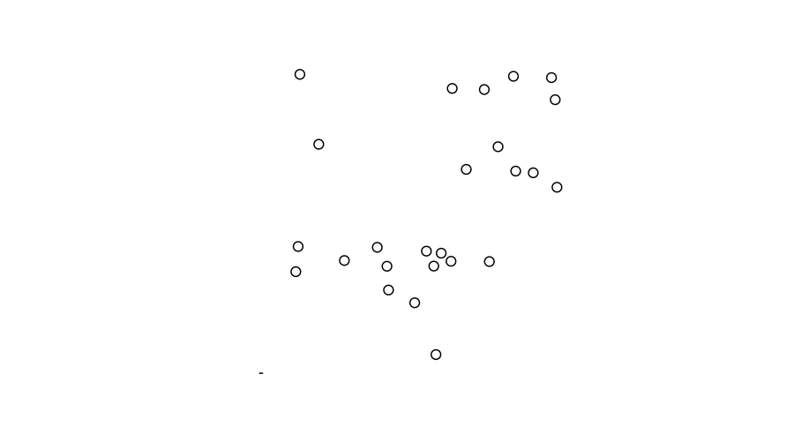
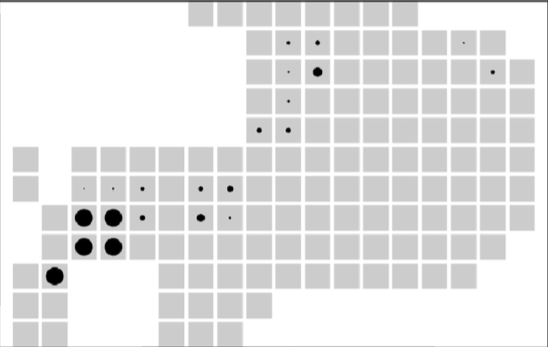
Handling non-stationary dispersal with networks
Dispersal can be represented by the probability distribution function of the “arrival location” of an organism emitted and departing from a “source location”
Location is conceptual: geographic site, grid cell, moving host…
Network formalism accommodates with such “conceptual locations” and “non-stationary dispersal” via the versatile definitions of nodes and edges
Notes:
And this probability distribution can depend on the location of the source, in which case the dispersal is non-stationary

Slide 27



: A webapp for generating tropospheric networks
https://tropolink.fr/
Richard et al. (2023)

Slide 28
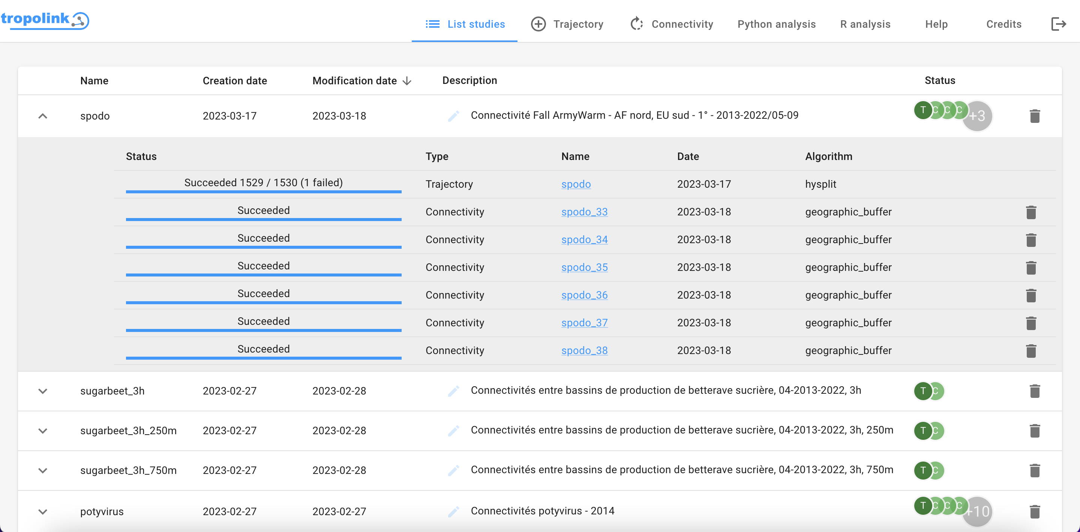
: A webapp for generating tropospheric networks
Notes:
This is how the main tab of the application looks like. I can make a demo later.

Slide 29
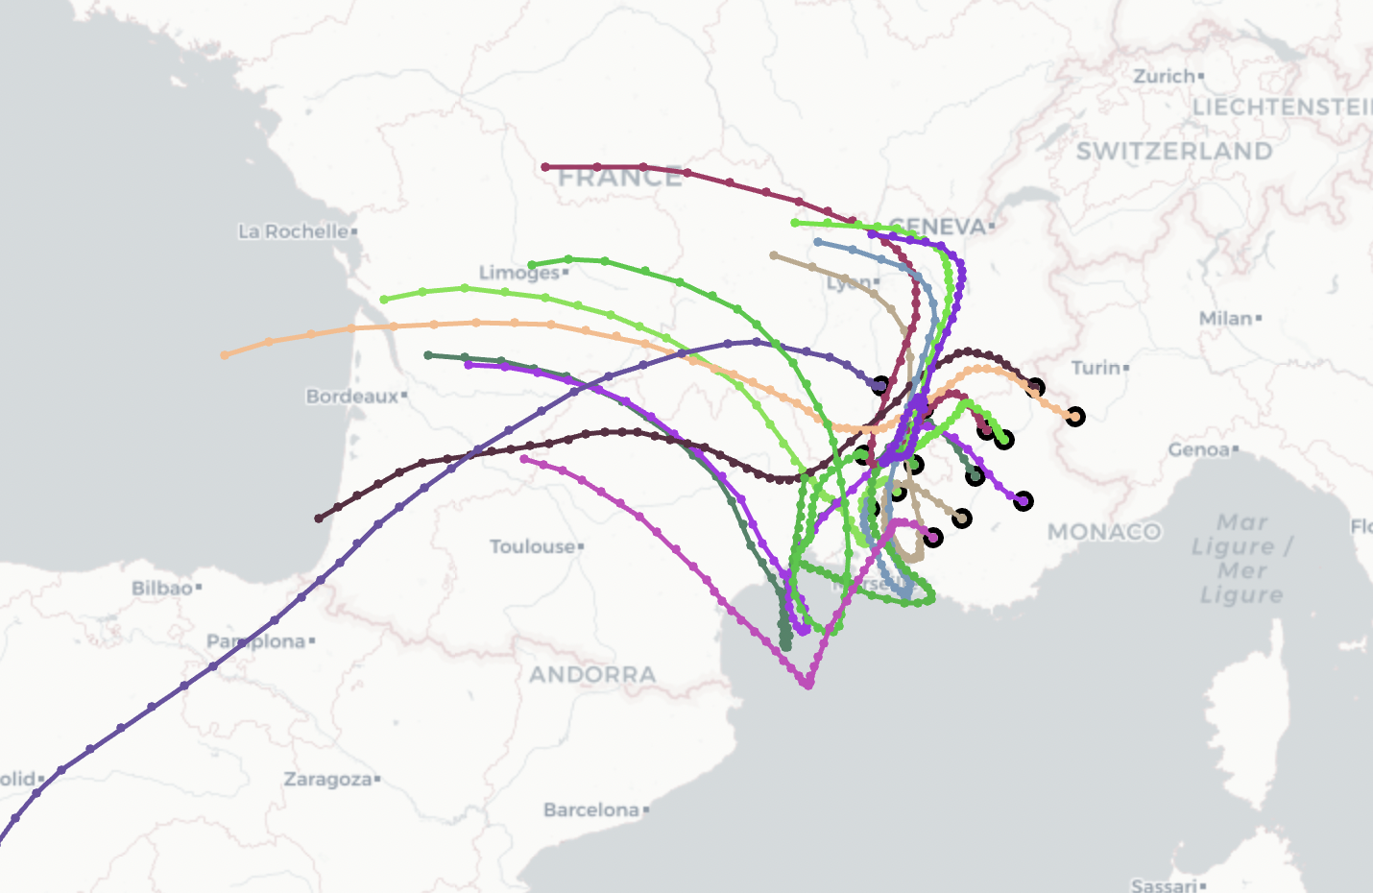
Contact networks generated by air mass trajectories
Example
Choufany et al. (2021)
Notes:
Dans ce cadre là on a mené une recherche pour formaliser l’estimation d’un réseau à partir de données de trajectoires.
Ainsi on introduit une fonction de flot qui décrit le mouvement de particules en tout lieu et en tout temps.
Pour ce faire on peut utiliser un modèle du mouvement des masses d’air tel qu’HYSPLIT fondé sur l’advection.

Slide 30
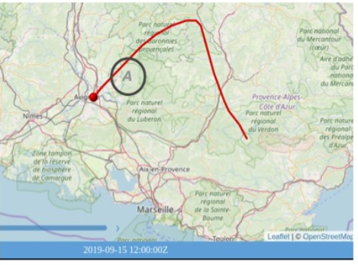
Contact networks generated by air mass trajectories
Choufany et al. (2021)
Notes:
Ensuite on introduit la connectivité pointwise qui mesure la connectivité entre un point et un polygone. Elle peut être binaire ou quantitative selon que l’on s’intéresse au passage de la particule dans le polygone ou au temps qu’elle y passe, à la distance qu’elle y parcourt ou à bien d’autres mesures possibles.

Slide 31
Contact networks generated by air mass trajectories
Estimation
Choufany et al. (2021)
Notes:
On peut alors définir une connectivité intégrée qui mesure la connectivité entre 2 polygones. Et là on pose des questions de stat et notamment comment estimer cette intégrale, et quel plan d’échantillonnage utiliser.

Slide 32
Contact networks generated by air mass trajectories
1
Choufany et al. (2021)
Notes:
Enfin on définit un réseau spatial ou spatio-temporel dont les liens coïncident avec les connectivités intégrées, et c’est comme cela que l’on passe d’un ensemble de trajectoires à un réseau orienté pondéré.

Slide 33
Observed pattern up to 2023 from FAO dataset
Red: presence
Green: absence

Slide 34
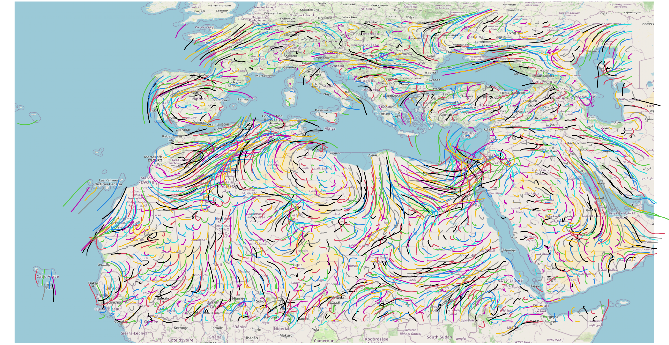
Air-mass trajectories possibly transporting the pest for one date
2365 locations
1530 dates
3.6M trajectories

Slide 35
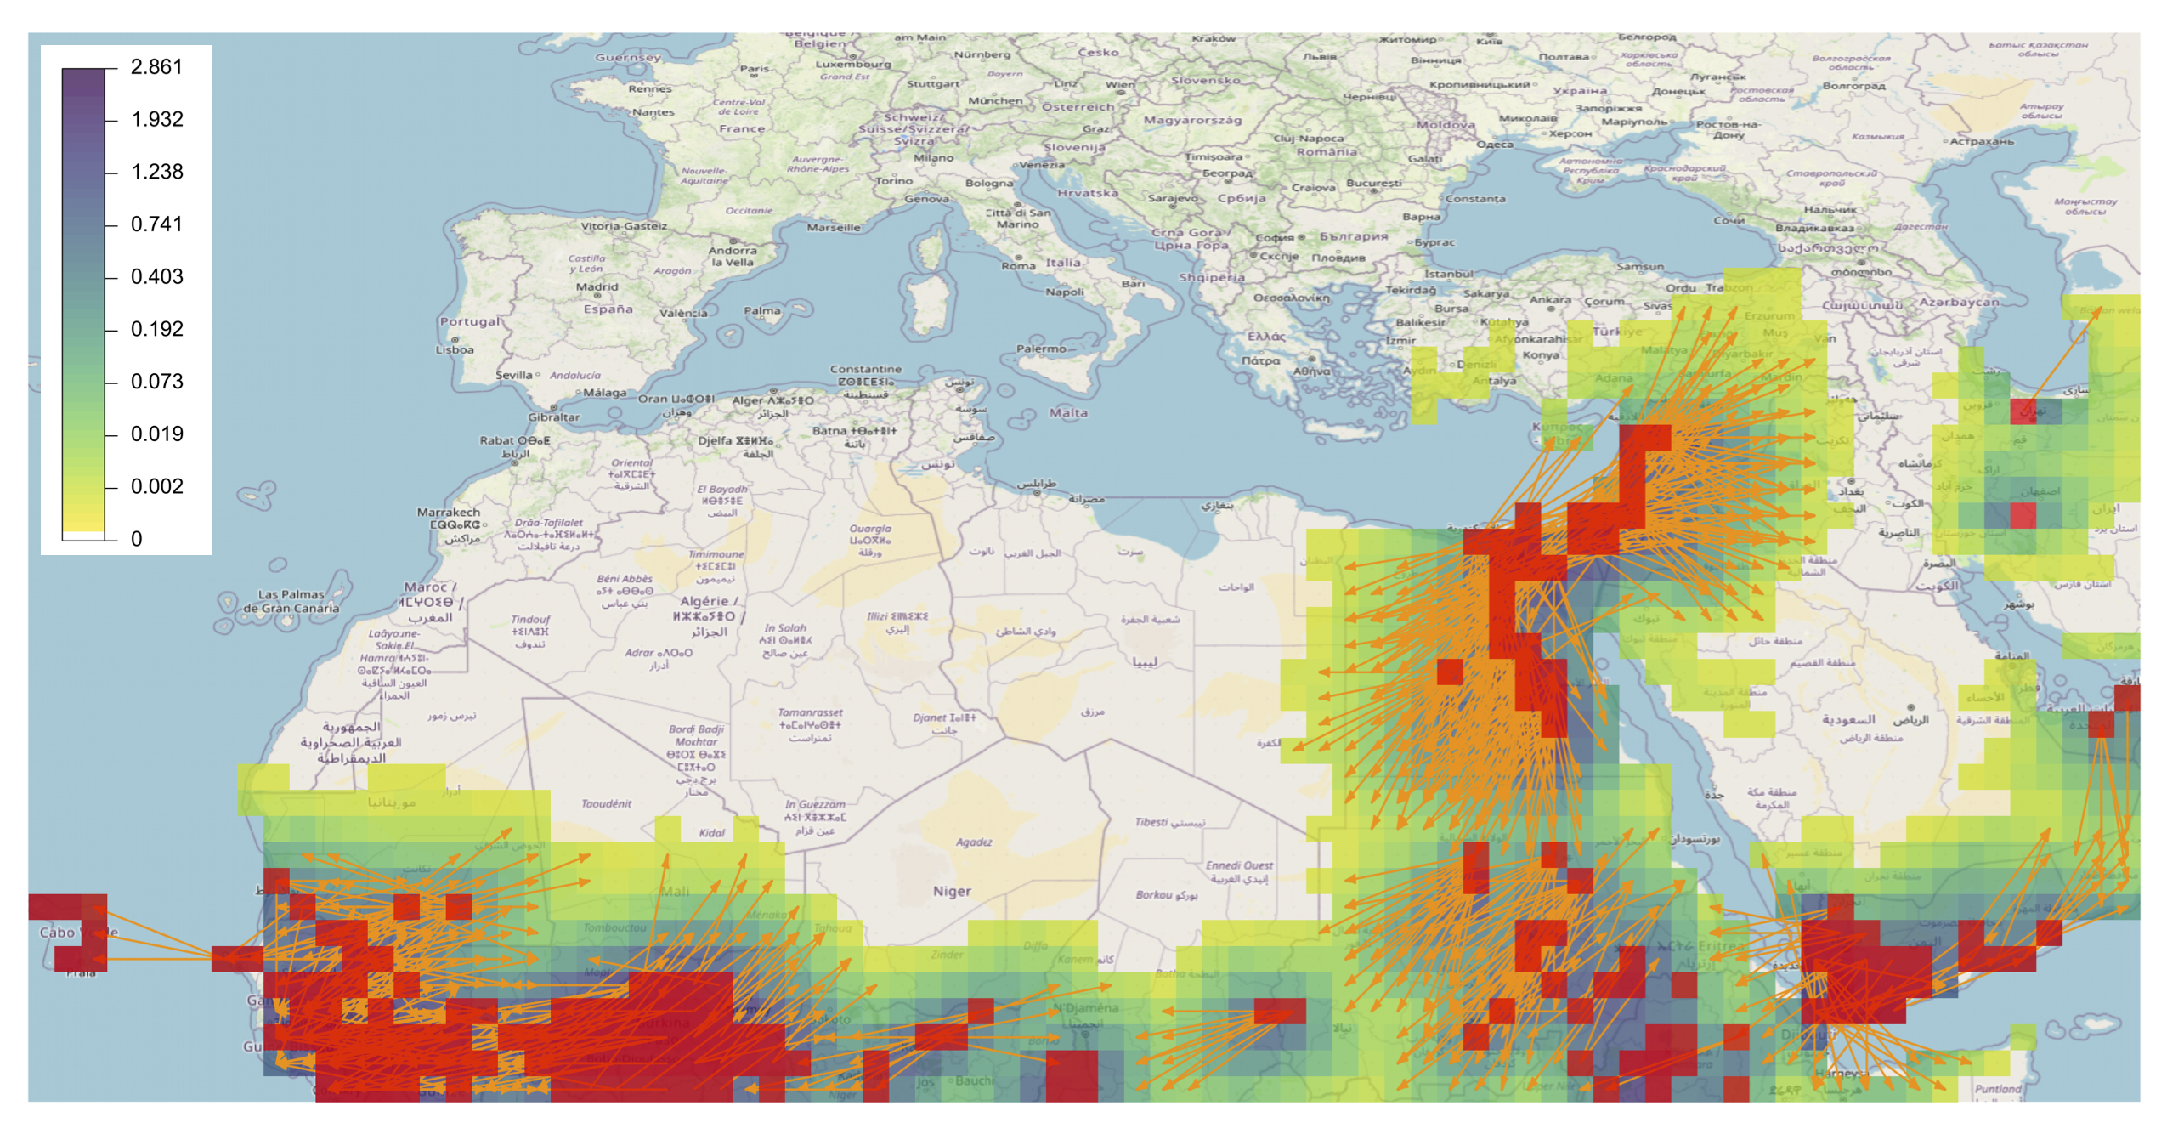
Risk map for pest introduction
Risk of Spodoptera frugiperda spread from pest-occupied areas based on FAO information

Slide 36
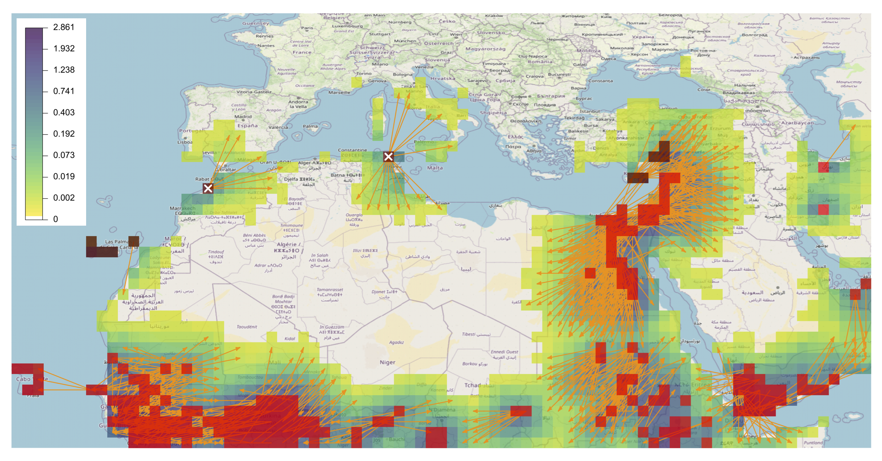
Risk map for pest introduction
Risk of Spodoptera frugiperda spread from pest-occupied areas based on FAO and EPPO information
and from two hypothetical pixels in Tunisia and Morocco

Slide 37
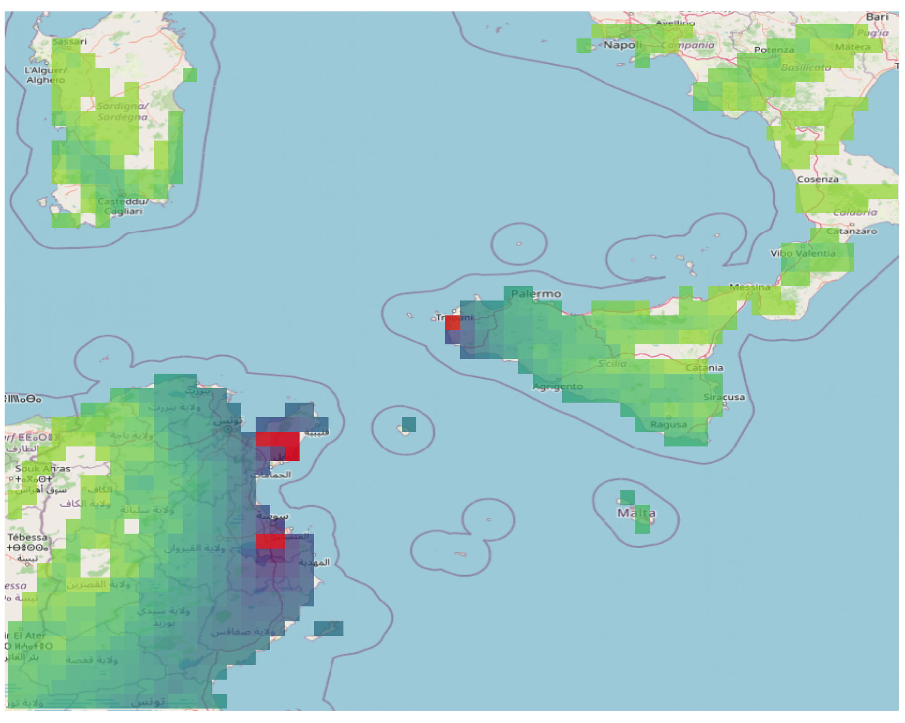
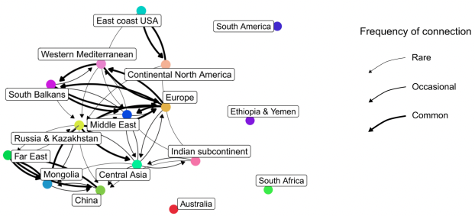
Other examples
Dispersal of midges transmitting bluetongue virus
See also Bibard et al. (2025) and WindiApp
Network for wheat black rust dispersal
Radici et al. (2022)
Connectivity between sugarcane production areas infected by orange rust
Dijoux et al. (in prep)

Slide 38
Conclusion: a few research avenues
Modeling and inferring movement of entities that cannot be followed
Fusion of heterogeneous data into models
Mobilizing new data for (indirect) surveillance in the open/massive data era
Environmental data, citizen data, social media, satellite data, actor behaviors…
Coupling mechanistic and deep learning approaches and, in the meantime, inferring unknown parameters and processes
Embedding genetic inputs & processes in models
Pest-strain fitness, transmission chains, adaptation, recombination…
Embedding socio-economic inputs & processes in models
Cost-benefit, decision under uncertainty, incentives, insurance…
Aggregating models for enhanced inference and prediction
Adaptive surveillance, automated data acquisition and associated algorithms
See communications of Lucie, César, Annaelle, Joshua, Stephen, Janine, Christ, Gaël, Subhasish…

Slide 39
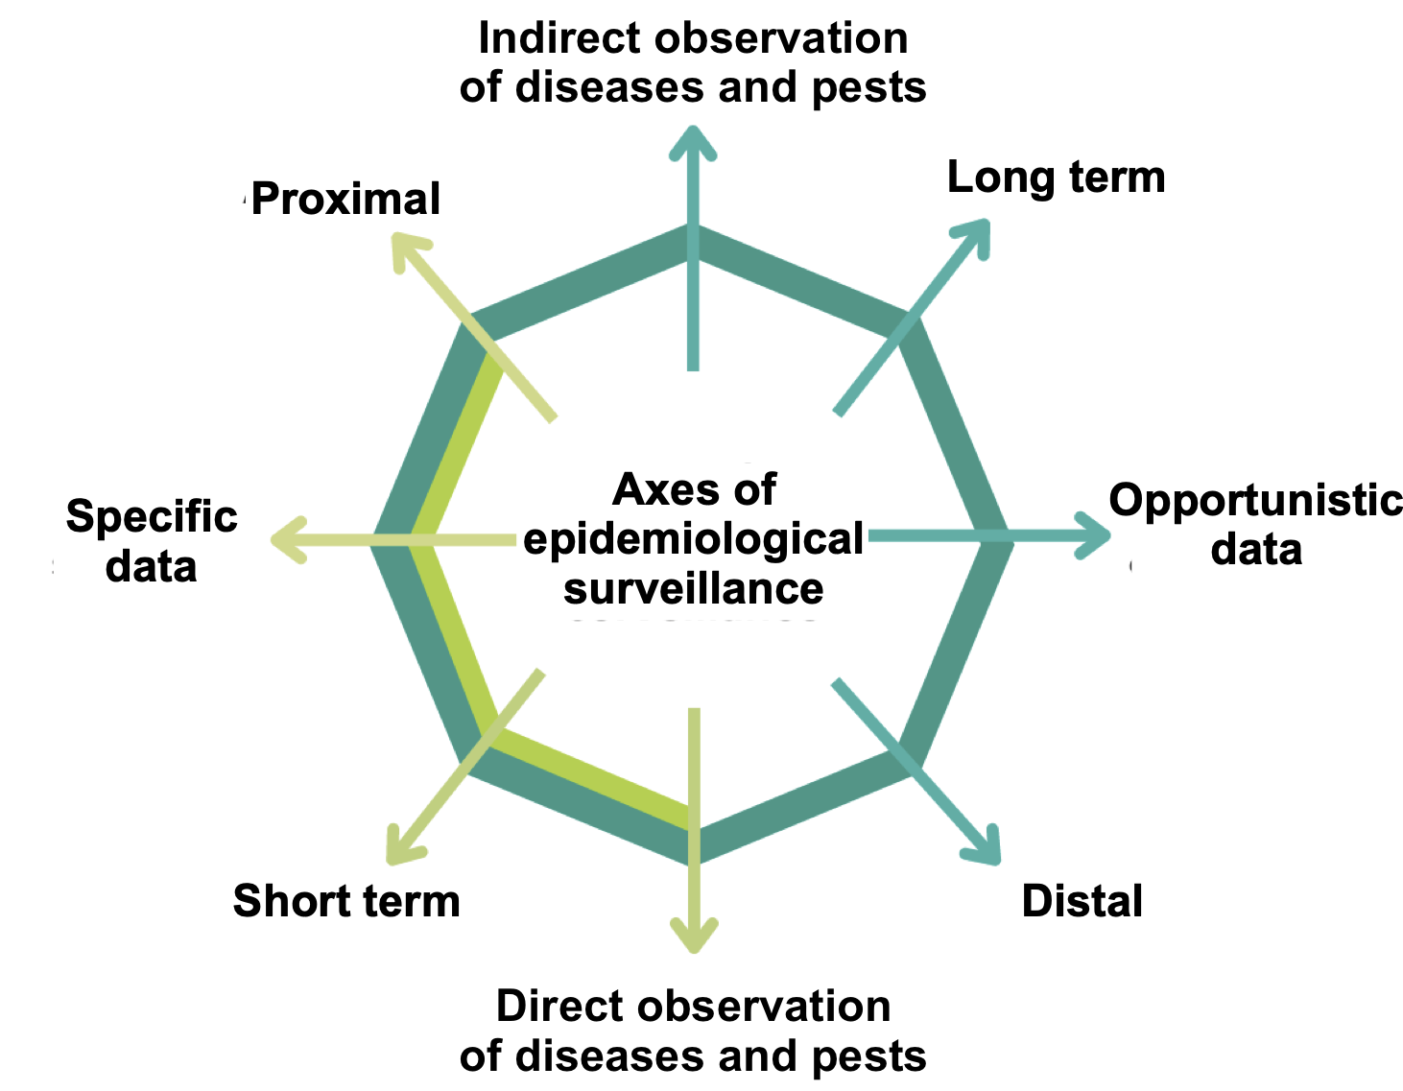
Complementary axes of epidemiological surveillance
Yield losses
Historical meteorological trends and future predictions
In-field observation
Data from abiotic sensor networks
Regional land use & landscape data
Disease symptoms
Pest occurrence
Plant health bulletins
Remote-sensing data
Pest bio-sensor data
Slide adapted from Cindy Morris

Slide 40
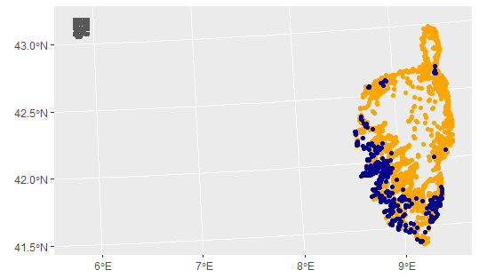
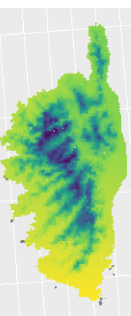









Multiple surveillance sources and data integration
Existing data
…
Land-use
Enhanced epidemiological surveillance
Presence
Absence
Meteorology
Topography
Services producing data
Data library
Modeling / inference / prediction of risk and risk factors
Improvement / optimization of surveillance strategies (risk-based sampling, adaptive sampling)
Decision support (control measures, prophylaxis, treatments, etc.)
Connectivity
2100
Climatic forecast
Risk map
Collected data
…
Text mining
Satellite images
Biosensor networks, …
Slide adapted from Edith Gabriel

Slide 41
References
Abboud C., Bonnefon O., Parent E., Soubeyrand S. (2019). Dating and localizing an invasion from post-introduction data and a coupled reaction-diffusion-absorption model. Journal of Mathematical Biology 79: 765-789. https://doi.org/10.1007/s00285-019-01376-x
Abboud C., Parent E., Bonnefon O., Soubeyrand S. (2023). Forecasting pathogen dynamics with Bayesian model-averaging: Application to Xylella fastidiosa. Bulletin of Mathematical Biology 85:67. https://doi.org/10.1007/s11538-023-01169-w
Bibard, A., Martinetti, D., Picado, A., Chalvet-Monfray, K., & Porphyre, T. (2025). Spatial and temporal risk assessment of Epizootic Hemorrhagic Disease Virus introduction in Europe: A comparative analysis of trade and wind dispersal pathways. Preventive Veterinary Medicine, 106656.
Choufany M., Martinetti D., Senoussi R., Morris C.E., Soubeyrand S. (2021). Spatiotemporal large-scale networks shaped by air mass movements. Frontiers in Applied Mathematics and Statistics 6:602621. https://doi.org/10.3389/fams.2020.602621
d’Alayer F., Gabriel E., Soubeyrand S. (2025). A Marked Sequential Point Process for Disease Surveillance: Modelling and Optimization. Preprint.
Lannou C., J.-Y. Rasplus, S. Soubeyrand, M. Gautier, J.-P. Rossi (2023). Crises sanitaires en agriculture. Les espèces invasives sous surveillance.. Versailles, Quae.https://www.quae.com/produit/1749/9782759234837
Mikaberidze A., Cruz C. D., Zerihun A., Barreto A., Beck P., Calderón R., Camino C., et al. (2025). Opportunities and challenges in combining optical sensing and epidemiological modelling. Phytopathology. https://doi.org/10.1094/PHYTO-11-24-0359-FI
Morris C.E., Géniaux G., Nédellec C., Sauvion N., Soubeyrand S. (2022). One Health concepts and challenges for surveillance, forecasting, and mitigation of plant disease beyond the traditional scope of crop production. Plant Pathology 71:86-97. https://doi.org/10.1111/ppa.13446
Papaïx J., Soubeyrand S., Bonnefon O., Walker E., Louvrier J., Klein E., Roques L. (2022). Inferring Mechanistic Models in Spatial Ecology Using a Mechanistic-Statistical Approach. In Statistical Approaches for Hidden Variables in Ecology (eds N. Peyrard and O. Gimenez). https://doi.org/10.1002/9781119902799.ch4
Richard H., Martinetti D., Lercier D., Fouillat Y., Hadi B., Elkahky M., Ding J., Michel L., Morris C.E., Berthier K., Maupas F., Soubeyrand S. (2023). Computing geographical networks generated by air-mass movement. GeoHealth 7:e2023GH000885. https://doi.org/10.1029/2023GH000885
Radici et al., 2022, https://doi.org/10.1088/1748-9326/ac73aa
Soubeyrand S., Estoup A., Cruaud A., Malembic-Maher S., Meynard C., Ravigné V., et al. (2024). Building integrated plant health surveillance: a proactive research agenda for anticipating and mitigating disease and pest emergence. CABI Agriculture and Bioscience 5:72. https://doi.org/10.1186/s43170-024-00273-8
Soubeyrand S., Martinez C. (2023) Récents progrès sur l’utilisation des images satellitaires pour évaluer la sévérité de la jaunisse au niveau parcellaire. https://hal.inrae.fr/hal-04254586
Soubeyrand S., Roques L. (2014). Parameter estimation for reaction-diffusion models of biological invasions. Population Ecology 56: 427-434. https://doi.org/10.1007/s10144-013-0415-0

