Slide 1
Modelling pathogen spread over inter-individual contact networks within hospitals
Laura Temime, MESuRS, Cnam

Slide 2
Healthcare-associated infections (HAI)
Infections which occur after 48h of admission into healthcare settings
Infection opportunity due to
Weakened state of patients (e.g., immunocompromised)
Frequent invasive procedures breaching natural barriers (e.g. central line)
High incidence worldwide:
7.5% of ICU patients with at least one HAI in Europe (ECDC, 2019)
1.7 million affected patients in the US in 2002 (CDC)
Key infection setting for bacteria
Specific problem of multi-resistant bacteria

Slide 3
Case study for this talk: S. aureus
Staphylococcus aureus: a major cause of hospital-acquired infections
10% of bloodstream infections, 20% of pneumonia (ECDC, 2019 data)
Problem worse with methicillin-resistant S. aureus (MRSA)
Resistant to antibiotics
Harder to treat
More severe outcomes
Frequent asymptomatic colonisation
S. aureus colonisation is a risk factor for infection
Image from CDC – James Archer

Slide 4
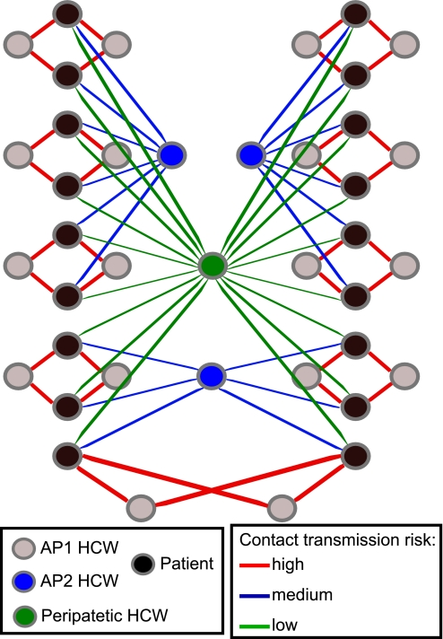
Control strategies against HAI
Several control interventions available to reduce pathogen transmission within healthcare settings:
Contact precautions (e.g. gloves or masks, hand hygiene)
Patient cohorting (e.g., isolation of known infected patients)
Staff cohorting
Vaccination
... but contact heterogeneity in healthcare facilities is a challenge
Can we use information on contact patterns to implement more efficient control strategies?
Temime et al. Peripatetic health-care workers as potential superspreaders. PNAS. 2009 Oct 27;106(43):18420-5.

Slide 5
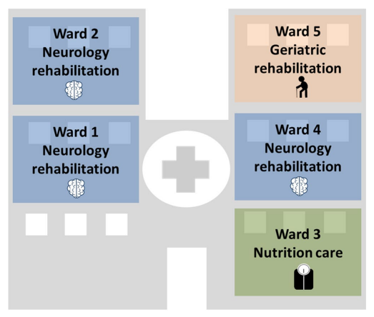
Setting for this study
Data collected in a long-term care facility (i-Bird/MOSAR study, 2009, PI: D. Guillemot)
Patient categories:
geriatric , neurology, nutrition, orthopaedic, postoperative, persistent vegetative state
Staff categories:
care assistants, nurses, rehabilitation, physicians, porters, other
Duval et al. “Measuring dynamic social contacts in a rehabilitation hospital: effect of wards, patient and staff characteristics”. Scientific reports. 2018 Jan 26;8(1):1-1.

Slide 6
Collected data over 4 months
Proximity interaction data (sensors)
Used to build a contact network for the facility
Hospital data on patient and staff presence
Swabs for prevalence of MRSA colonisation

Slide 7
Contact network reconstruction
Original contact network only partially observed (40% of staff presence and 33% of patient presence without contacts recorded)
Algorithm to reconstruct unobserved contacts and stochastically generate new networks using:
1) Contact rates by hour between individuals, stratified by patient/staff category and ward:
$$T_{ h, c_{1}w_{1}→c_{2}w_{2}}=\frac{\sum_{i∈C_{1}W_{1}}{\sum_{j∈C_{2}W_{2} }{\sum_{k=1}^{N_{h,i}}{V_{i,j,k}}}}}{\sum_{l = 1}^{N_{h}}{N_{C_{1}W_{1},l}}}$$
2) Recurring contact probability per day per individual
$$p_{i,d}=\frac{|U_{i,d} ∩U_{i,[d_{0},d[}|}{|U_{i,d}|}$$
Notes:
T_{h,c1w1->c2w2} is the average per-person contact rate at the hour h between individuals from category C₁ belonging to ward W₁ and individuals from category C₂ belonging to ward W₂. For given hour h and individual i, N_{h,i} is the number of instances of the hour h where at least one contact was recorded for individual i. For example, if i had a contact recorded on Tuesday 11th August at 10h, and on Tuesday 18th August at 10h, N_{10,i} would be equal to 2. For two individuals i from C1W1 and j from C2W2, V_{i,j,k} indicates whether contacts have been recorded between them on instance k of the hour h: it equals 1 if i and j had at least one contact recorded at that time, and 0 otherwise. Finally, N_{h} is the total number of instances of the hour h in the full dataset and, for a given instance l of the hour h, N_{C1W1,l} is the number of individuals from C₁W₁ that had any contact recorded during that hour.
U_{i,d} is the set of unique individuals with whom i had a contact on day d, U_{i,[d0,d[} is the set of unique individuals with whom i had at least one contact on any day between the first day d₀ and the current day d (d non-included), and the notation |x| indicates the cardinality of the set x. For example, if i had a contact with four unique individuals on day d, and previously had a contact with two of those on any day between d₀ and d, the probability of recurring contact for day p_{i,d} would be 2/4 = 0.5.

Slide 8
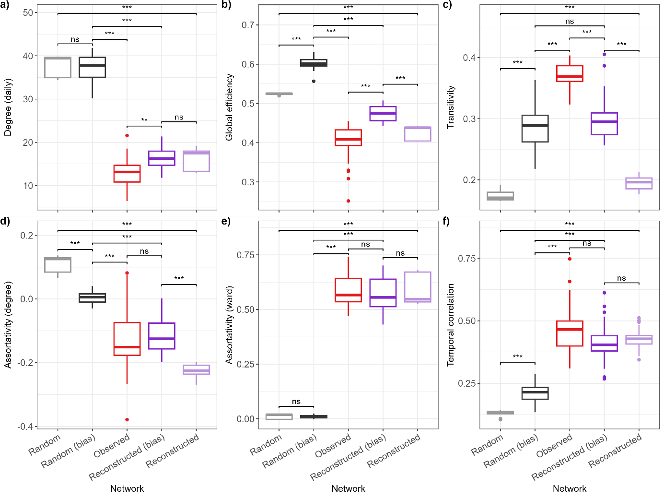
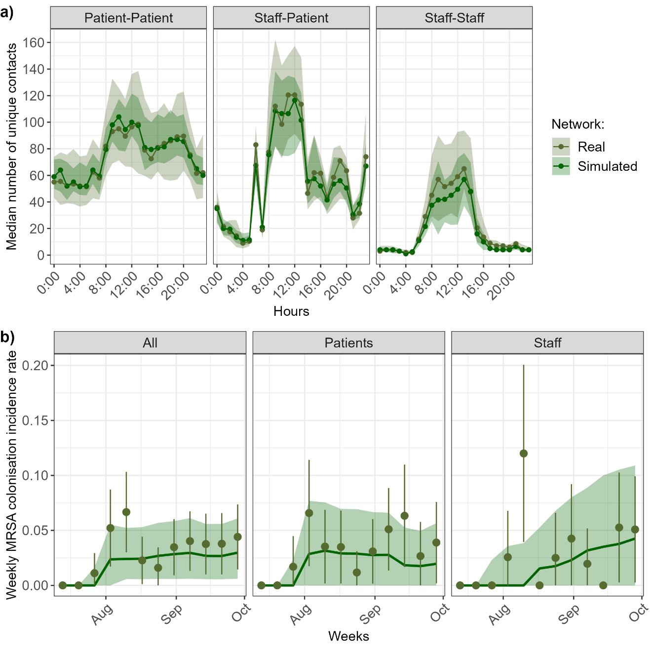
Contact network reconstruction
The reconstructed network allows to reproduce the observed data

Slide 9
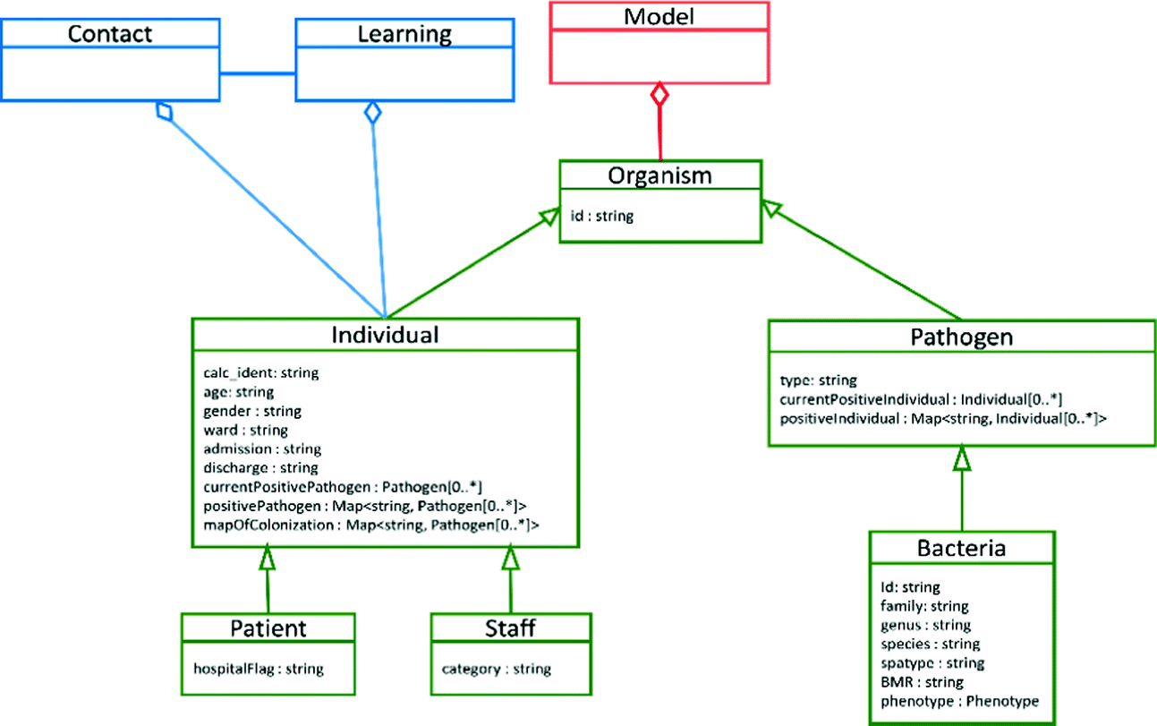
Transmission model
Stochastic individual-based model (CTCmodeler)
Susceptible-Colonised-Susceptible type process
All individuals assumed to be equally susceptible
Contacts simulated every 30 seconds
Daily simulation of admissions and discharges
Coded in C++
Duval et al. "CTCmodeler: An Agent-Based Framework to Simulate Pathogen Transmission Along an Inter-individual Contact Network in a Hospital." International Conference on Computational Science. Springer, Cham, 2019.

Slide 10
Transmission model: simulations
For each contact between a susceptible and a colonized individual:
Transmission probability per 30 sec of contact (patient-patient, staff-staff, patient-staff, staff-patient), estimated from the observed data:
Saturating probability after 1h of contact
$$T_{g1→g2}=\frac{1}{\left(N^{w}−n\right)}\sum_{w=n+1}^{N^{w}}{\frac{\sum_{i=1}^{C_{w−n→w−1}^{g1}}{\sum_{j=1}^{S_{w−n→w−1}^{g2}}{I_{i,j,w−n→w−1} × A_{w,j}}}}{\sum_{l=w−n}^{w−1}{D_{C^{g1}→S^{g2}, l}}}}$$

Slide 11
Model validation
Model simulations allow to reproduce the observed MRSA colonisation incidence data, in the absence of interventions:
Notes:
Olive points correspond to the observed weekly incidence during the i-Bird study, with lines indicating the margin of error, estimated using the number of individuals swabbed that week. Simulated results are obtained from 15,000 stochastic model simulations (500 simulations of 50 simulated networks). The dark green line shows the median incidence, and the shaded area shows the 95% prediction interval, defined as the interval between the 2.5th and 97.5th percentiles.

Slide 12
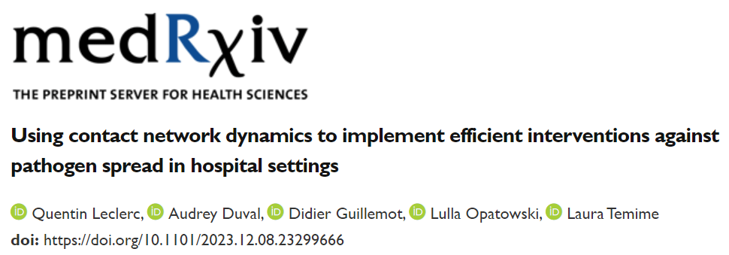
Exploration of control strategies
Three control strategies simulated:
Staff reallocation/cohorting
Reinforced contact precautions
Vaccination (hypothetical)
⇒ For each control strategy:
Effectiveness of control measures = relative reduction in cumulative colonisation incidence over the period

Slide 13
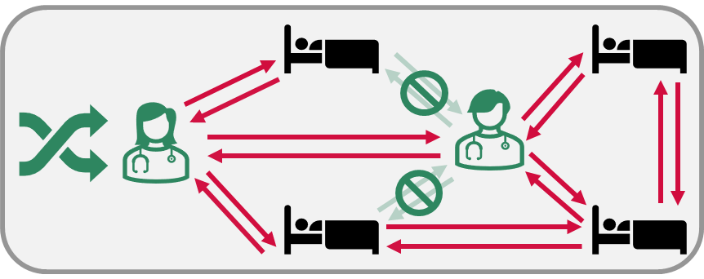
First intervention: staff reallocation
Random allocation of fewer patients to each staff member (maintaining patient care needs)
Reduction of contacts between unique patients and staff
63 scenarios for different targeted staff categories

Slide 14
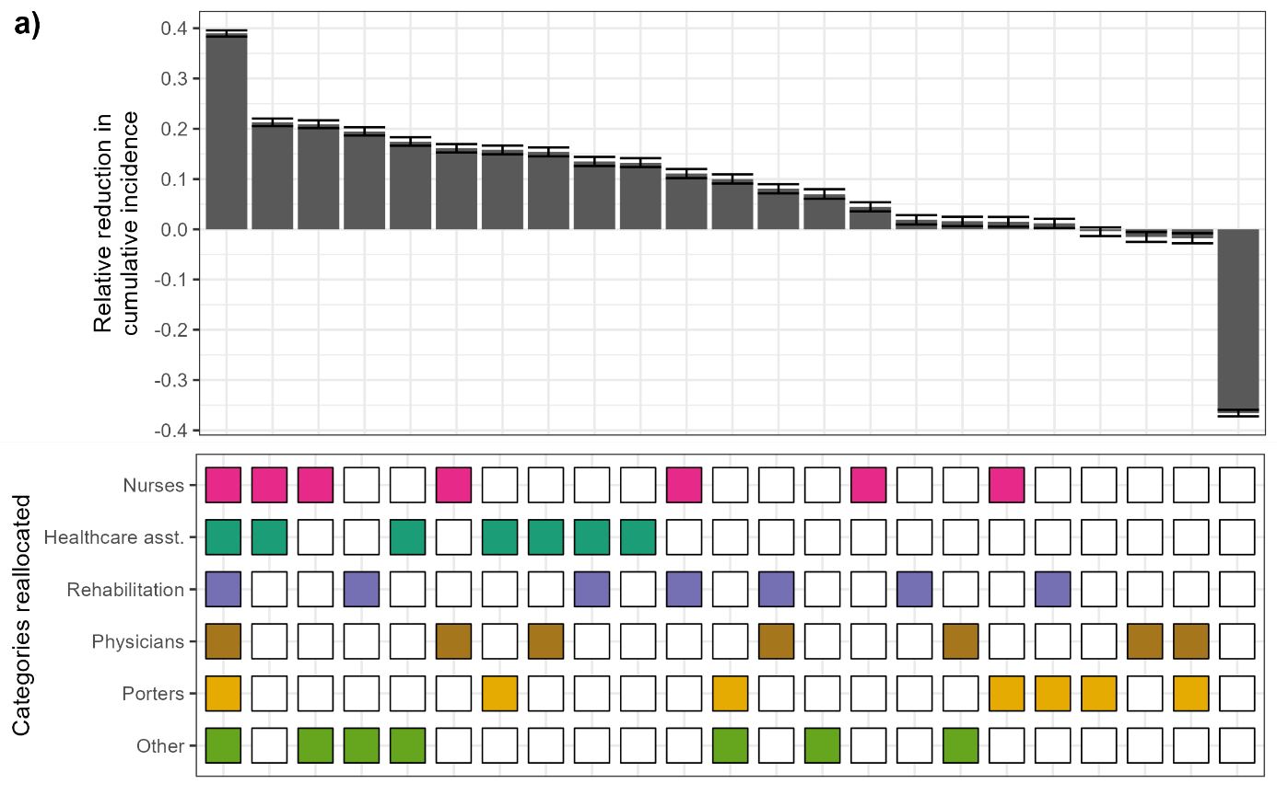
Effectiveness of reallocation depends on staff category
High effectiveness when reallocating care assistants or nurses
Low effectiveness when reallocating physicians or porters
Last scenario: random reassignment
increase in contacts
increase in incidence

Slide 15
Second intervention: reinforced contact precautions
For example, wearing gloves or improving hand hygiene compliance
Reducing the risk of transmission between patients and staff
Scenarios: reduction in transmission rate by a factor of 2, 4, 6, 8 or 10

Slide 16
Effectiveness of contact precautions depends on staff category
Contact precautions of nurses or care assistants may be more effective than reallocation
No substantial effect of contact precautions if targeting any other staff categories
Notes:
Dashed lines = effectiveness of reallocation of all staff, assistants only, nurses only….

Slide 17
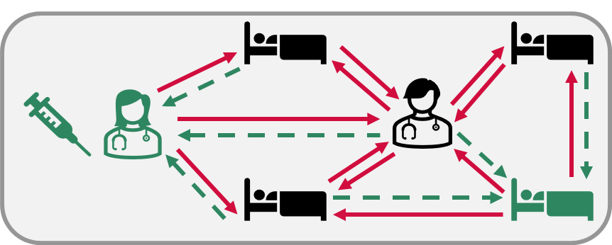
Third intervention: vaccination
Partial protection of the vaccinee against acquisition from any other individual
Reduction of acquisition risk only
Reduction applies to all contacts
Scenarios: reduction in transmission rate by a factor of 2, 4, 6, 8 or 10

Slide 18
Effectiveness of staff vaccination depends on staff category
Impact similar to that of contact precautions
Again, effective if target healthcare assistants or nurses…
… But no effect of vaccination on other categories of staff

Slide 19
Network heterogeneity
Questions:
Why is there a different impact when targeting different staff categories?
Which relevant element differs between staff categories?

Slide 20
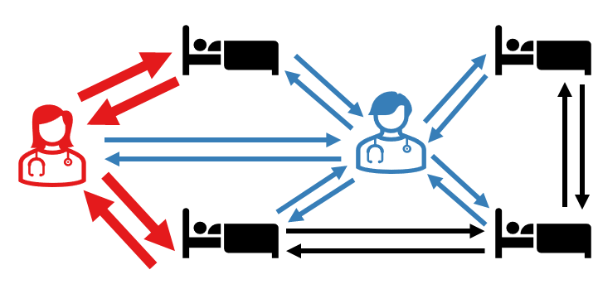
Network heterogeneity
Supercontactors: individuals with more contacts than others
Duration-based: highest average daily cumulative time spent in contact
Frequency-based: highest average daily number of unique contacts
For future simulations:
Supercontactors defined as top 20% staff and patients (60 staff and 60 patients, for each type of SC)

Slide 21
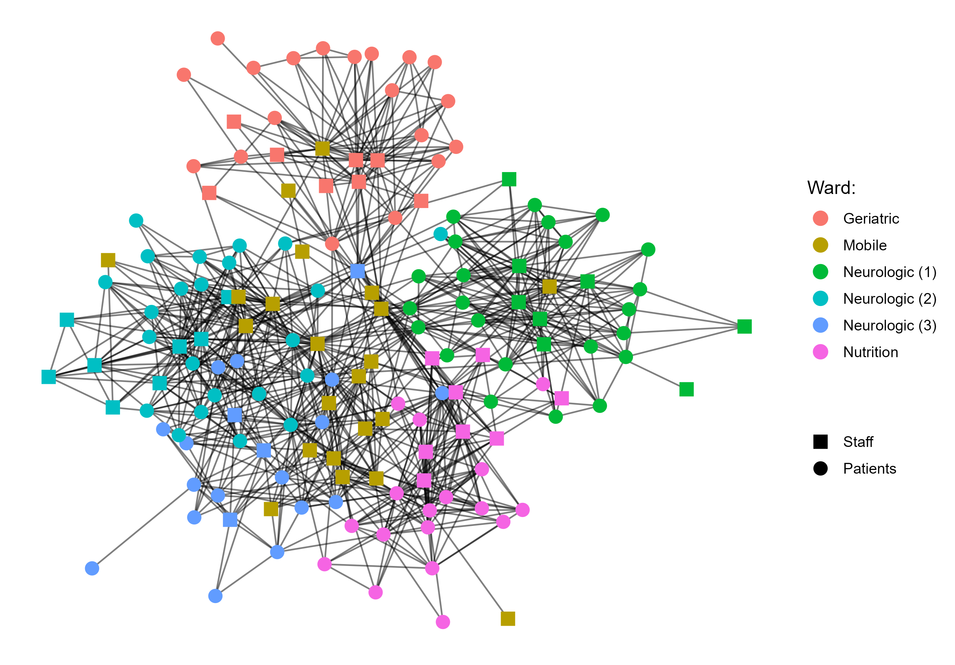
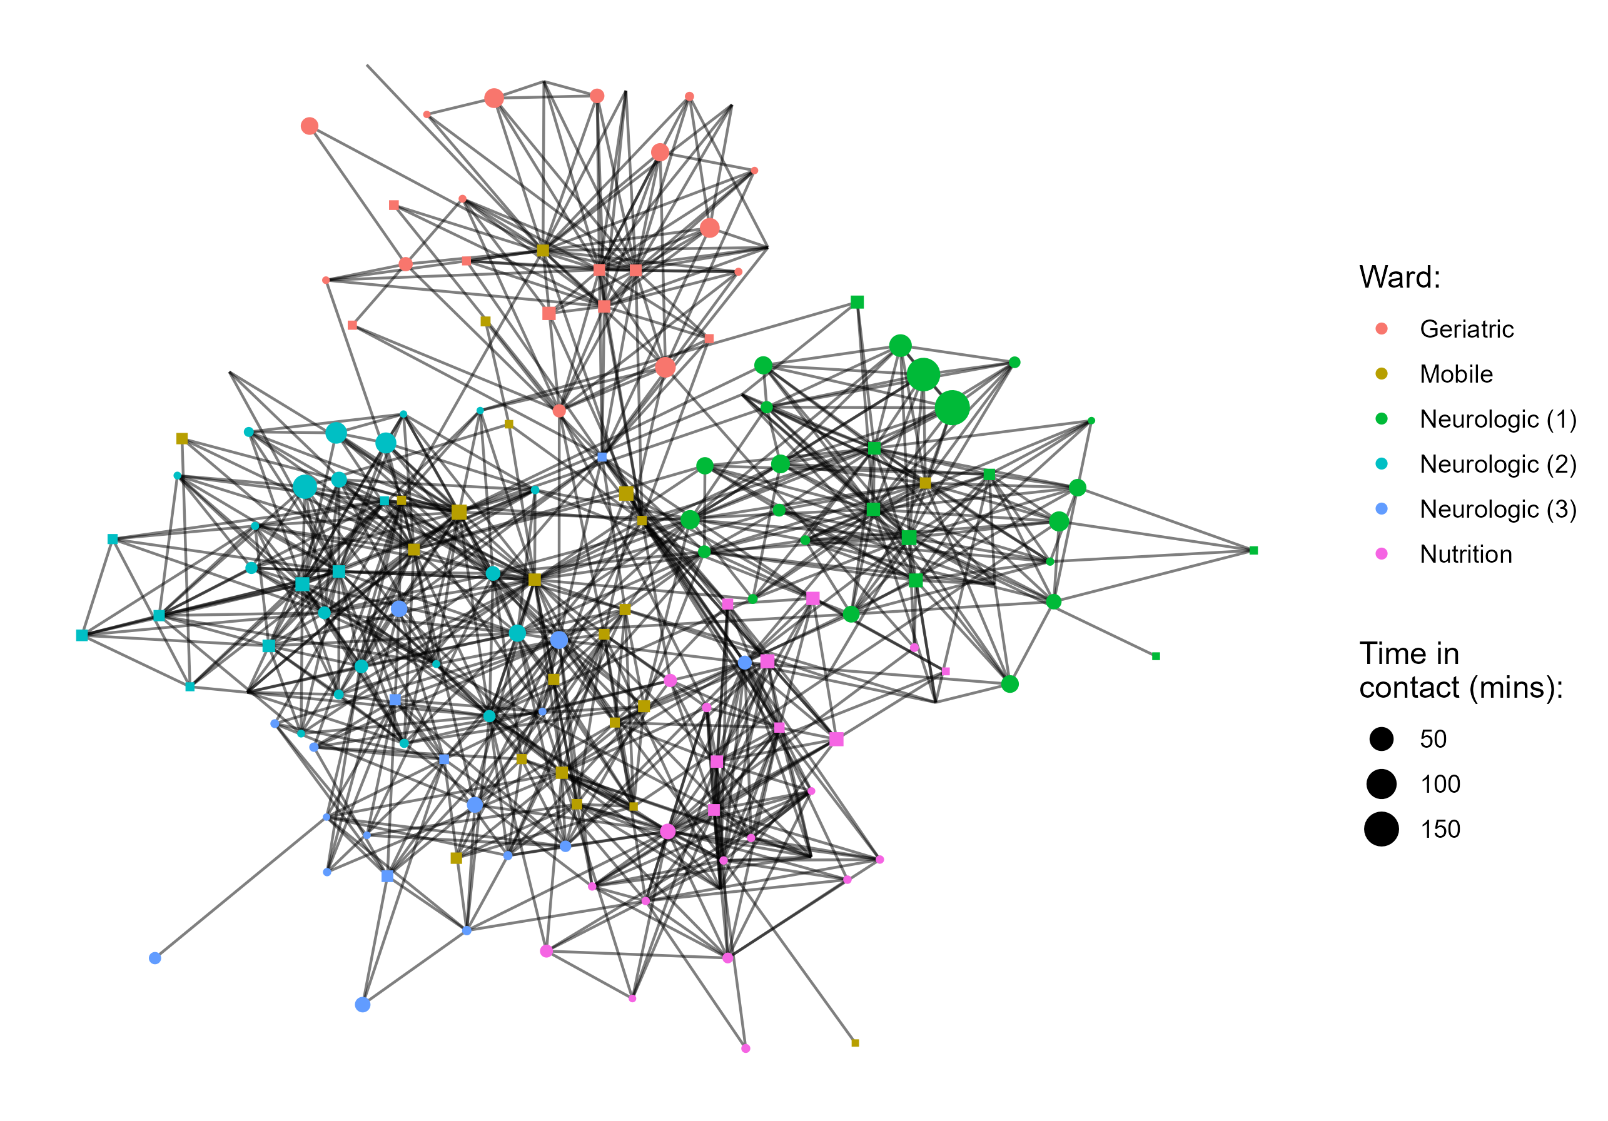
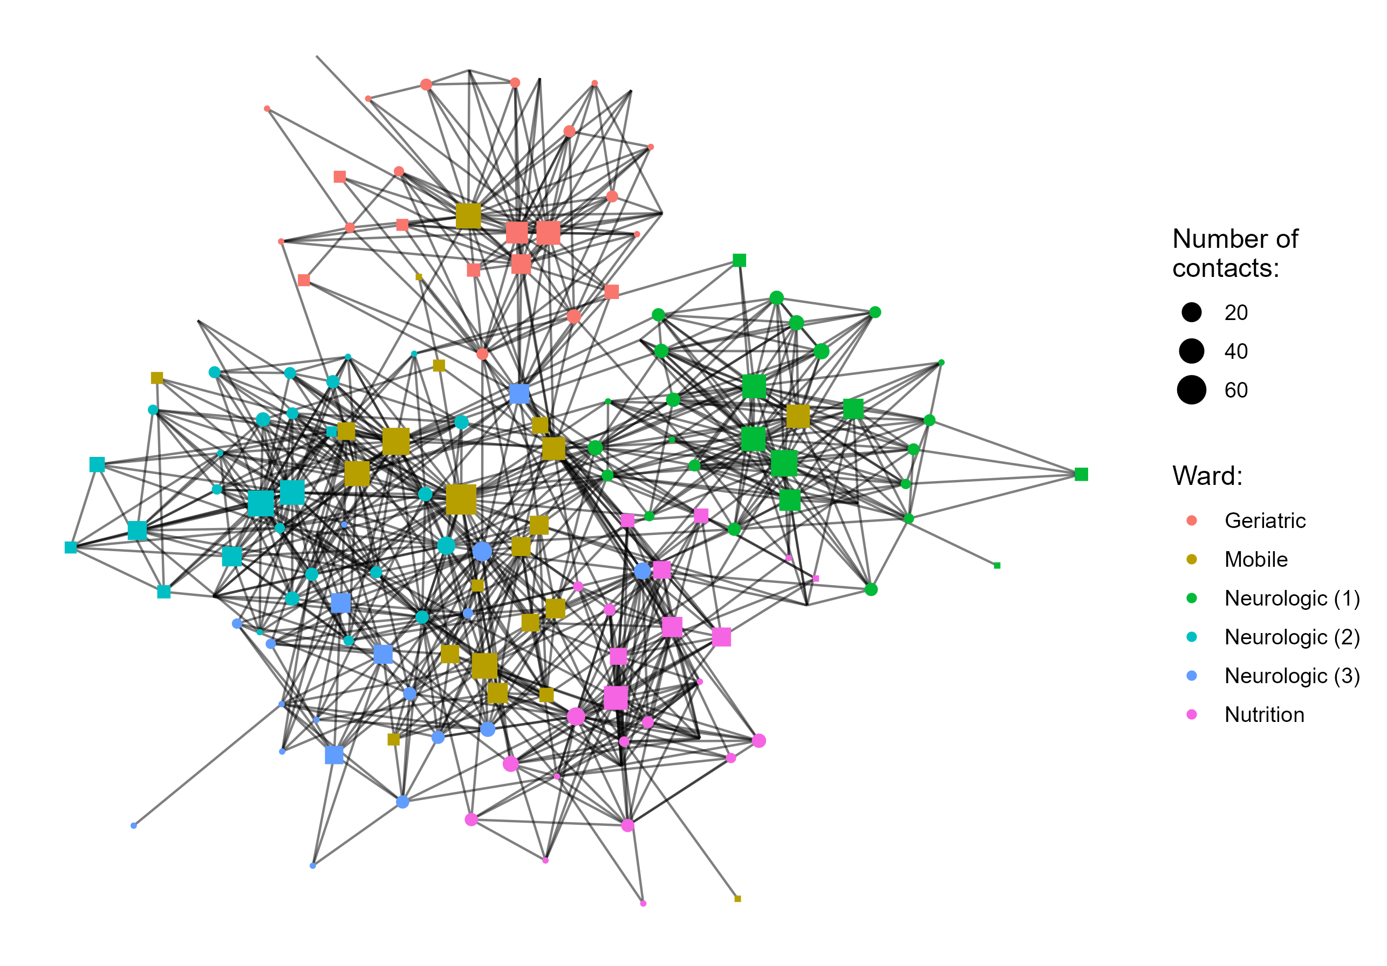
Network heterogeneity
Duration-based: highest cumulative time spent in contact
Frequency-based: highest number of unique contacts

Slide 22
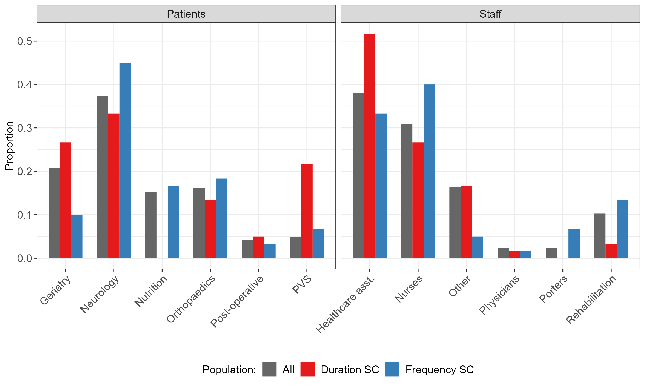
Supercontactor identification
The distribution of supercontactors between staff and patient categories is heterogeneous
Grey bars: distribution of all patients/staff
Coloured bars: distribution of supercontactors
Patients | Staff
Geriatry, PVS | Healthcare asst. | Duration
Neurology | Nurses, Porters, Reeducation | Frequency
What is the value of targeting supercontactors with interventions?

Slide 23
Optimisation of contact precautions
Constant number of 60 people targeted
Targeting supercontactors is as good or better than targeting randomly
Best to target a mix of frequency and duration-based SC amongst staff
Best to target duration-based SC amongst patients
Intermediate results for mixed scenarios

Slide 24
Vaccination more effective than contact precautions when targeting supercontactors
Best intervention: vaccination
Best individuals to target: mix of staff + patient duration-based supercontactors
Why these results?

Slide 25
The impact of contacts on intervention effectiveness
Contact precautions only reduce staff-patient probabilities, but in both directions (acquisition + transmission)
Vaccination reduces staff-staff, patient-patient, staff-patient probabilities, but in one direction only (acquisition)
Vaccination impacts the most important transmission probabilities
Patients spend most of their time in contact with other patients

Slide 26
Conclusions
Identifying and targeting supercontactors improves the effectiveness of control measures
Supercontactors can be both staff and patients
Important to involve all in control measures
Best intervention depends on balance between probabilities of transmission and categories of individuals in contact
Overall: understanding contact patterns is key to implement efficient interventions in healthcare settings

Slide 27
Main study limitations
Only include transmission between participants
Potential transmission from visitors or outside facility ?
Real “cost” of interventions not considered, eg:
Logistical challenge for staff reallocation
Compliance to hand hygiene
Delay/waning of vaccine immunity
Model calibrated to a specific healthcare institution
Neurological patients/PVS as supercontactors, and high patient-patient contact rates
Long-term care facility ≠ acute care facility
Hard to generalize

Slide 28
Main study strengths
Accounts for real proximity data
Disentangle and use the underlying contact network
May be used to study the spread and control of other pathogens
Example: how to best target testing strategies within healthcare settings during the COVID pandemic

Slide 29
Acknowledgements
Audrey Duval
Didier Guillemot
Quentin Leclerc
Lulla Opatowski
Epidemiology and Modelling of Bacterial Escape to Antimicrobials (PI: Didier Guillemot)
Modelling group (PI: Lulla Opatowski)
Modélisation, Epidemiologie et Surveillance des Risques Sanitaires (PI: Laura Temime)
IMI grant n°101034420
CESP INSERM U118 – Echappement aux anti-infectieux et pharmacoépidémiologie (PI: Didier Guillemot)
SPHINx project

