Slide 1
Les comportements humains : l'angle mort de la modélisation épidémiologique ?
Séminaire de modélisation du vivant de l'institut de mathématiques de Rennes
Jocelyn Raude, PhD, HDR
Ecole des Hautes Etudes en Santé Publique Département des Sciences Humaines et Sociales
UMR ARENES – Equipe RSMS

Slide 2
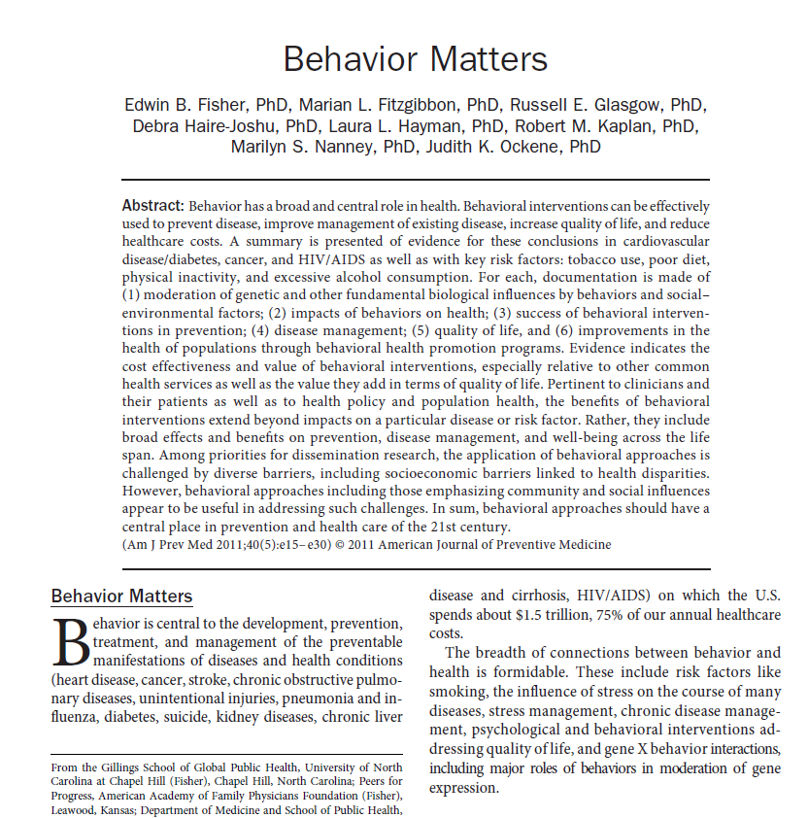

Slide 3
Behavioral Epidemiology
Worldwide accounting for DALYs (Disability Adjusted Life Years = years lost through disability or early death):
Behavioral risk factors: 32.7% (30.7-34.8)
Metabolic risk factors 16.8% (15.7-18.0), and
Environmental and occupational factors 13.1% (12.1-14.2).
Source: Global Burden of Disease study (http://www.who.int/healthinfo/global_burden_disease/GlobalHealthRisks_report_full.pdf)

Slide 4
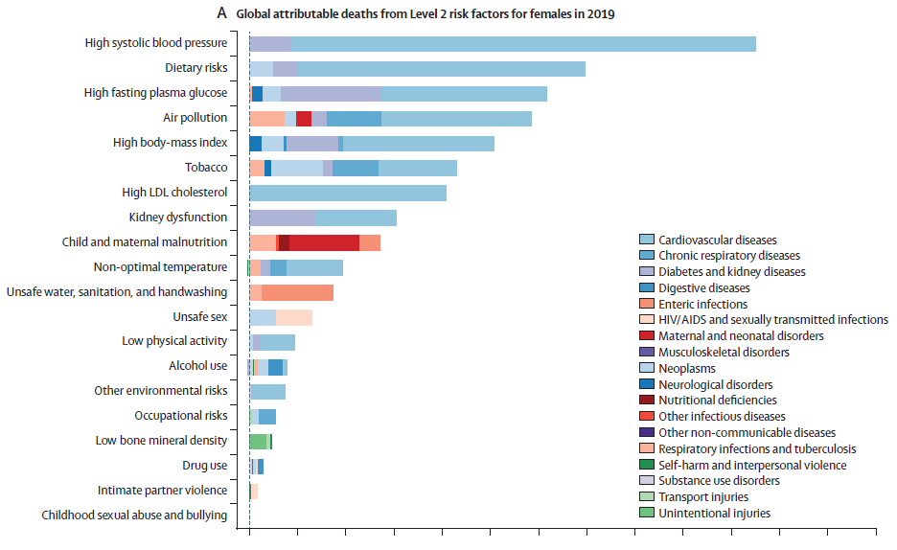
The main risk factors in the developing countries

Slide 5
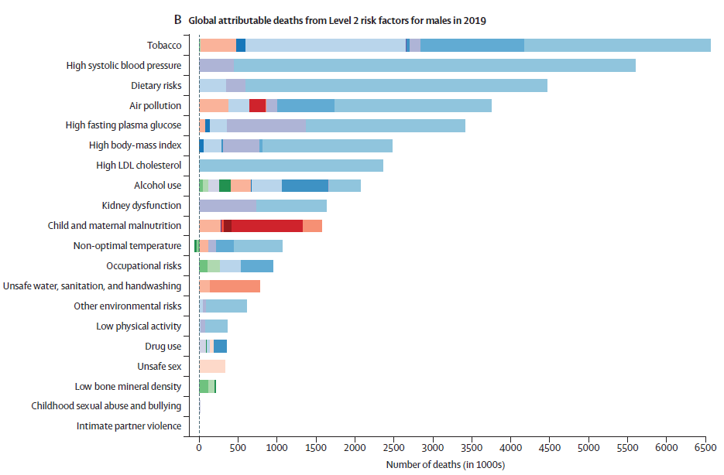
The main risk factors in the developing countries

Slide 6
Behavioral Epidemiology
In 1965, Belloc and Breslow asked for the first time a representative sample of 6,928 residents of Alameda county (California) whether they engaged in the following seven health practices:
1) Sleeping seven to eight hours daily.
2) Eating breakfast almost every day.
3) Never or rarely eating between meals.
4) Currently being at or near prescribed height-adjusted weight.
5) Never smoking cigarettes.
6) Moderate or no use of alcohol.
7) Regular physical activity.

Slide 7
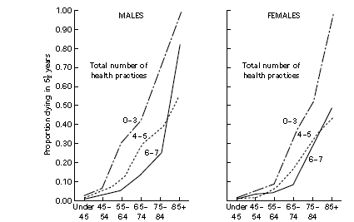
Behavioral Epidemiology
Age-specific mortality rates by number of health practices followed by sub-groups of males and females.
Source: Matarazzo (1984)

Slide 8
Behavioral Epidemiology
In a recent paper, Stringhini et al (JAMA 2010) have established from the Whitehall Cohort that a little number of unhealthy behavior (smoking, alcohol consumption, physical activity, diet) might explain a large proportion of the social inequalities of health in England:
75% of deaths from all-causes
45% of deaths from cardiovascular diseases
94% of non-cancer and non-cardiovascular diseases

Slide 9
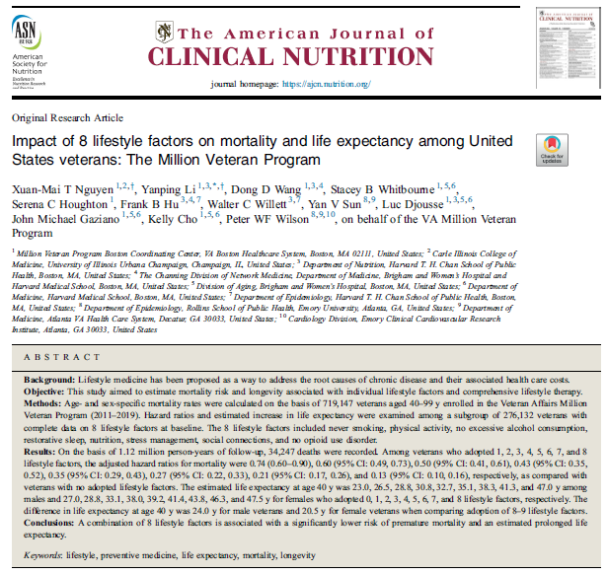
Behavioral Epidemiology
Tobacco consumption
Alcohol consumption
Activité physique
Diet
Opioid addiction
Sleep
Stress management
Social isolation
Nguyen, X. M. T., Li, Y., Wang, D. D., Whitbourne, S. B., Houghton, S. C., Hu, F. B., ... & Wilson, P. W. (2024). Impact of 8 lifestyle factors on mortality and life expectancy among United States veterans: The Million Veteran Program. The American Journal of Clinical Nutrition, 119(1), 127-135.

Slide 10
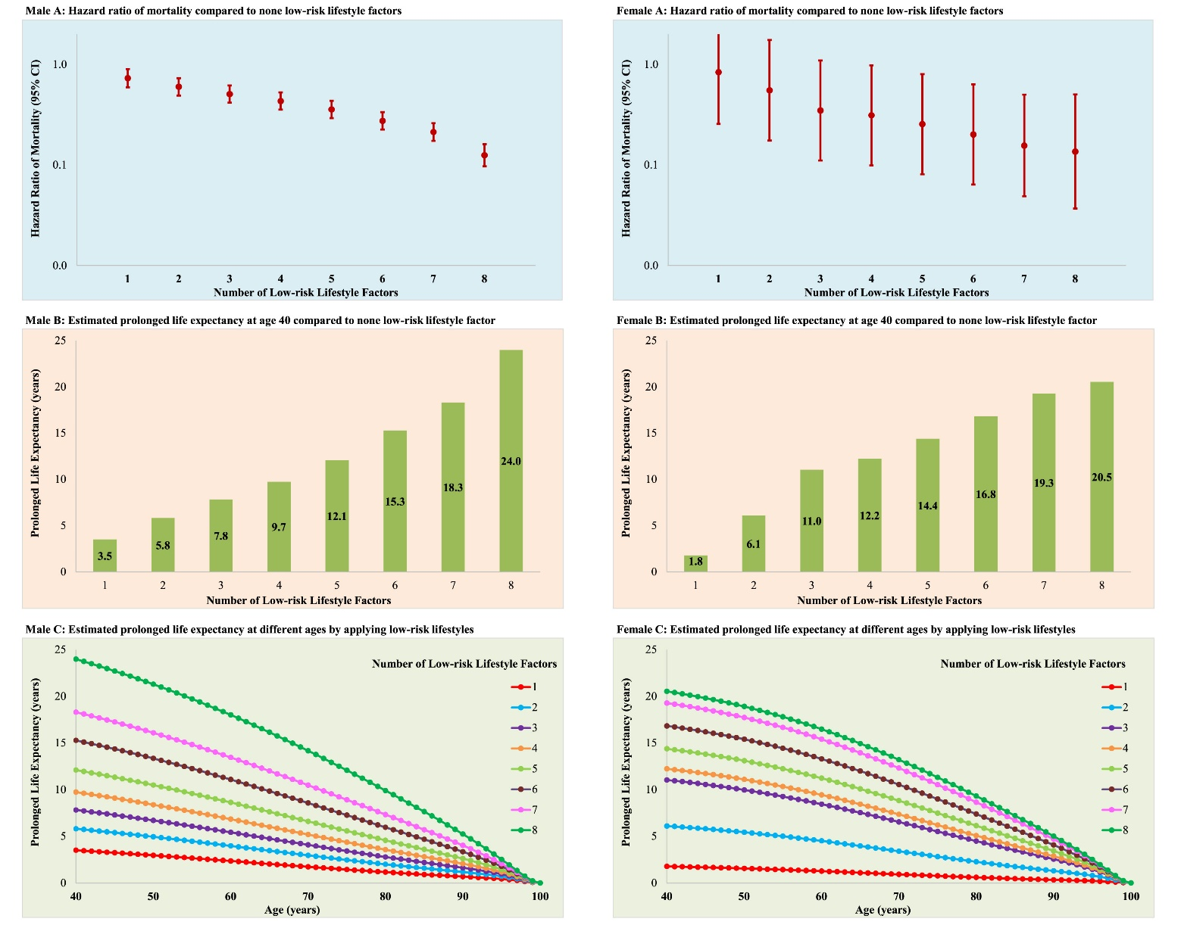
Behavioral Epidemiology
Nguyen, X. M. T., Li, Y., Wang, D. D., Whitbourne, S. B., Houghton, S. C., Hu, F. B., ... & Wilson, P. W. (2024). Impact of 8 lifestyle factors on mortality and life expectancy among United States veterans: The Million Veteran Program. The American Journal of Clinical Nutrition, 119(1), 127-135.

Slide 11
What did we know about the determinants of protective behaviors in response to epidemics?

Slide 12
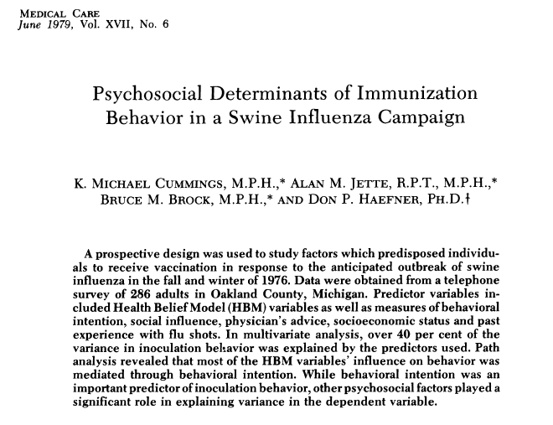
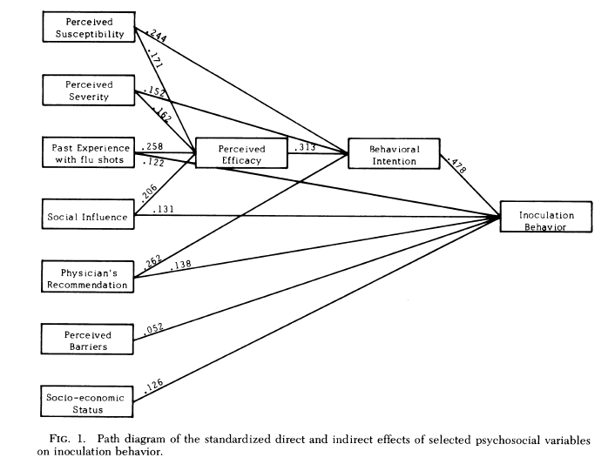
Psychosocial determinants of HP behaviors

Slide 13
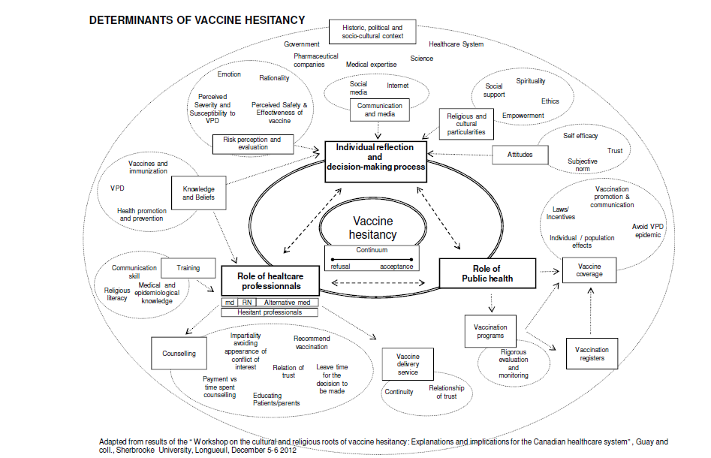
Psychosocial determinants of HP behaviors
Source : WHO, Report of the Sage Working Group on Vaccine Hesitancy, 2014

Slide 14
The categories of adaptation to health threats
In the psychological sciences, two main types of adaptation to stressful events (including health threats) has been documented since the 70s :
Problem-based coping Emotion-based coping
Behavioral adaptation
Source: Lazarus, R, Folkman, S. (1984) "Stress, Appraisal and Coping." Springer, New York..
For most theorists, the choice of a coping strategy essentially depends on the perceived effectiveness of the HB promoted to control the threat.

Slide 15
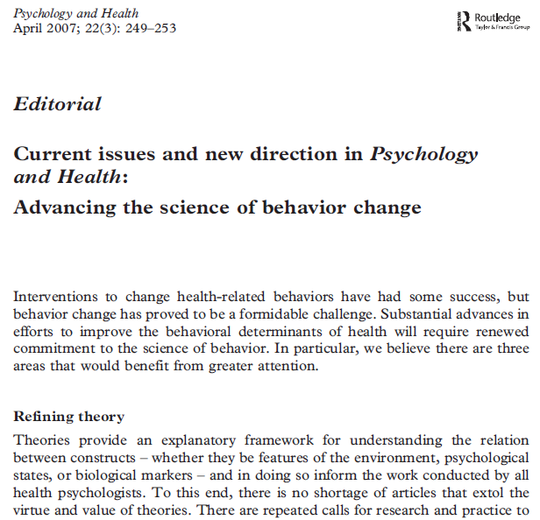
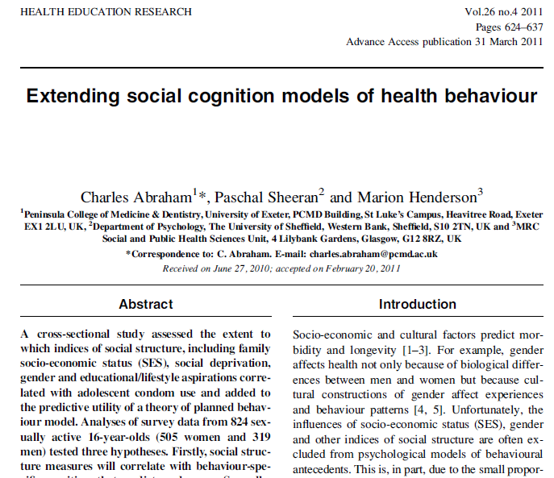
New directions for research on HB
Despite a shared commitment to theory, there is a growing concern that we are not tending to our theories as well as we ought (…). Theories need to be nurtured by the community of researchers and practitioners. Over time, theoretical models should evolve, based on a series of activities in which formal predictions are derived from the theory and tested…

Slide 16
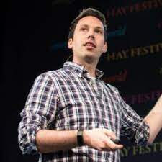
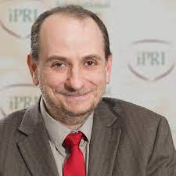
New directions for research on HB
The socioecological approach of health behaviors has been boosted in the context of the COVID-19 pandemics
Social sciences
Epidemiology/modelling
Understanding the role of values, ideological orientations and worldviews in health behavior
Understanding the role of epidemiological parameters in the dynamic of adoption of health behavior

Slide 17
How epidemics change social and individual behaviors?

Slide 18
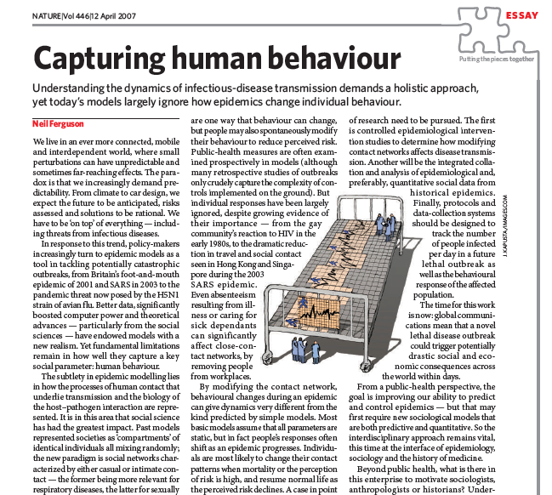
How epidemics change social and individual behaviors?
Fundamental limitations remain in how well they capture a key parameter: human behaviour.
Understanding the dynamics of infectious disease transmission demands a holistic approach, yet today’s models largely ignore how epidemics change individual behavior .

Slide 19
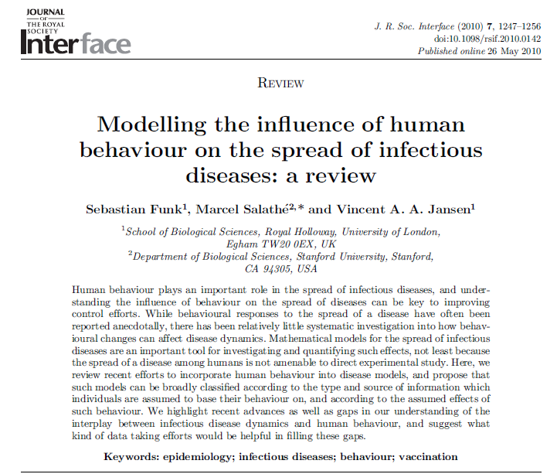
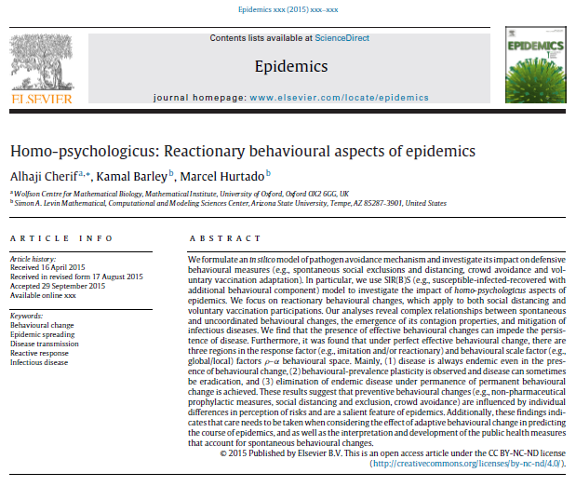
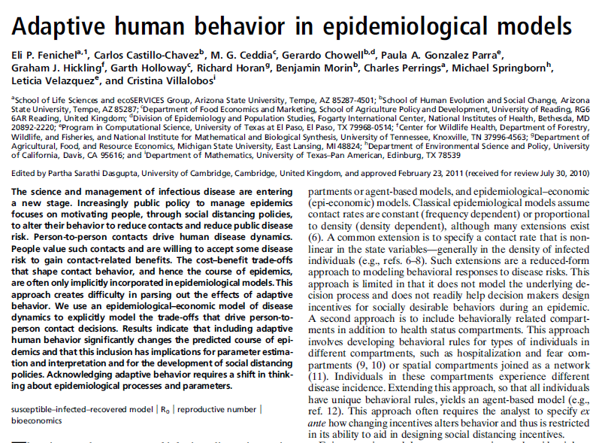
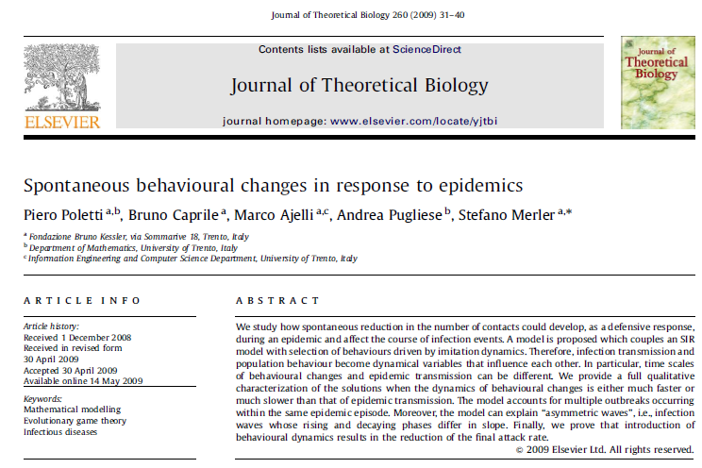
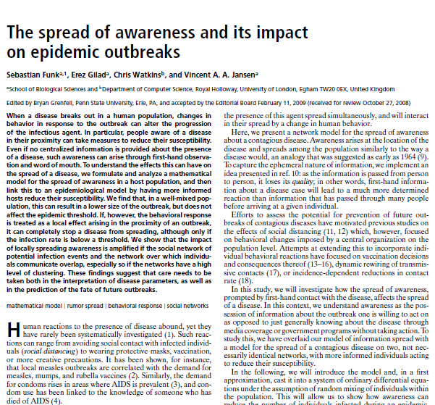
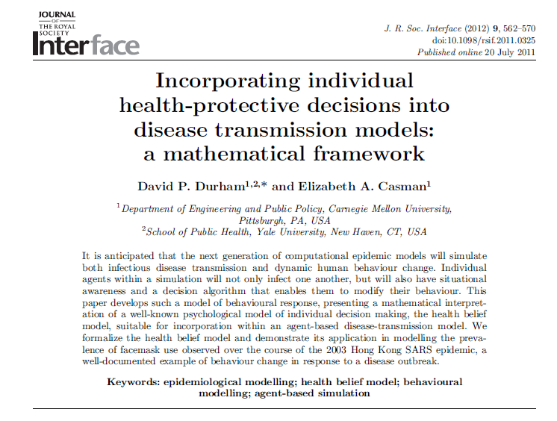
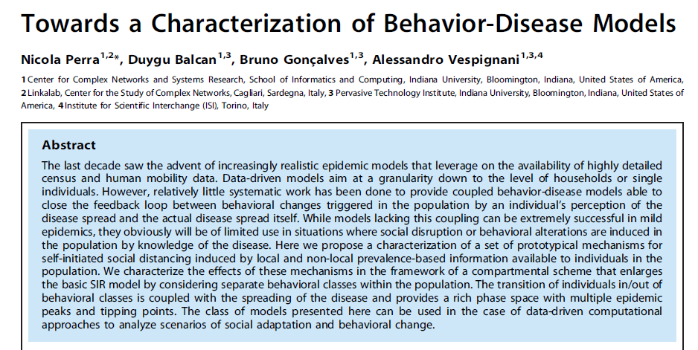
How epidemics change social and individual behaviors?

Slide 20
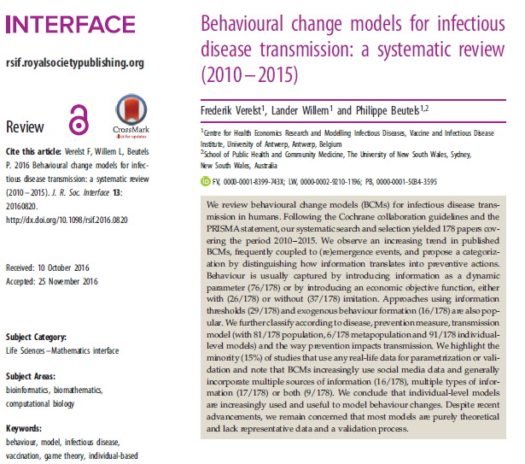
How epidemics change social and individual behaviors?
We remain concerned that most models are purely theoretical and lack representative data

Slide 21
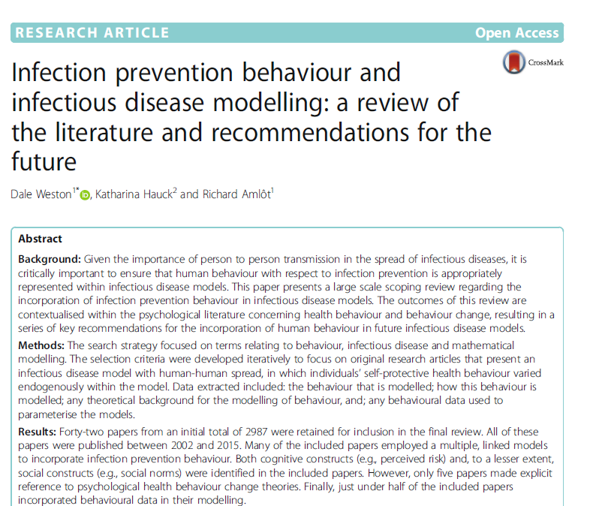
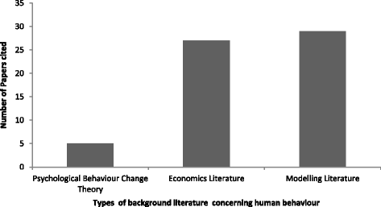
How epidemics change social and individual behaviors?

Slide 22
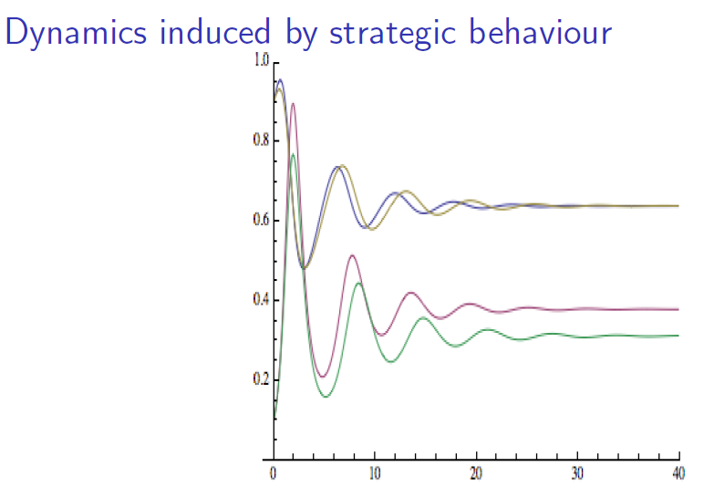
The strategic behavior hypothesis
Incidence rate
The strategic behavior hypothesis (also called risk homeostatis):
When an infectious disease spreads in a population, individuals are inclined to adopt preventive behaviors which in turn impact the speed at which the disease can spread in the population...
Risk behaviors

Slide 23
How epidemics change social and individual behaviors?
Modellers interested in exploring the relationships between behaviour and disease spread should draw on social psychology literature to increase the complexity of the social world represented (in their models).

Slide 24
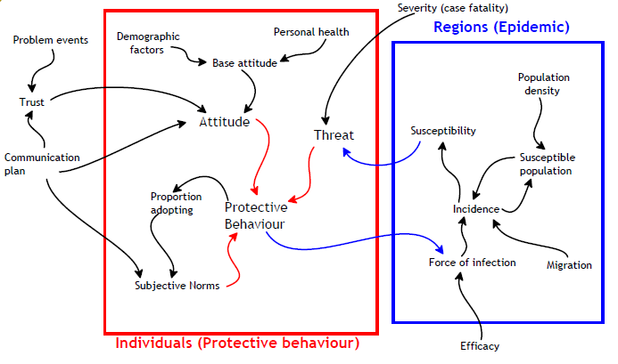
How epidemics change social and individual behaviors?
Possible hypotheses from the social psychological literature
Badham, et al (2018). Developing agent-based models of complex health behaviour. Health Place. 54, 170–177.

Slide 25
3 hypotheses about the dynamic of HP behaviors during an epidemic
--- Observed incidence
― Public panic
― Accuracy of risk perceptions
― Risk habituation
Engagement in health behaviors
Time
Source : Raude, J., et al. (2019) Understanding health behaviour changes in response to outbreaks: findings from a longitudinal study of a large epidemic of mosquito-borne disease. Social Science & Medicine.

Slide 26
Materials and method
Data was collected in France by Santé publique France trough a questionnaire (including a variety of items about protective behaviors recommended by the health authorities).
A series of 25 cross-sectional surveys was conducted from March 2020 to September 2021 (over 18 months).
A large and representative sample of the French adult population (N=50,019).
Multilevel regression analyses were conducted to examine the impact of individual and contextual variables on the engagement in HP behaviors.
Contextual variables included in the analyses were the death incidence rate of the COVID-19, the time since the beginning of the pandemic, and the stringency of health policy.

Slide 27
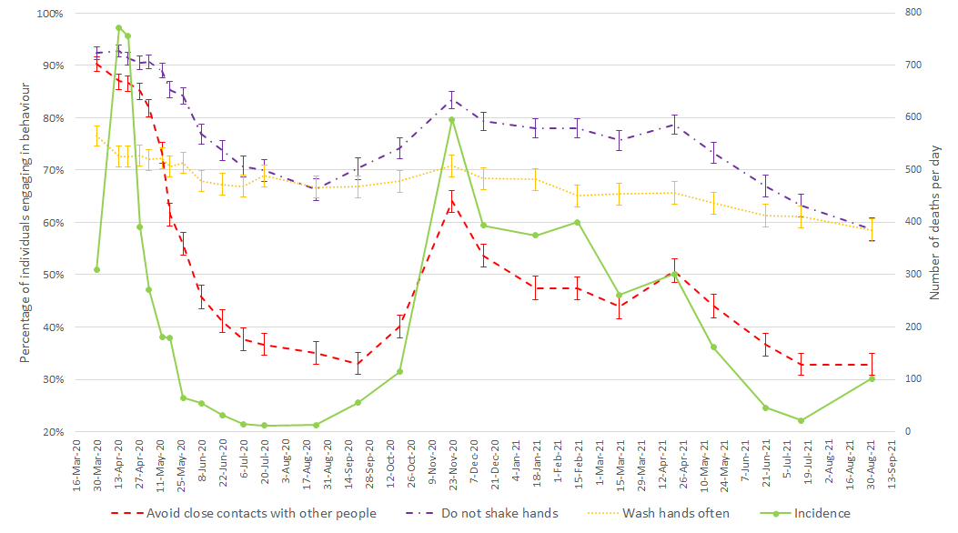
The dynamic of health protective behaviors in France
COVID-19 risk habituation or adaptation?
Percentages of participants engaging in HPB and death incidence level over time. Error bars are 95% confidence intervals.

Slide 28
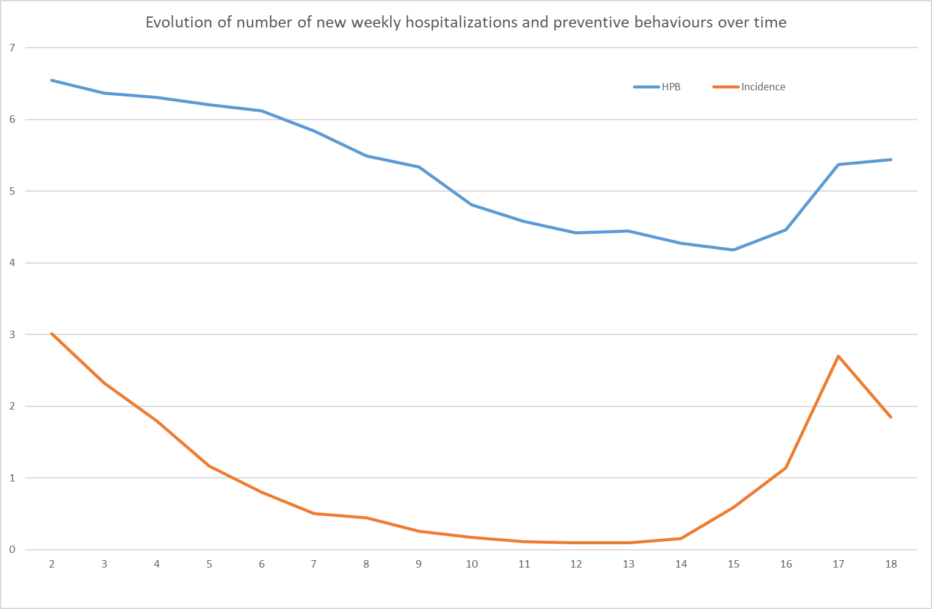
The dynamic of health protective behaviors in France

Slide 29
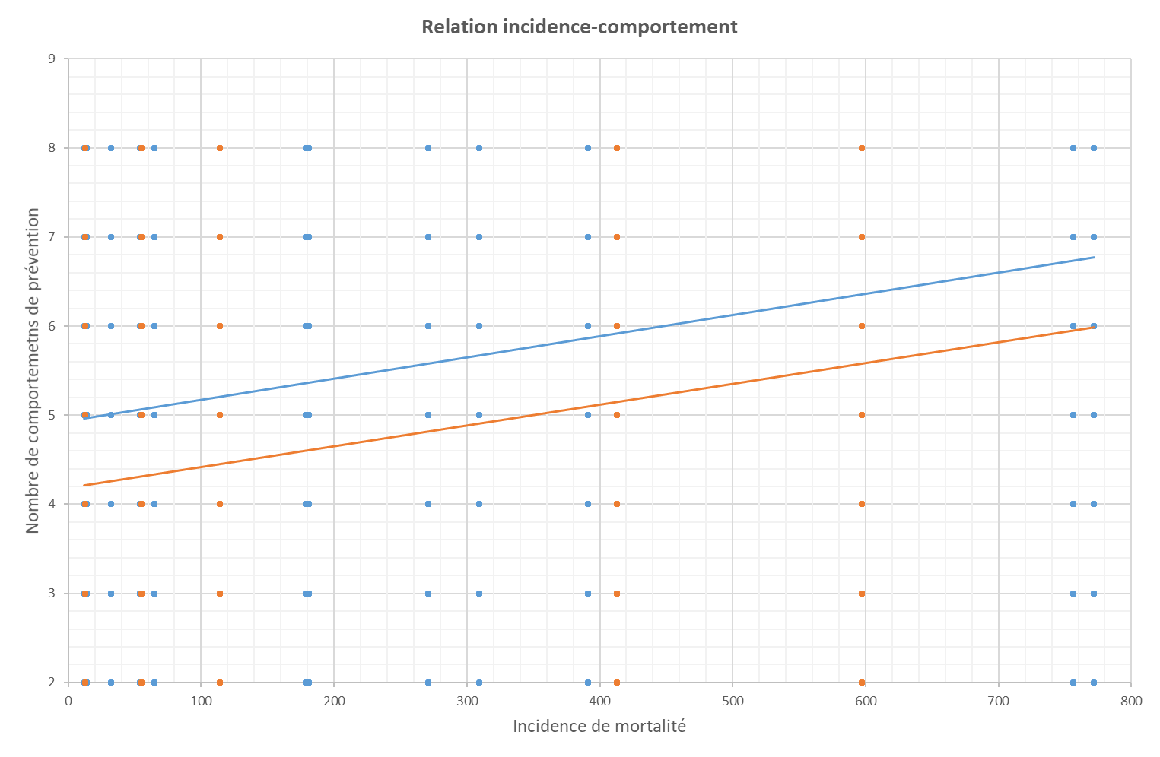
The dynamic of health protective behaviors in France
First period
+ 300 deaths !
Second period

Slide 30
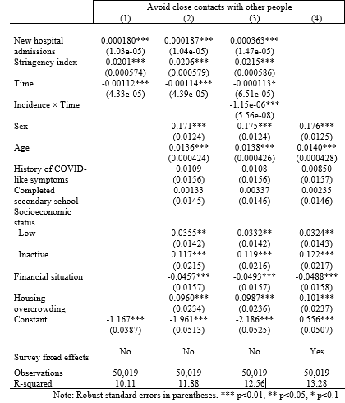
The dynamic of health protective behaviors in France
Epidemiological and contextual variables were found to explain about 10% of the variance in the adoption of HP behaviors.
The introduction of socio-demographic variables in the model did not increase substantially the explained variance of HP behaviors.
Effect of incidence and sociocultural and demographic factors on the probability of avoiding close contacts with other people.

Slide 31
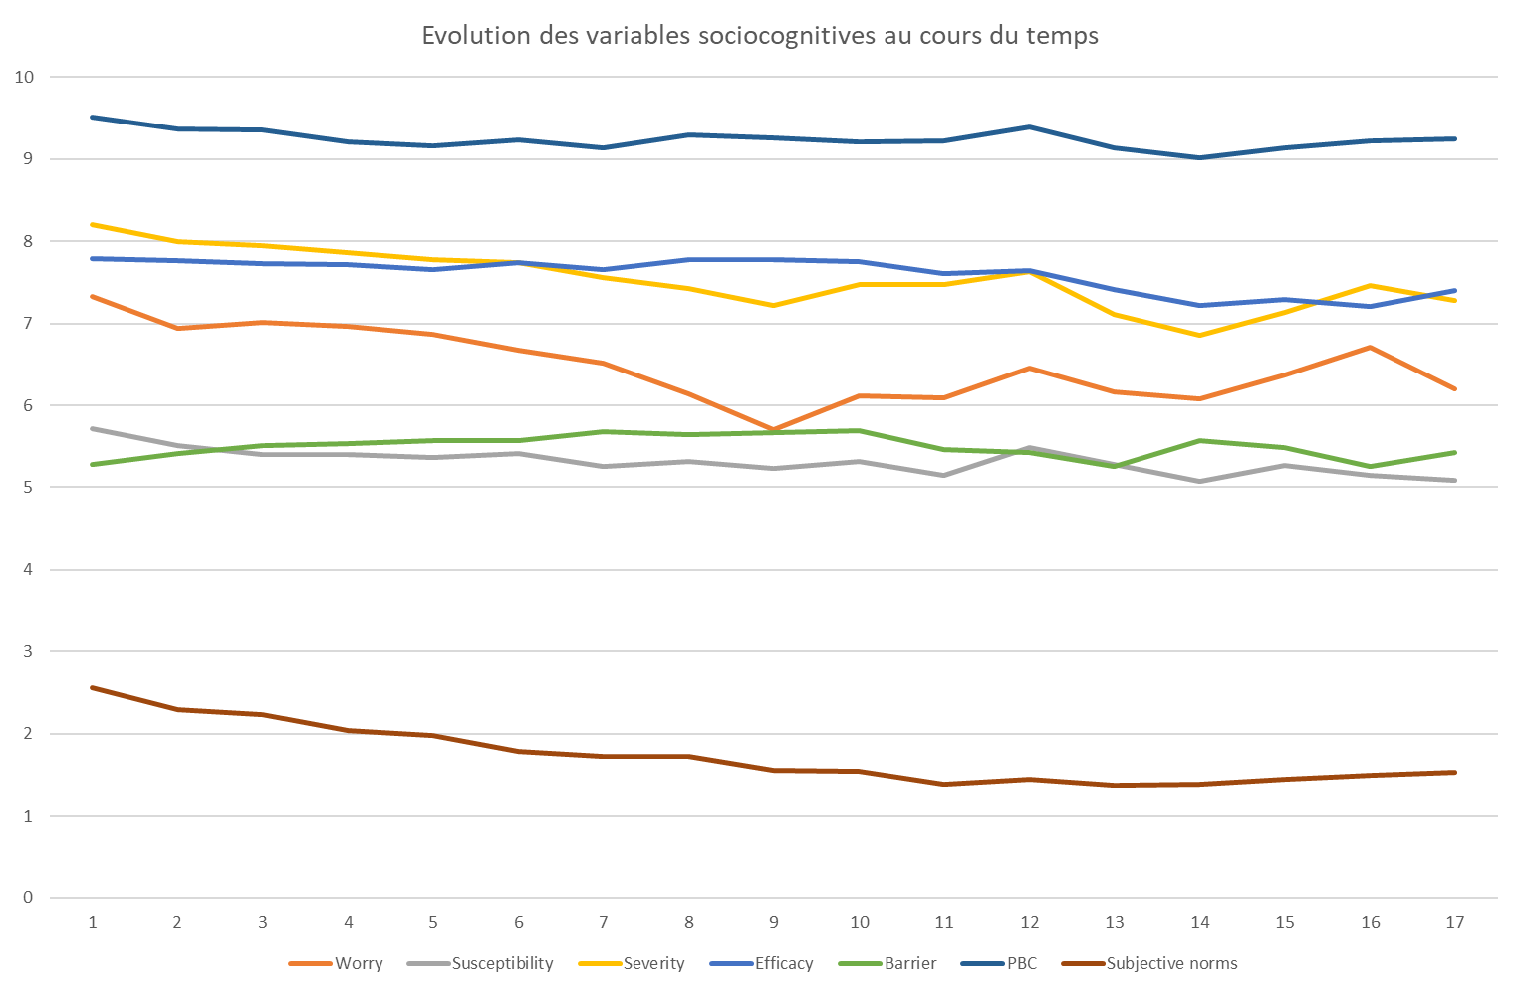
The dynamic of social cognitive variables
An unexpected temporal stability during the first year of the pandemic!

Slide 32
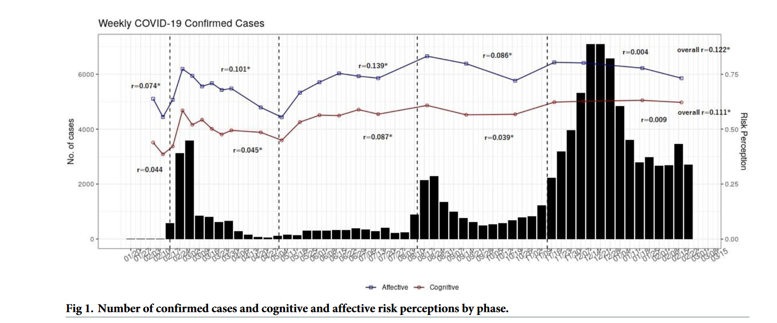
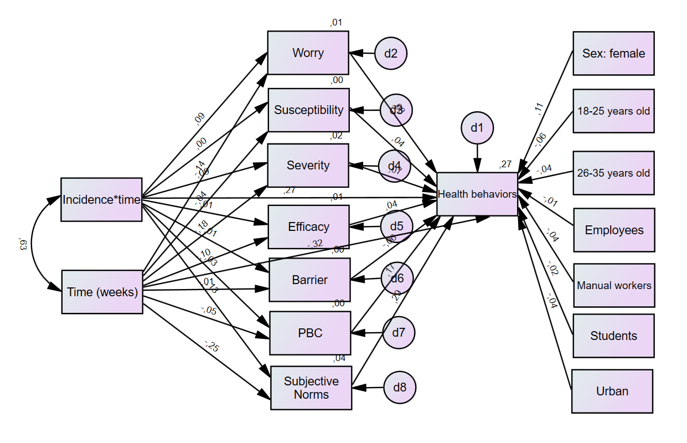
Results of mediation analysis
Social cognitive variables are poorly sensitive to the epidemiological context !
Lee YH, Heo H-H, Noh H, Jang DH, Choi Y-G, Jang WM, et al. (2023) The association between the risk perceptions of COVID-19, trust in the government, political ideologies, and socio-demographic factors: A year-long cross-sectional study in South Korea. PLoS ONE 18(6): e0280779

Slide 33
Conclusion
Health protective behaviors (HPB) but not their social cognitive predictors tend to considerably vary over time (and these variations may be underestimated by self-reported measures).
Engagement in protection tend to be positively associated with the incidence of the disease (in particular with death incidence rate for COVID, which is largely moderated by the time factor).
Regardless the incidence, familiarity with the health threat seems to exert a negative effect on the adoption of protective behaviors.
For COVID-19, these two different cognitive mechanisms (risk habituation and risk adaptation) accounted relatively well for the temporal variation in the adoption of HPB.
Unexpectedly, the effect of the epidemiological context wass poorly mediated by the social cognitive variables drawn from leading models of health behaviors.

